Slide 1
DXS Optics
3x Crystal profile comparison

Slide 2
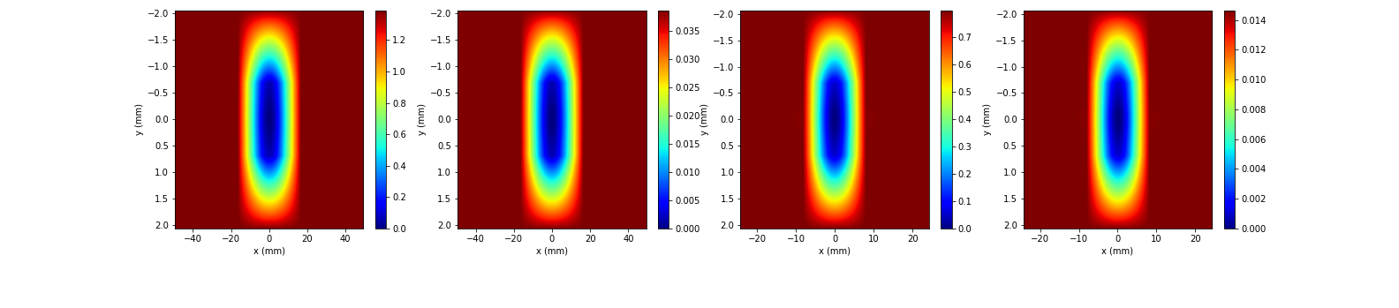
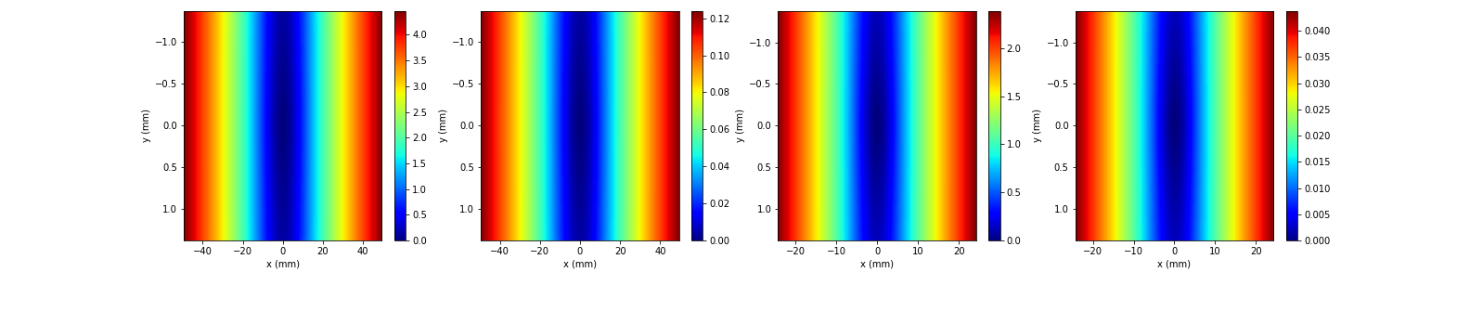
Profiles
Old padded
New (2x in y)

Slide 3
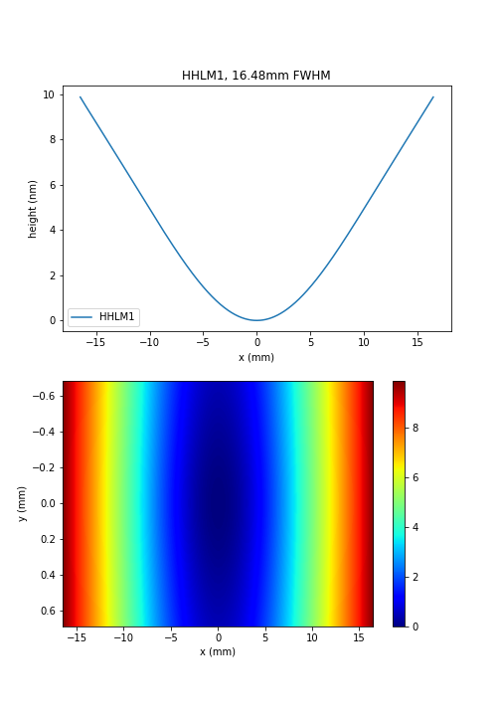
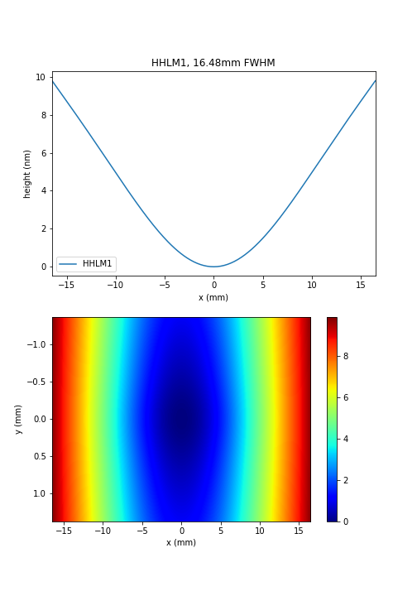
Old
New

Slide 4


Bending only
Old padded
New (2x in y)

Slide 5


BCB
Old padded
New (2x in y)

Slide 6


Tails (same phase corrector aperture)

