Slide 1
DXS Optics Simulation
Nan Wang, Mar 10th 2021

Slide 2
Outline
HHLM simulation results
Geometry
Results
HHLM+HRM simulations results
Initial results
Aliasing
Changing sampling parameters

Slide 3
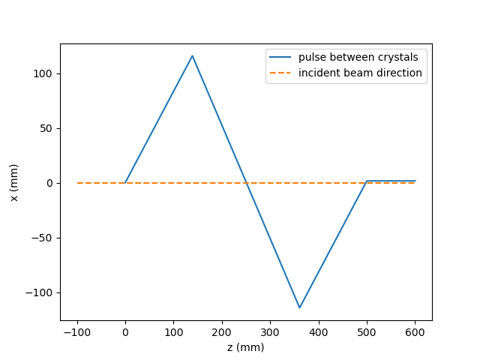
HHLM geometry
Beamline:
9481 eV
CRL0 at 290m
C1 at 295m (z=0 in the plot)
Sampling parameters:
256 x 256 x 198 for HHLM
Crystals | Type | Asymmetry
C1 | 220 | -17
C2 | 440 | 0
C3 | 440 | 0
C4 | 220 | 17

Slide 4
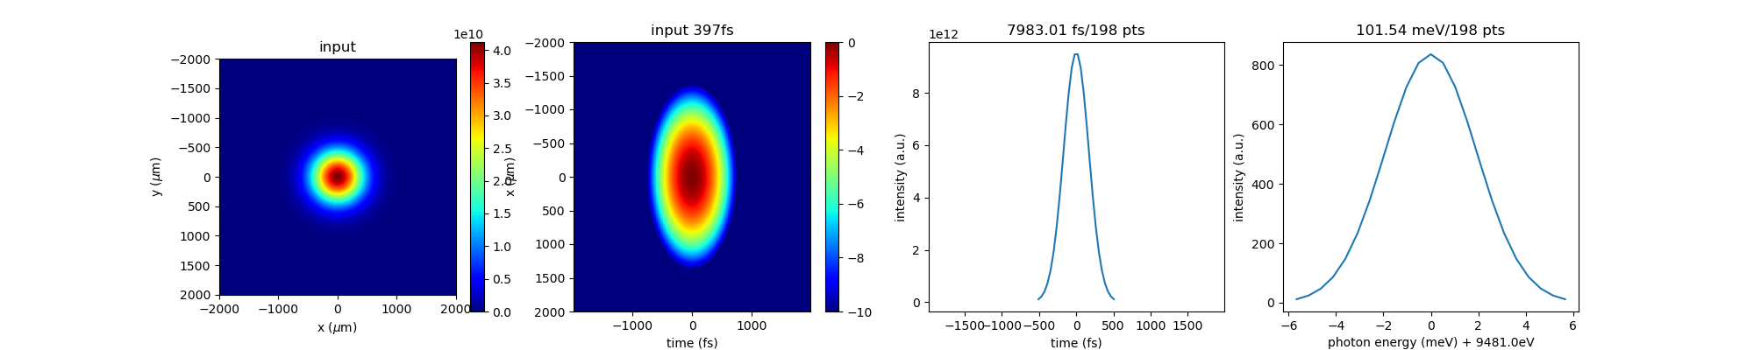
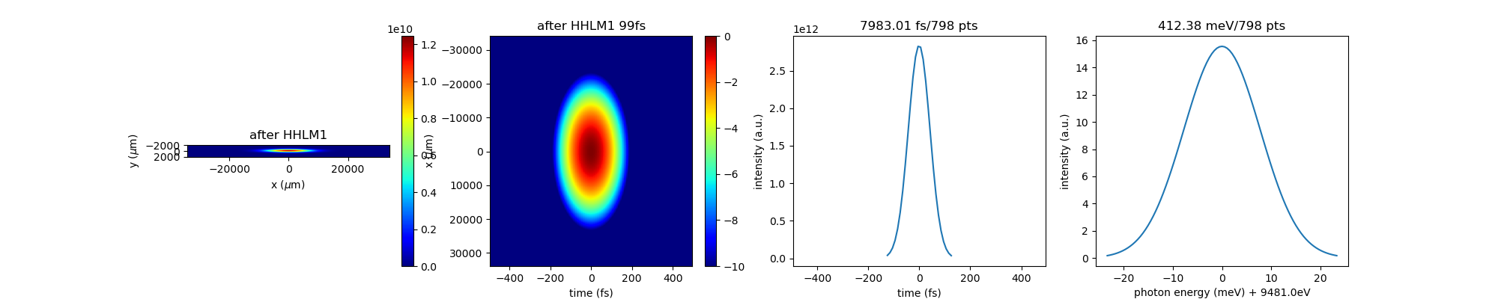
HHLM Results (log scale)
Input, 400fs
After C1

Slide 5
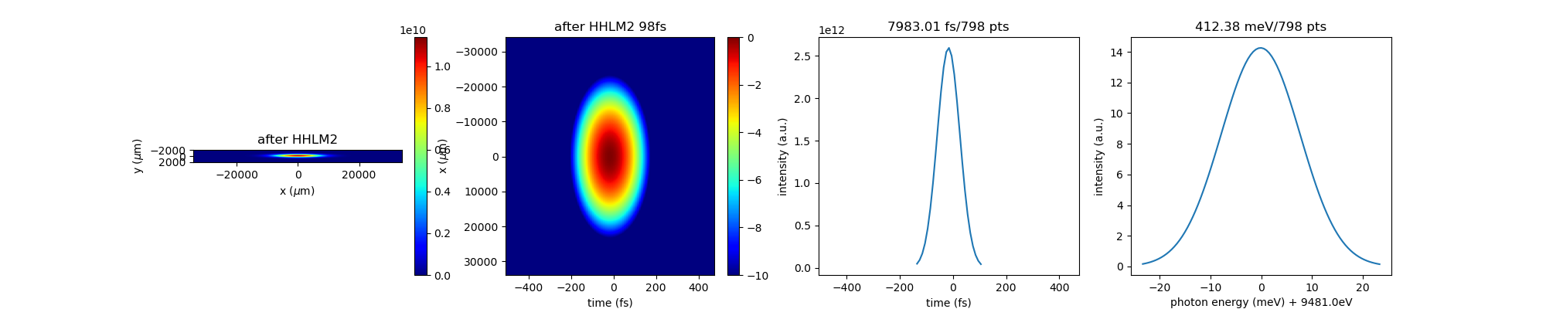

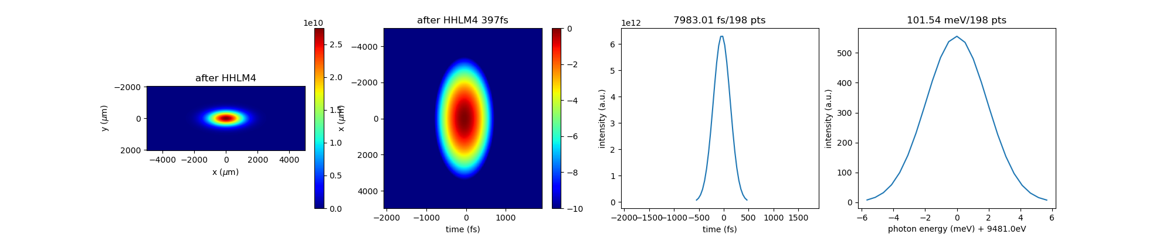
After C2
After C3
After C4

Slide 6
HHLM+HRM geometry
Beamline:
CRL0 at 290m
HHLM starts at 295m
HRM starts at 300m
Sampling parameters
256 x 256 x 396 pts at HHLM output (for 400fs incident beam)
1280 x 256 x 396 pts at CRL1

Slide 7
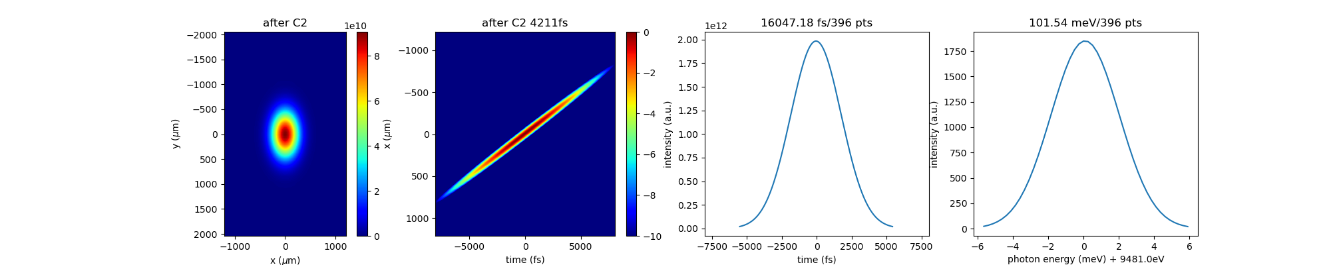
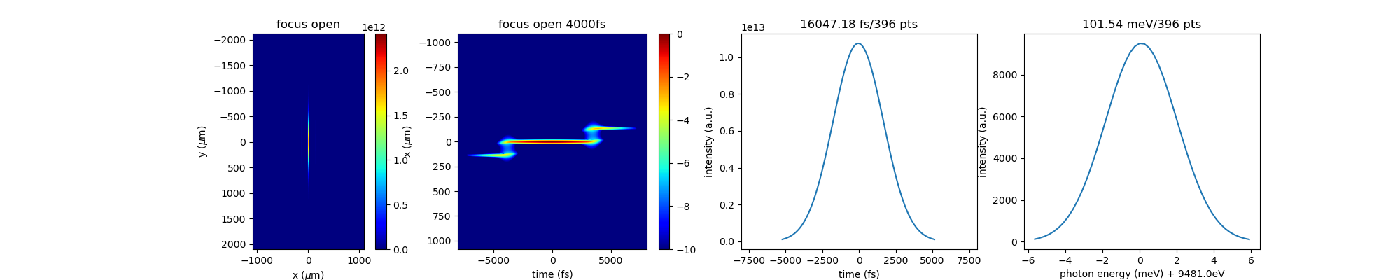
HHLM+HRM Results (log scale)
After CC1
aliasing
At focus, open slit

Slide 8
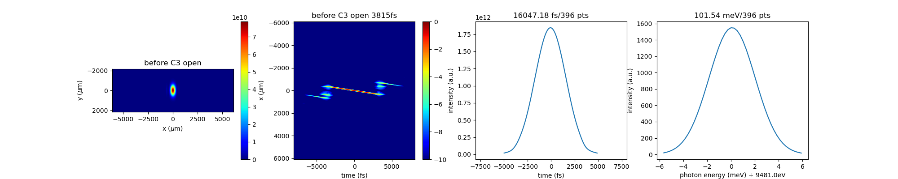
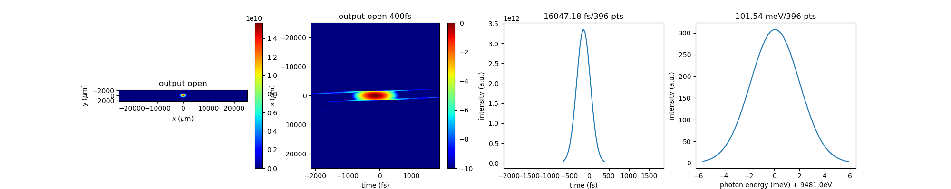
HHLM+HRM Results (log scale) cont’d
Before CC2
Output

Slide 9
Change in sampling parameters
For getting rid of the aliasing, my first attempt is to change the sampling resolutions
Change log:
1. 400 100 fs incident pulse
2. 1280 5120 x 256 x 1600 pts at CRL1
3. 256 x 256 x 1600 3200 pts at HHLM output (for 100fs incident beam)
To do:
5120 10240 x 256 x 3200 pts at CRL1

Slide 10
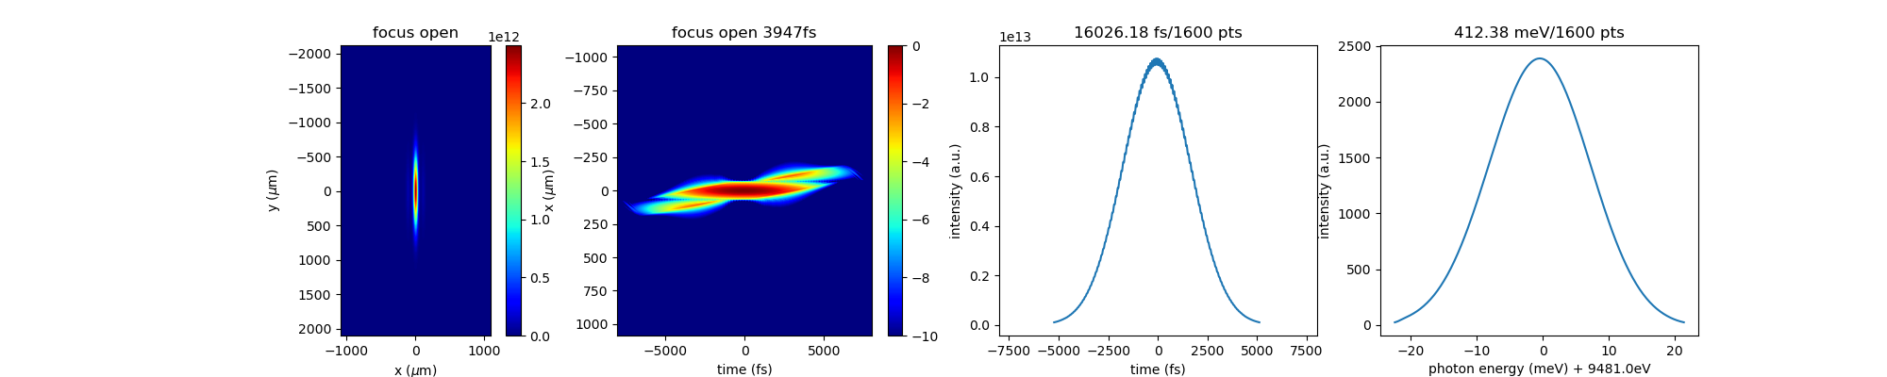
400 100fs incident beam comparison
before
after

Slide 11
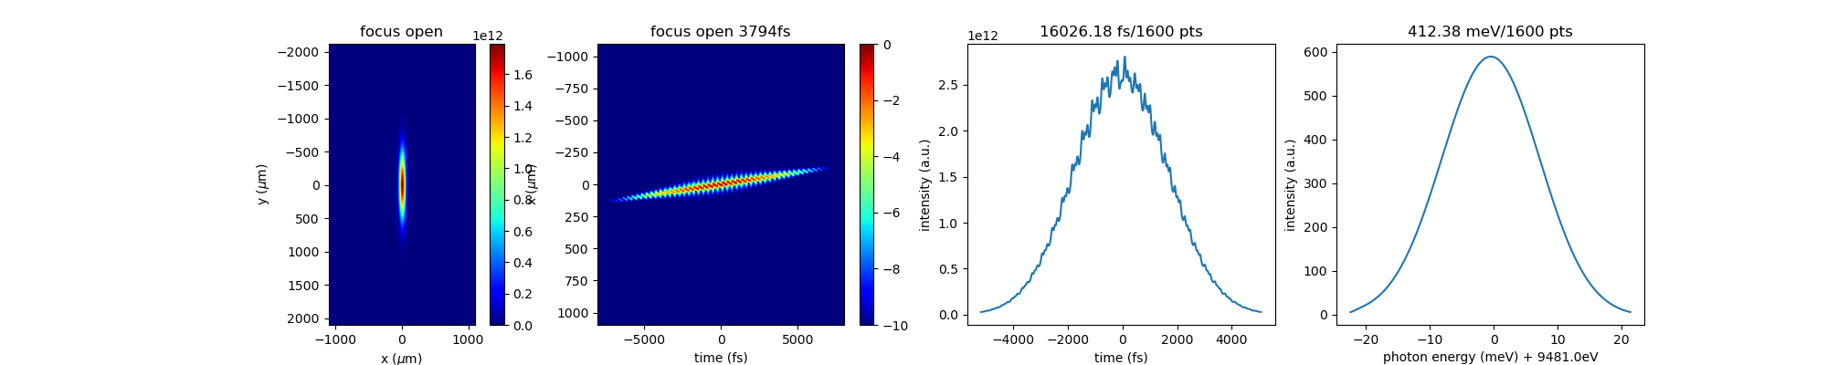
1280 5120 x 256 x 1600 pts at CRL1
before
after

Slide 12

256 x 256 x 1600 3200 pts at HHLM output
before
Increasing the time resolution doesn’t really do much
after

