Slide 1
DXS Optics Simulation
Nan Wang, Mar 11th 2021

Slide 2
Outline
HHLM simulation results
Geometry
Results
HHLM+HRM simulations results
Initial results
Get rid of aliasing
Efficiency

Slide 3
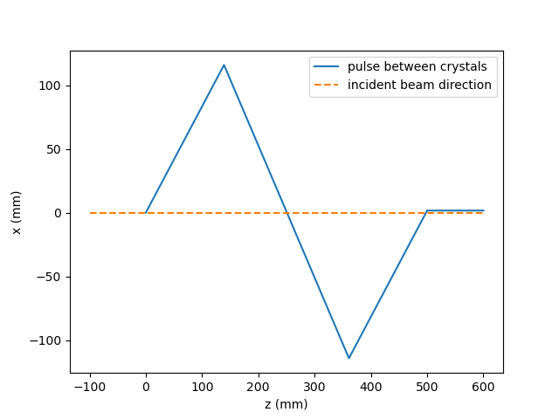
HHLM geometry
Beamline:
9481 eV
CRL0 at 290m
C1 at 295m (z=0 in the plot)
Sampling parameters:
256 x 256 x 998 (100 fs)
Crystals | Type | Asymmetry
C1 | 220 | -17
C2 | 440 | 0
C3 | 440 | 0
C4 | 220 | 17

Slide 4
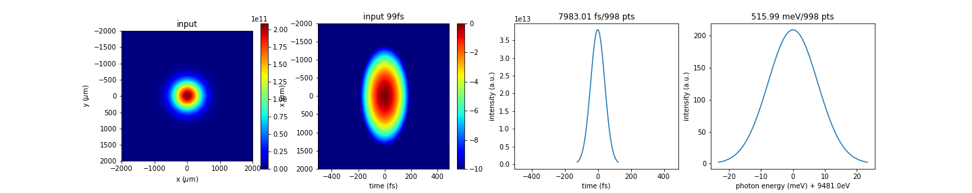
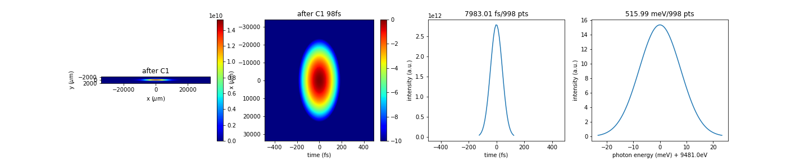
HHLM Results (log scale)
Input, 100fs
256 x 256 x 998
After C1
256 x 256 x 998

Slide 5
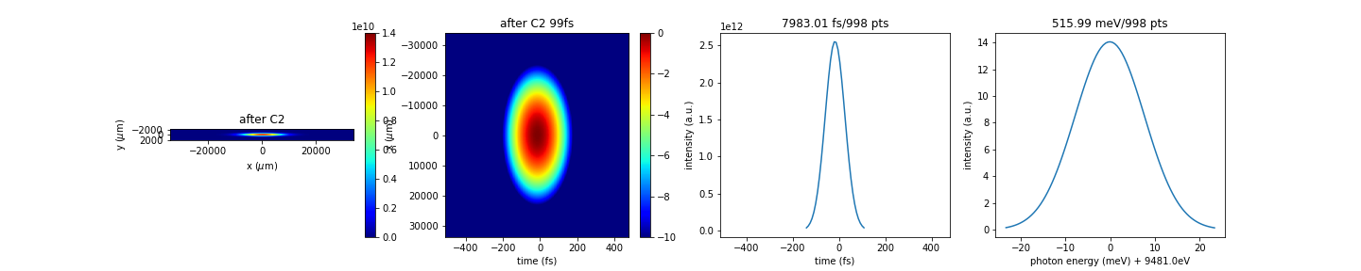
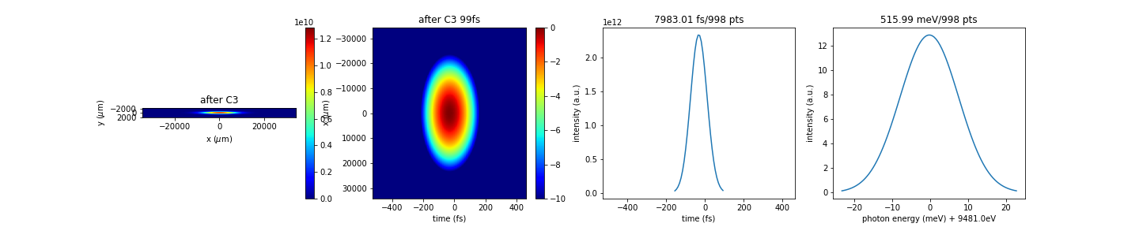
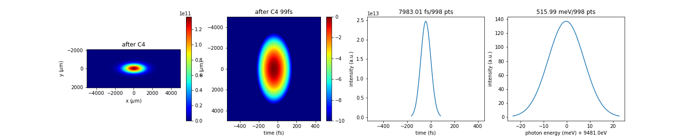
After C2
256 x 256 x 998
After C3
256 x 256 x 998
After C4
256 x 256 x 998

Slide 6
HHLM+HRM geometry
Beamline:
CRL0 at 290m
HHLM starts at 295m
HRM starts at 300m
Sampling parameters
256 x 256 x 798 pts at HHLM output (for 100fs incident beam)

Slide 7
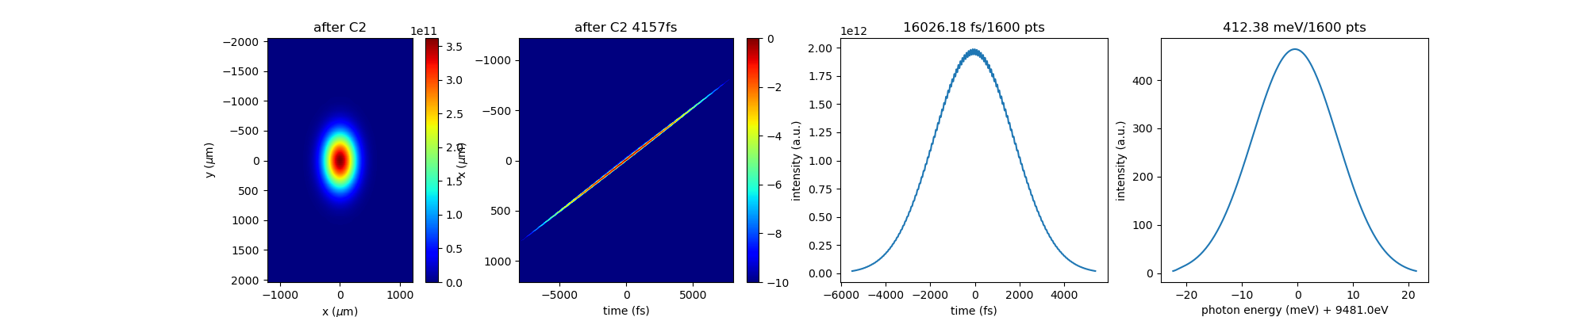
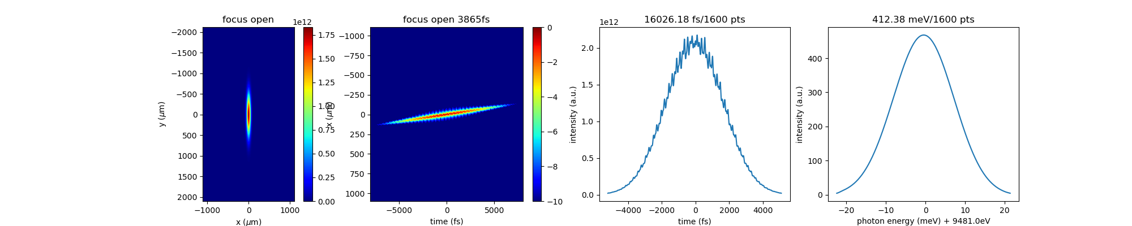
HHLM+HRM Results (log scale)
After CC1
256 x 256 x 1600
aliasing
At focus, open slit
256 x 256 x 1600

Slide 8
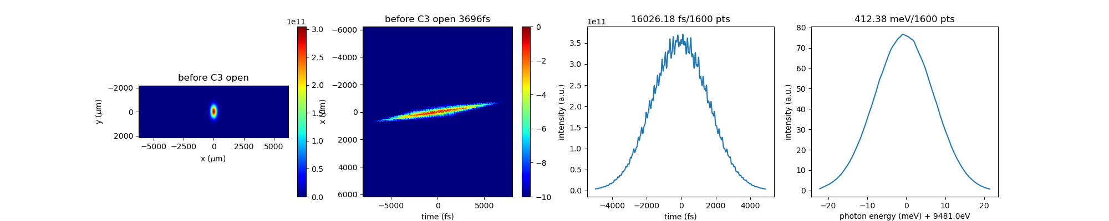
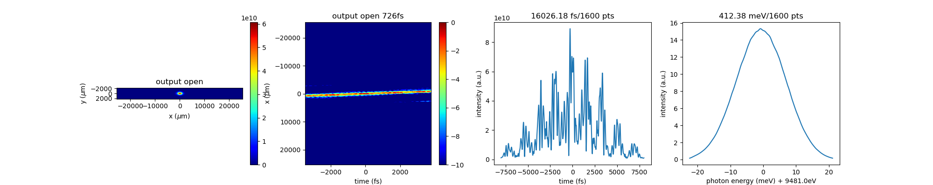
HHLM+HRM Results (log scale) cont’d
Before CC2
256 x 256 x 1600
Output
256 x 256 x 1600

Slide 9
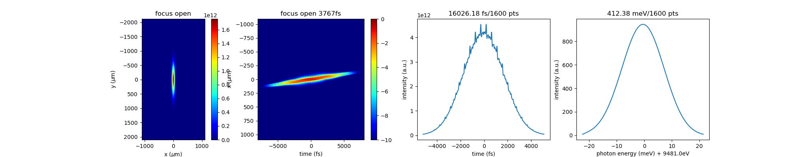
Getting rid of aliasing
Increase xres at CRL1 to see effect on aliasing
256 x 256 x 1600
512 x 256 x 1600

Slide 10
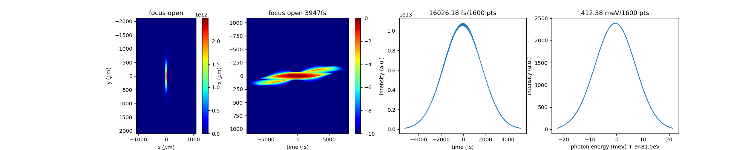
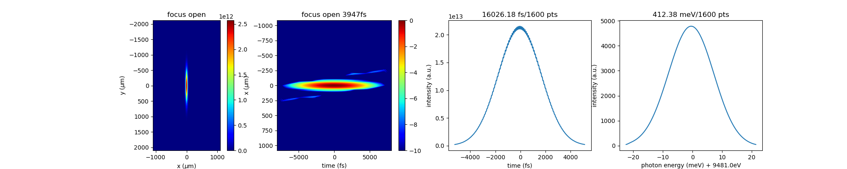
Getting rid of aliasing cont’d
Increase xres at CRL1 to see effect on aliasing
1280 x 256 x 1600
2560 x 256 x 1600

Slide 11


Getting rid of aliasing cont’d
Increase xres at CRL1 to see effect on aliasing
5120 x 256 x 1600
At this point I think the aliasing is gone.
10240 x 256 x 1600

Slide 12
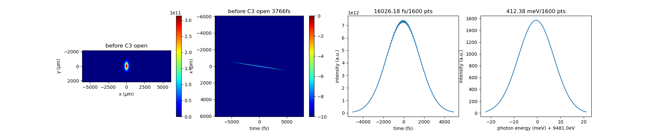
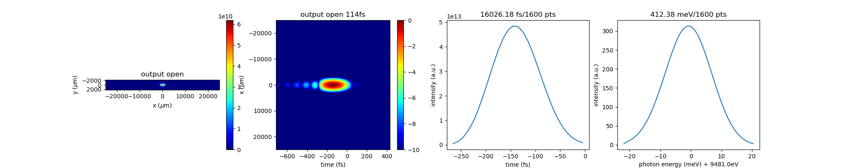
Rest of the beamline
Beam before C3
5120 x 256 x 1600
Output
5120 x 256 x 1600

Slide 13
Efficiency
Component | Propagation (s) | Plot (s)
Input | 27.97 | 26.58
CRL0+HHLM1 | 3.64 | N/A
HHLM2 | 2.61 | N/A
HHLM3 | 2.60 | N/A
HHLM4 | 2.16 | 85.45
Resize in time | 23.82 | N/A
CC1 | 16.96 | 47.76
To focus | 108.09 | 859.24
To CC2 | 113.72 | 850.30
Output | 191.85 | 870.87
Total | 493.42 | 2740.20
256 x 256 x 798
256 x 256 x 1600
5120 x 256 x 1600

