Slide 1
DXS Optics Simulation Summary
Nan Wang, Jun 22nd 2021

Slide 2
Timeline
SRW, lens
HRM only
HHLM only
Telescope only
SRW, mirror
Lcls-beamline-toolbox
Full beamline
ShapeError correction

Slide 3
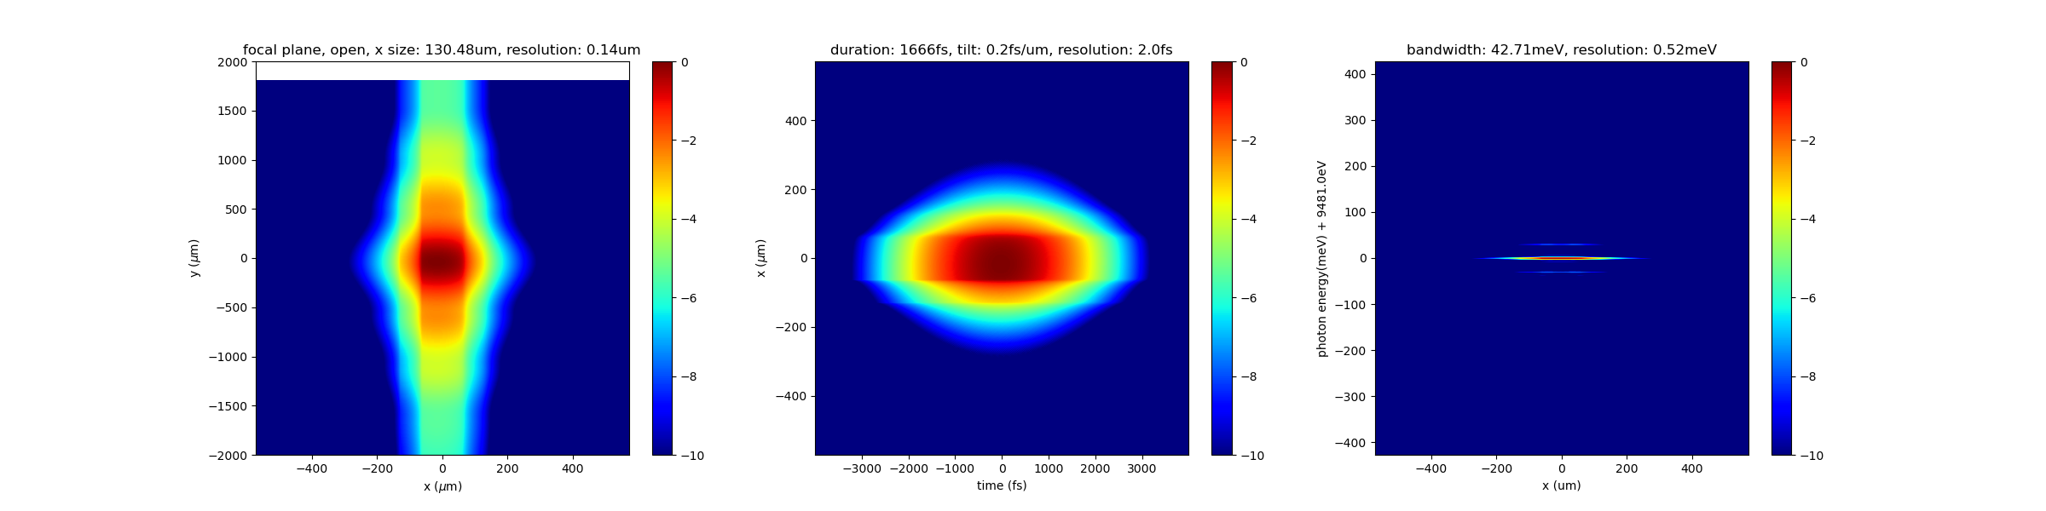
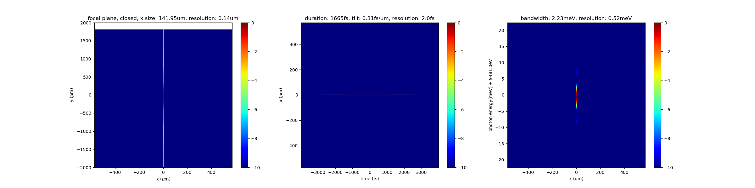
SRW, HRM Only, focus
The vertical dimension is suppressed to 8 pts.
20fs incident Gaussian beam.
Can see some aliasing in log scale

Slide 4
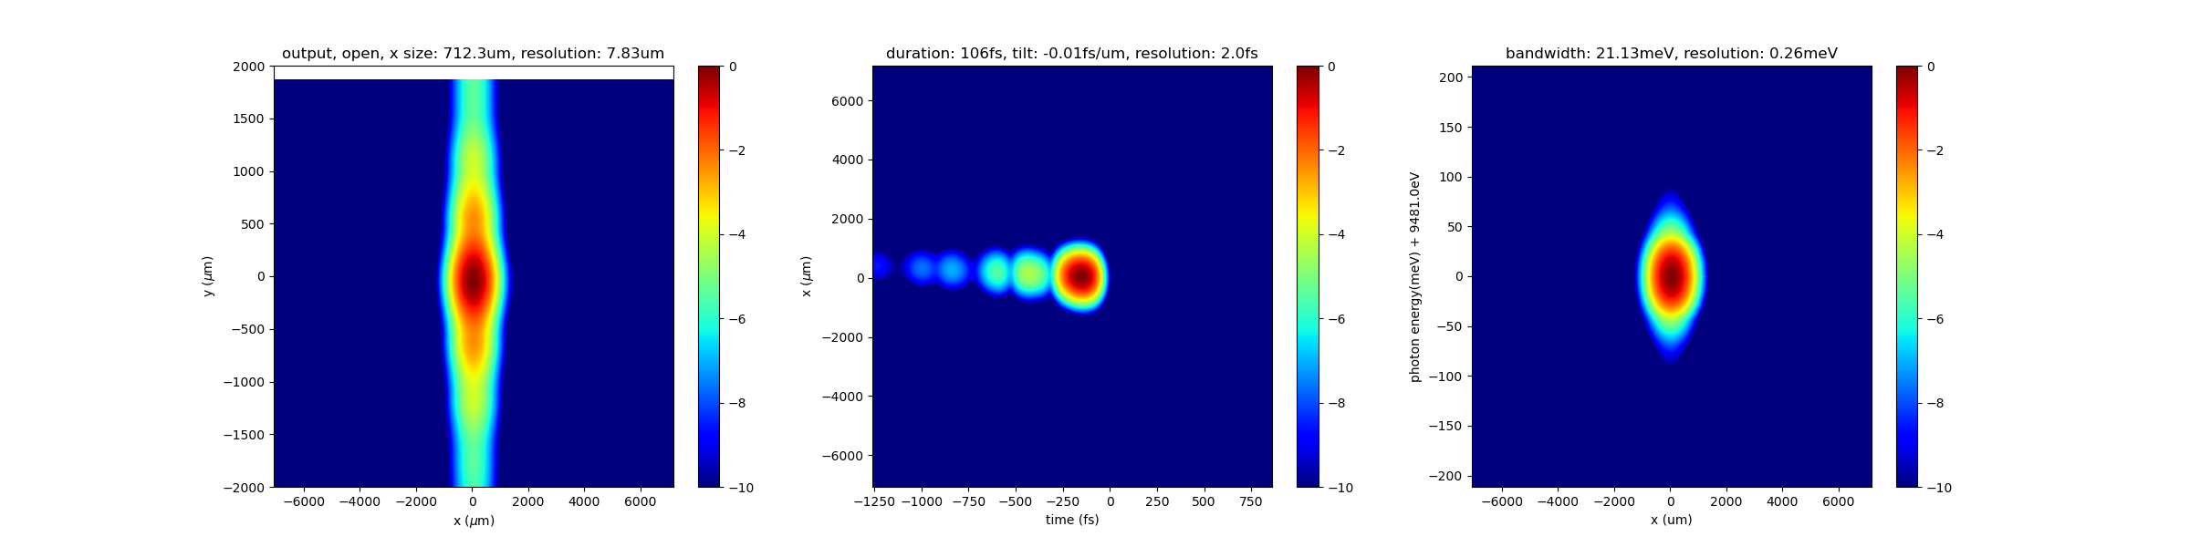
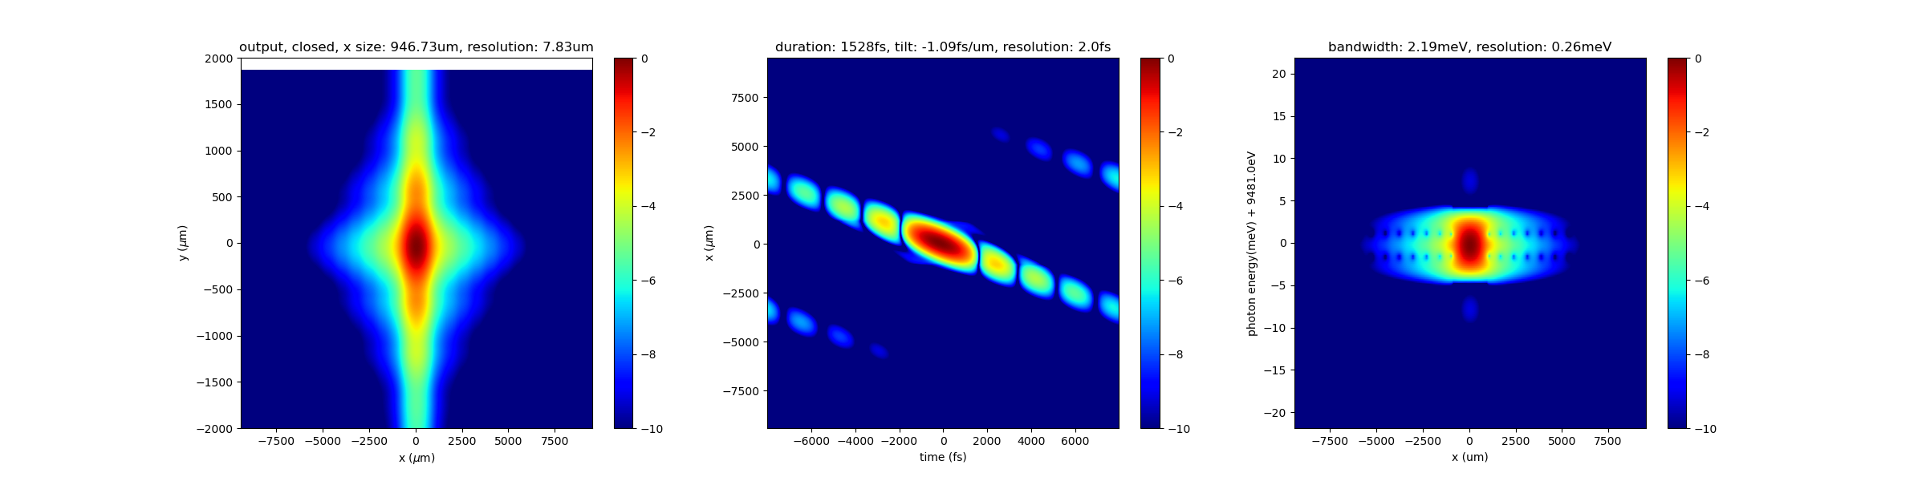
SRW, HRM Only, output
Output bandwidth is about 2.2 meV.

Slide 5
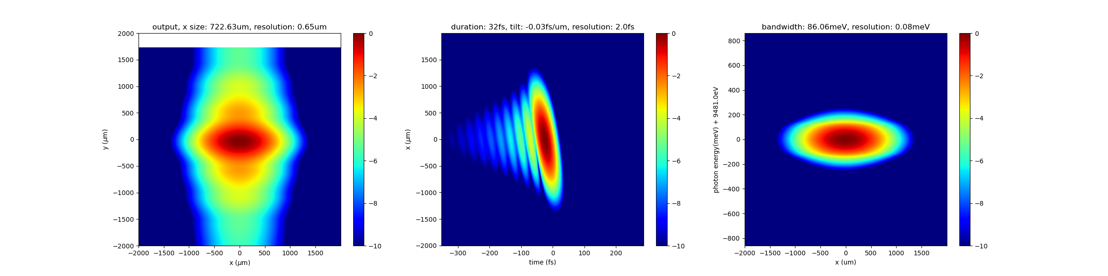
SRW, HHLM Only, output

Slide 6
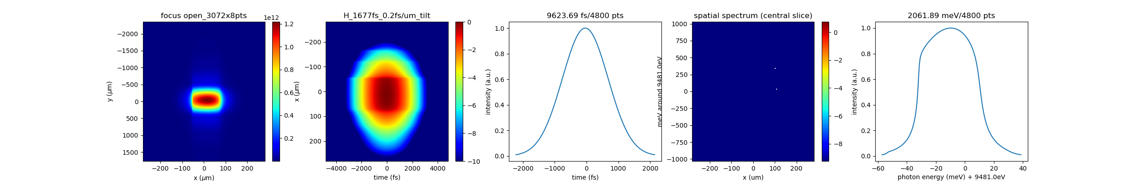
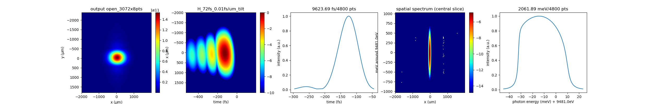
SRW, HHLM+HRM, focus
Can see similar aliasing as in the HRM only case.
The closed slit case cannot be simulated due to sampling limitations.

Slide 7
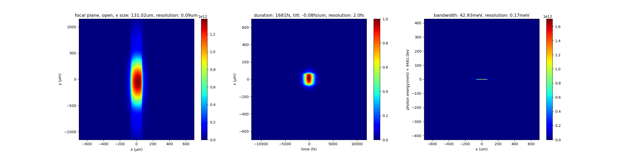
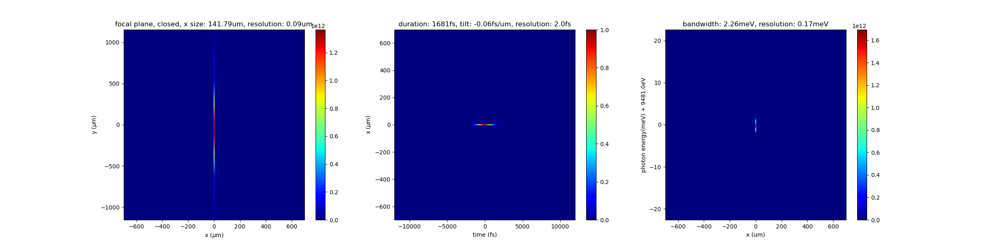
SRW, HRM Only, focus, mirror
20fs incident Gaussian beam.
Plots shown here are in linear scales. However, we can see similar aliasing as in the lens cases in log scale.

Slide 8
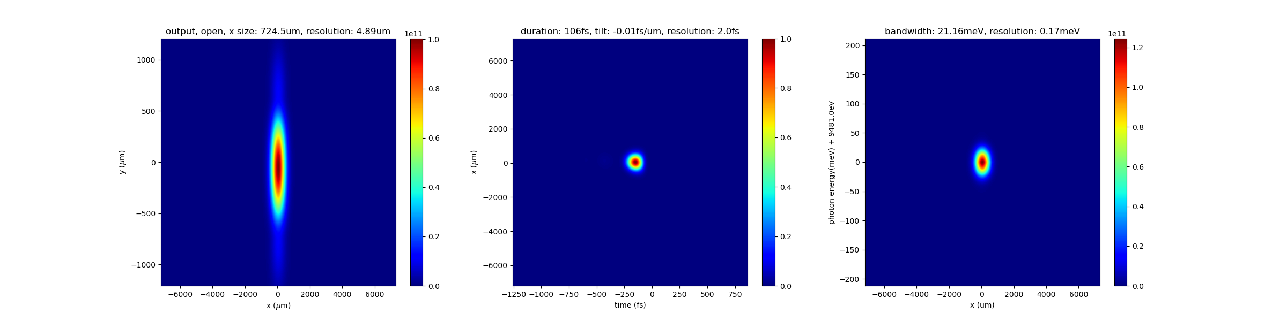
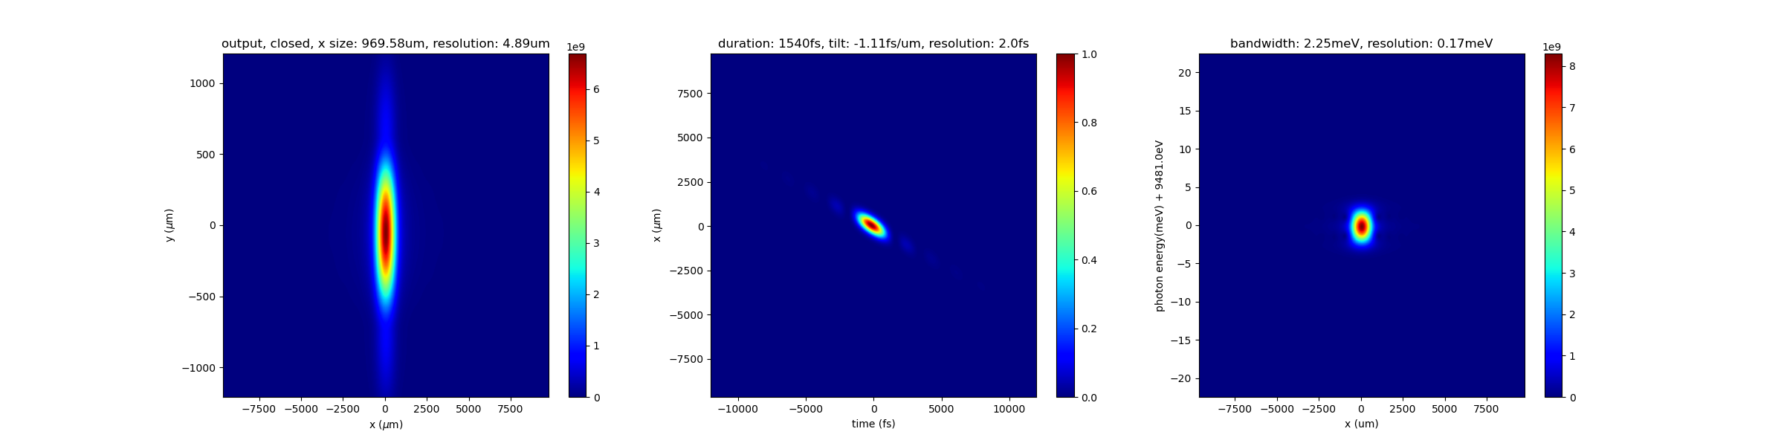
SRW, HRM Only, output, mirror
We get very similar results compared to the lens case

Slide 9
SRW, Telescope Only
SRW needs to update features including convex mirrors. So far, the shape of the mirrors are calculated theoretically and superimposed onto flat mirrors as shape error profiles in SRW.
Tried propagating SASE pulses through but eventually gave up due to tricky sampling along the beamline.

Slide 10
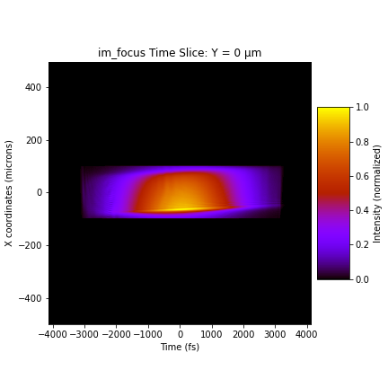
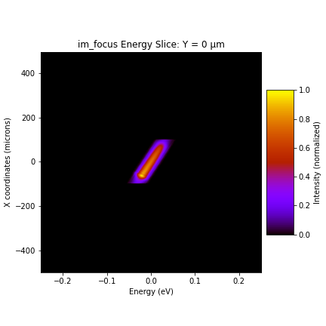
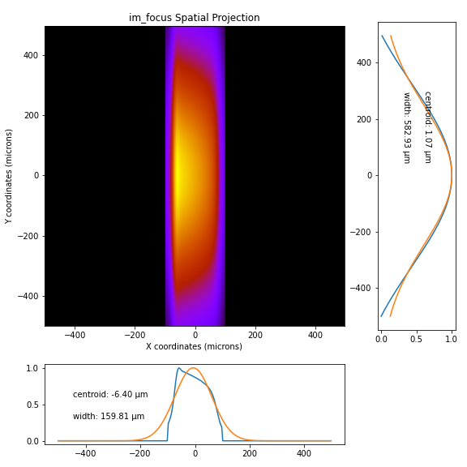
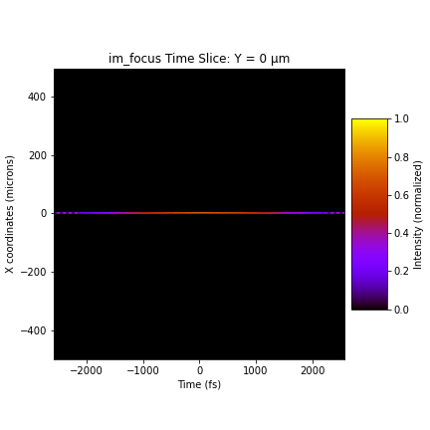
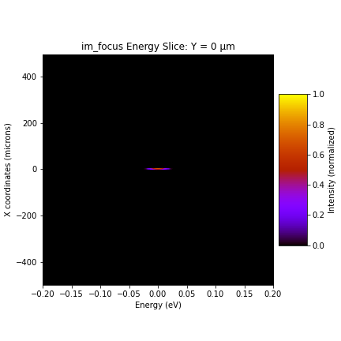
LCLS, Full beamline, focus
open
closed

Slide 11
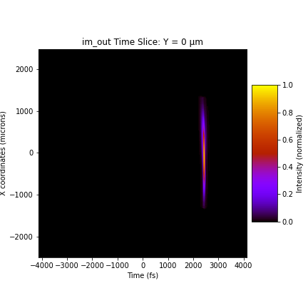
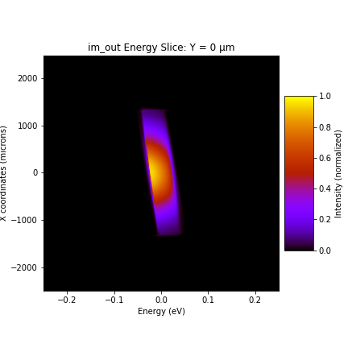
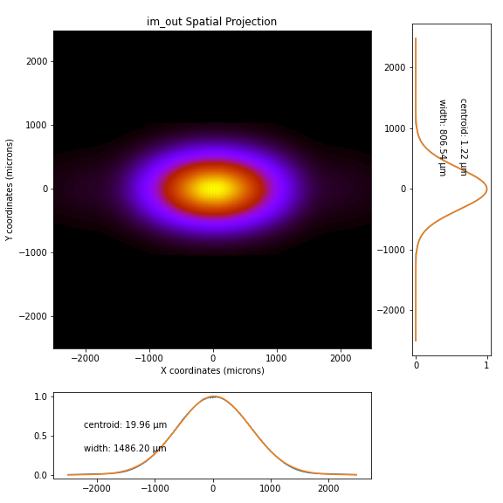
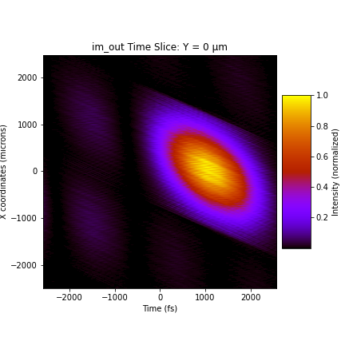
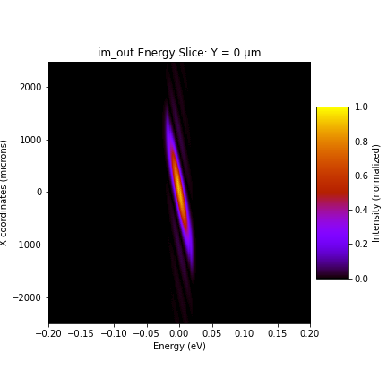
LCLS, Full beamline, output
open
closed
closed

Slide 12
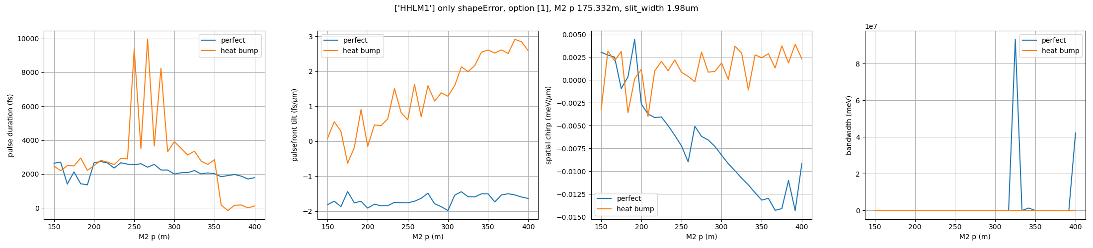
ShapeError, HHLM1, 73.15W
SASE (option 1, 2), 2FWHM: 24.62 x 0.66mm
In any case, 70+W is too large. I don’t think we can correct for this at all.

Slide 13
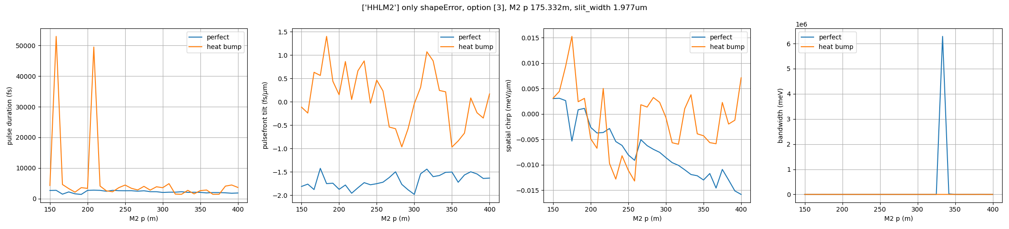
ShapeError, HHLM2, 50.1W
Self-seeded (option 3) , 2FWHM: 17.73 x 0.66mm
50W is still too large

Slide 14
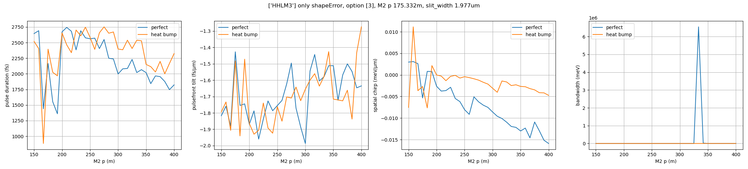
ShapeError, HHLM3, 1.78W
Self-seeded (option 3), 2FWHM: 17.73 x 0.66mm

Slide 15
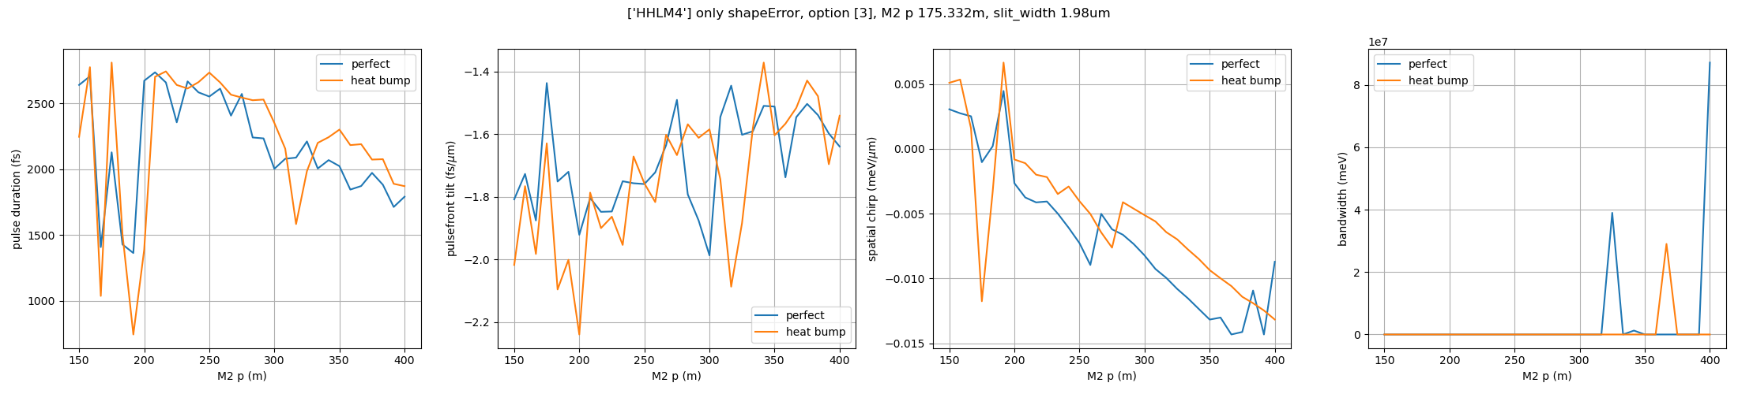
ShapeError, HHLM4, 1.69W
Self-seeded (option 3), 2FWHM: 24.62 x 0.66mm

Slide 16
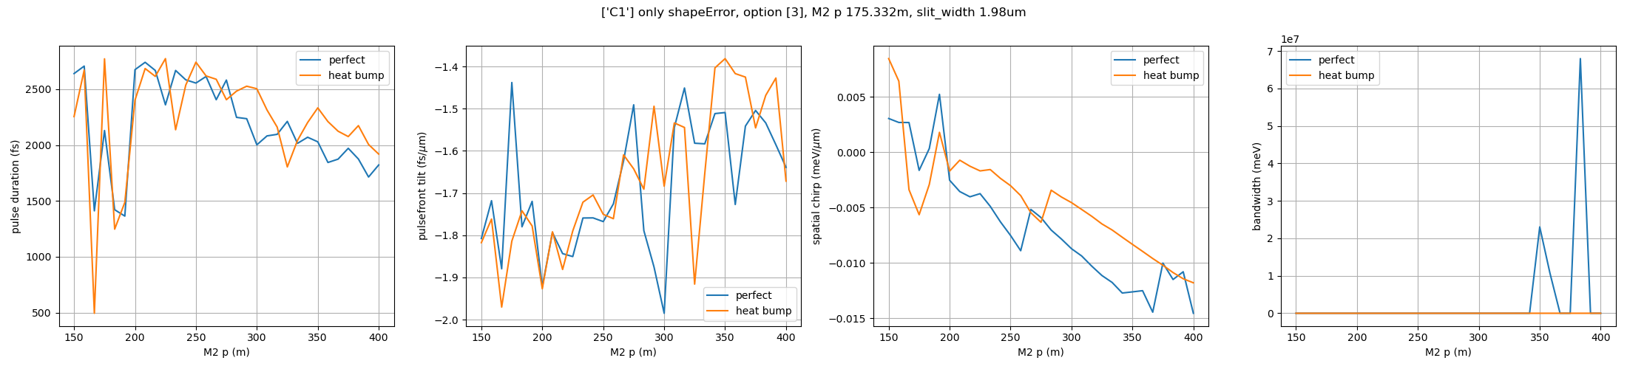
ShapeError, HRM1, 1.61W
Self-seeded (option 3), 2FWHM: 1.84 x 0.66mm

Slide 17
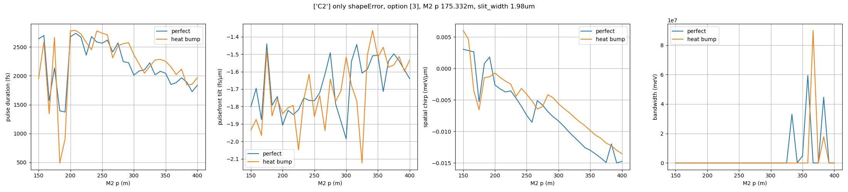
ShapeError, HRM2, 1.88W
Self-seeded (option 3), 2FWHM: 1.48 x 0.66mm

Slide 18
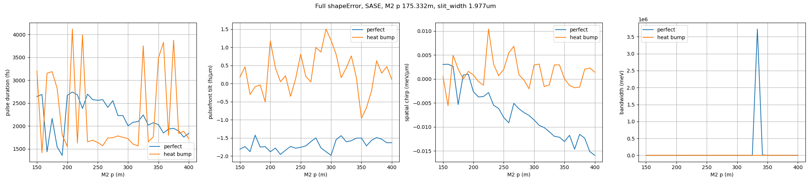
ShapeError, full, SASE
SASE (option 1)
Weakest link: HHLM1

Slide 19
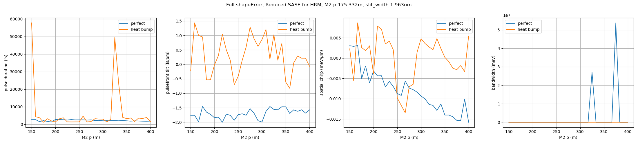
ShapeError, full, SASE (reduced at HRM)
SASE with reduced intensity for the HRM (option 2)
Weakest link: HHLM1

Slide 20
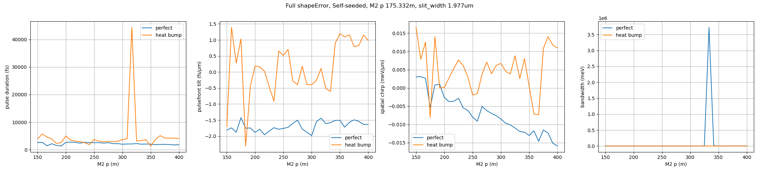
ShapeError, full, self-seeded
Self-seeded (option 3)
Weakest link: HHLM2

Slide 21
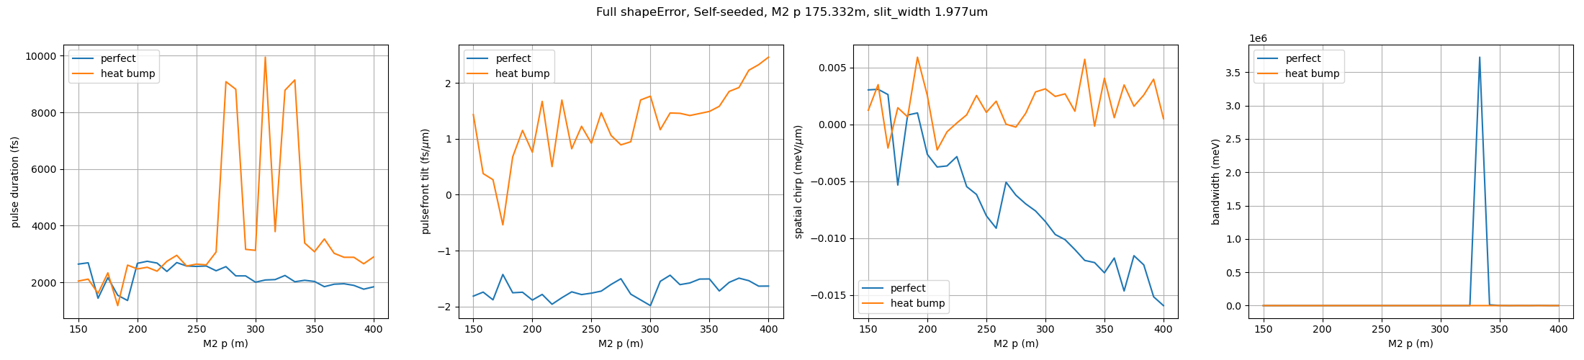
ShapeError, HHLM2, 50.1W, halved
Plot to be updated
Self-seeded (option 3) , 2FWHM: 17.73 x 0.66mm
Reducing the shapeError by a factor of 2 for HHLM2

Slide 22
ShapeError, full, self-seeded, halved
Plot to be updated
Self-seeded (option 3)
Reducing the shapeError by a factor of 2 for all crystals

Slide 23
ShapeError, HHLM2, 16.53W
Plot to be updated
SASE (option 1, 2), 2FWHM: 17.73 x 0.66mm
In the SASE case, the beam power at HHLM2 is reduced from 50.1W to 16.5W.

