Slide 1
DXS Optics Summary
- Checking validity of previous m2_p simulations
Nan Wang, Aug 05 2021

Slide 2
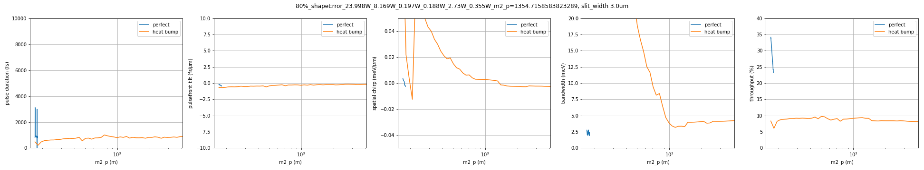
Zigzag-9481eV-Si-111-220-440, tolerance
Individual crystal shapeError correction to find the weakest crystal
 | Perfect | HHLM1 | HHLM2 | HHLM3 | HHLM4 | HRM1 | HRM2
Power (W) | N/A | 29.9778 | 10.2117 | 0.2468 | 0.2344 | 3.4120 | 0.4440
m2 p (m) | 175.7567547 | 523.3670250 | 216.9631929 | N/A | N/A | 201.6045856 | N/A
Full crystal shapeError correction to see the maximum power acceptable

Slide 3
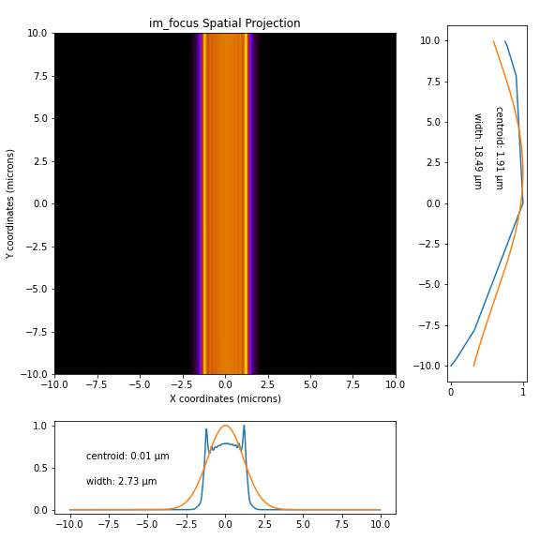
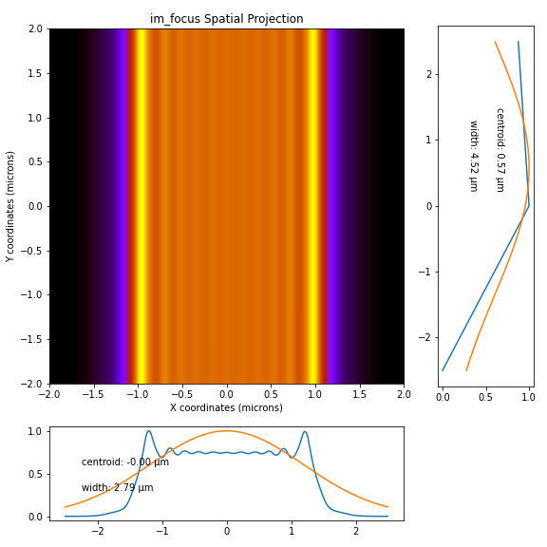
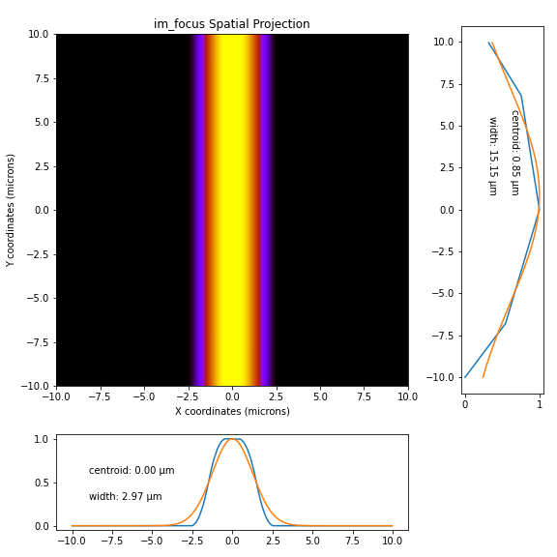
Zigzag-9481eV-Si-111-220-440, spatial
perfect
error only
bending
Profile at focus

Slide 4
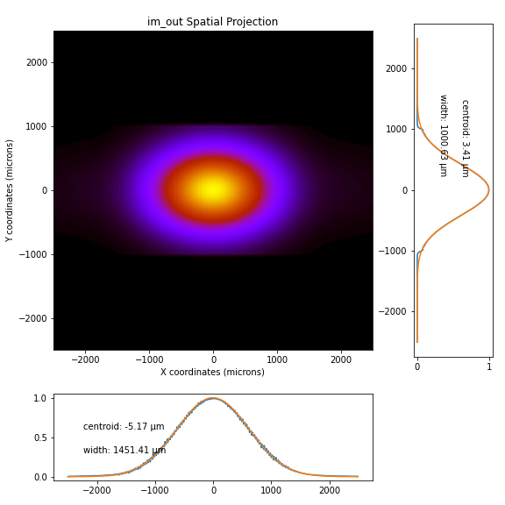
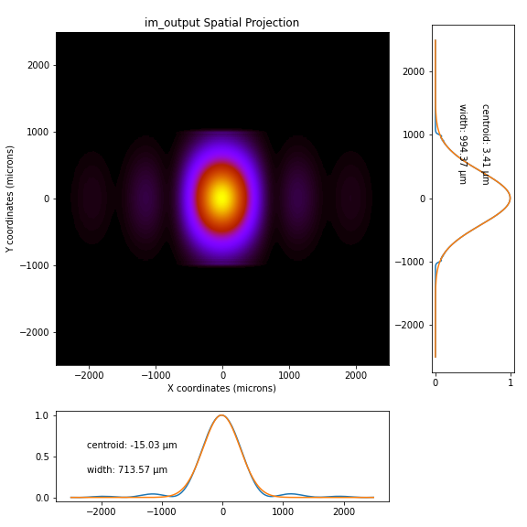
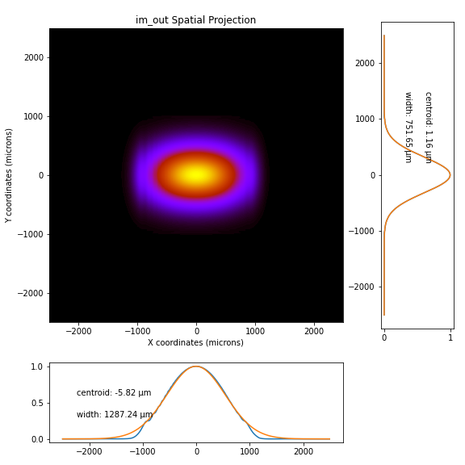
Zigzag-9481eV-Si-111-220-440, spatial
perfect
error only
bending
Profile at output

Slide 5
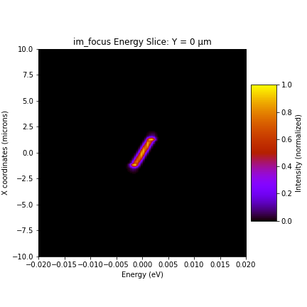
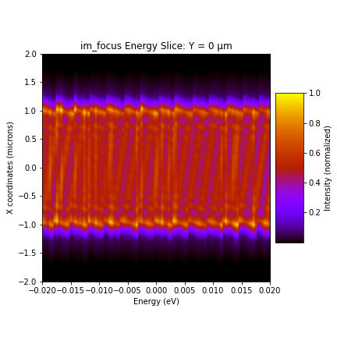
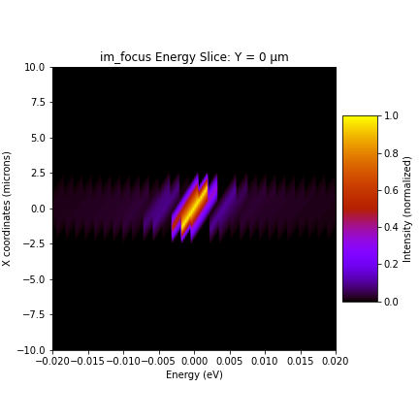
Zigzag-9481eV-Si-111-220-440, spectrum
perfect
Error only
bending
Spectrum at focus
This looks like an artifact

Slide 6
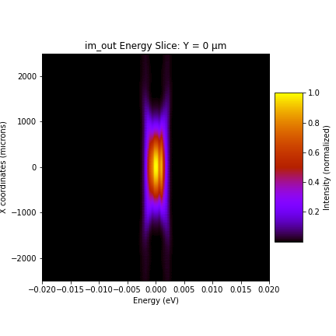
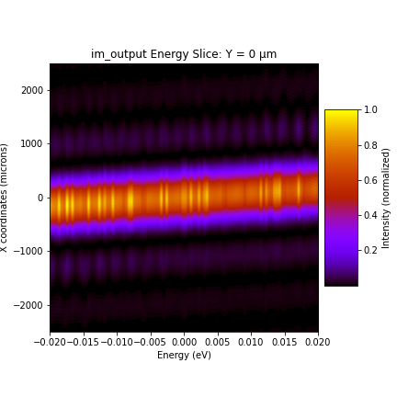
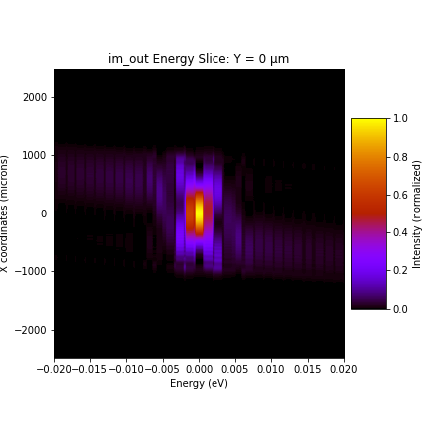
Zigzag-9481eV-Si-111-220-440, spectrum
perfect
Error only
bending
Spectrum at output
Add 1D plot at x=0 and see what tail looks like

Slide 7
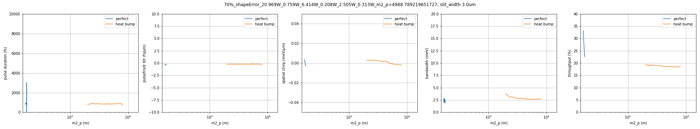
2DCM-9481eV-Si-111-220-440, tolerance
Individual crystal shapeError correction to find the weakest crystal
 | Perfect | HHLM1 | HHLM2 | HHLM3 | HHLM4 | HRM1 | HRM2
Power (W) | N/A | 29.9552 | 1.0849 | 9.1635 | 0.2965 | 3.5789 | 0.4476
m2 p (m) | 175.7567547 | 529.1965262 | N/A | 319.4762650 | N/A | 202.3190781 | N/A
Full crystal shapeError correction to see the maximum power acceptable

Slide 8
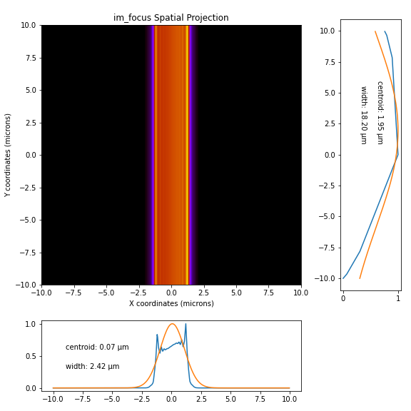

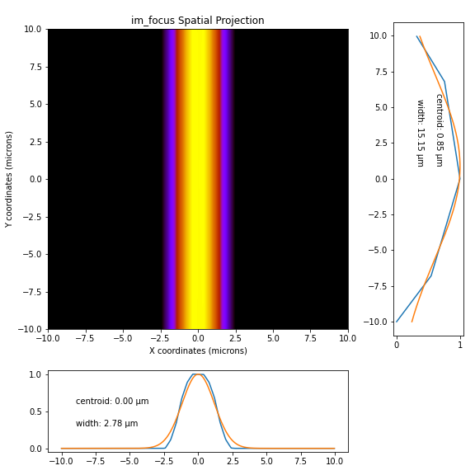
2DCM-9481eV-Si-111-220-440, spatial
perfect
error only
bending
Profile at focus

Slide 9



2DCM-9481eV-Si-111-220-440, spatial
perfect
error only
bending
Profile at output

Slide 10
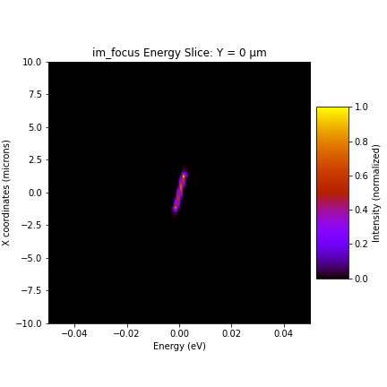
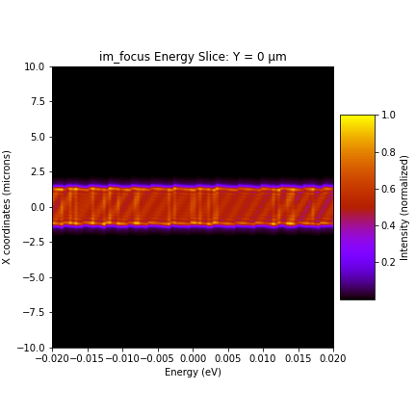
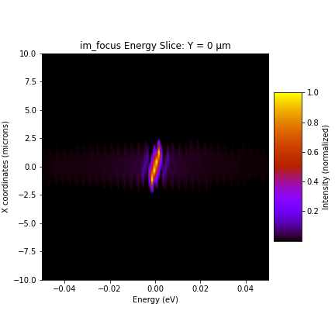
2DCM-9481eV-Si-111-220-440, spectrum
perfect
Error only
bending
Spectrum at focus

Slide 11
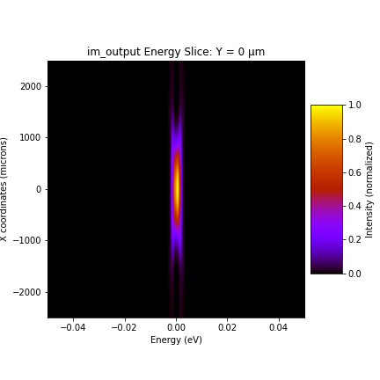
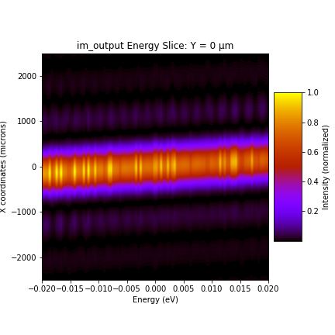
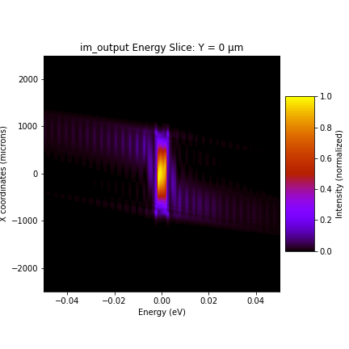
2DCM-9481eV-Si-111-220-440, spectrum
perfect
Error only
bending
Spectrum at output

Slide 12
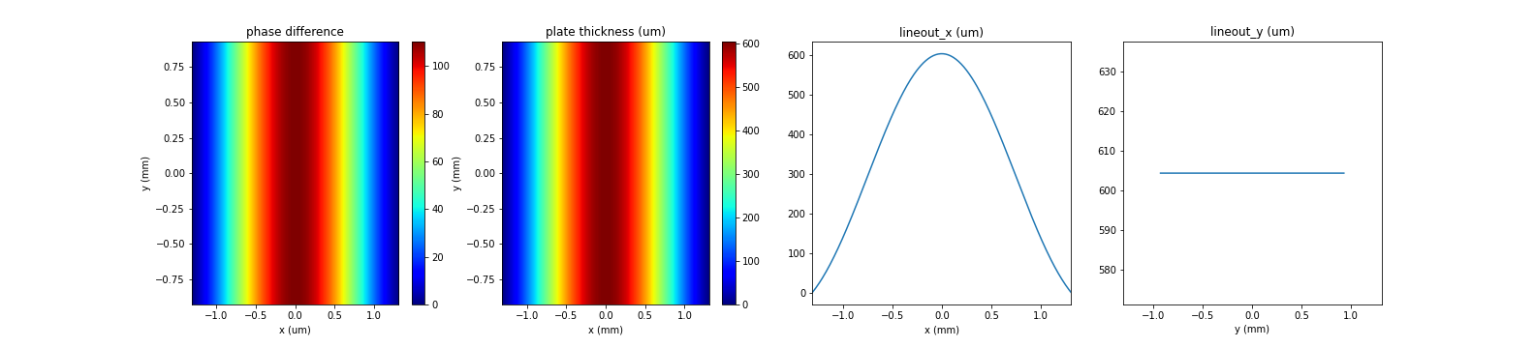
Phase plate at HHLM
HHLM
plate
difference
HRM
Close slit
Open slit

Slide 13
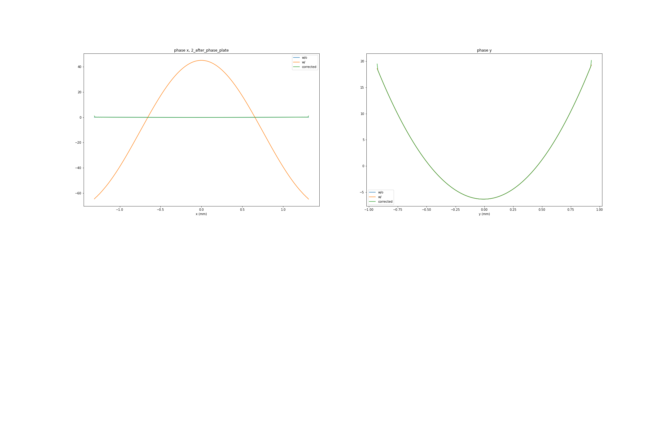
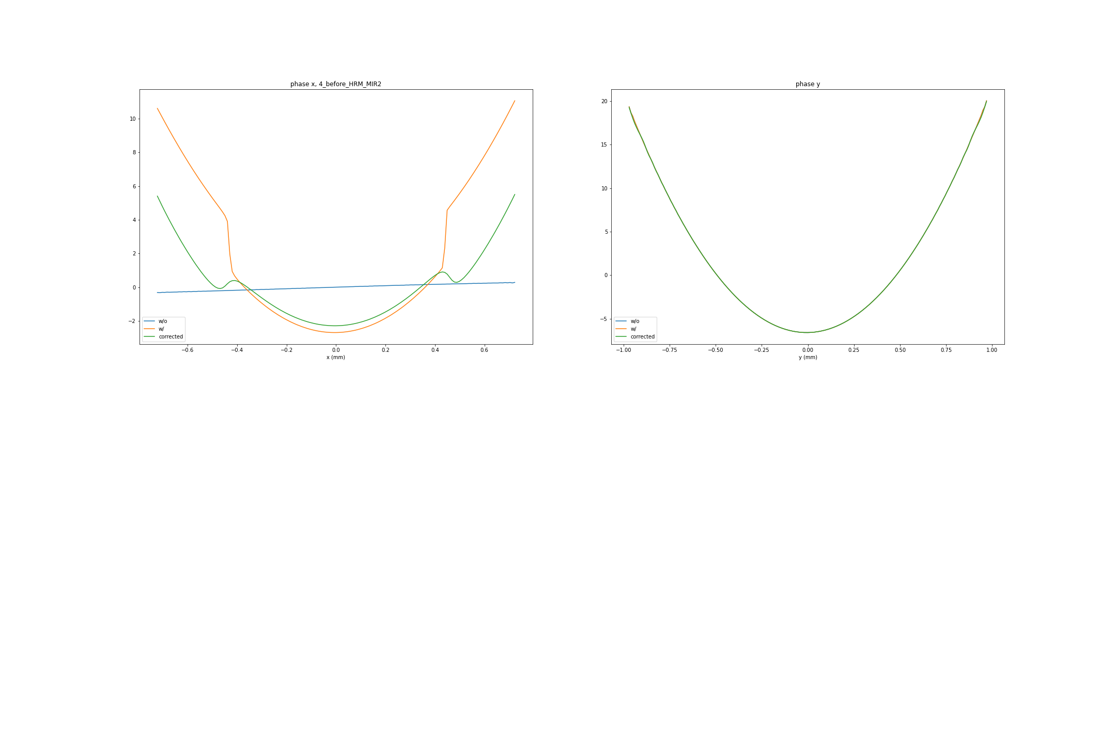
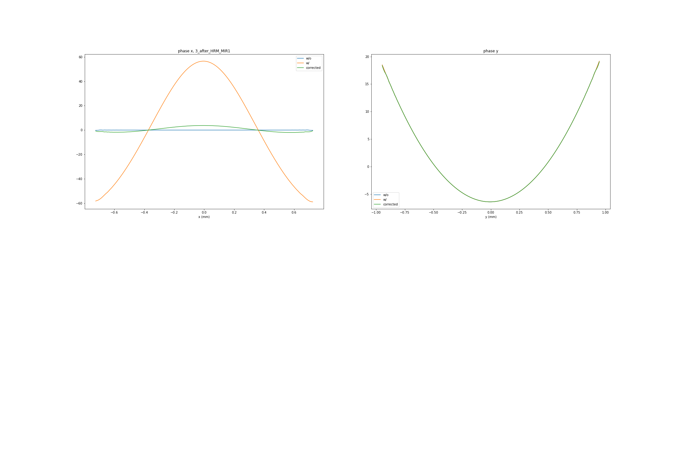
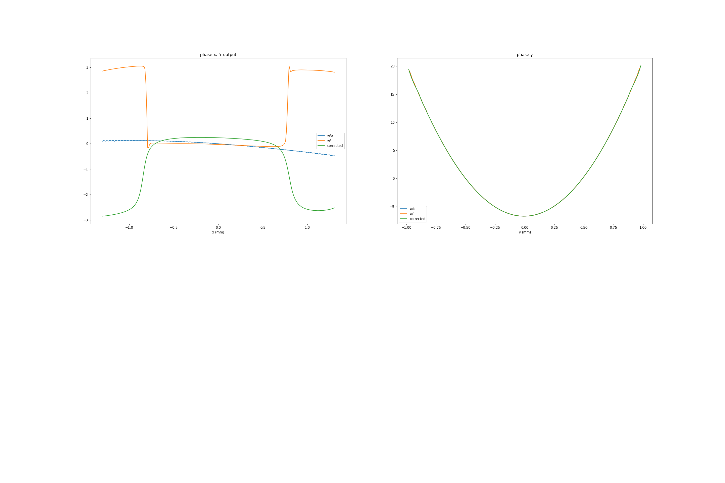
Phase difference at HHLM, close slit
HHLM
plate
difference
HRM
Right after phase plate
Before HRM mirror 2
After HRM mirror 1
Output

Slide 14
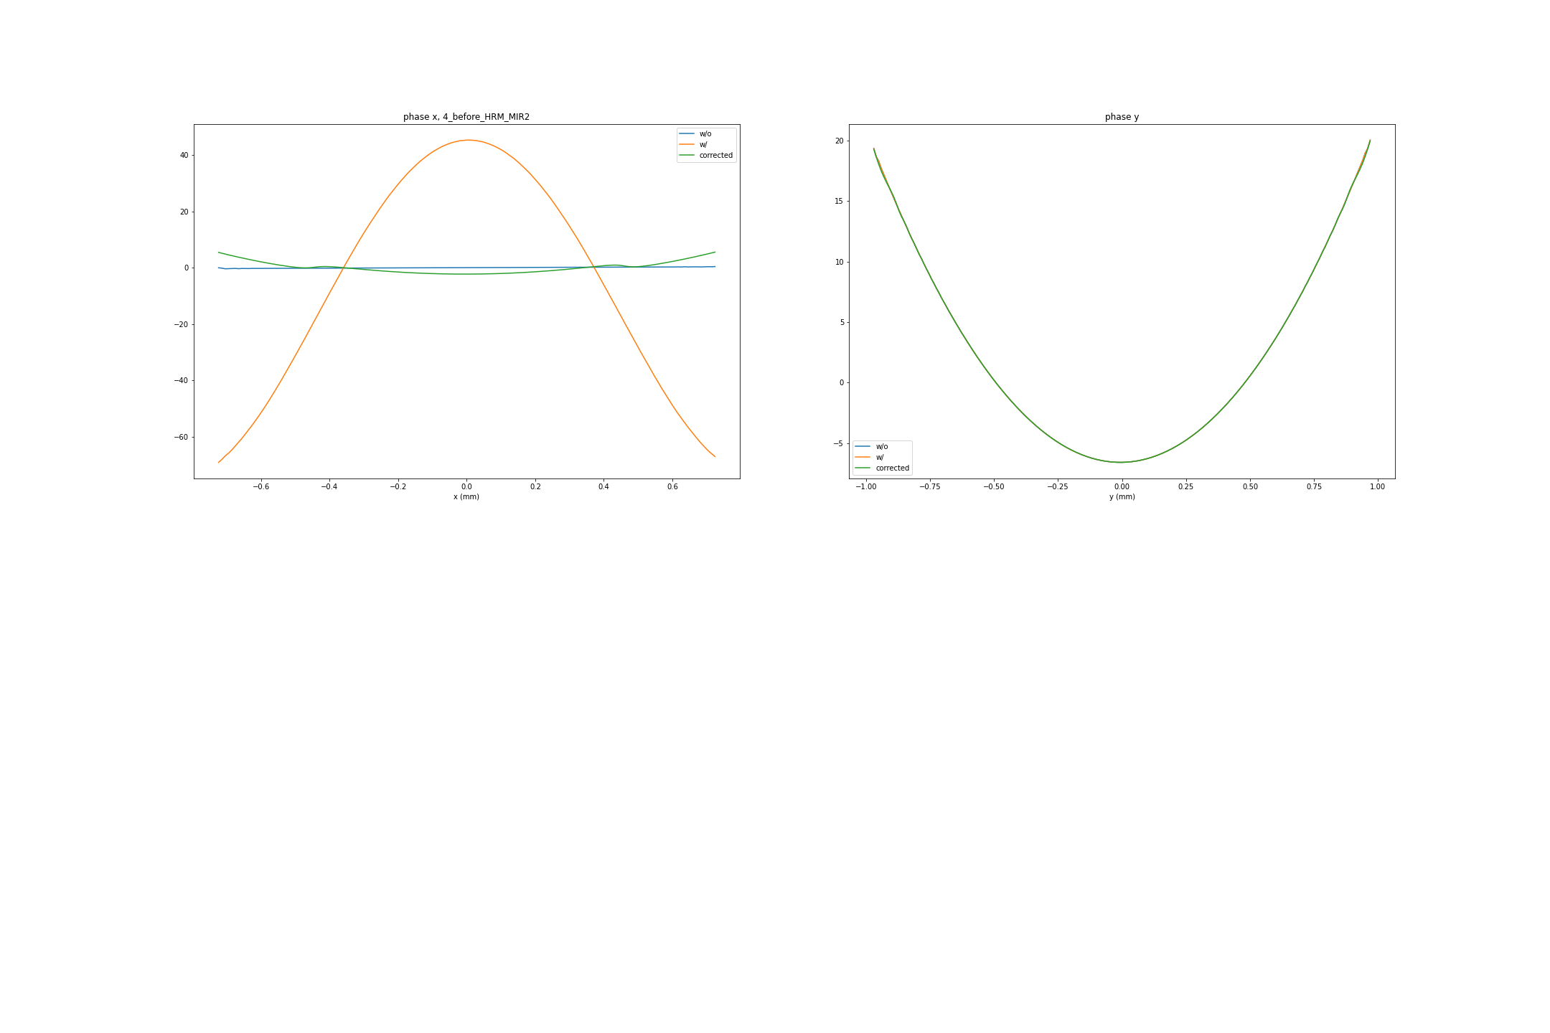
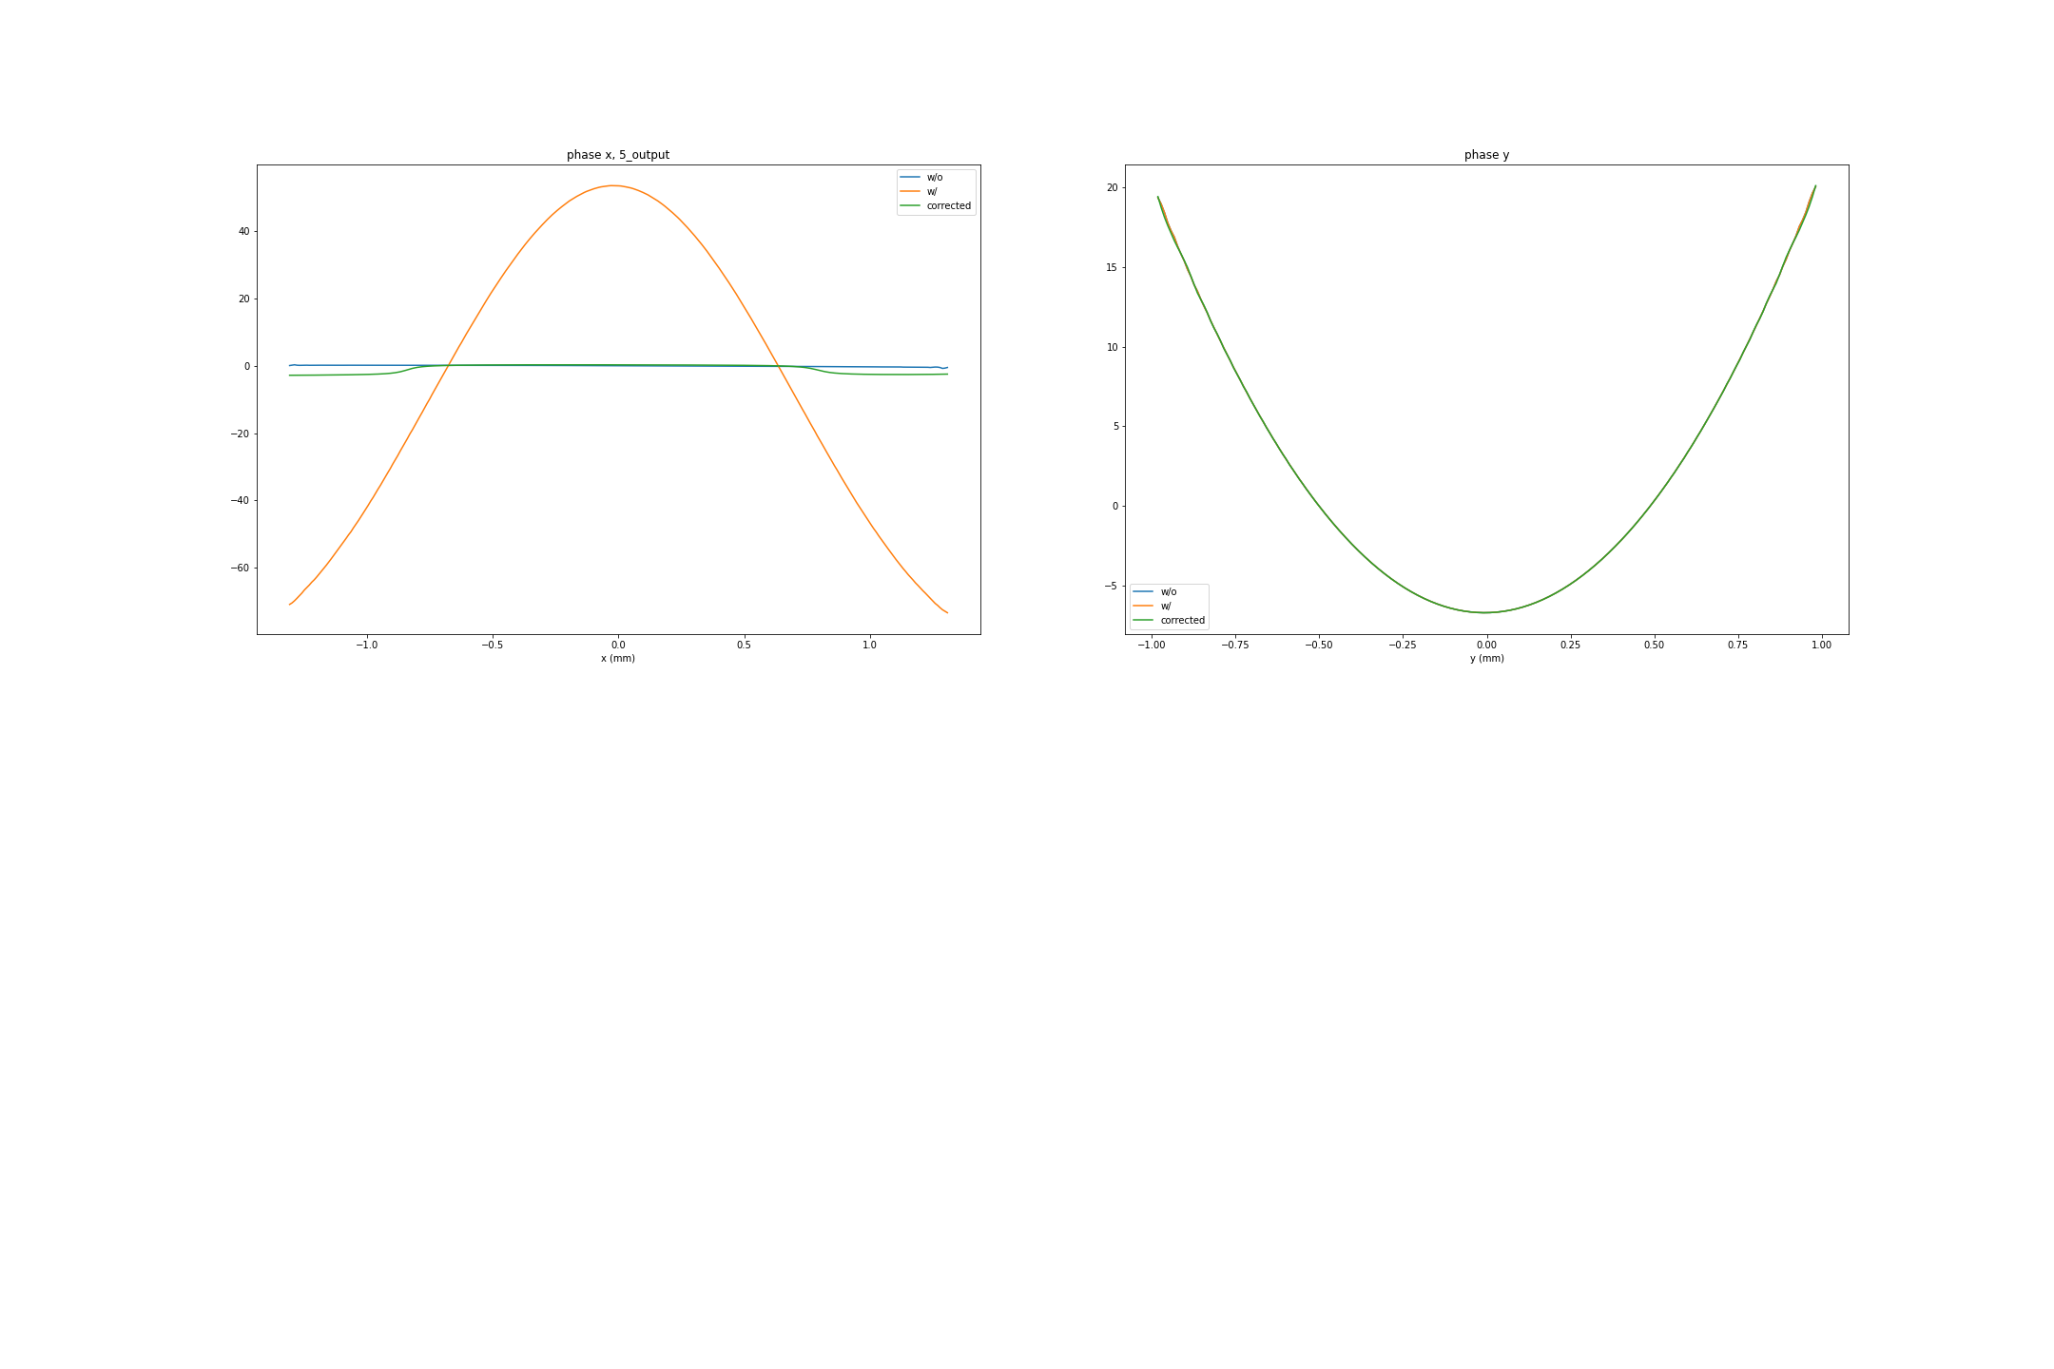
Phase difference at HHLM, open slit
HHLM
plate
difference
HRM
Right after phase plate
Before HRM mirror 2
After HRM mirror 1
Output

Slide 15
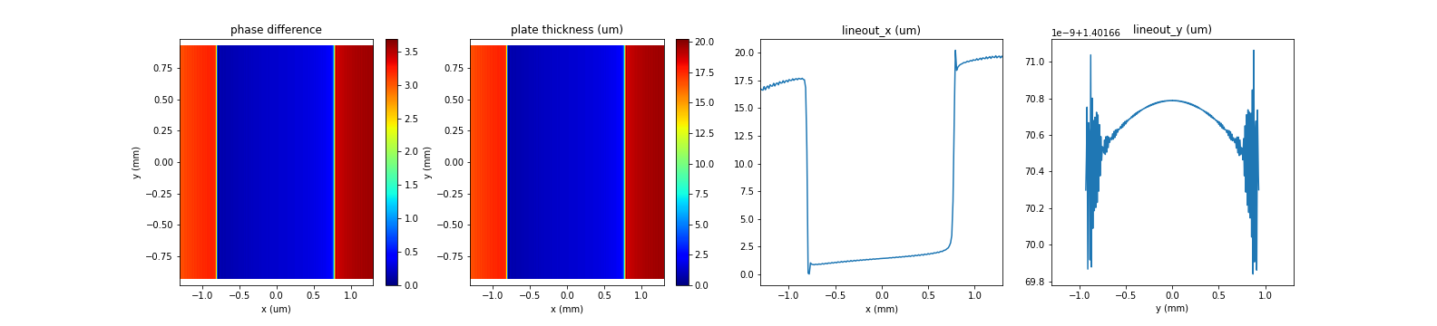
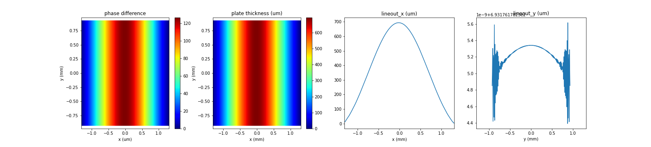
Phase plate at HRM
HHLM
plate
HRM
difference
Close slit
Open slit

Slide 16
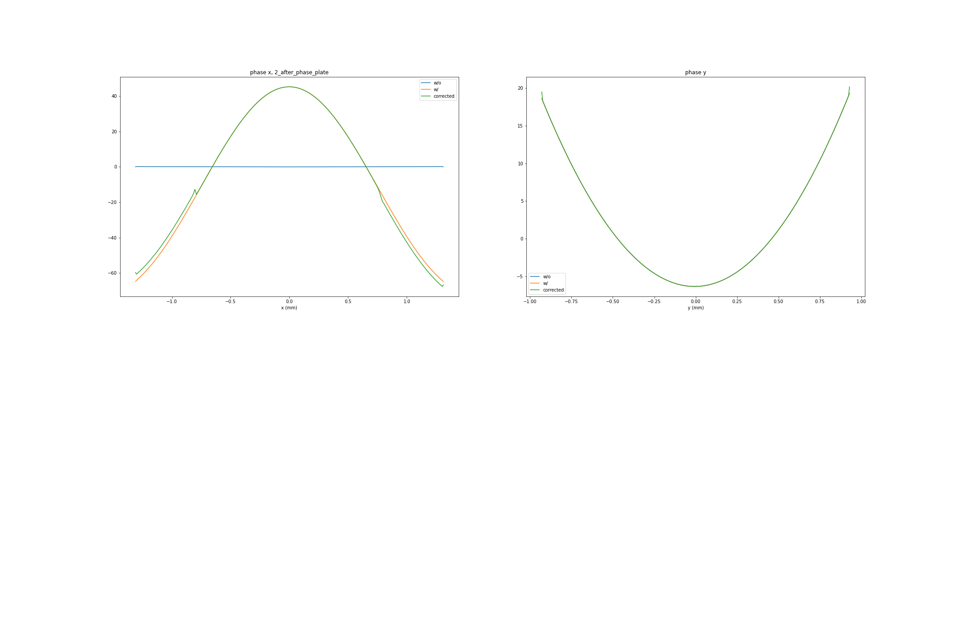
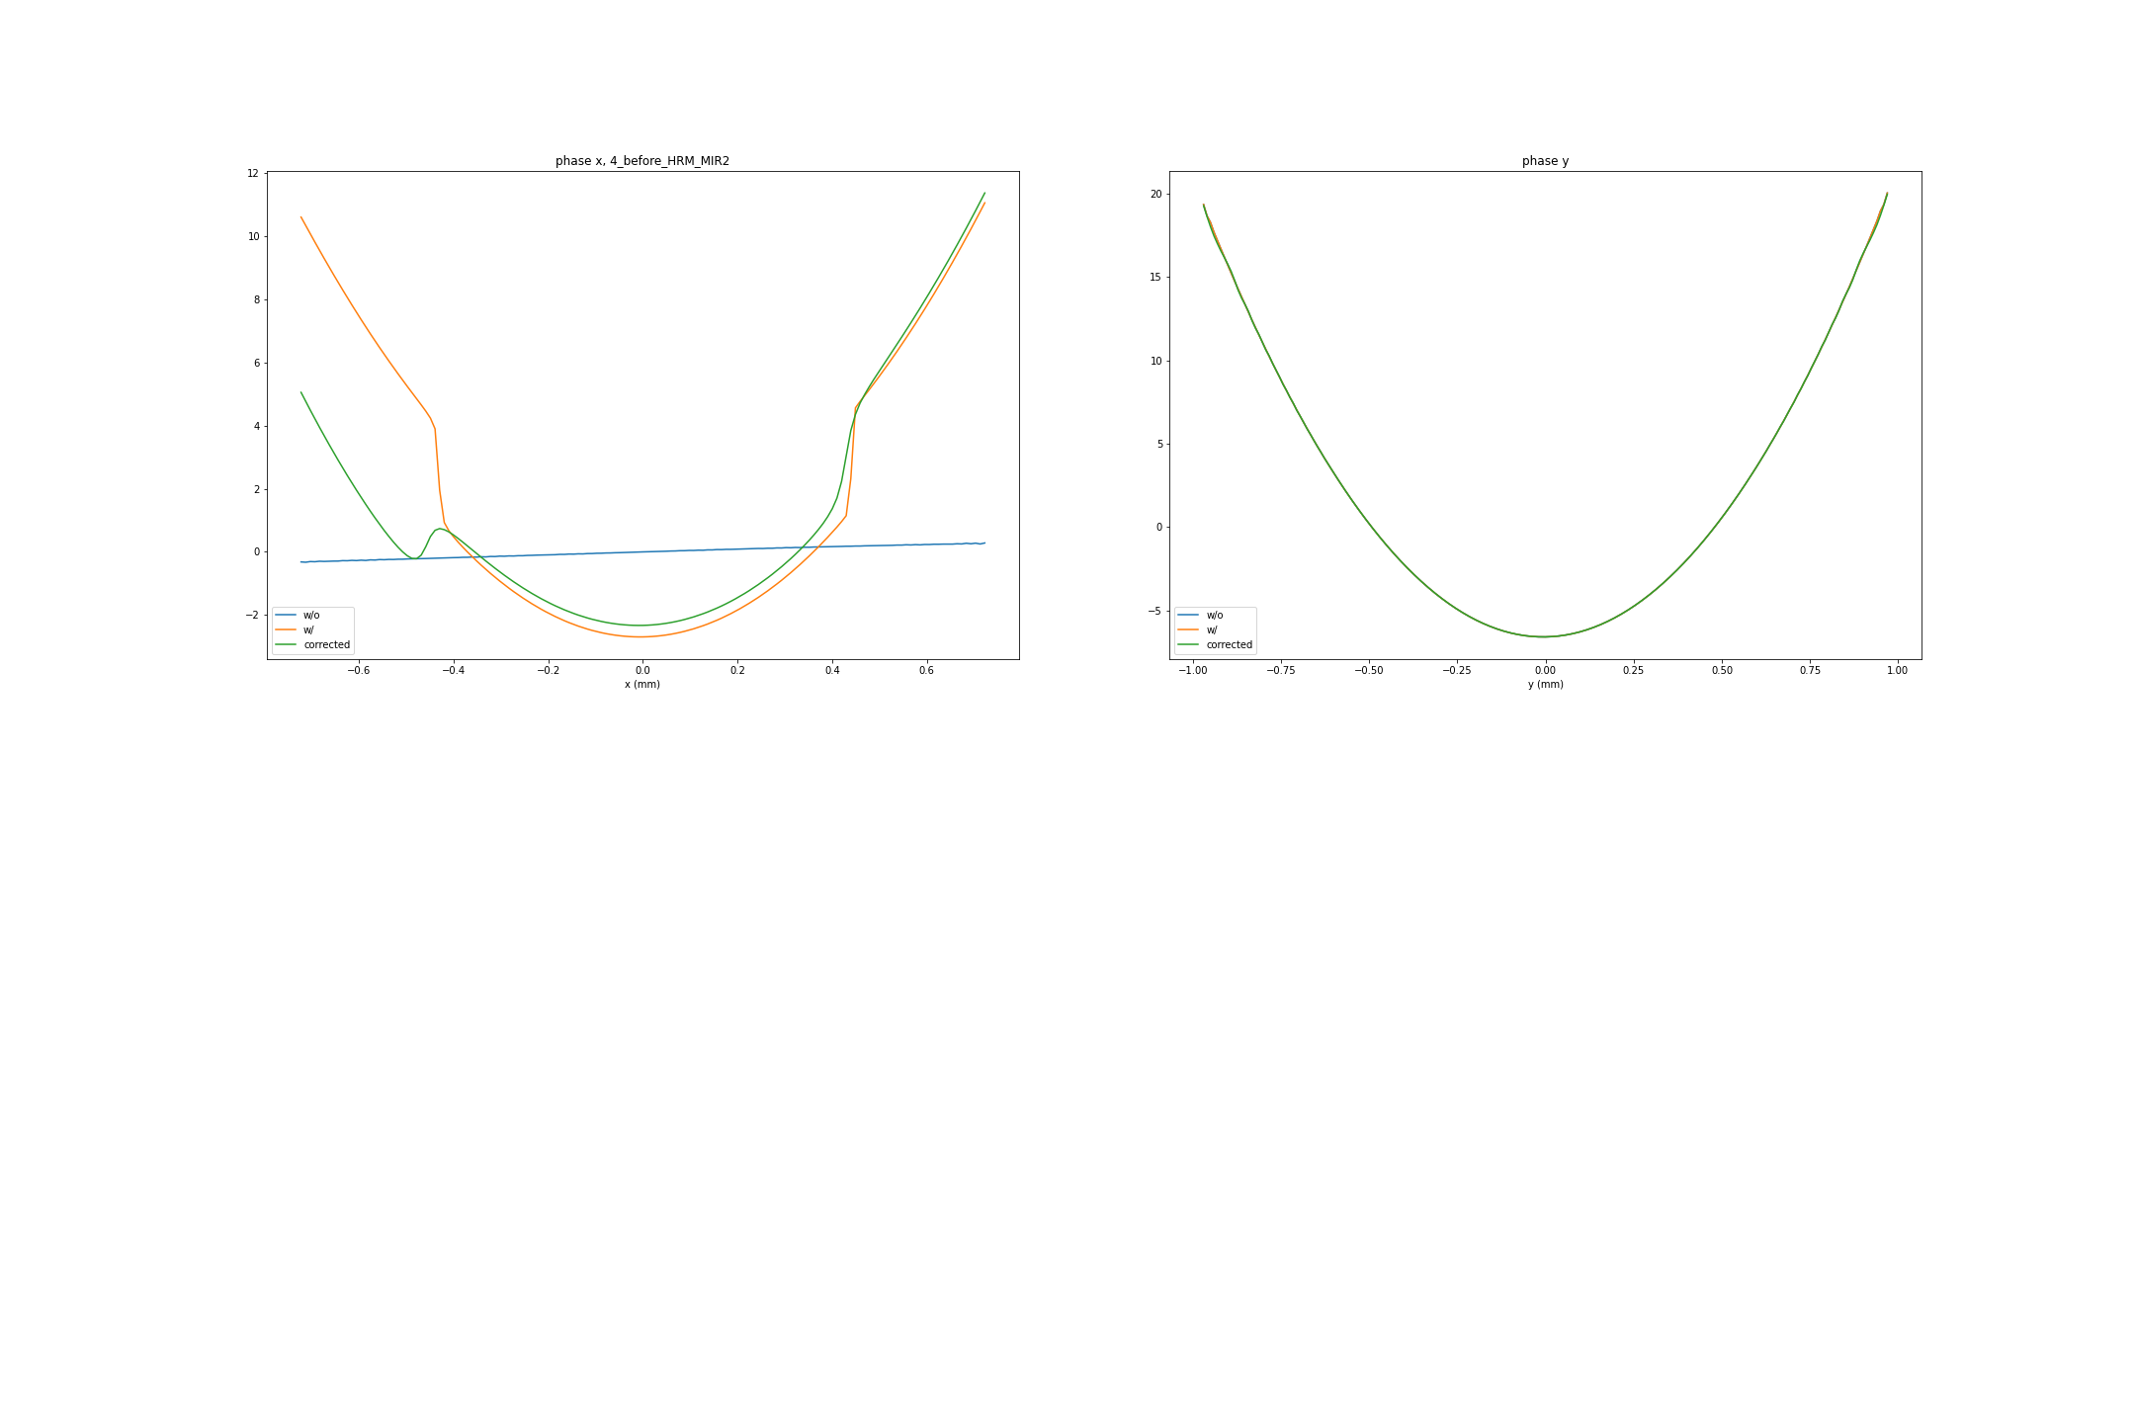
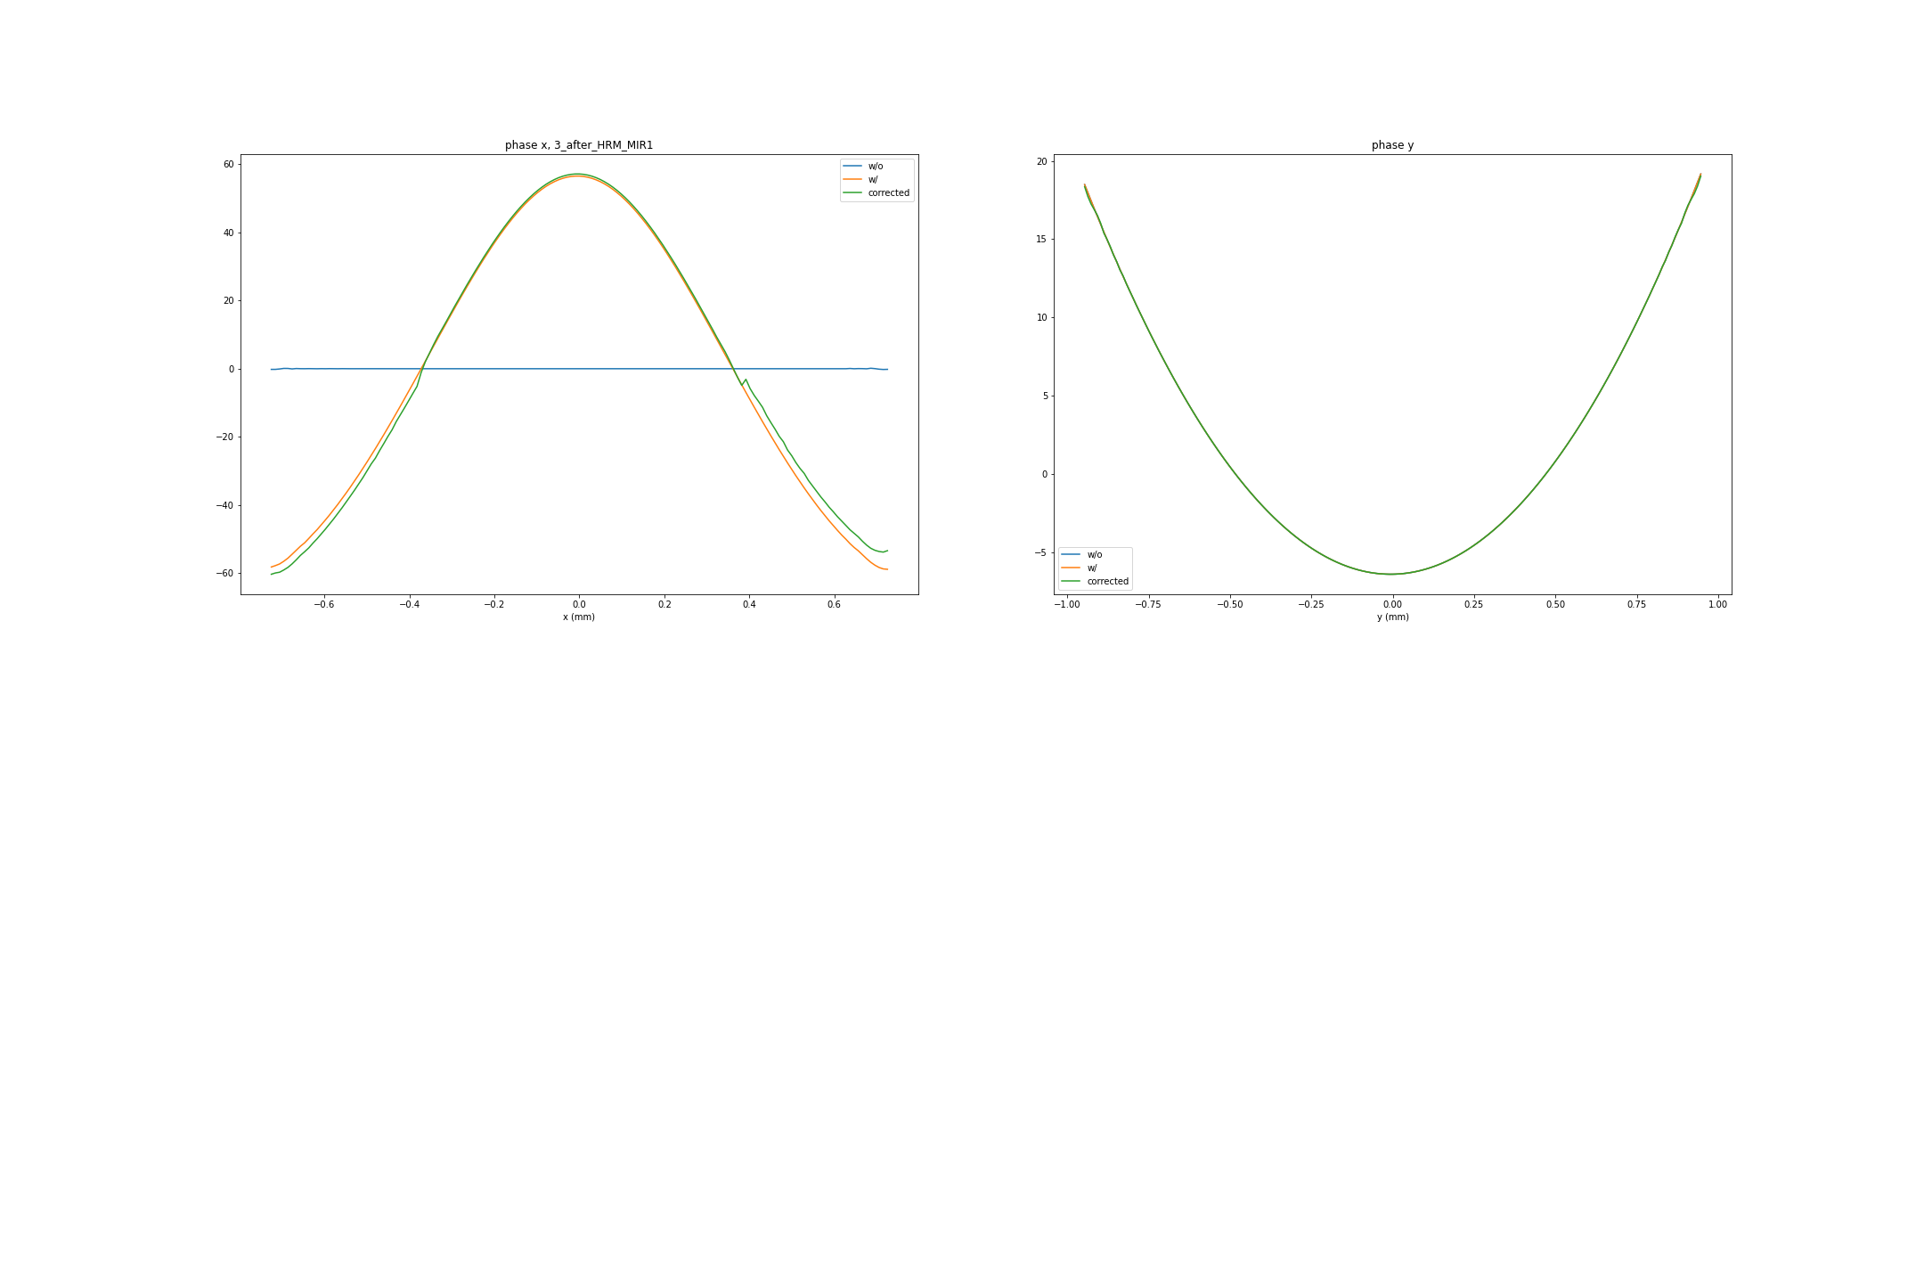
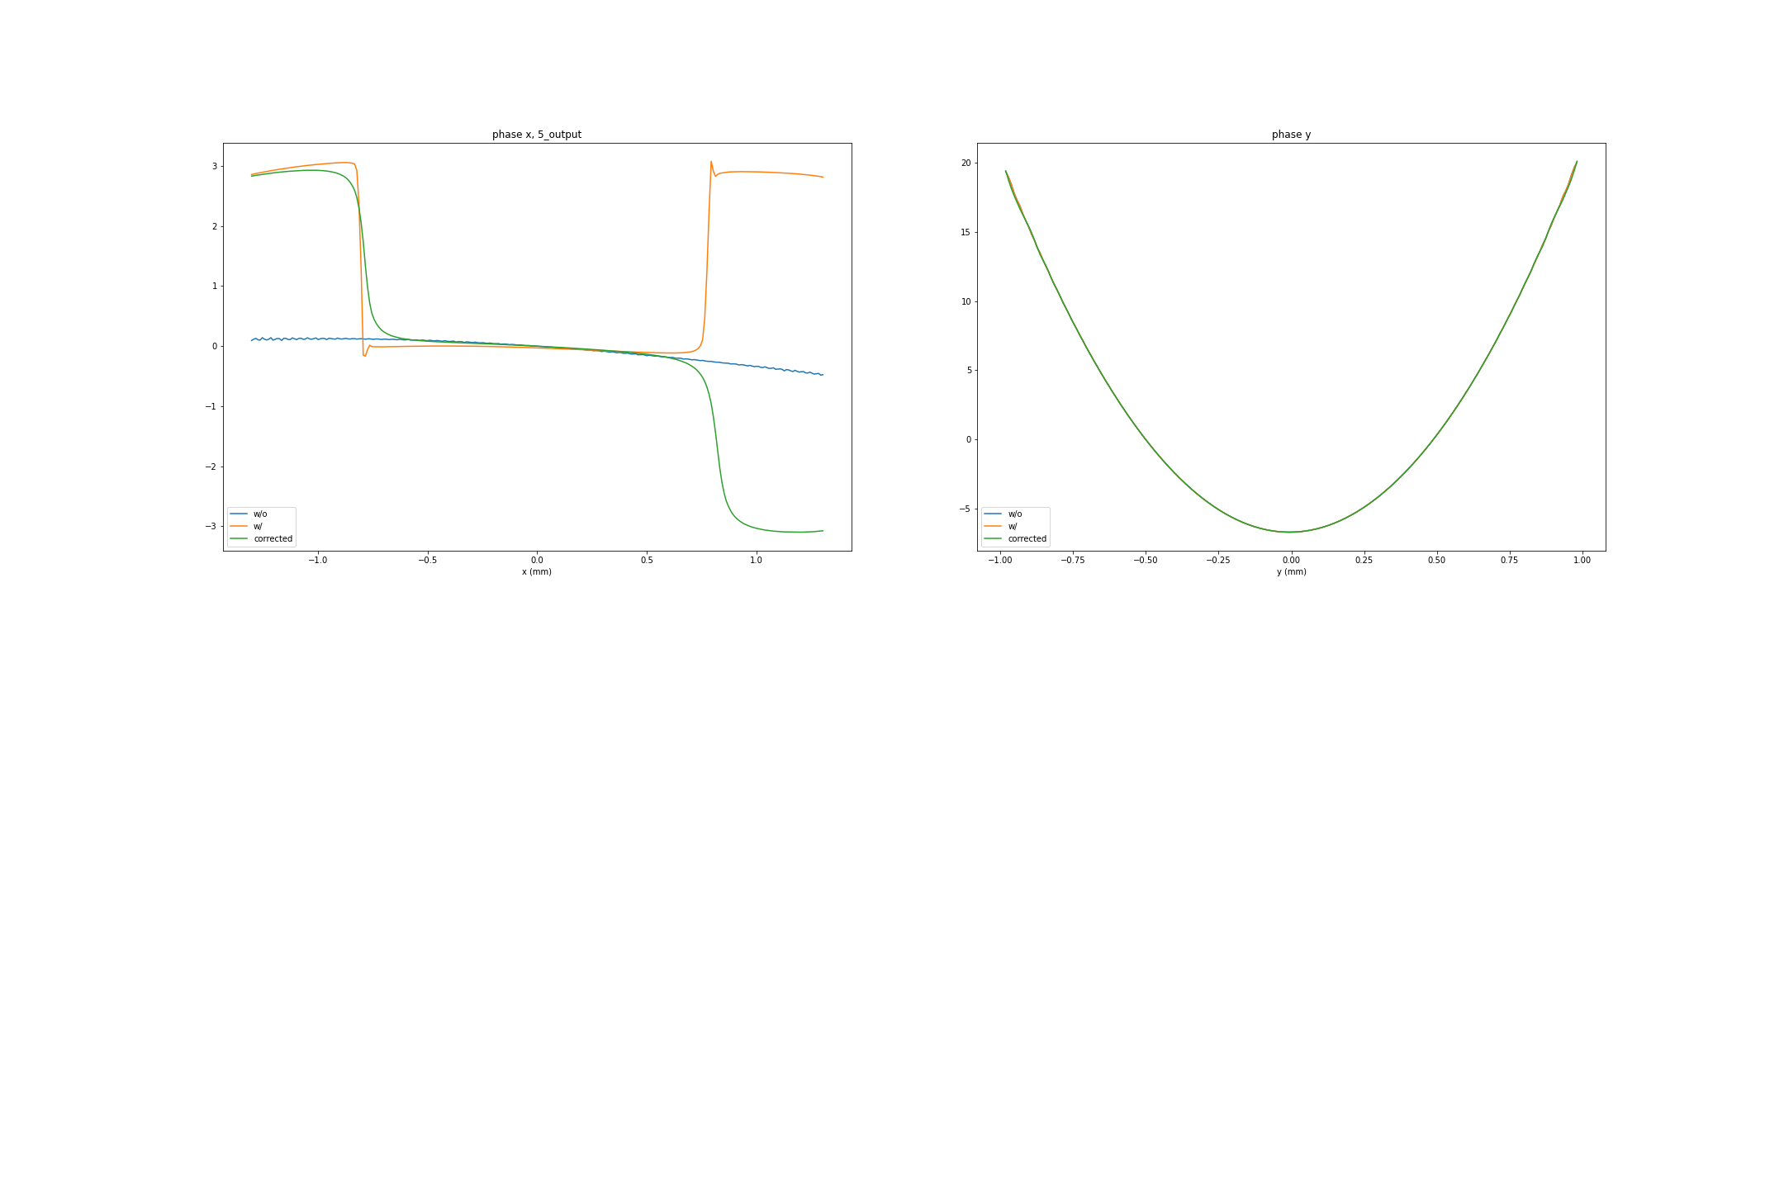
Phase difference at HRM, close slit
HHLM
plate
HRM
difference
Right after phase plate
Before HRM mirror 2
After HRM mirror 1
Output

Slide 17
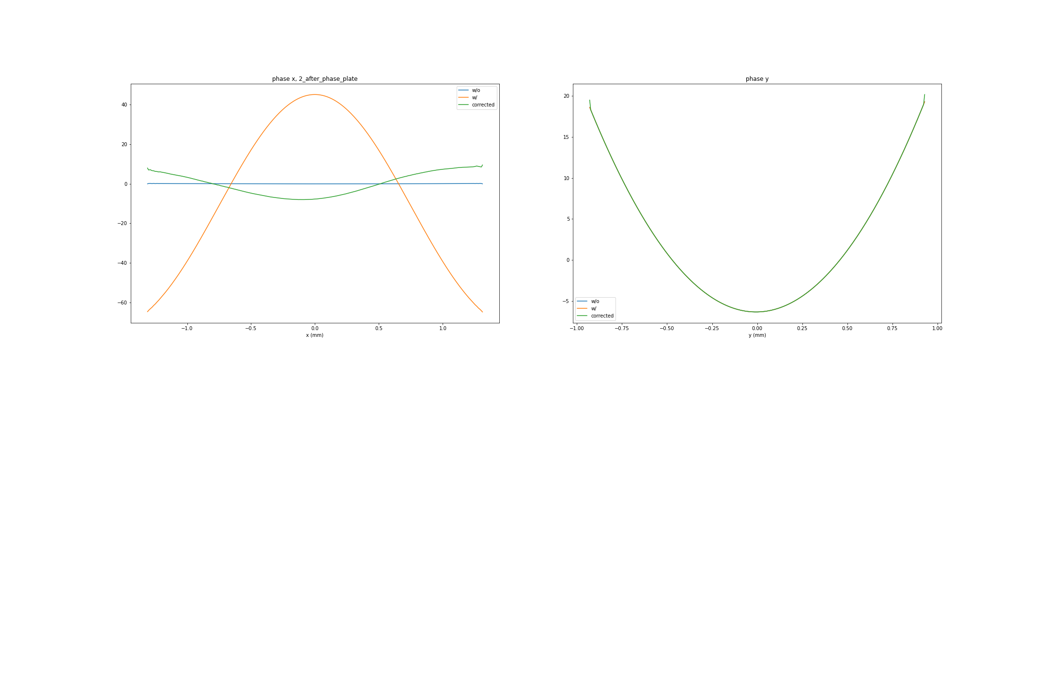
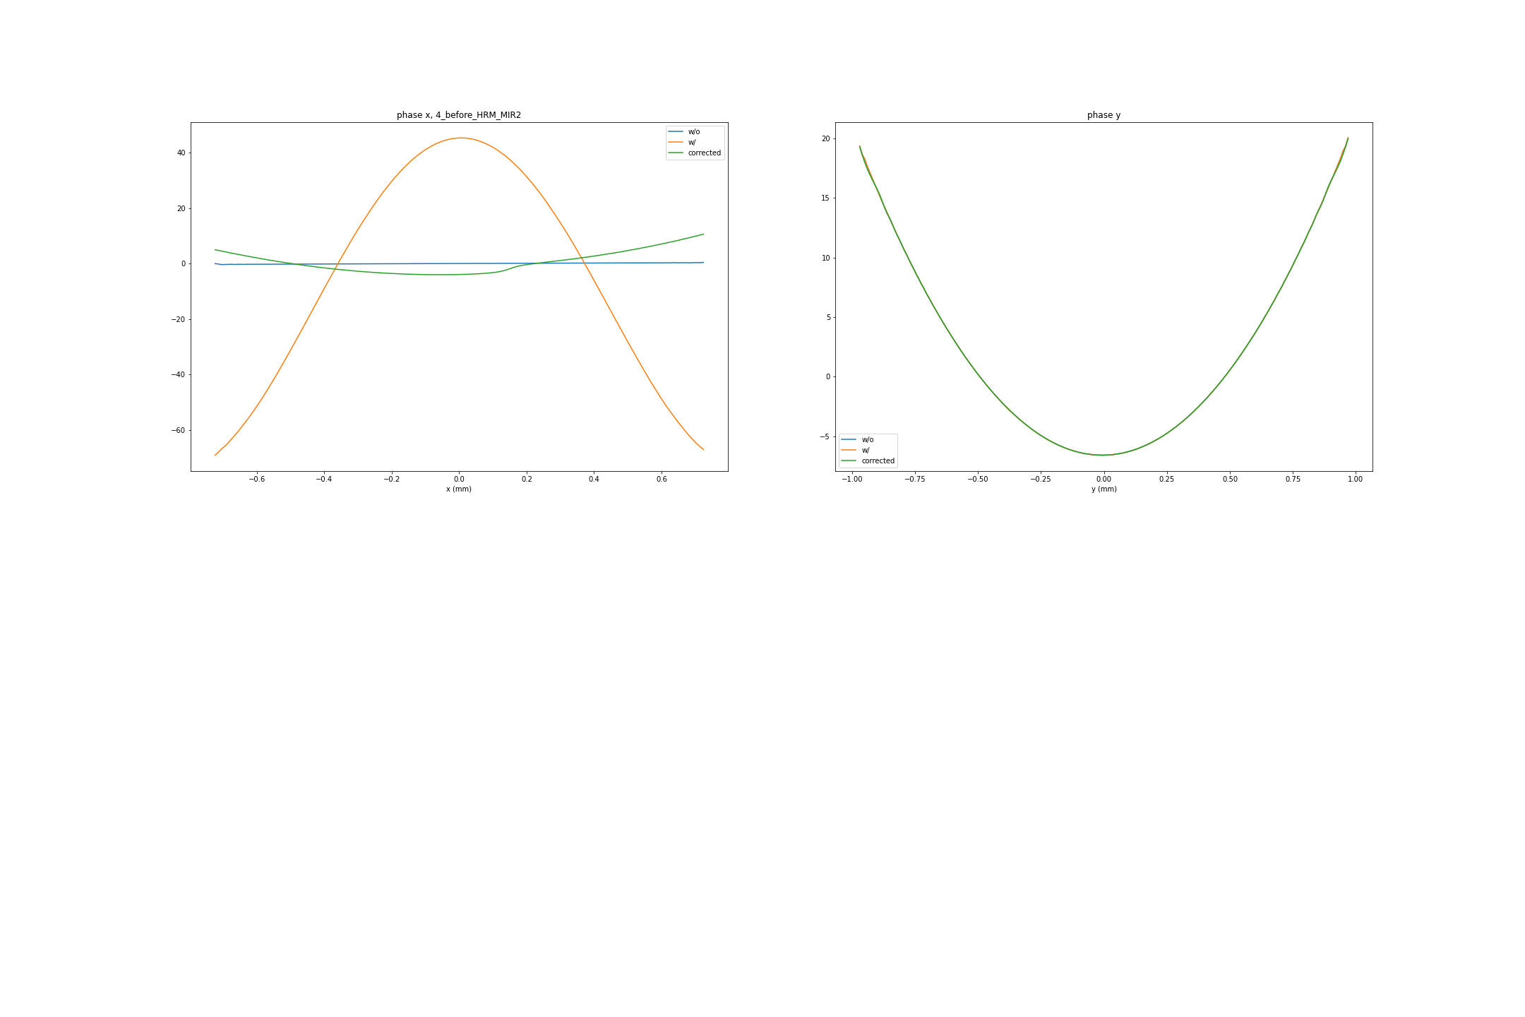
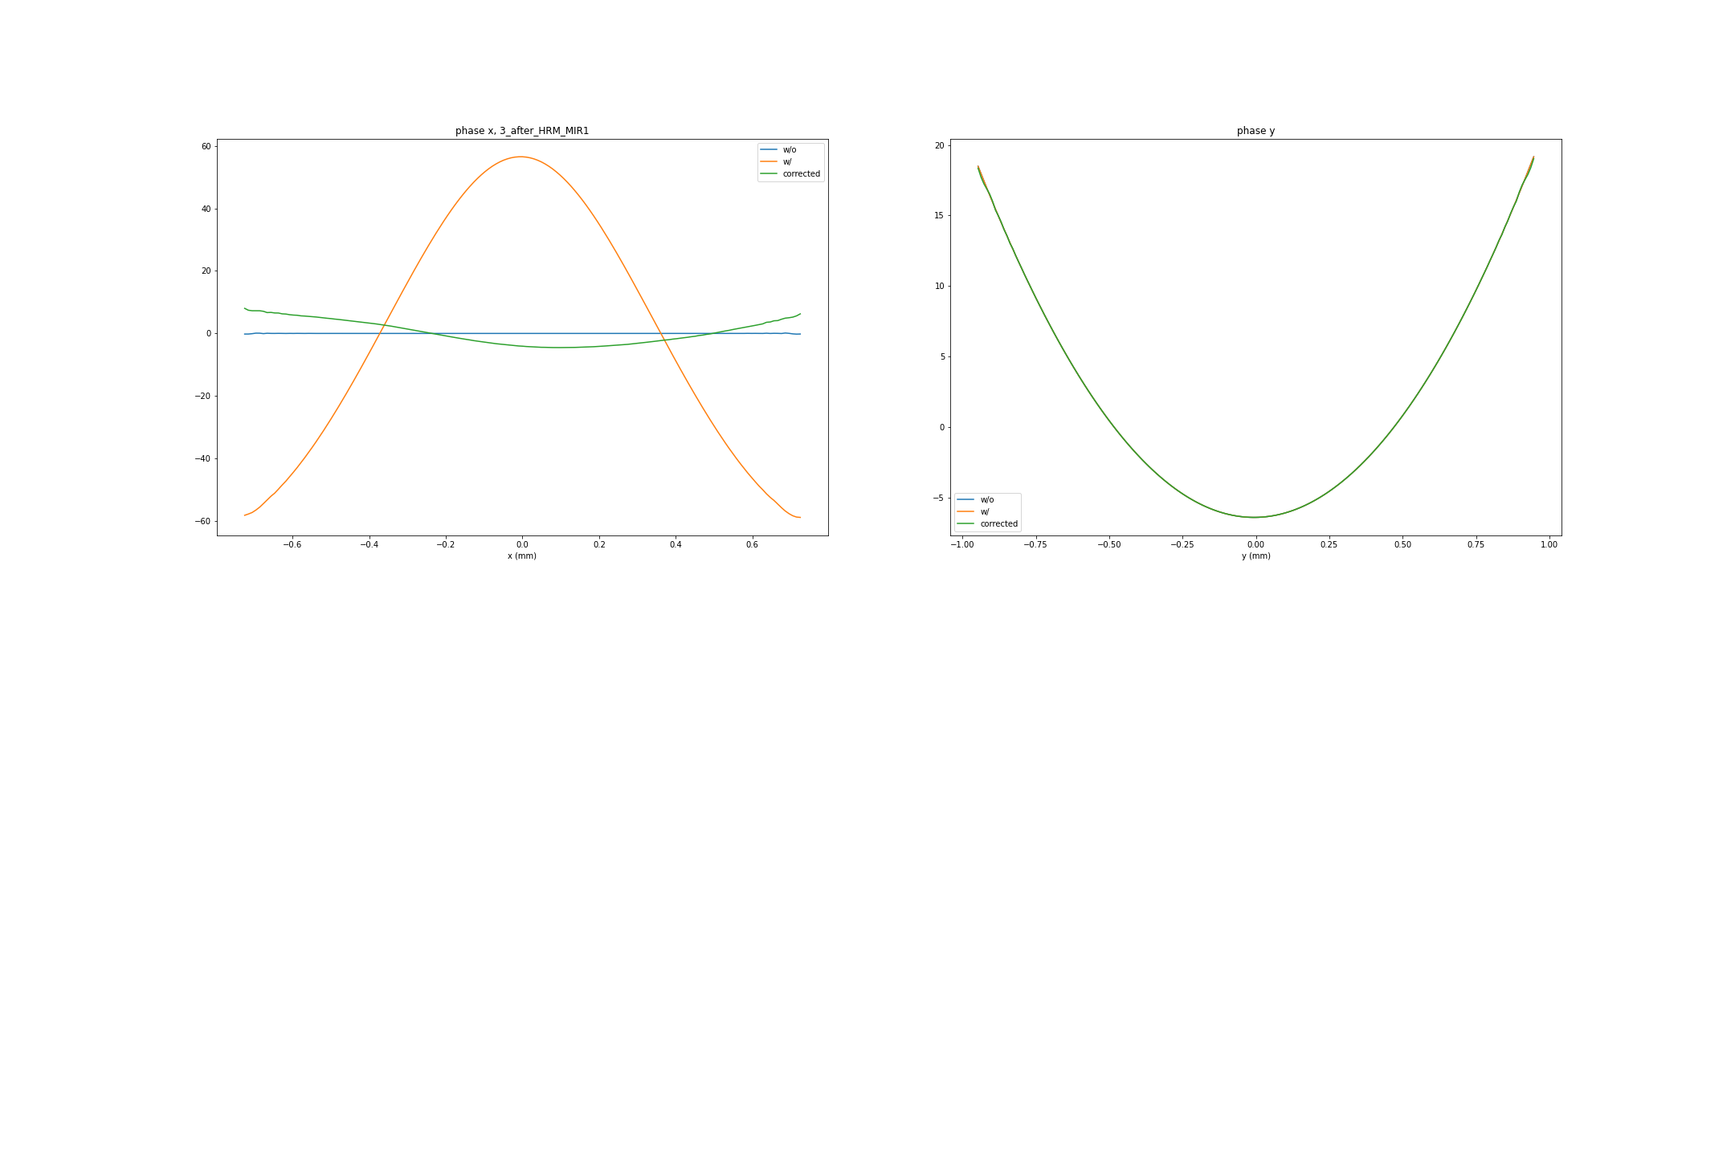
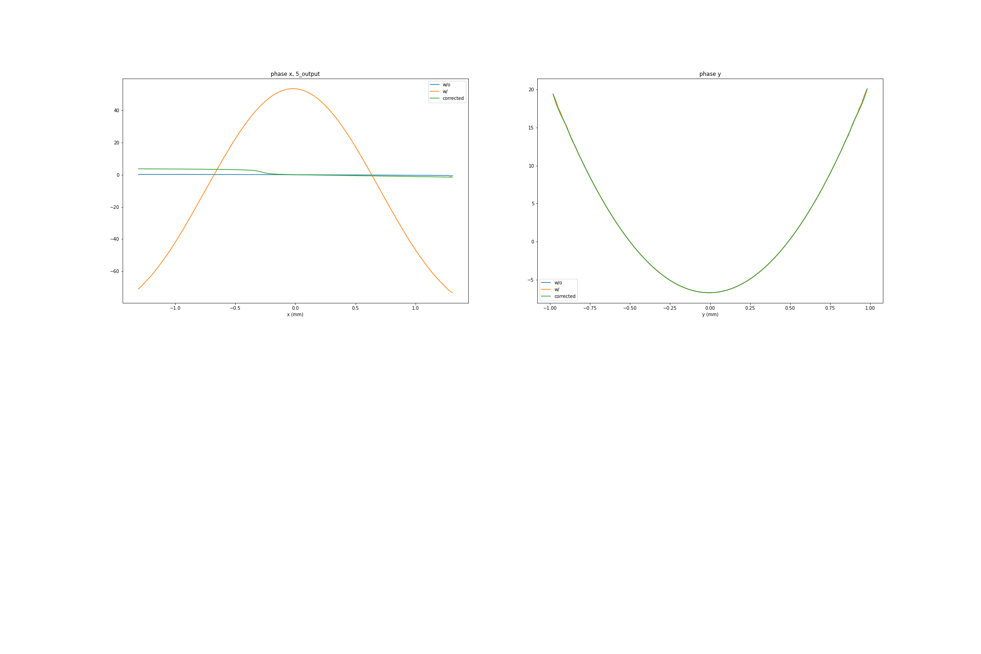
Phase difference at HRM, open slit
HHLM
plate
HRM
difference
Right after phase plate
Before HRM mirror 2
After HRM mirror 1
Output

Slide 18
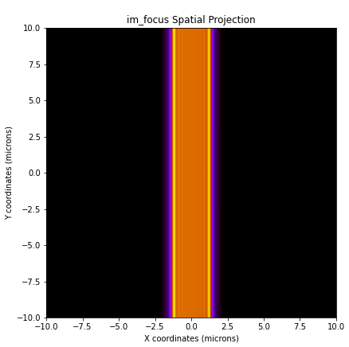

Beam profiles comparison (HHLM open)
perfect
error only
bending
corrector
Focus
perfect
error only
bending
corrector
Output

Slide 19
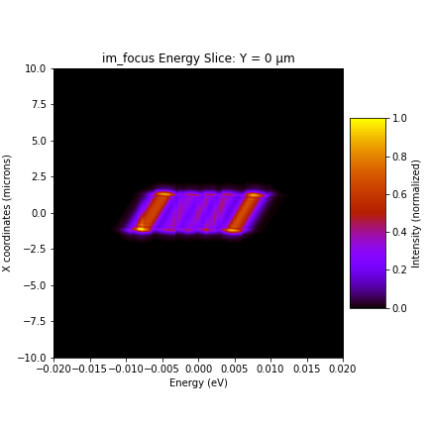
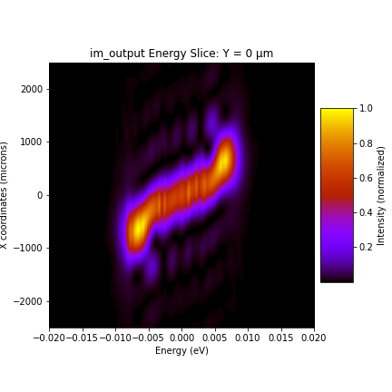
Beam spectrum comparison (HHLM open)
perfect
error only
bending
corrector
Focus
perfect
error only
bending
corrector
Output

