Slide 1
Spectrometer Simulation
through interference fringe
Nan

Slide 2
Outline
Schematics
Simulated beam profiles
Added spectrometer (crystal -> lens)
Simulated beam profiles
Effect of time shift
Effect of incident photon energy difference
Effect of pulse front tilt
Effect of pulse spatial offset
Added spectrometer (lens -> crystal)
Same as above

Slide 3
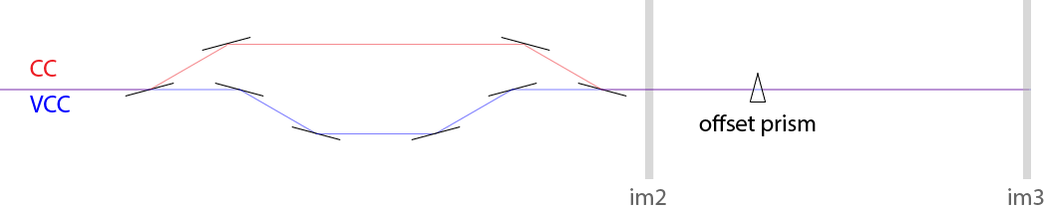
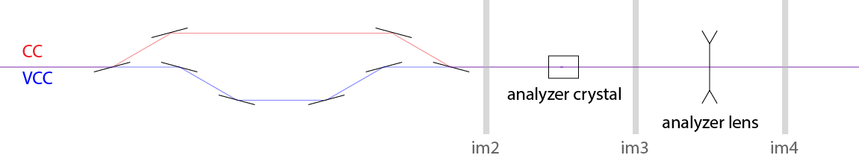
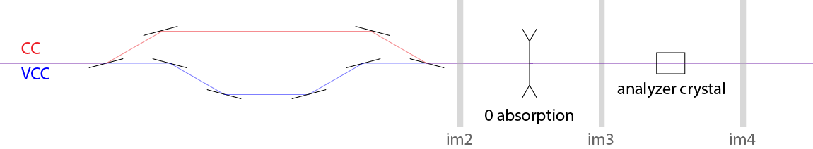
Beamline optics schematics
Regular setup as in Yanwen’s experiment
Adding spectrometer
Ray-tracing geometry

Slide 4
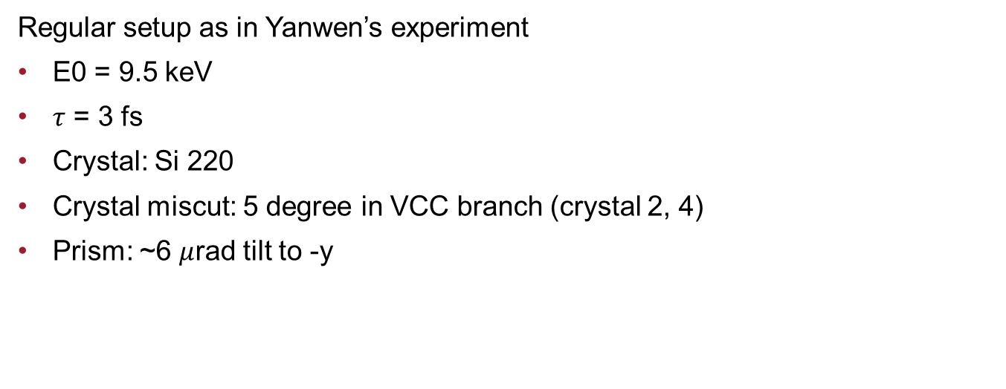
Beamline optics schematics
Regular setup as in Yanwen’s experiment
E0 = 9.5 keV
$τ$ = 3 fs
Crystal: Si 220
Crystal miscut: 5 degree in VCC branch (crystal 2, 4)
Prism: ~6 $μ$rad tilt to -y

Slide 5
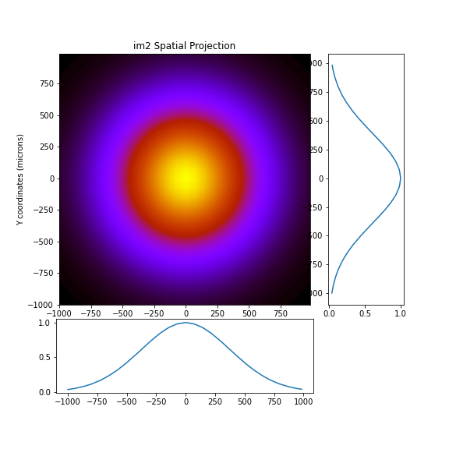
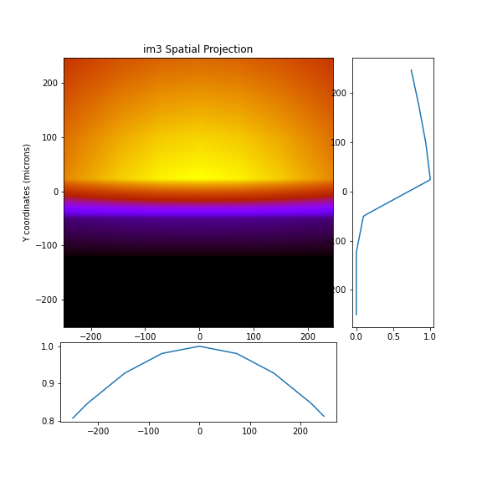
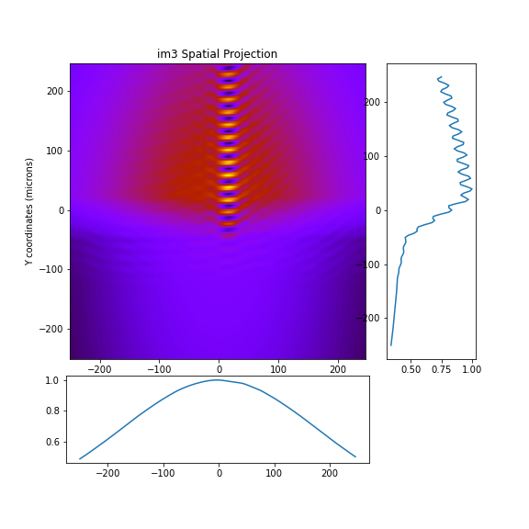
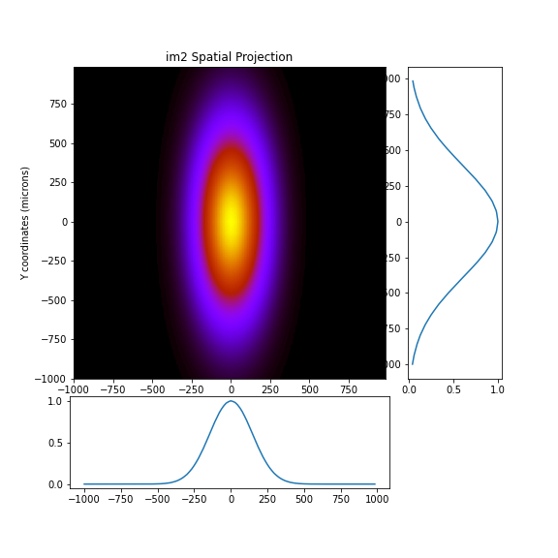
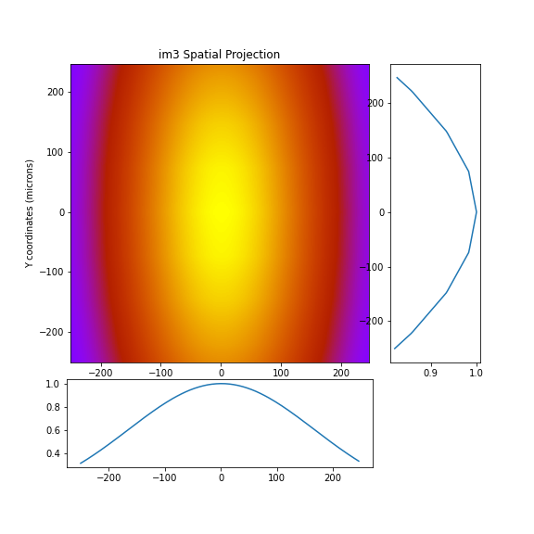
Beam profiles (xy)
Sum
CC
VCC

Slide 6
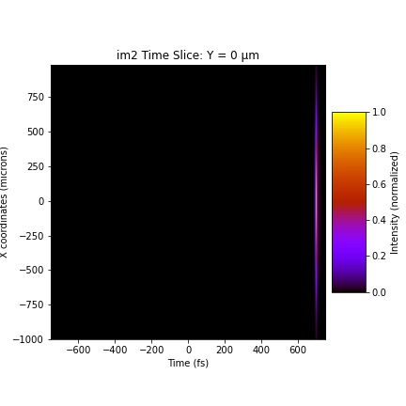
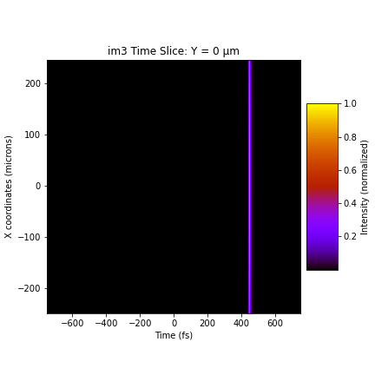


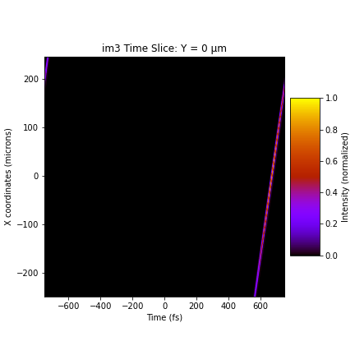
Pulse front tilt (xt)
Sum
CC
VCC
Two branches are manually shifted in time so that they overlap

Slide 7

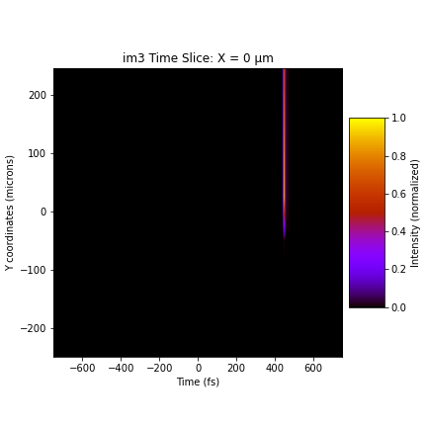

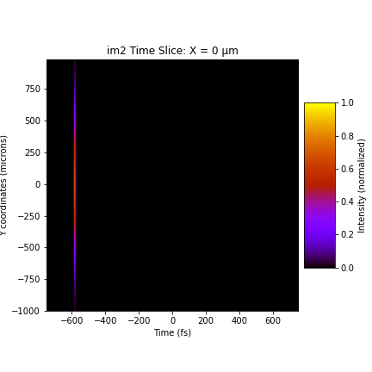
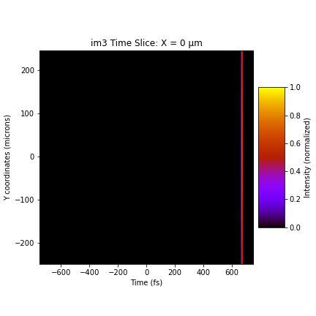
Pulse front tilt (yt)
Sum
CC
VCC

Slide 8
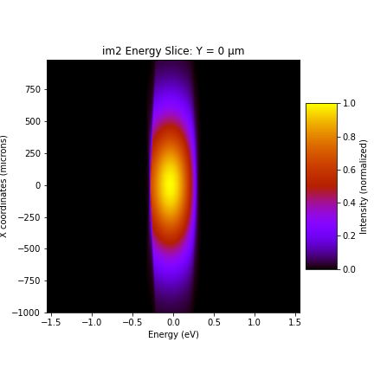
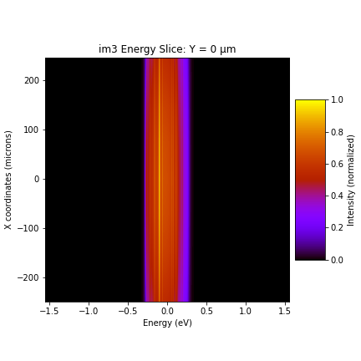
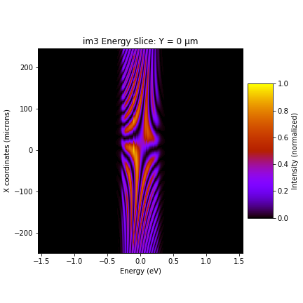
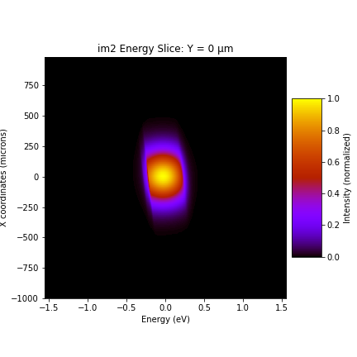
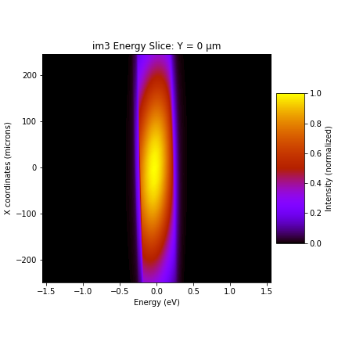
Energy components (x vs E)
Sum
CC
VCC
Two branches are manually shifted in time so that they overlap

Slide 9

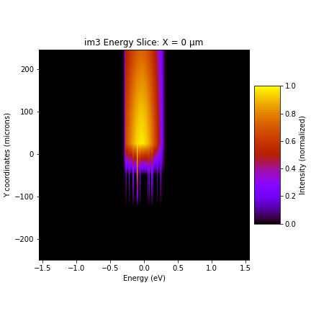
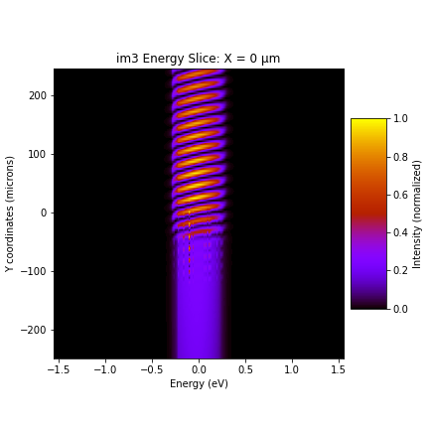

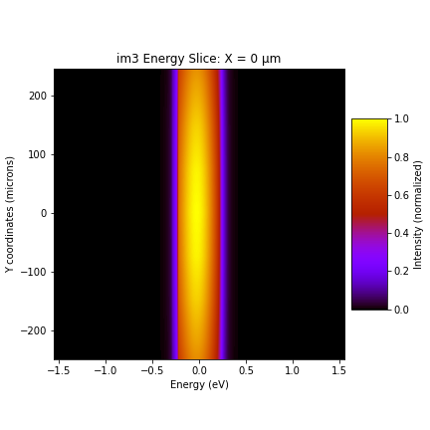
Energy components (y vs E)
Sum
CC
VCC

Slide 10
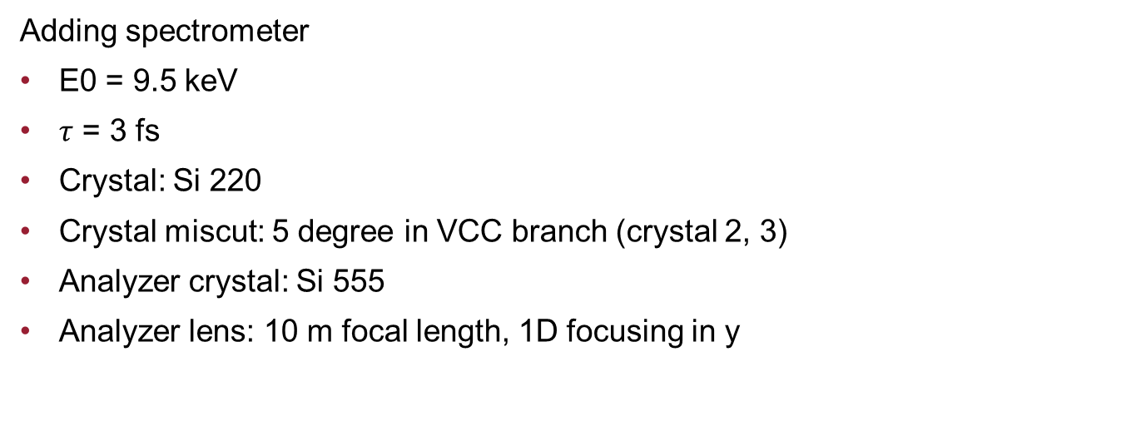
Beamline optics schematics
Adding spectrometer
E0 = 9.5 keV
$τ$ = 3 fs
Crystal: Si 220
Crystal miscut: 5 degree in VCC branch (crystal 2, 3)
Analyzer crystal: Si 555
Analyzer lens: 10 m focal length, 1D focusing in y

Slide 11

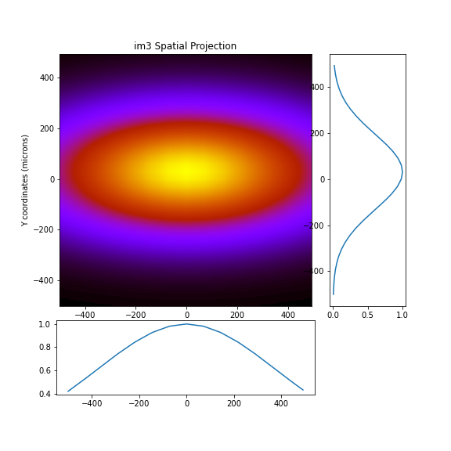
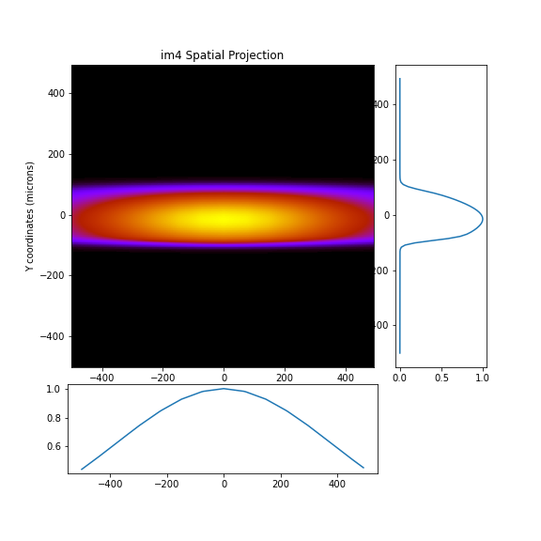
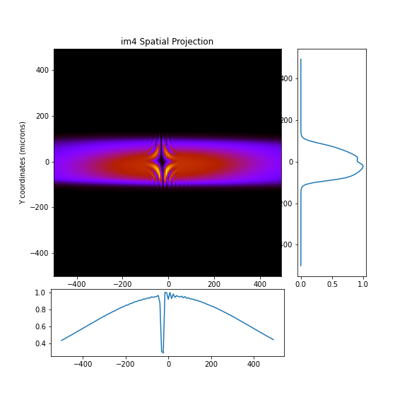
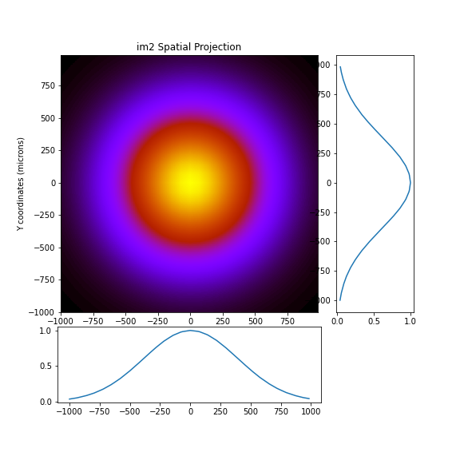
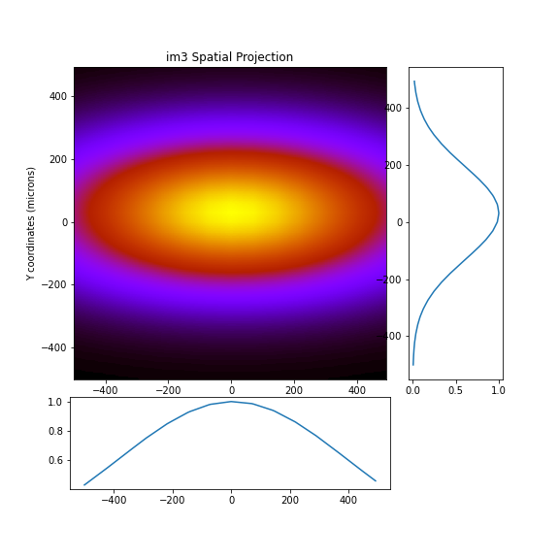
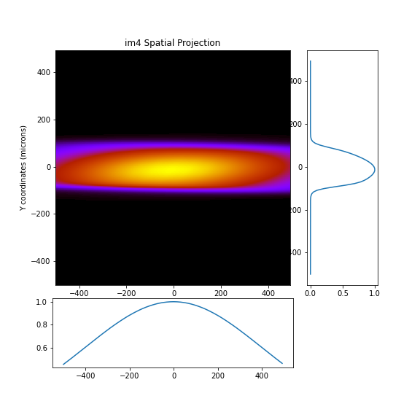
Beam profiles (xy)
CC
Sum
VCC

Slide 12


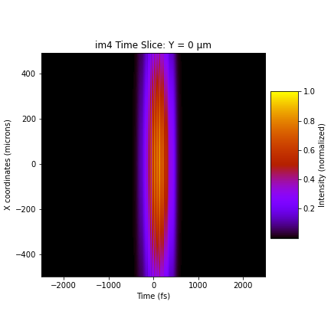
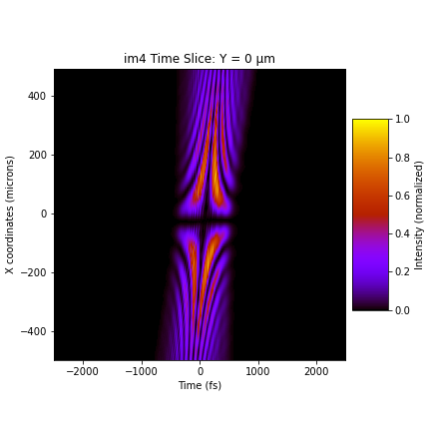


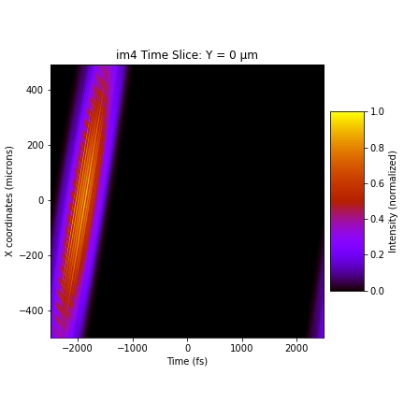
Pulse front tilt (xt)
CC
Sum
VCC

Slide 13
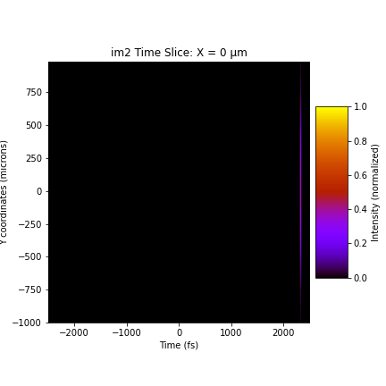

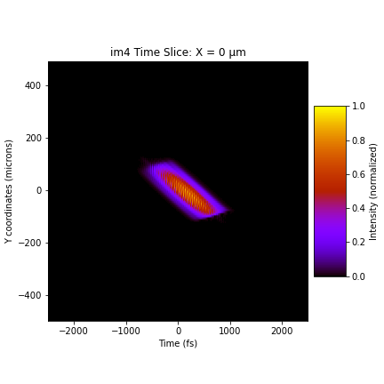
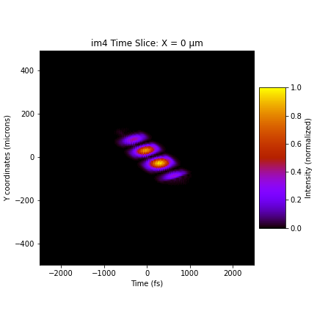


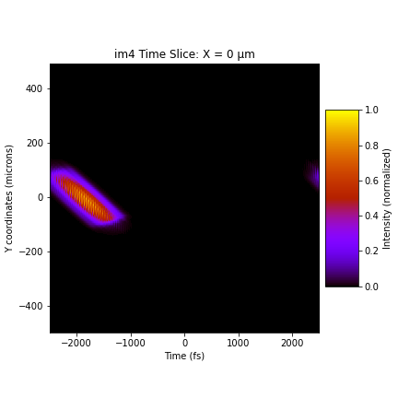
Pulse front tilt (yt)
CC
Sum
VCC

Slide 14

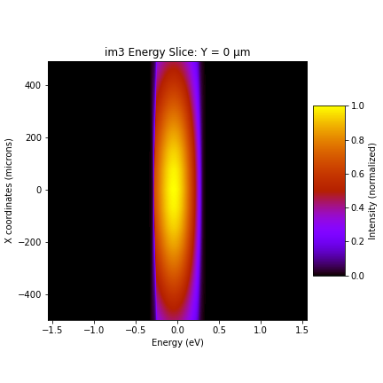
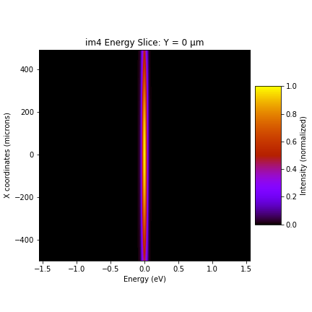
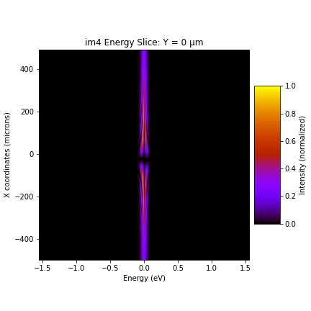

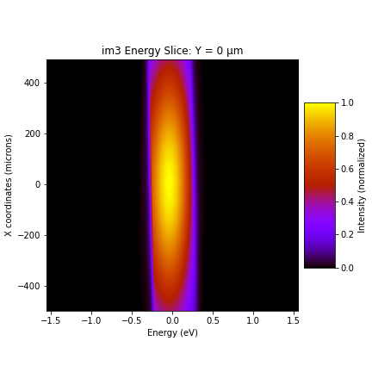

Energy components (x vs E)
CC
Sum
VCC

Slide 15

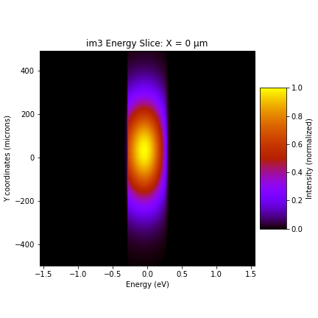
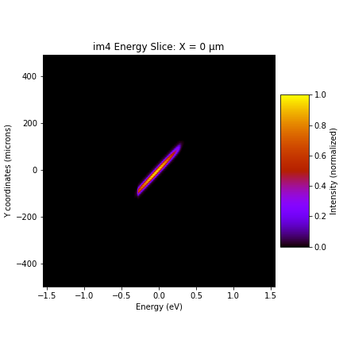


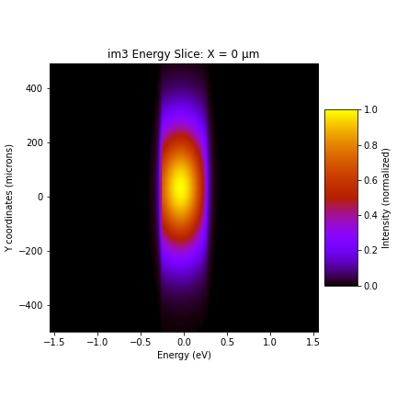
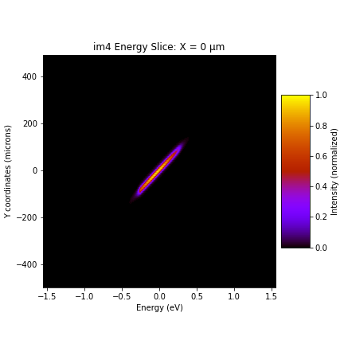
Energy components (y vs E)
CC
Sum
VCC

Slide 16
Effect of time shift
CC
At the image plane, manually shifting the VCC branch in time by [-20, -10, 0, +10, +20 fs] so the two branches overlap differently in space
VCC

Slide 17
Effect of time shift
x vs t
y vs t
profile
x vs E
y vs E

Slide 18



Effect of energy difference, beam profile (xy)
$Δf=$0 THz
$Δf=$5 THz
Adding a 5 THz (~ 20meV) difference in the incident pulse for the CC branch

Slide 19
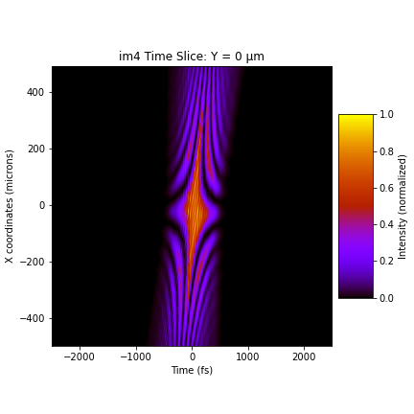
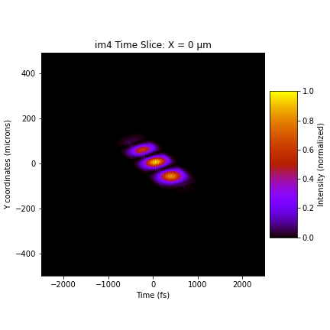

Effect of energy difference, pulse front tilt
$Δf=$0 THz
$Δf=$5 THz
x vs t
y vs t

Slide 20


Effect of energy difference, energy profile
$Δf=$0 THz
$Δf=$5 THz
x vs E
y vs E

Slide 21

Effect of tilt, beam profile (xy)
tilt = 0
tilt = 4 $μ$rad
Manually tilt the CC branch to –y at im4

Slide 22
Effect of tilt, pulse front tilt
tilt = 0
tilt = 4 $μ$rad
x vs t
y vs t

Slide 23
Effect of tilt, energy profile
tilt = 0
tilt = 4 $μ$rad
x vs E
y vs E

Slide 24

Effect of shift, beam profile (xy)
shift = 0
shift = 5 $μ$m
Manually shift the CC branch in +y at im4

Slide 25
Effect of tilt, pulse front tilt
shift = 0
shift = 5 $μ$m
x vs t
y vs t

Slide 26
Effect of tilt, energy profile
shift = 0
shift = 5 $μ$m
x vs E
y vs E

Slide 27
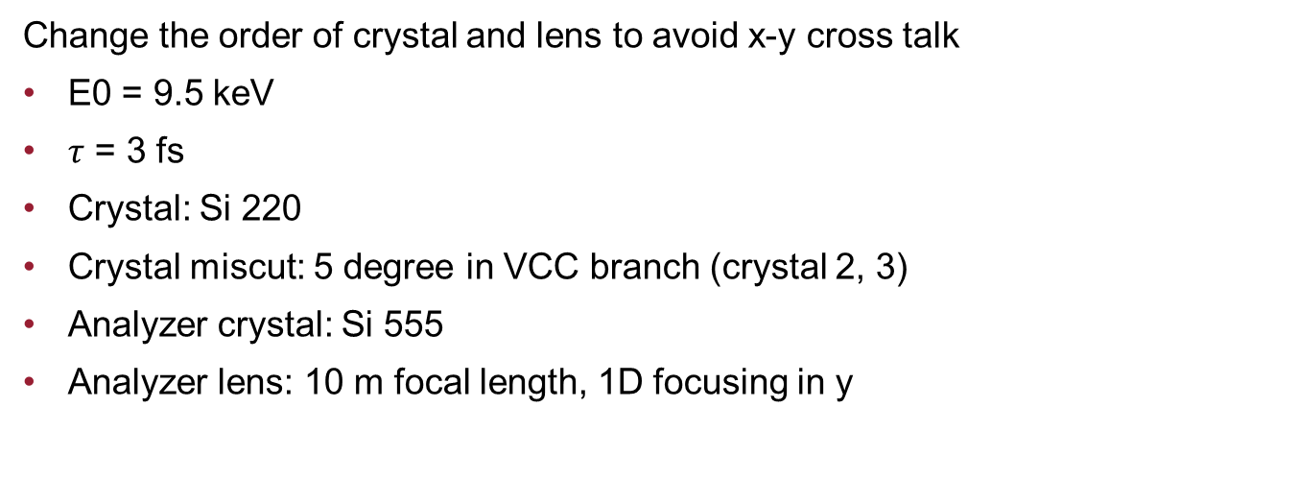
Beamline optics schematics
Change the order of crystal and lens to avoid x-y cross talk
E0 = 9.5 keV
$τ$ = 3 fs
Crystal: Si 220
Crystal miscut: 5 degree in VCC branch (crystal 2, 3)
Analyzer crystal: Si 555
Analyzer lens: 10 m focal length, 1D focusing in y

Slide 28

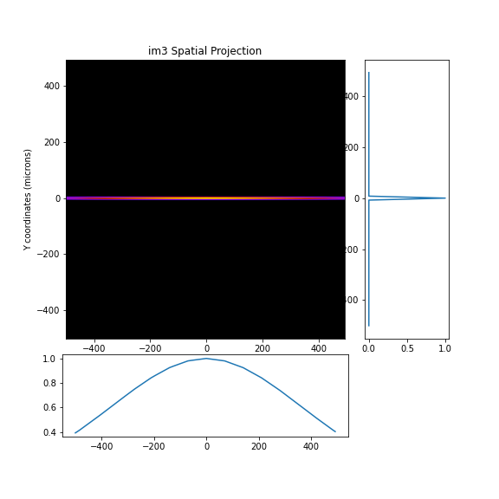
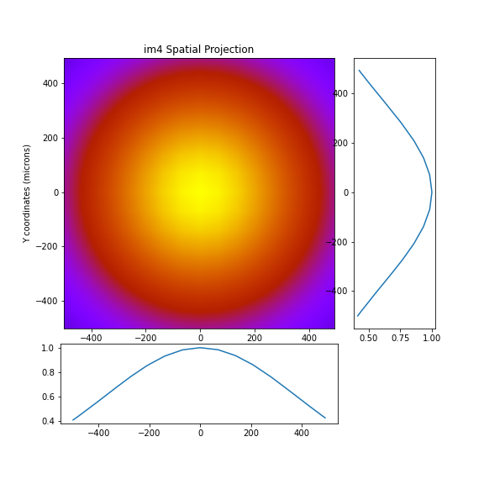




Beam profiles (xy)
CC
Sum
VCC

Slide 29


Pulse front tilt (xt)
CC
Sum
VCC

Slide 30
Pulse front tilt (yt)
CC
Sum
VCC

Slide 31
Energy components (x vs E)
CC
Sum
VCC

Slide 32
Energy components (y vs E)
CC
Sum
VCC

Slide 33
Effect of time shift
CC
At the image plane, manually shifting the VCC branch in time by [-20, -10, 0, +10, +20 fs] so the two branches overlap differently in space
VCC

Slide 34
Effect of time shift
x vs t
y vs t
profile
x vs E
y vs E

Slide 35
Effect of energy difference, beam profile (xy)
$Δf=$0 THz
$Δf=$5 THz
Adding a 5 THz (~ 20meV) difference in the incident pulse for the CC branch

Slide 36
Effect of energy difference, pulse front tilt
$Δf=$0 THz
$Δf=$5 THz
x vs t
y vs t

Slide 37
Effect of energy difference, energy profile
$Δf=$0 THz
$Δf=$5 THz
x vs E
y vs E

Slide 38
Effect of tilt, beam profile (xy)
tilt = 0
tilt = 4 $μ$rad
Manually tilt the CC branch to –y at im4

Slide 39
Effect of tilt, pulse front tilt
tilt = 0
tilt = 4 $μ$rad
x vs t
y vs t

Slide 40
Effect of tilt, energy profile
tilt = 0
tilt = 4 $μ$rad
x vs E
y vs E

Slide 41
Effect of shift, beam profile (xy)
shift = 0
shift = 5 $μ$m
Manually shift the CC branch in +y at im4

Slide 42
Effect of tilt, pulse front tilt
shift = 0
shift = 5 $μ$m
x vs t
y vs t

Slide 43
Effect of tilt, energy profile
shift = 0
shift = 5 $μ$m
x vs E
y vs E

