Slide 1
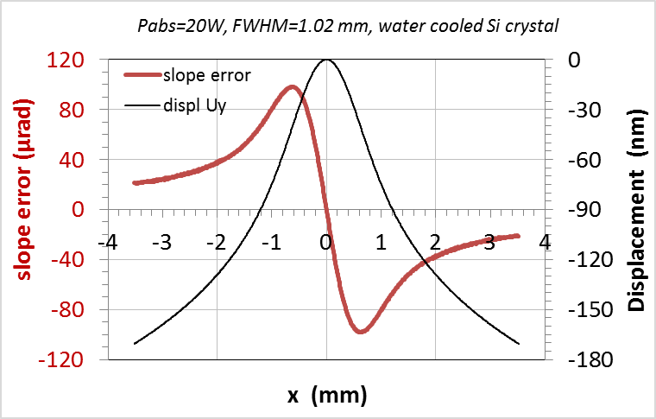
An example of thermal deformation of thewater-cooled
crystal

