Slide 1
SRW Temporal Simulation
4-bounce Monochromator
Nan Wang, Jul 3rd 2020

Slide 2
Outline
Hasan’s 4 bounce monochromator setup
SRW sampling parameters
Performance, Si 111
Narrow band 50fs beam
Broad band 1fs beam
Super broad band 0.1fs beam
Overall performance
Performance, Si 220

Slide 3
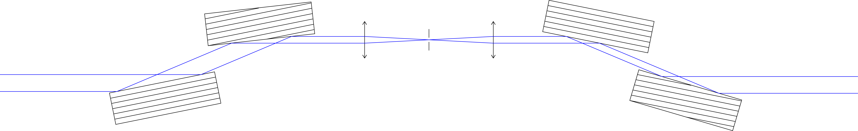
Schematics
Crystal1, -5 deg miscut
Crystal2
Slit
Path length 3 cm
3 cm
Lens 0, f = 1m
Lens 1, f = 1m
Crystal0, z = 200m
Crystal3, 5 deg miscut
Setup:
Incident beam: 10keV, w0 = 50um (full width)
Si 111 crystal with 1cm thickness
Achromatic lens
Vertical slit

Slide 4
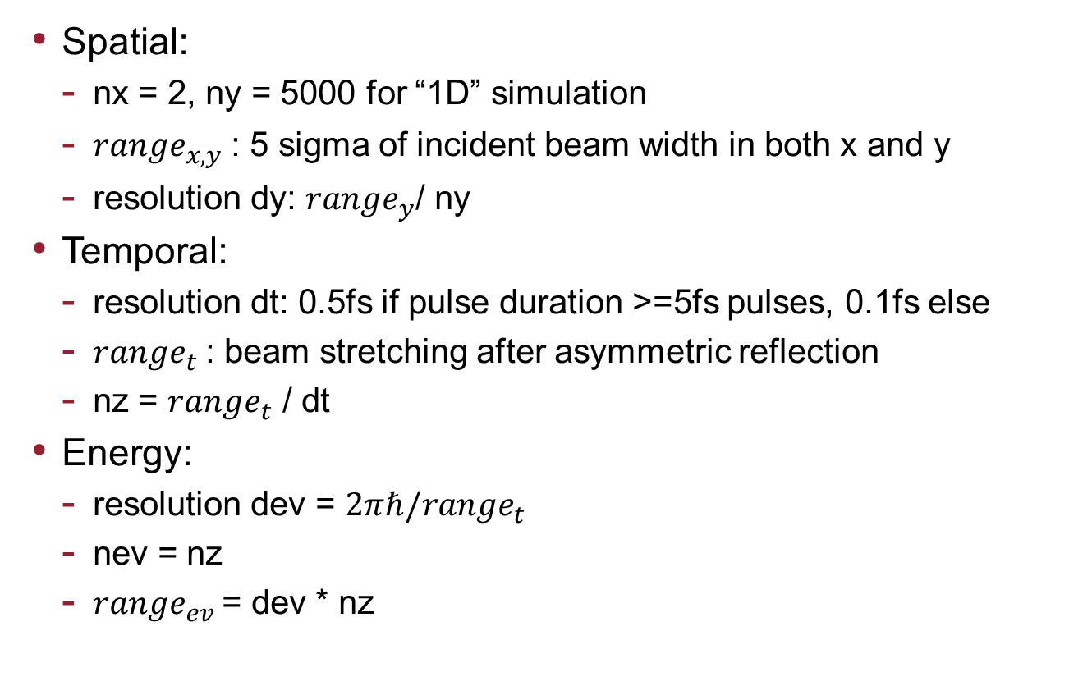
Sampling parameter
Spatial:
nx = 2, ny = 5000 for “1D” simulation
${range}_{x,y}$: 5 sigma of incident beam width in both x and y
resolution dy: ${range}_{y}$/ ny
Temporal:
resolution dt: 0.5fs if pulse duration >=5fs pulses, 0.1fs else
${range}_{t}$: beam stretching after asymmetric reflection
nz = ${range}_{t}$ / dt
Energy:
resolution dev = $2πℏ/{range}_{t}$
nev = nz
${range}_{ev}$= dev * nz

Slide 5
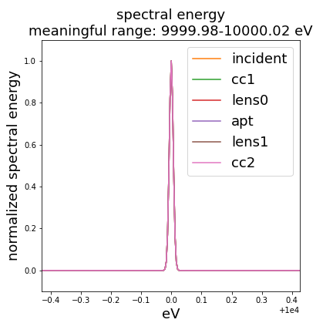
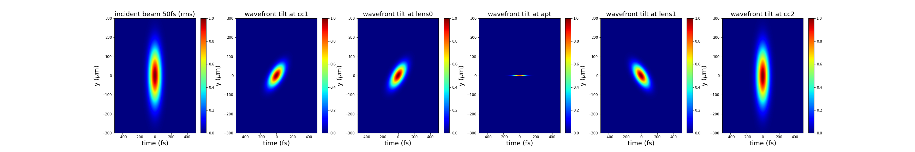
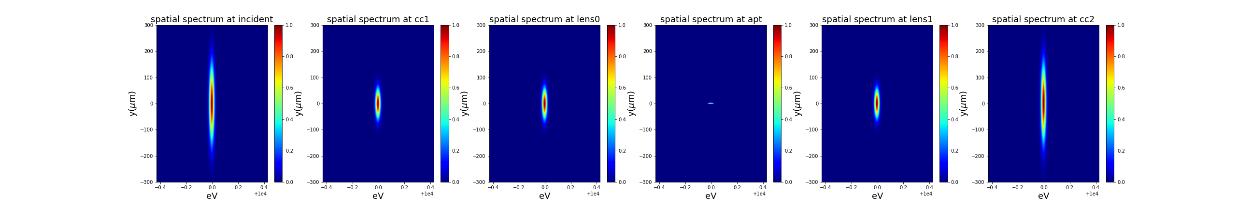
Narrow band 50fs beam, no slit
Crystal1
Crystal2
Slit
3 cm
3 cm
Lens 0
Lens 1
Crystal0
Crystal3

Slide 6
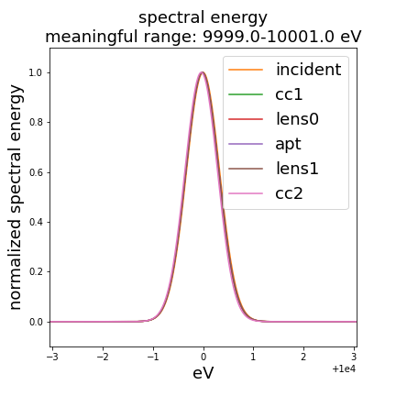
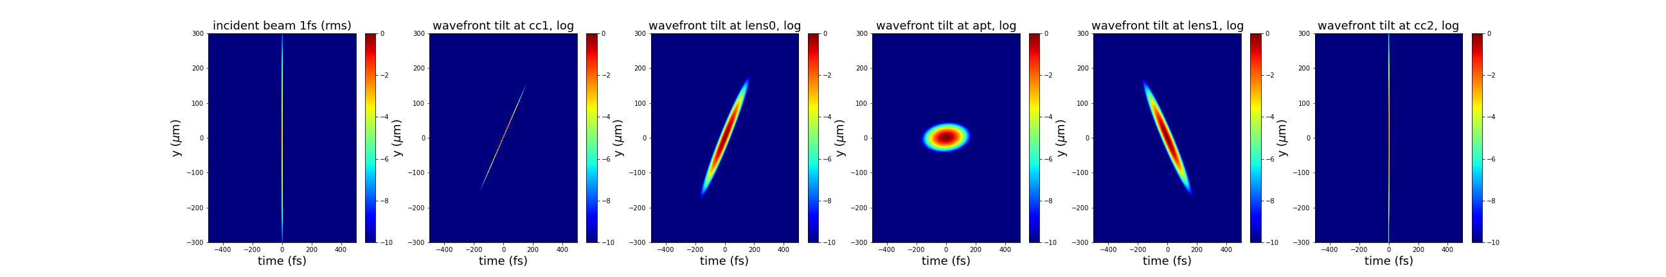
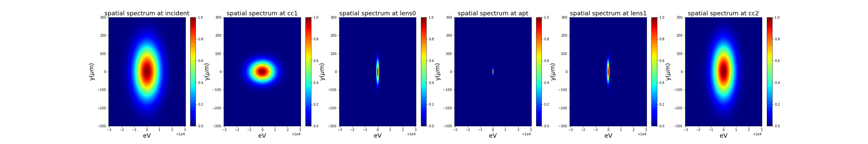
Broad band 1fs beam, no slit
Crystal1
Crystal2
Slit
3 cm
3 cm
Lens 0
Lens 1
Crystal0
Crystal3

Slide 7
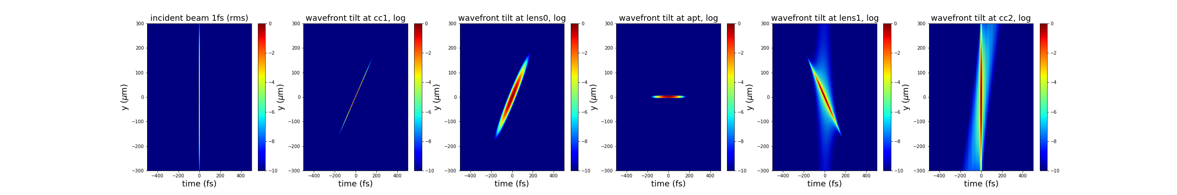
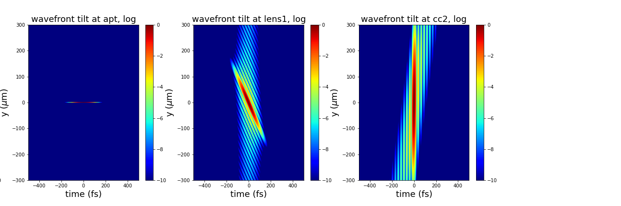
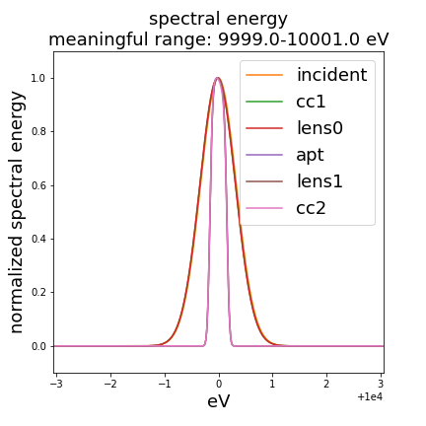

Broad band 1fs beam, closing down the slit
Crystal1
Crystal2
Slit
3 cm
3 cm
Lens 0
Lens 1
Crystal0
Crystal3
No slit
10um slit
5um slit

Slide 8
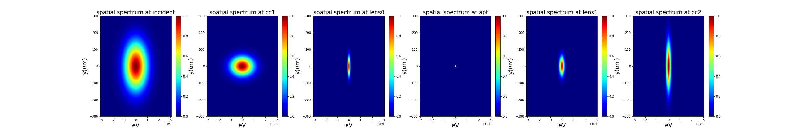

Broad band 1fs beam, spatial spectrum
Crystal1
Crystal2
Slit
3 cm
3 cm
Lens 0
Lens 1
Crystal0
Crystal3
No slit
10um slit
5um slit

Slide 9
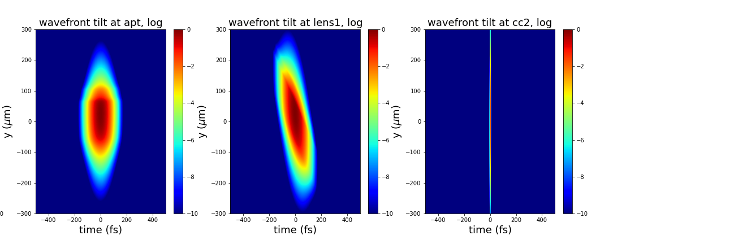
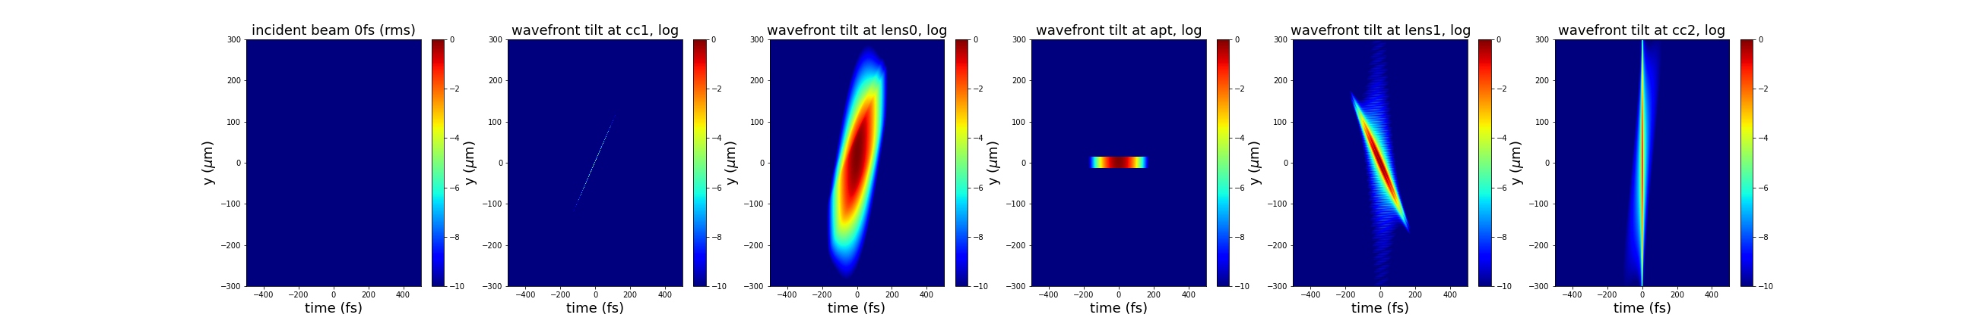
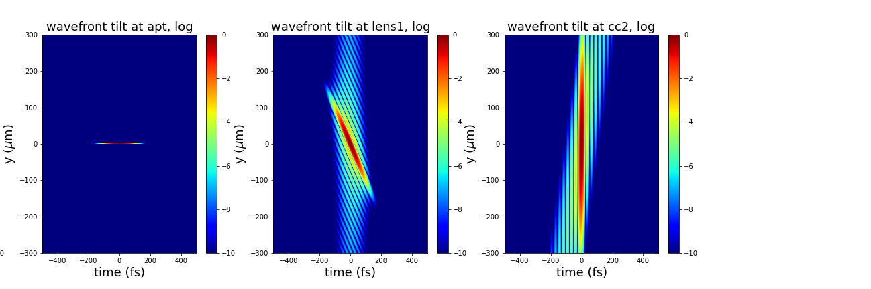
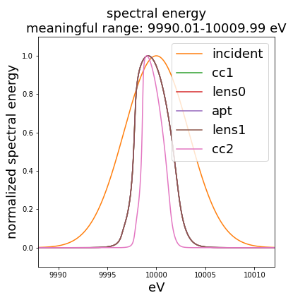
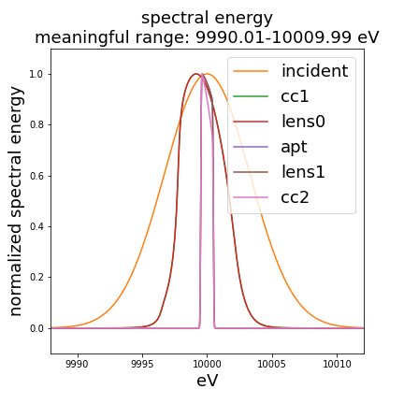

Broad band 0.1fs beam, closing down the slit
Crystal1
Crystal2
Slit
3 cm
3 cm
Lens 0
Lens 1
Crystal0
Crystal3
No slit
30um slit
5um slit

Slide 10
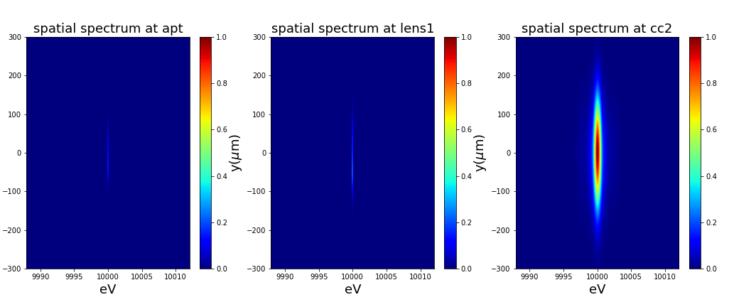


Broad band 0.1fs beam, spatial spectrum
Crystal1
Crystal2
Slit
3 cm
3 cm
Lens 0
Lens 1
Crystal0
Crystal3
No slit
30um slit
5um slit

Slide 11
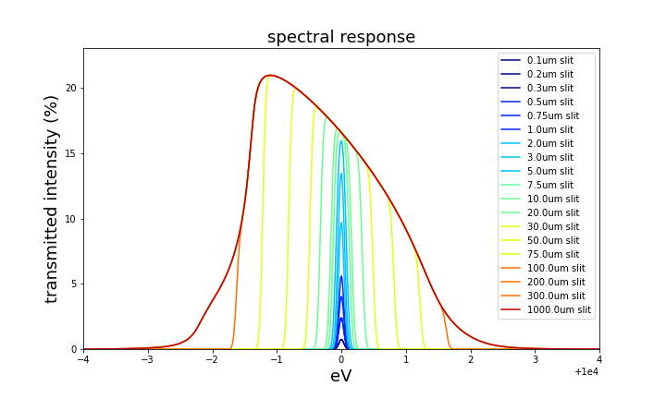
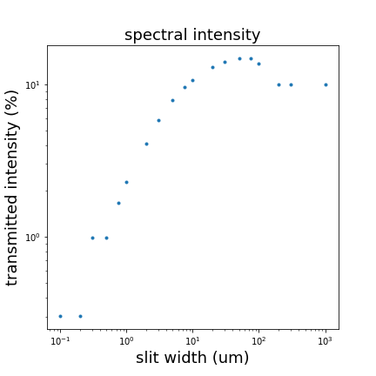
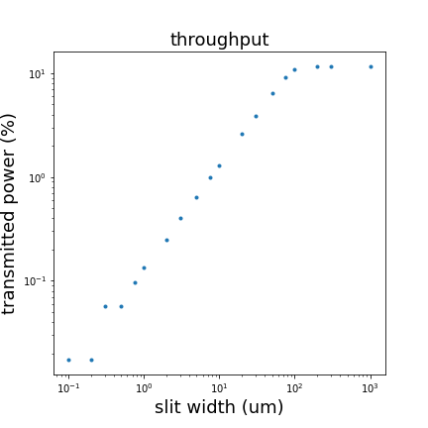
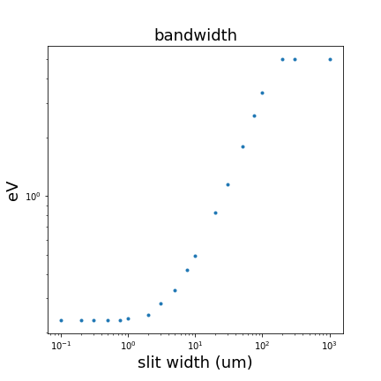
Overall performance
Plots:
Spectral intensity: the mean transmitted intensity over the spectral range vs. slit width
Throughput: total transmitted power vs. slit width
Bandwidth: energy resolution limit vs. slit width

Slide 12
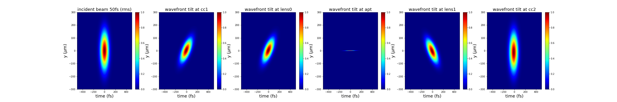
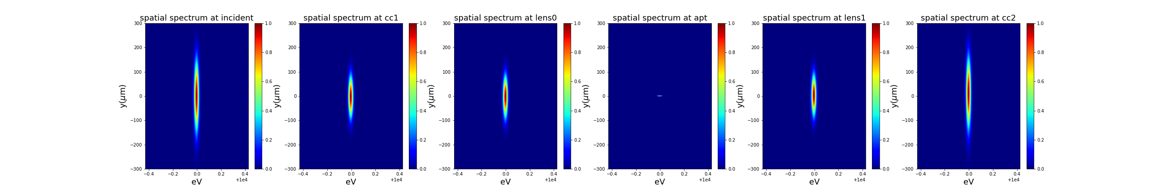
Narrow band 50fs beam, no slit, Si 220
Crystal1
Crystal2
Slit
3 cm
3 cm
Lens 0
Lens 1
Crystal0
Crystal3

Slide 13
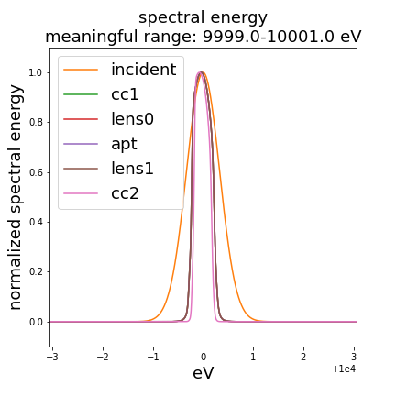
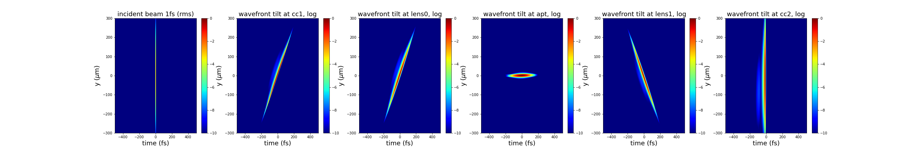
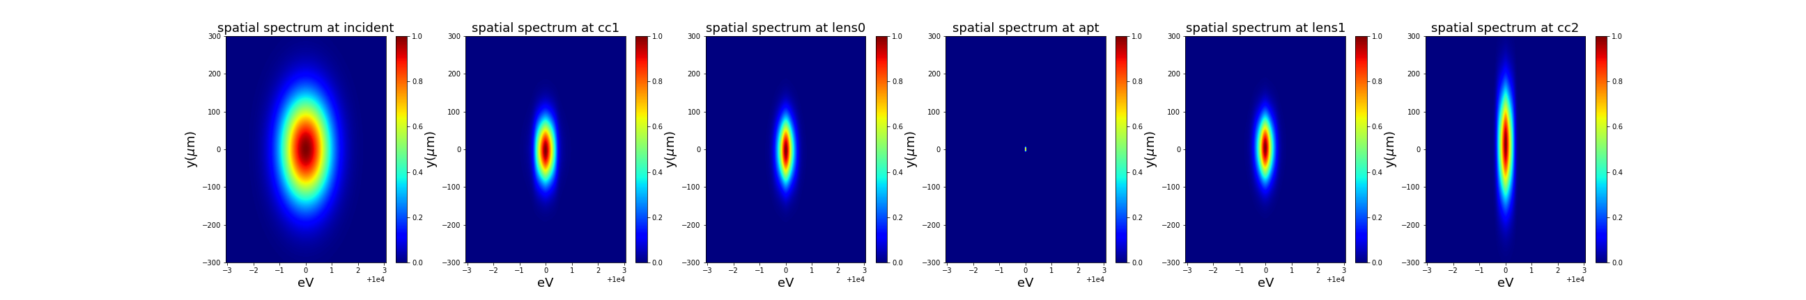
Broad band 1fs beam, no slit, Si 220
Crystal1
Crystal2
Slit
3 cm
3 cm
Lens 0
Lens 1
Crystal0
Crystal3

Slide 14
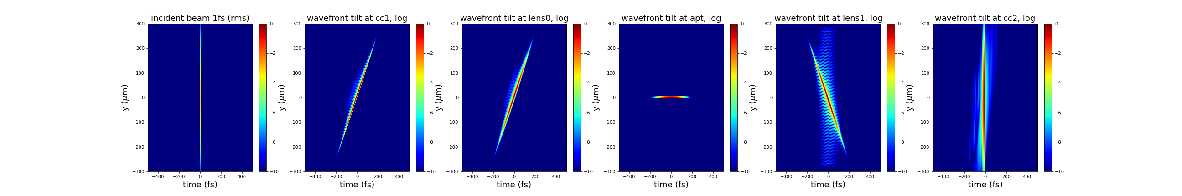
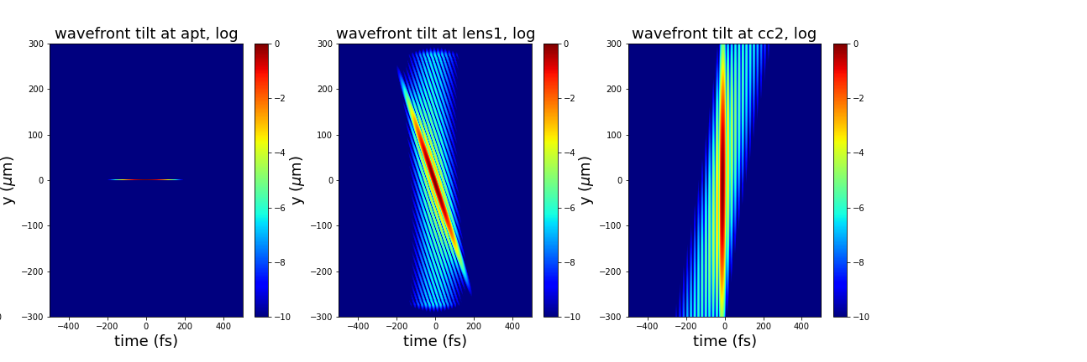
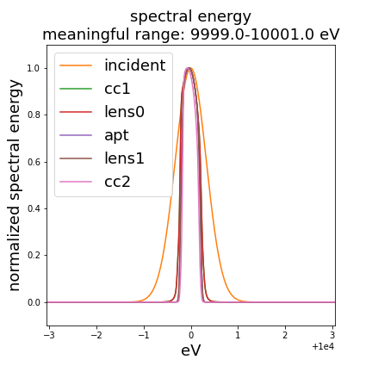

Broad band 1fs beam, closing down the slit, Si 220
Crystal1
Crystal2
Slit
3 cm
3 cm
Lens 0
Lens 1
Crystal0
Crystal3
No slit
10um slit
5um slit

Slide 15

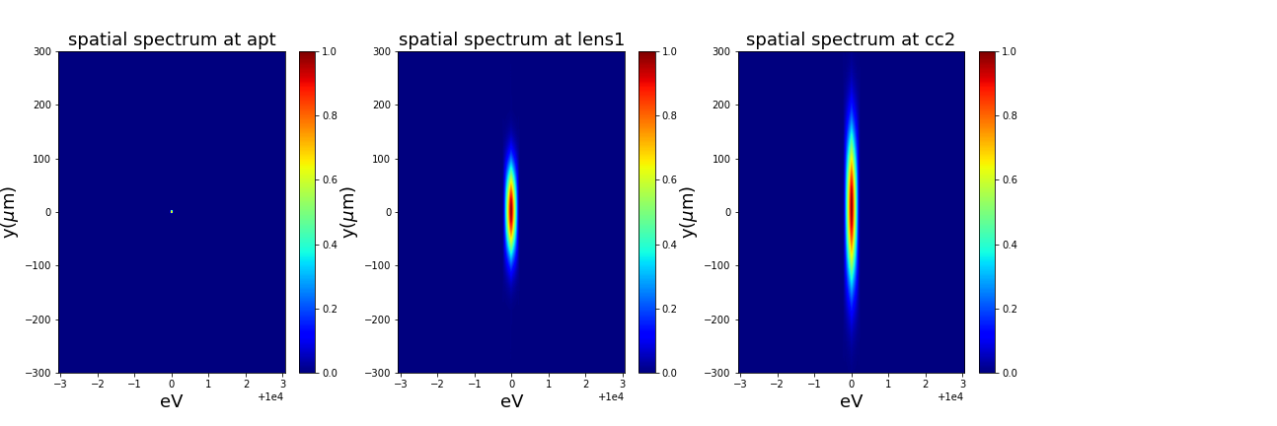
Broad band 1fs beam, spatial spectrum, Si 220
Crystal1
Crystal2
Slit
3 cm
3 cm
Lens 0
Lens 1
Crystal0
Crystal3
No slit
10um slit
5um slit

Slide 16
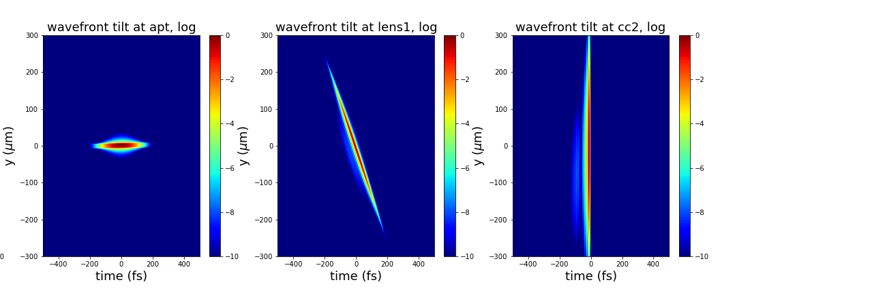

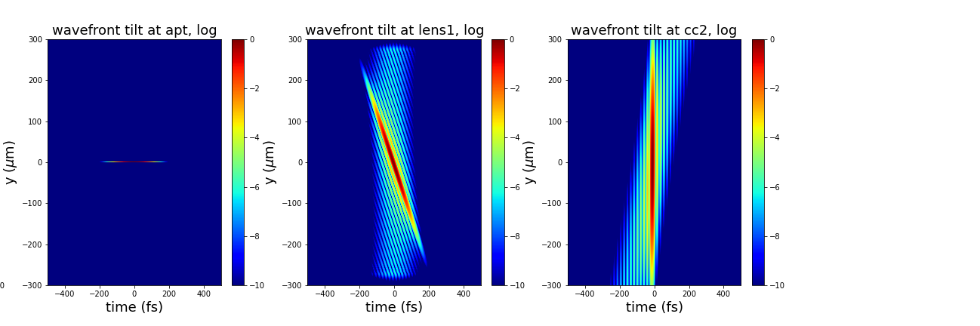
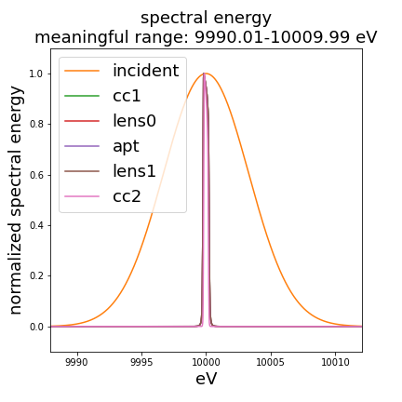

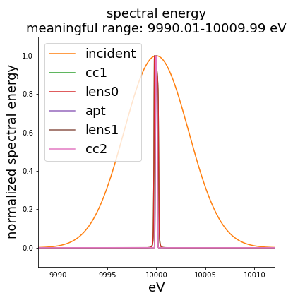
Broad band 0.1fs beam, closing down the slit, Si 220
Crystal1
Crystal2
Slit
3 cm
3 cm
Lens 0
Lens 1
Crystal0
Crystal3
No slit
30um slit
5um slit

Slide 17
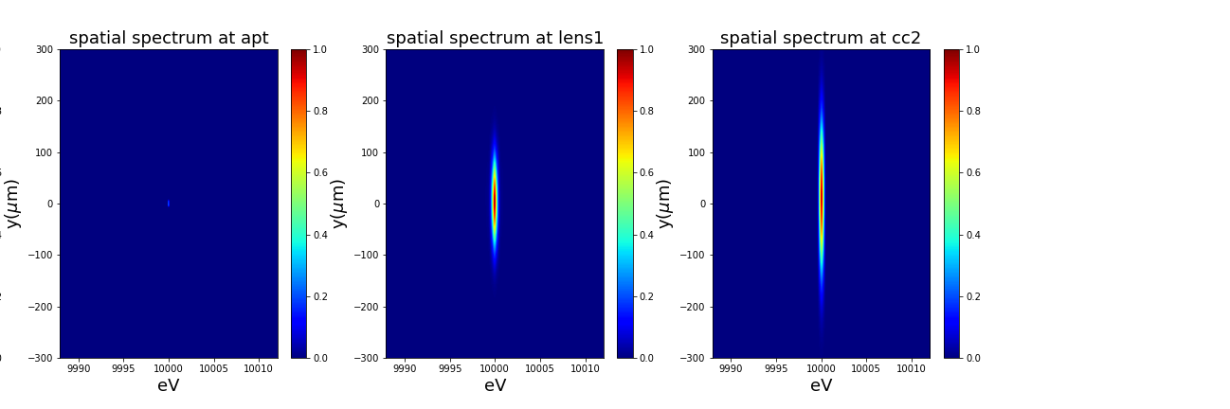

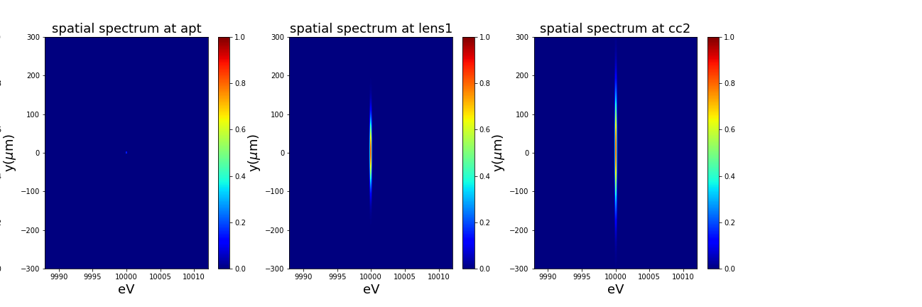
Broad band 0.1fs beam, spatial spectrum, Si 220
Crystal1
Crystal2
Slit
3 cm
3 cm
Lens 0
Lens 1
Crystal0
Crystal3
No slit
30um slit
5um slit

Slide 18
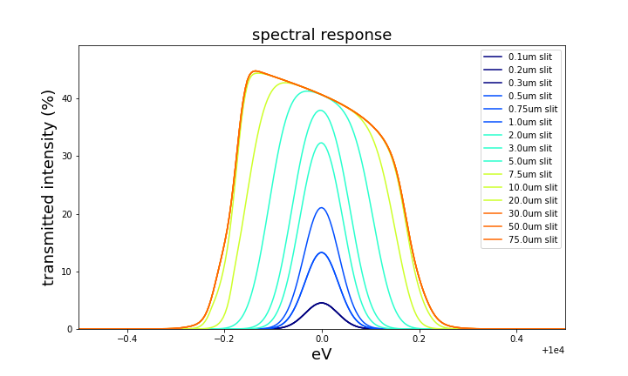
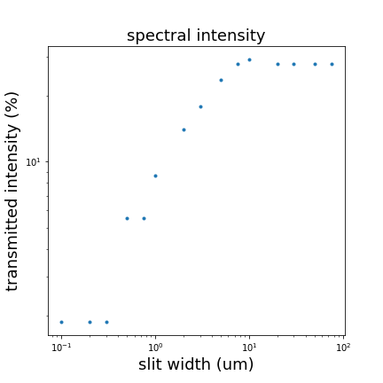
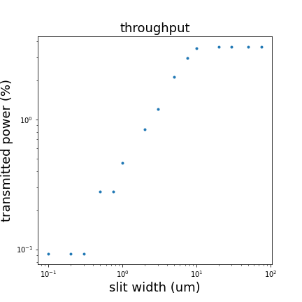
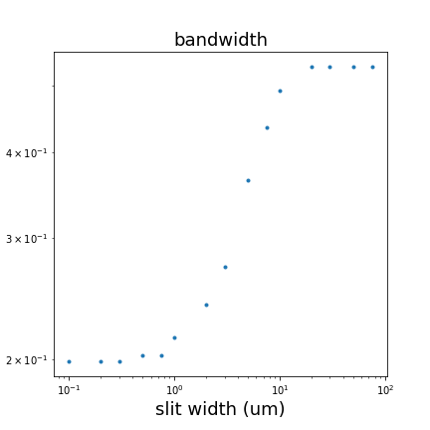
Overall performance
Plots:
Spectral intensity: the mean transmitted intensity over the spectral range vs. slit width
Throughput: total transmitted power vs. slit width
Bandwidth: energy resolution limit vs. slit width

Slide 19
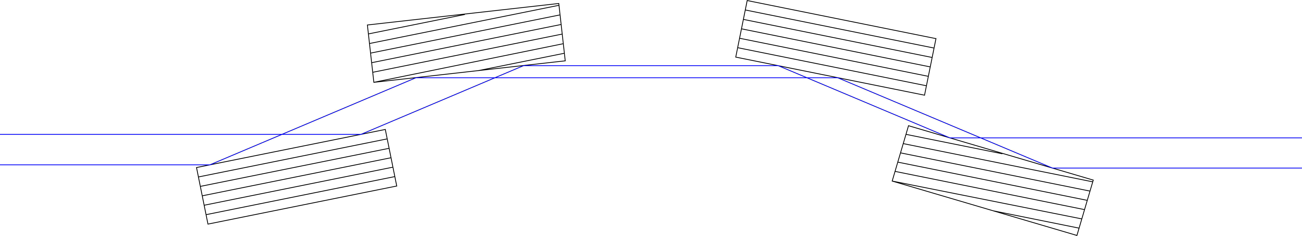
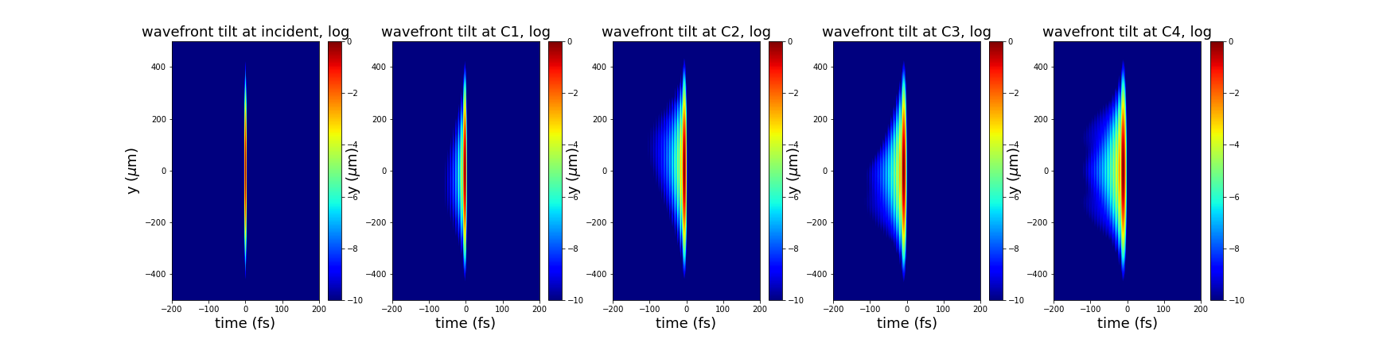
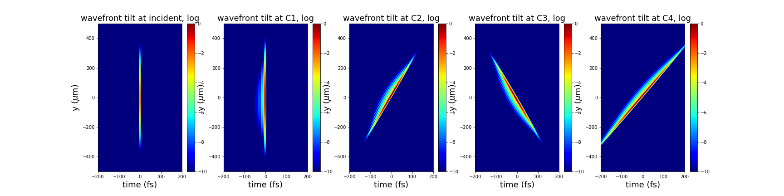
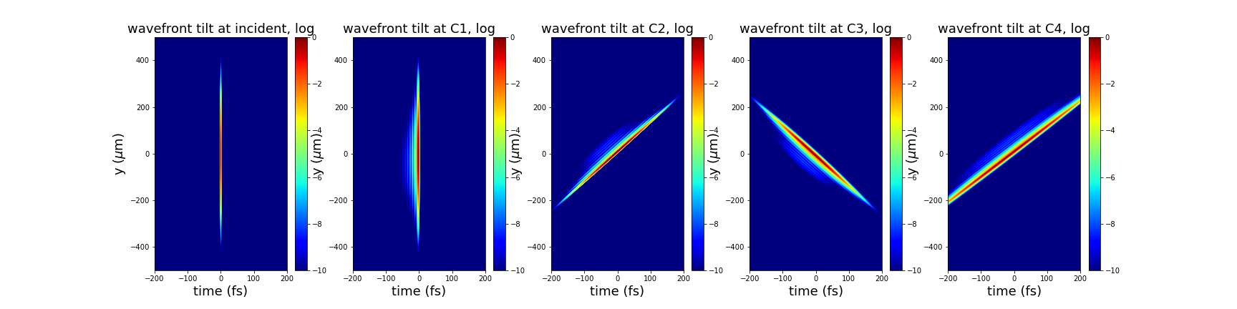
Crystal only, changing miscut, Si 220
C2
C3
miscut | C1 | C2 | C3 | C4
Top | 0° | -0° | 0° | 0°
Mid | 0° | -3° | 0° | 3°
Bottom | 0° | -5° | 0° | 5°
3cm
1m
C1, z = 200m
C4
Parameters:
Incident beam: 10keV, 50um (full width), 1fs
Sampling range: 1.8mm, 1000fs
Issues:
Looks alright now

Slide 20
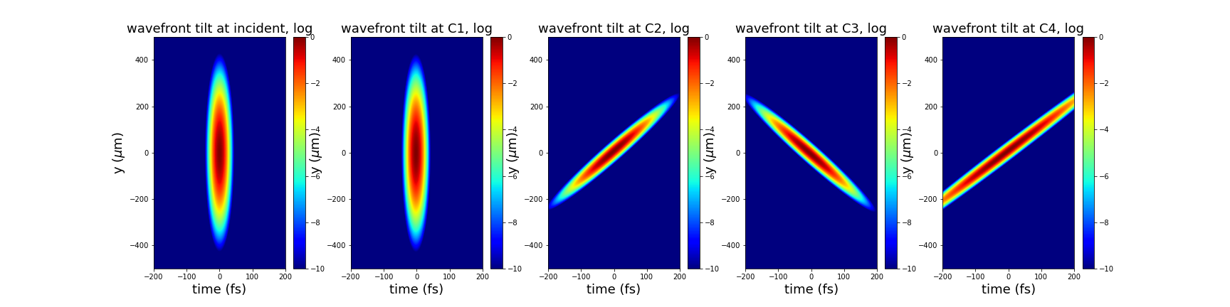
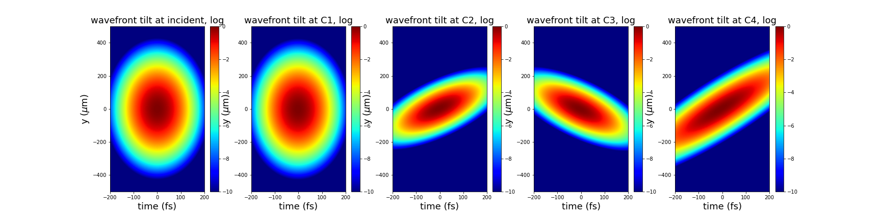
Crystal only, changing pulse duration, Si 220
C2, -5 deg
C3
 | Pulse duration
Top | 1 fs
Mid | 10 fs
Bottom | 50 fs
3cm
1m
C1, z = 200m
C4, 5 deg
Looks alright now

