Slide 1
RG-SAN: Rule-Guided Spatial Awareness Network for End-to-End 3D Referring Expression Segmentation
Changli Wu, Qi Chen, Jiayi Ji, Haowei Wang, Yiwei Ma, You Huang, Gen Luo, Hao Fei, Xiaoshuai Sun, Rongrong Ji
Bug Killers
Apr 10, 2025

Slide 2
Background & Motivation
What is 3D-RES?
3D Referring Expression Segmentation (3D-RES) aims to segment specific objects in point cloud scenes based on natural language descriptions. Unlike 3D-REC, which uses bounding boxes, 3D-RES generates precise 3D masks, enabling more detailed understanding—especially important in robotics and human-computer interaction.
Early 3D-RES methods adopted a two-stage pipeline, separating segmentation and language grounding, which limited efficiency and accuracy. Recent end-to-end approaches improve integration, but challenges persist due to over-reliance on text and weak spatial reasoning.

Slide 3
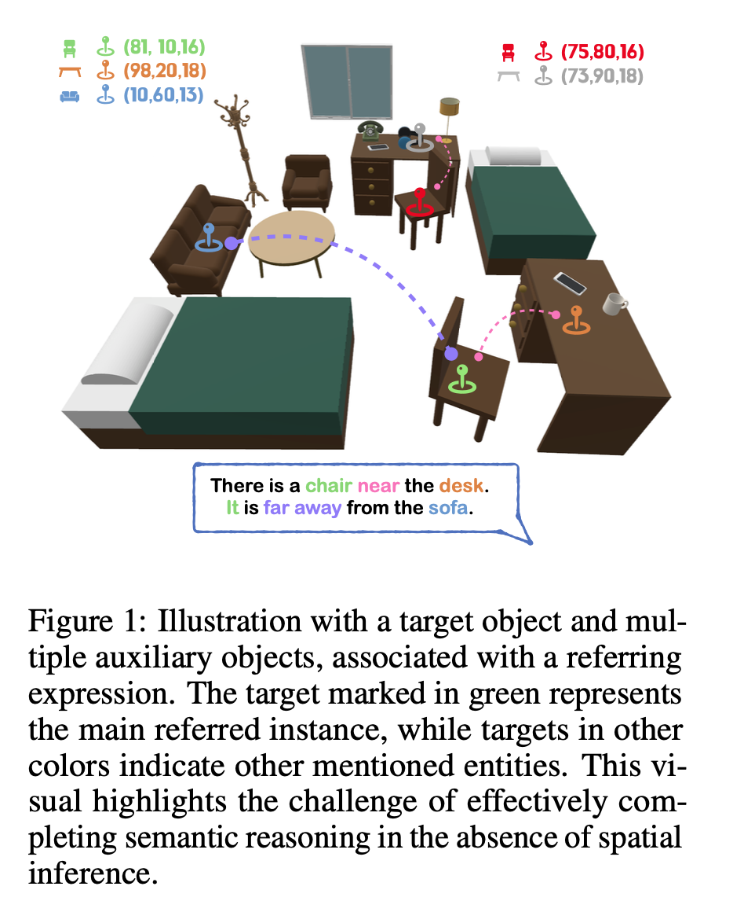
Background & Motivation
Challenges in Existing Methods
Over-reliance on language reasoning
Insufficient spatial relationship modeling → mis-segmentation
Difficulty handling multiple similar objects
🎯Goal:
How to accurately model spatial relationships among all mentioned entities using supervision only on the target object?

Slide 4
RG-SAN Overview
Proposed Method: RG-SAN
A rule-guided spatial reasoning framework, composed of:
TLM: Text-driven Localization Module
Locates all mentioned entities in 3D space
Iteratively refines their positions
RWS: Rule-guided Weak Supervision
Uses only the target object’s position as supervision
Guides spatial reasoning via dependency tree rules

Slide 5
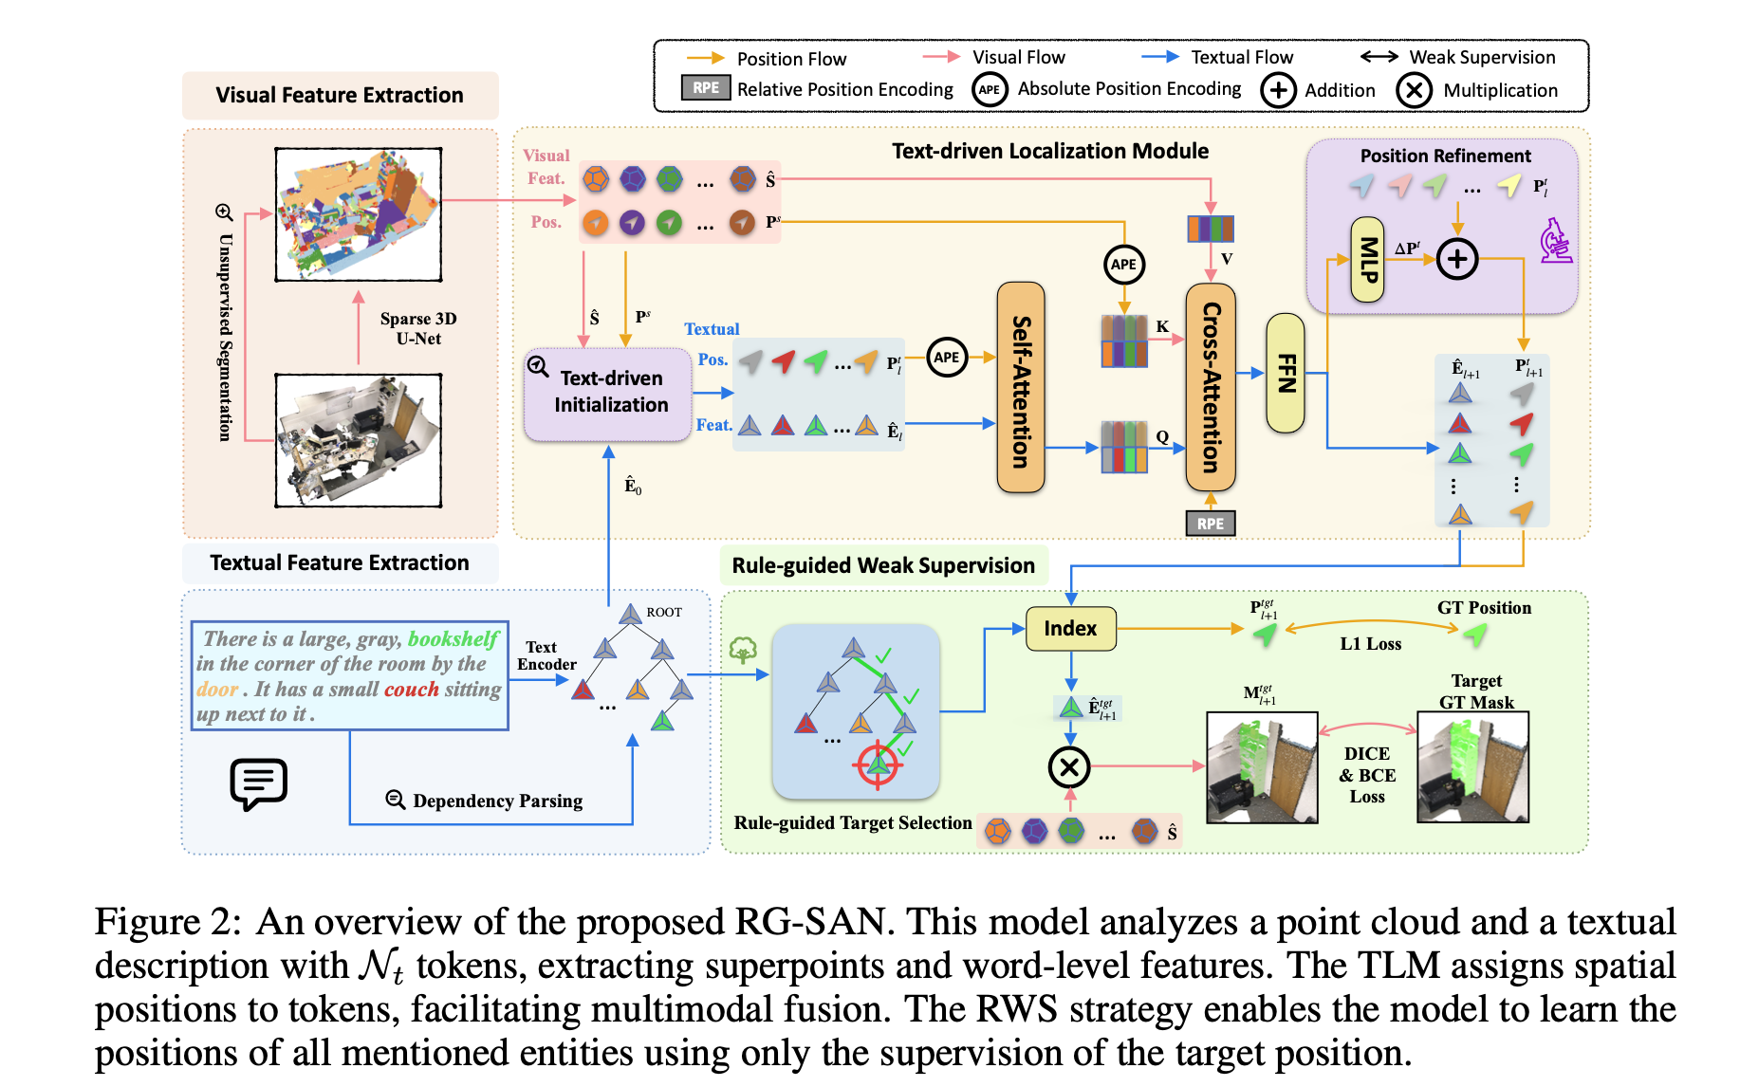
RG-SAN Overview
Proposed Method: RG-SAN

Slide 6
Text-driven Localization Module (TLM)
Text-driven Localization Module (TLM) is a key part of RG-SAN that enables accurate spatial grounding of language in 3D point clouds. It starts by initializing the positions of entity nouns from text, then iteratively refines them through multimodal interactions.
TLM aligns visual and textual features using Dependency-Driven Interaction (DDI) and maps language tokens into 3D space by estimating spatial probability distributions. An MLP predicts position offsets, allowing the model to gradually improve its localization over multiple rounds.
This iterative refinement ensures precise alignment between text and 3D data, enhancing segmentation performance in complex spatial scenarios.

Slide 7
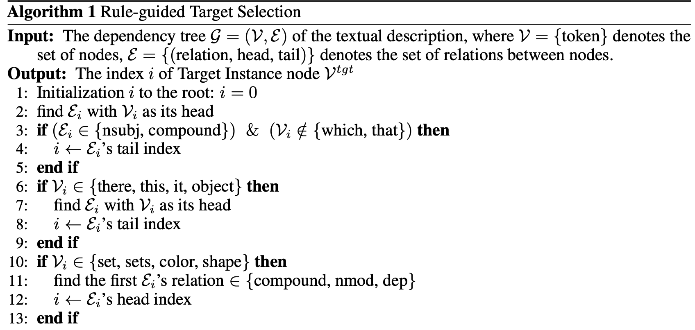
Rule-guided Weak Supervision (RWS)
Challenge: Many entities in the text, but only the target’s position is labeled.
Our Solution: RWS
Use dependency parsing to find the core noun (target) in the sentence
Develop a Rule-based Target Selection (RTS) system:
Identify main subject or demonstrative pronouns (“this”, “that”)
Avoid modifiers or secondary nouns

Slide 8
Experiment Setup & Dataset
📊 Setup:
Point Cloud Encoder: Sparse 3D U-Net
Text Encoder: MPNet
Dataset: ScanRefer, ReferIt3D
Evaluation: mIoU, Acc@0.25, Acc@0.5
Baselines: 3D-STMN, 3DRefTR, TGNN, etc.
📍 Focus: Handling complex expressions and similar-category objects

Slide 9
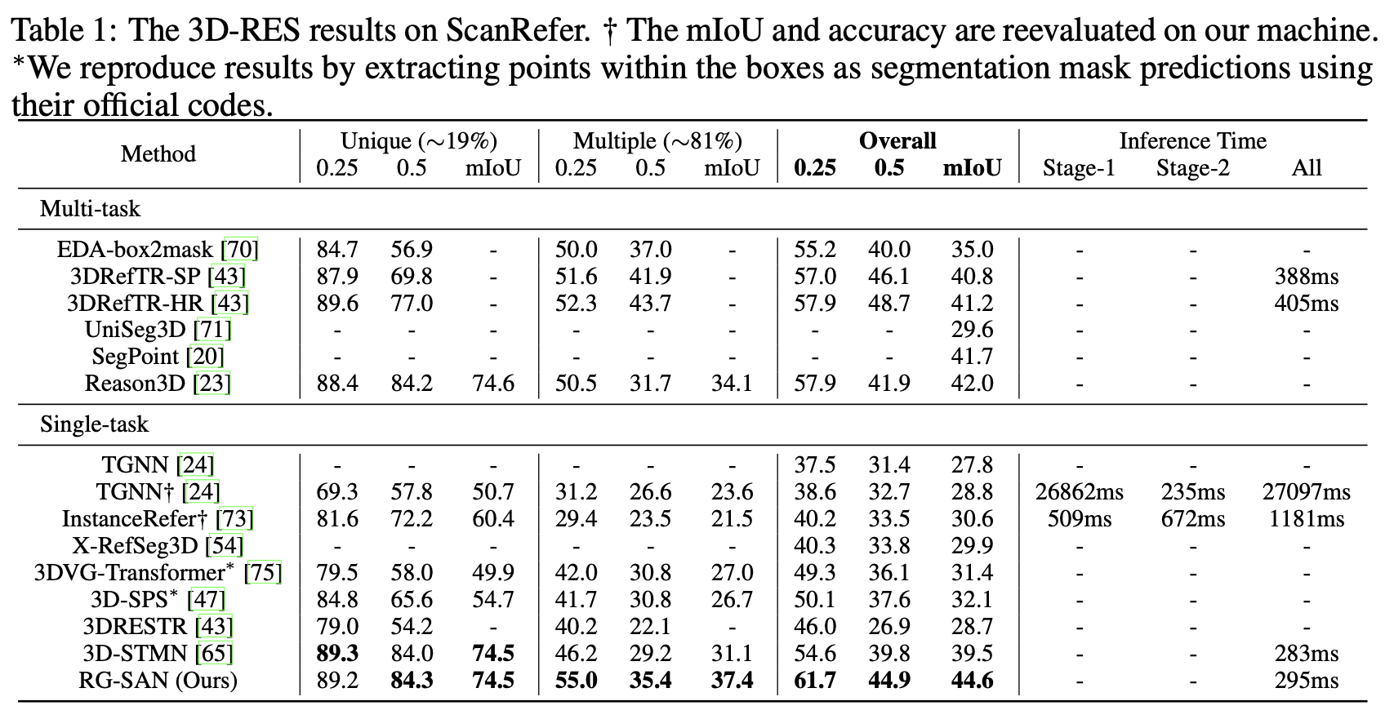
Results & Comparison
Achievements:
+5.1 mIoU improvement over state-of-the-art
Robust to spatial ambiguity and multi-instance settings
⏱️ Inference speed: 295ms – fast and efficient

Slide 10
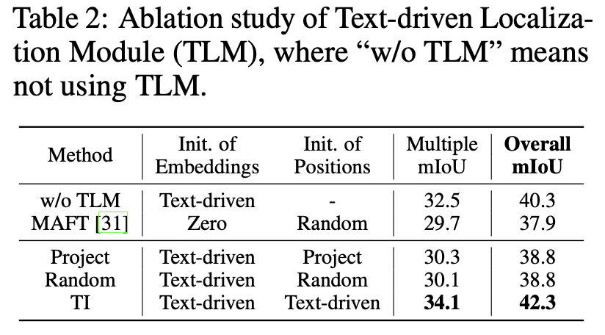
Ablation Studies
TLM Effectiveness
Without TLM → 10%+ drop in mIoU

Slide 11
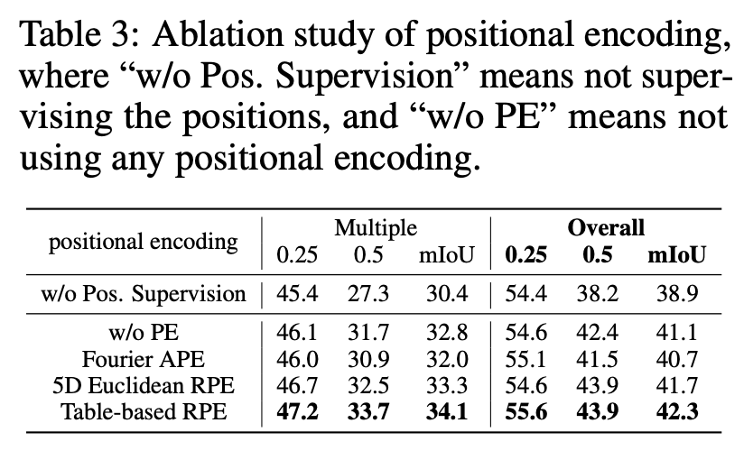
Ablation Studies
Positional Encoding Comparison
Table-based RPE performs best
Absolute PE may even hurt performance

Slide 12
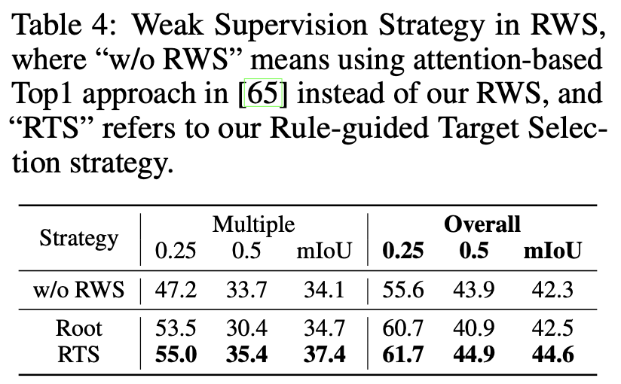
Ablation Studies
Rule-guided Weak Supervision (RWS)
op-1 Attention (w/o RWS): Less consistent supervision, lower accuracy.
Dependency Root only: Slight improvement.
Rule-guided Target Selection (RTS): Achieves the best results by accurately identifying the true referring noun, improving mIoU by +3.3 over the baseline.

Slide 13
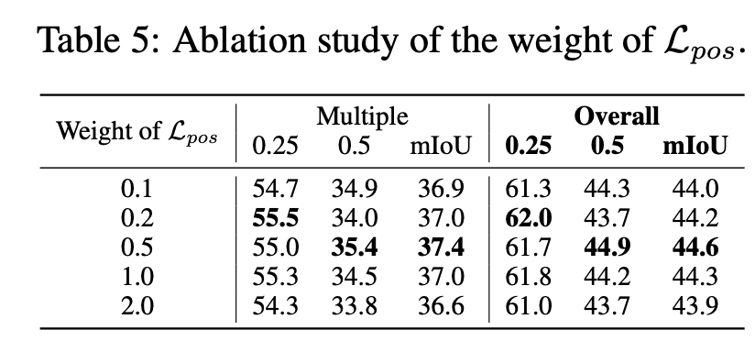
Ablation Studies
Supervision Weight (Lpos)
Best results when weight = 0.5

Slide 14
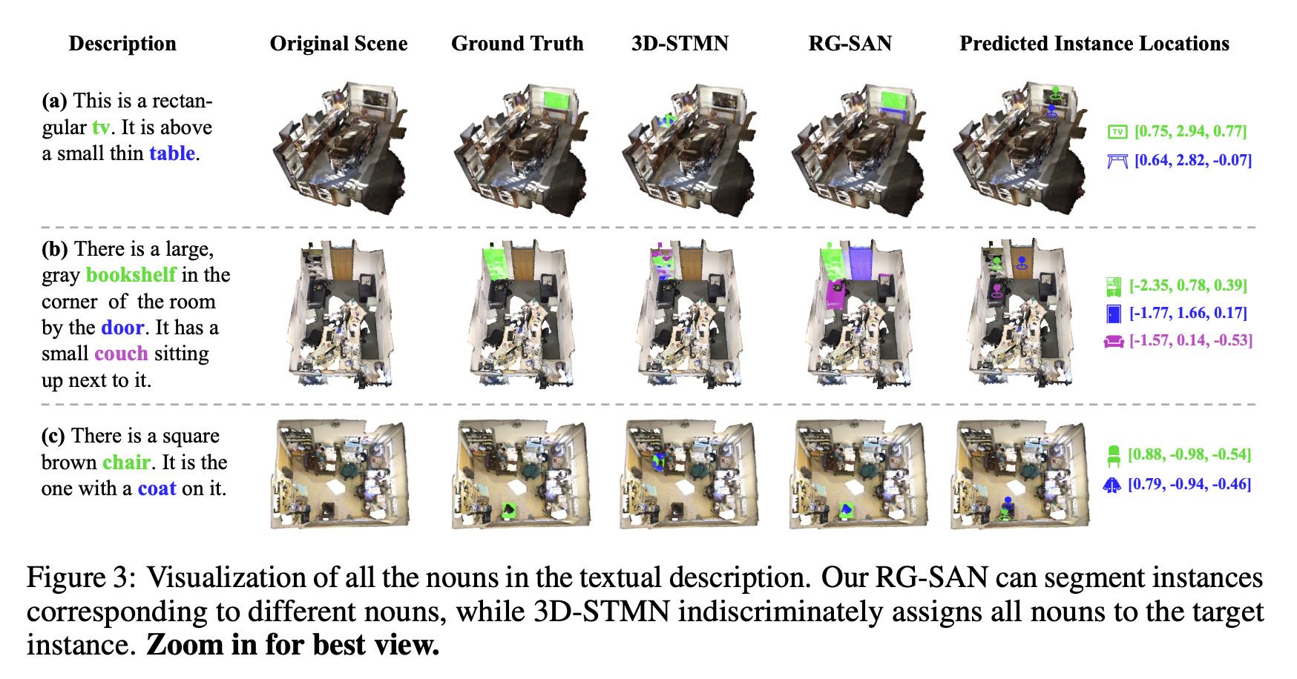
Qualitative Visualization
Key Observations
RG-SAN can differentiate multiple nouns and segment corresponding objects
Baseline (3D-STMN) tends to assign all nouns to the same instance

Slide 15
Conclusion & Future Work
Contributions:
Introduced RG-SAN for spatial reasoning in 3D-RES
Proposed TLM for position refinement and RWS for weak supervision
Achieved new state-of-the-art results on ScanRefer and ReferIt3D
Future Directions:
Adaptation to multilingual and spoken expressions
Integration with LLMs (e.g., 3D-LLM) for enhanced reasoning
Real-world deployment in robotics and AR/VR navigation

Slide 16
Thanks for watching!
Bug Killers
Apr 10, 2025

