Slide 1
Fall Detection and Speech Emotion Detection for elderly people living alone
Hui Jin
Jayadithya Nalajala
Saniya Pandita
Sai Jahnavi Devabhakthuni
Mar 12, 2025

Slide 2
Why is Fall Detection & Psychological Monitoring Important?
Over 30% of elderly individuals experience falls annually, leading to severe health risks.
Golden rescue time after a fall is < 60 minutes; delays can be fatal.
15-20% of elderly individuals suffer from depression, but it often goes undiagnosed.
Emotional distress increases fall risk; depression doubles the likelihood of falling.
Integrate Computer Vision (CV) and Natural Language Processing (NLP) to detect both falls and psychological health.

Slide 3


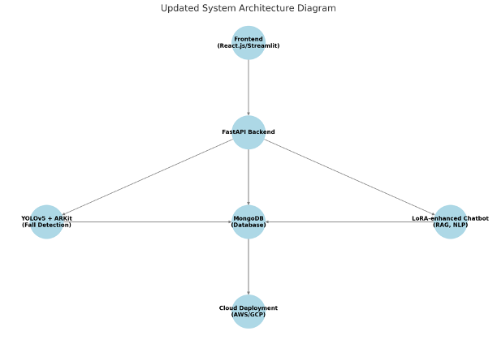
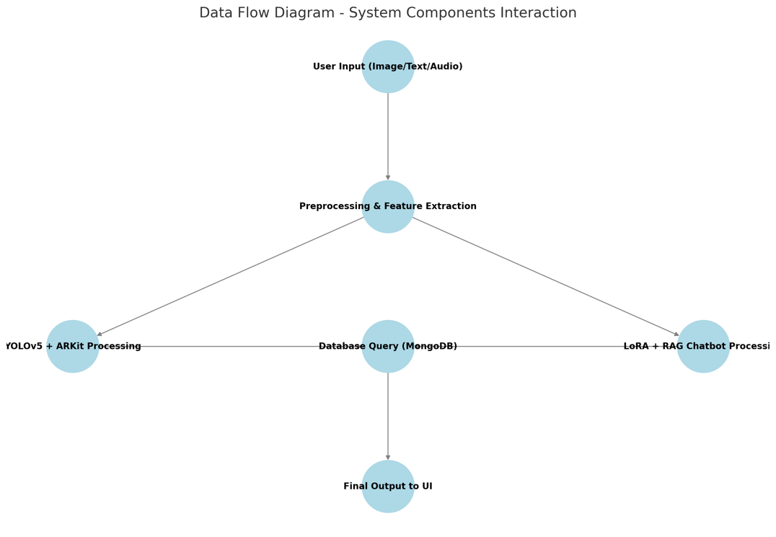
System Overview
Overall system architecture
CV module (YOLOv5 + ARKit)
NLP module (LoRA + RAG Chatbot)
Data storage (MongoDB, FAISS)
API layer (FastAPI, TensorRT acceleration)
Data flow (How data moves through the system)

Slide 4
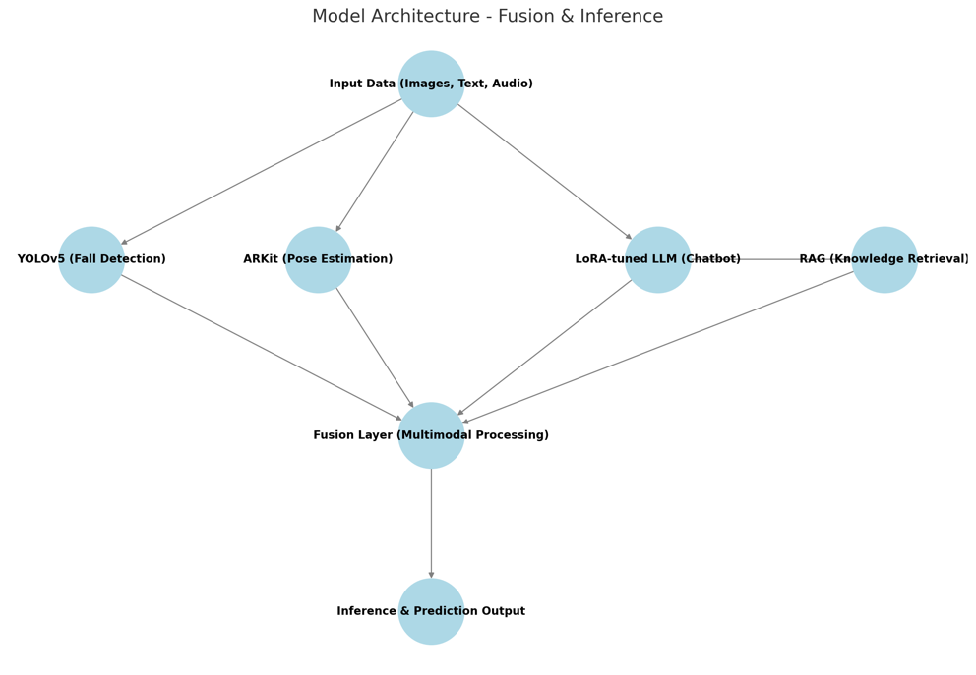
AI Models Used in Our System
Computer Vision (CV): YOLOv5 + ARKit
Object Detection + 3D Pose Estimation
Data Enhancement (GANs to generate fall data)
Key Optimization (CIoU Loss, TensorRT Reasoning Acceleration)
Natural Language Processing (NLP): LoRA + RAG Chatbot
Low Rank Adaptation (LoRA) fine-tuning GPT-4
Combining RAG (Retrieval Enhanced Generation) to provide personalized answers
Prompt Engineering to improve conversation quality

Slide 5
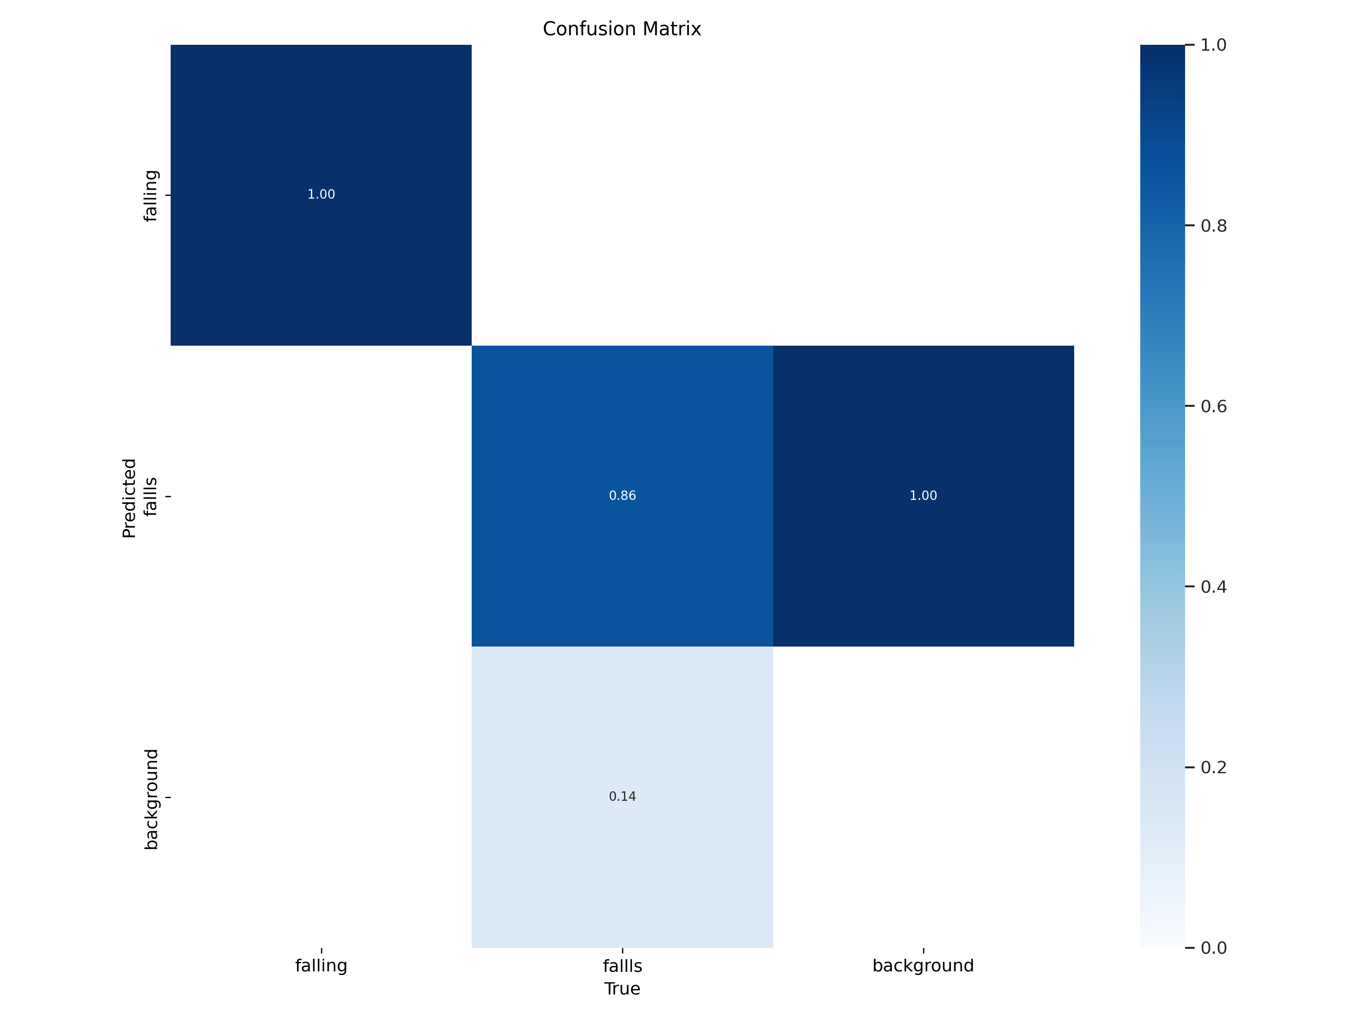
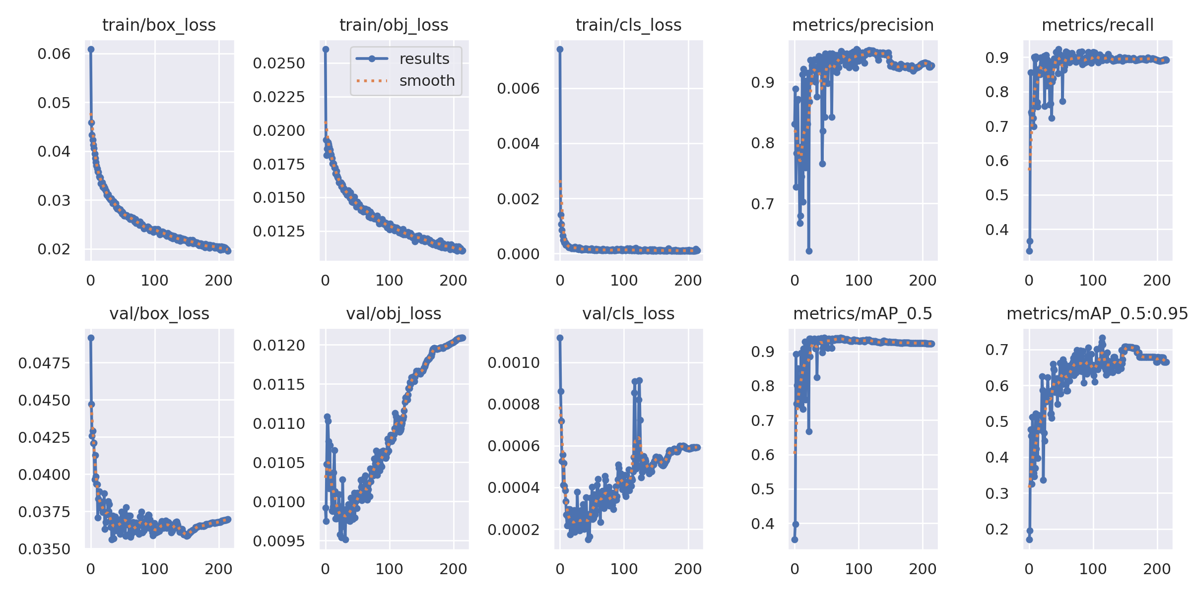
How Well Do Our Models Perform?
YOLOv5 + ARKit
mAP (93.5%), Recall (92.8%)
False alarm rate reduced by 2.5%
LoRA + RAG Chatbot
BLEU (0.78), ROUGE-L (0.82), F1-score (91.2%)
Recall speed optimized by 25%

Slide 6
Overcoming Key Challenges In Model Training Challenges
YOLOv5 + ARKit has limited generalization capabilities: fewer data samples, unstable detection under different angles and lighting conditions, and high false detection rate (nighttime, partial occlusion).
LoRA fine-tuning LLM has high computational cost: Direct fine-tuning of GPT-4 consumes computing resources. Although LoRA optimizes calculations, it is still limited by the size of the context window.
Solution:
Data enhancement: Use GANs & Stable Diffusion to generate fall data and improve the generalization ability of small samples.
Model fusion: Combine YOLOv5 + ARKit 3D pose estimation to enhance low-light environment detection capabilities.
Lightweight optimization: Reduce the low-rank dimension of LoRA (Rank 8 → Rank 4), reduce 40% of the computational cost, and maintain the quality of text generation.

Slide 7
Overcoming Key Challenges In API Integration & Deployment Challenges
FastAPI backend latency issues: YOLOv5 takes up a lot of RAM, causing slow inference when accessed by multiple users. RAG has latency in long text queries when using FAISS for vector retrieval.
Cross-platform compatibility issues: ARKit is limited to iOS devices, but some users need to run fall detection on the web.
Solution:
YOLOv5 quantization (TensorRT): Reduce model loading time and improve GPU computing efficiency.
FastAPI WebSocket implements streaming video inference, reduces HTTP overhead, and speeds up response.

Slide 8
Individual Contributions
Hui Jin (CV Development & Evaluation)
Trained and optimized YOLOv5 + ARKit Fall Detection Model.
Implemented loss function optimizations (CIoU) to improve detection accuracy.
Conducted model evaluation (mAP, Recall, BLEU, Confusion Matrix) to analyse misclassifications.
Fine-tuned hyperparameters, improving detection accuracy by 3.3%.
TensorRT-optimized YOLOv5 deployment, reducing inference time by 40%.
Jayadithya Nalajala (System Deployment & NLP Development)
LoRA fine-tuned GPT-3.5 (Chatbot): Improved RAG retrieval, reducing irrelevant responses by 30%.
Enhanced NLP generation quality (BLEU score +10%).
Prompt Engineering: Optimized prompts for more personalized LLM responses.
Optimized RAG API, improving vector search efficiency by 25%.

Slide 9
Individual Contributions
Sai Jahnavi Devabhakthuni (Data Processing & Augmentation)
Data Augmentation: GANs for fall detection data, Stable Diffusion for NLP data enhancement.
Optimized FAISS retrieval, improving NLP recall speed by 20%.
Cleaned NLP corpus, reducing noisy data by 15%.
Saniya Pandita (UI/UX Design & Frontend Development)
Visualized NLP generation results for better user interpretability.
Integrated low-latency WebRTC video streaming for smoother frontend interaction.
Enhanced model output visualization (Grad-CAM, SHAP analysis).

Slide 10
What’s Next?
Improve RAG recall mechanism and improve NLP generation quality
Expand multimodal AI research (voice, video, text)
Optimize WebRTC interactive experience

Slide 11
Thank You! Questions?
Hui Jin
Jayadithya Nalajala
Saniya Pandita
Sai Jahnavi Devabhakthuni
Mar 12, 2025

