Slide 1
AE-Morpher: Improve Physical Robustness of
Adversarial Objects against LiDAR-based
Detectors via Object Reconstruction
G13
Hui Jin
Jiarui Zhu
Harshitha Bashyam
Apr 21, 2025

Slide 2
Background & Research Motivation

Slide 3
Importance of Autonomous Driving System and LiDAR
The importance of safety in autonomous driving systems has become increasingly critical, especially as more vehicles on the road incorporate autonomous features, which raises concerns about their reliability and security.
LiDAR sensors play a vital role in autonomous driving by using laser pulses to measure distances and create 3D maps, providing precise information about nearby objects such as vehicles, pedestrians, and road signs.

Slide 4
Challenges of existing physical adversarial attacks
However, despite the existence of some adversarial attack methods against LiDAR-based perception models, effectively deceiving these models in the physical world remains a significant challenge. Existing methods often focus on optimizing adversarial objects in digital environments, but the discrepancies that arise during the LiDAR capturing process can severely undermine the effectiveness of these attacks.

Slide 5
Problem Analysis & Motivation

Slide 6
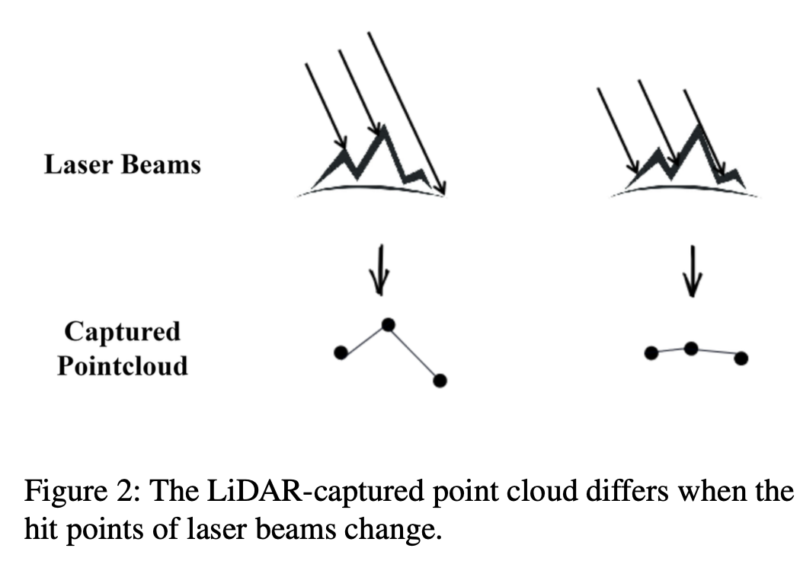
Why Physical Attacks on LiDAR are Difficult
LiDAR physical attacks are primarily challenging due to the significant differences between the captured point clouds and the ideal point clouds. The ideal point cloud refers to the one generated in a digital environment that can effectively deceive LiDAR perception models, while the actual captured point cloud is the result obtained when LiDAR scans objects in the physical world. This discrepancy arises mainly because the sparse laser beams of LiDAR struggle to accurately capture the scattered perturbations on the surfaces of adversarial objects, especially those with irregular surfaces and sharp protrusions.

Slide 7
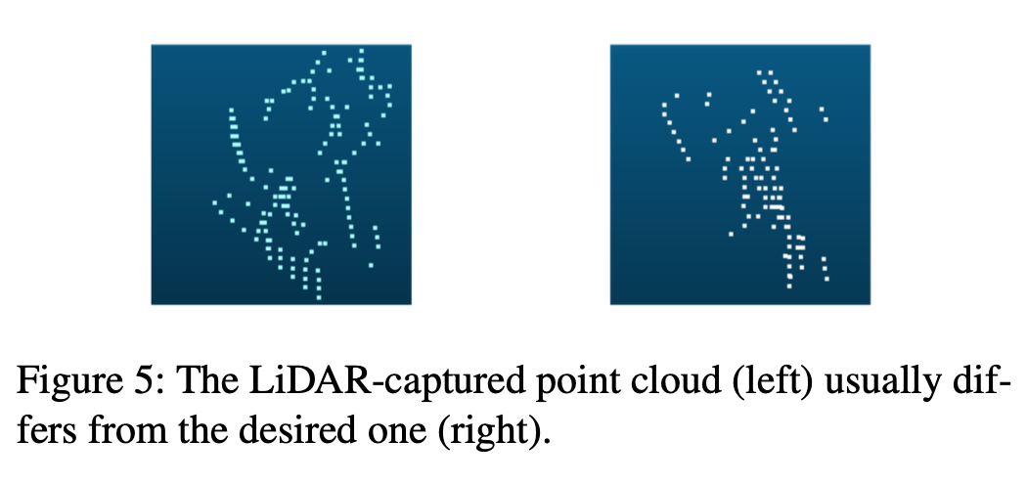
Why Physical Attacks on LiDAR are Difficult
In practical applications, the point clouds captured by LiDAR often deviate significantly from the ideal point clouds. For instance, when laser beams hit different locations on an object, the captured point clouds can exhibit errors due to surface irregularities, making it difficult for LiDAR to accurately reflect the ideal adversarial point cloud. Additionally, the sparsity of the laser beams leads to many effective adversarial perturbations being missed during the capturing process, further undermining the effectiveness of the adversarial attacks.

Slide 8
System framework & innovations

Slide 9
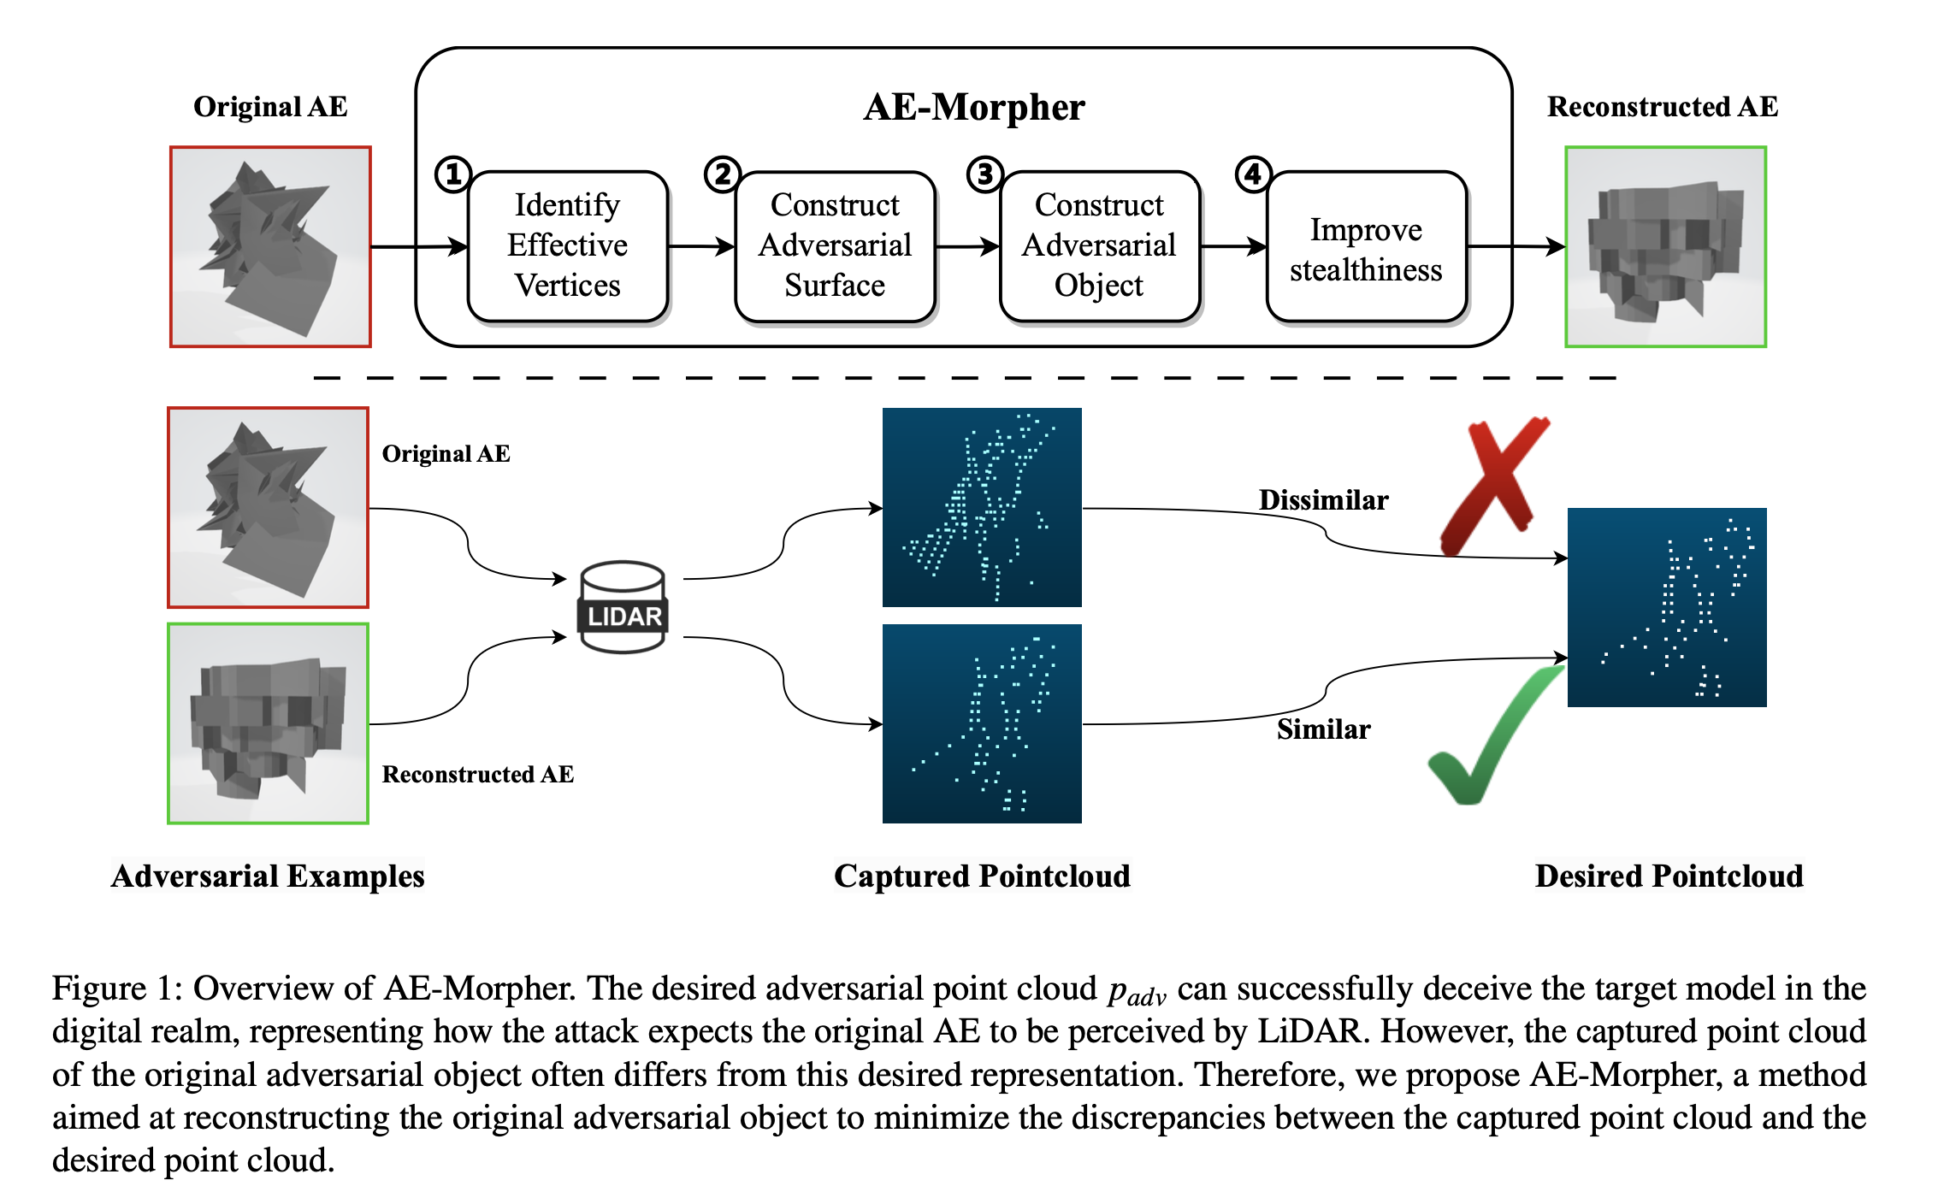
System Overall Design
Extracting effective adversarial vertices: In this stage, the system simulates the LiDAR capture process to identify effective vertices in the adversarial object. These vertices are key points that can effectively attack the LiDAR perception model. By selecting effective vertices, the system can reduce redundant information, thereby constructing a smaller adversarial object and improving its concealment.

Slide 10
System Overall Design
Constructing adversarial surfaces: After extracting valid vertices, the system constructs adversarial surfaces for each valid vertex. These adversarial surfaces are flat areas designed to reduce the errors caused by the laser beam deviating from the valid vertices during LiDAR capture. In this way, the system is able to improve the robustness of adversarial objects in the physical world.

Slide 11
System Overall Design
Constructing the adversarial object: Next, the system connects the constructed adversarial surfaces to form a continuous surface, thereby generating a complete three-dimensional adversarial object. This process ensures the structural integrity of the adversarial object and makes it easier to be captured by LiDAR in the physical environment.

Slide 12
System Overall Design
Improved stealth: Finally, the system further improves the stealth of the adversarial object by adjusting its size and shape. This process aims to balance the robustness and stealth of the adversarial object to make it more practical in real-world applications.

Slide 13
AE-Morpher Technical Details

Slide 14
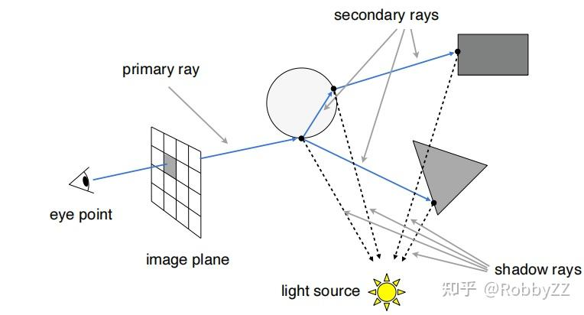
Valid Vertex Identification
In AE-Morpher, the identification of valid vertices is achieved through the ray-casting method. This method simulates the LiDAR capture process and evaluates the validity of each vertex by emitting a laser beam. In this way, the system is able to reduce redundant information, thereby building a smaller adversarial object and improving its concealment.
The ray-casting method generates a point cloud corresponding to the original adversarial object by simulating the emission and reflection of the laser beam. Valid vertices are those that successfully deceive the model during the simulation process, and these vertices will be used for subsequent adversarial surface construction.

Slide 15
Counter Surfaces and Counter Objects
When constructing the adversarial surface, AE-Morpher uses a planar extension vertex method. The system creates a flat area (adversarial surface) for each valid vertex to reduce the error caused by the laser beam deviating from the valid vertex during LiDAR capture. In this way, the system is able to improve the robustness of the adversarial object in the physical world.
The optimization of the geometric structure enables the adversarial surface to better capture the laser signal. The flat adversarial surface ensures that the laser beam can accurately hit the valid vertex, thereby generating a capture result that is closer to the ideal adversarial point cloud. This method not only improves the attack success rate of the adversarial object, but also enhances its concealment in the physical environment.

Slide 16
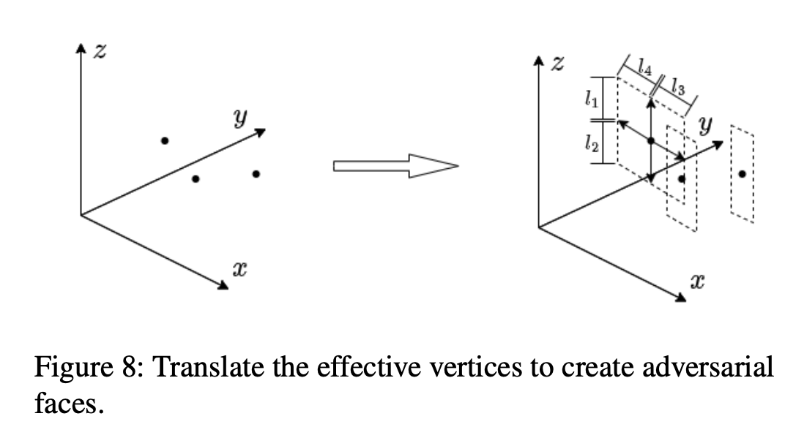
Adversarial Object Construction
In the process of constructing the adversarial object, AE-Morpher connects the generated adversarial surfaces to form a continuous 3D surface. This process ensures the structural integrity of the adversarial object and makes it easier to be captured by LiDAR in the physical environment.

Slide 17
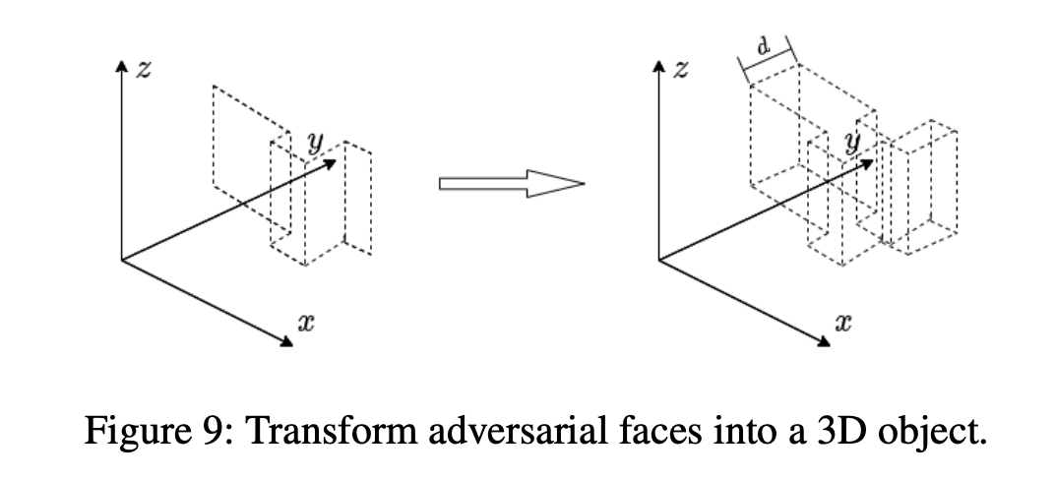
Concealment Adjustment
The system also further improves the stealthiness of adversarial objects by adjusting their size and shape. This process aims to balance the robustness and stealthiness of adversarial objects, making them more practical in real-world applications.

Slide 18
Experimental Design & Results Analysis

Slide 19
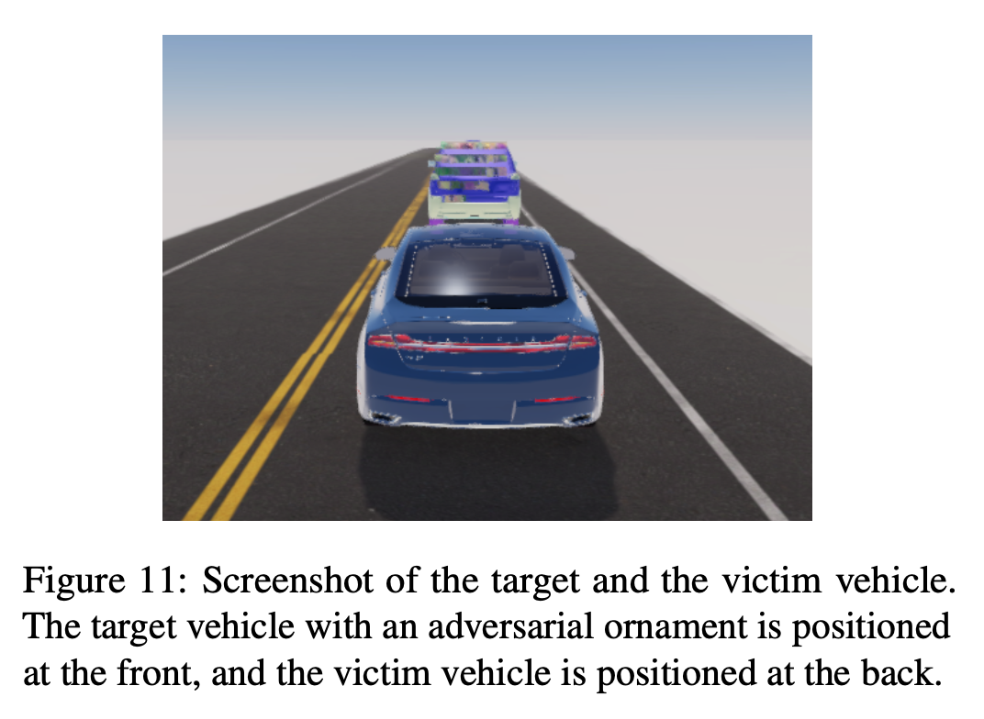
SVL Simulator + Apollo
In the experiment, static and dynamic attacks were designed using SVL Simulator and Apollo. SVL Simulator is an open source autonomous driving simulator that can create environments similar to real-world conditions to obtain sensor data.

Slide 20
Dynamic Attack Performance Improvement Comparison
According to the experimental results, the attack success rate of the AE-Morpher method increased by 38.64%, while the projection area was reduced by 67.59%. These data show that AE-Morpher performs well in dynamic attack scenarios and can effectively hide the target vehicle.
Method | Attack success rate | Reduced projection area
Original | 100% | -
AE-Morpher | 71.4% | 67.59%

Slide 21
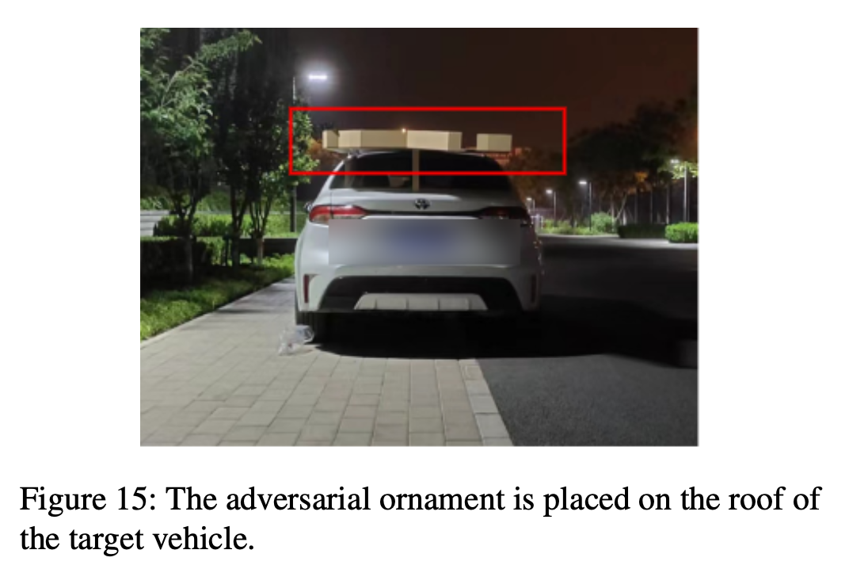
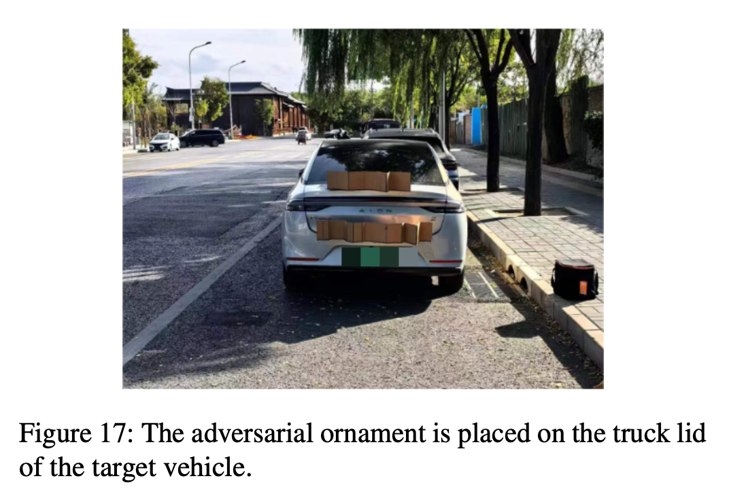
Real Environment Experiment
In a real environment, they conducted experiments during the day and at night, using RS-LiDAR-16 to collect point cloud data. In the night experiments, our attack success rate reached 71.4%, while in the day experiments, the success rate was 80.8%.

Slide 22
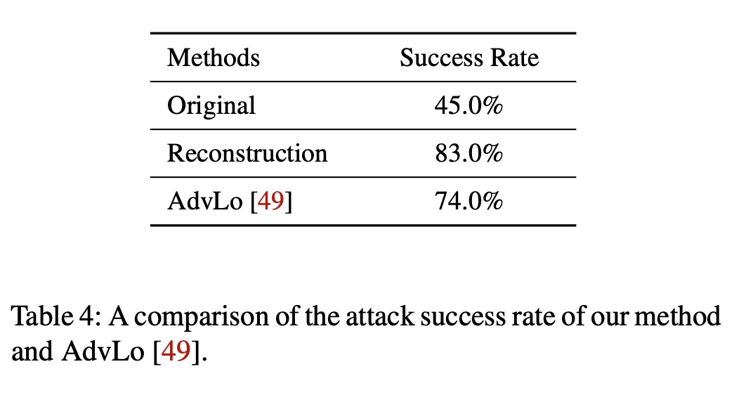
Comparison Results with AdvLo
AE-Morpher's success rate after reconstruction is 9% higher than AdvLo, which shows that AE-Morpher has a clear advantage in attack effect. Through these experimental results, we can see the significant advantages of AE-Morpher in improving the attack success rate and reducing the projection area.

Slide 23
Fusion Attack Effect

Slide 24
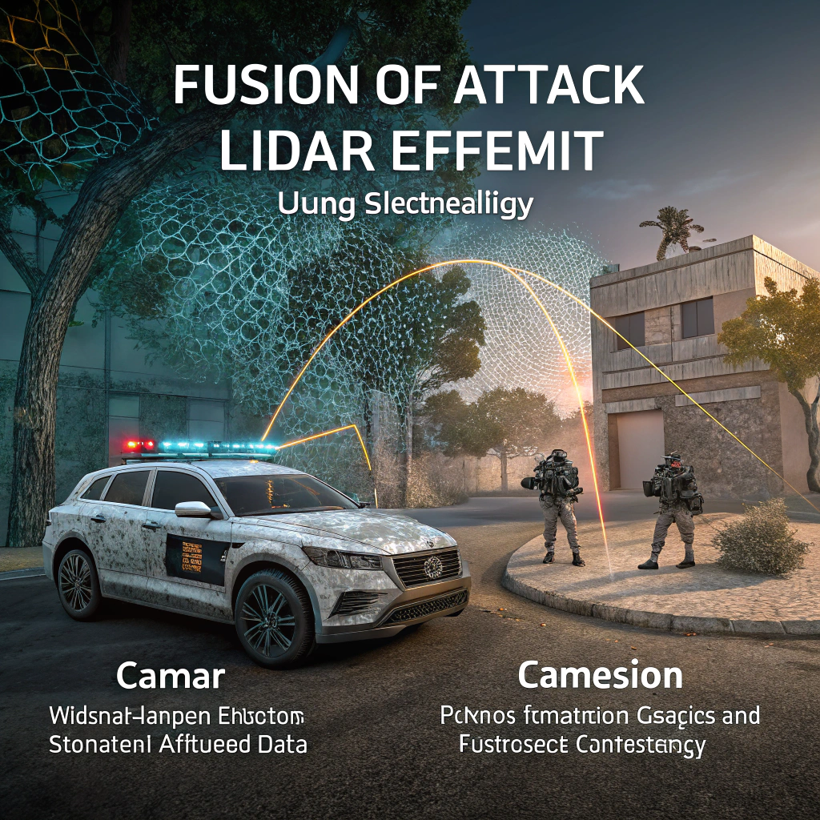
Fusion Attack (LiDAR+Camera)
Fusion attack refers to a strategy that uses both LiDAR and camera models for adversarial attacks. In this attack, the reconstructed adversarial object not only deceives the LiDAR perception model through its shape, but also affects the detection results of the camera model through its texture information.
In the experiment, they observed that when the LiDAR moved towards the target vehicle from a distance of 20 meters, the attack success rate of the fusion perception module reached 75.6%.

Slide 25
Advantages & Innovation

Slide 26
Advantages & Innovation
The relationship between sparse LiDAR point clouds and adversarial perturbations is revealed for the first time.
AE-Morpher proposes a geometry reconstruction method suitable for LiDAR to improve the robustness against physical attacks. This method reconstructs the surface of the adversarial object to better adapt it to the sparse laser signal, thereby reducing the error in the LiDAR capture process.
AE-Morpher does not require expensive 3D printing equipment, emphasizing its practicality and feasibility.

Slide 27
Restriction Analysis

Slide 28
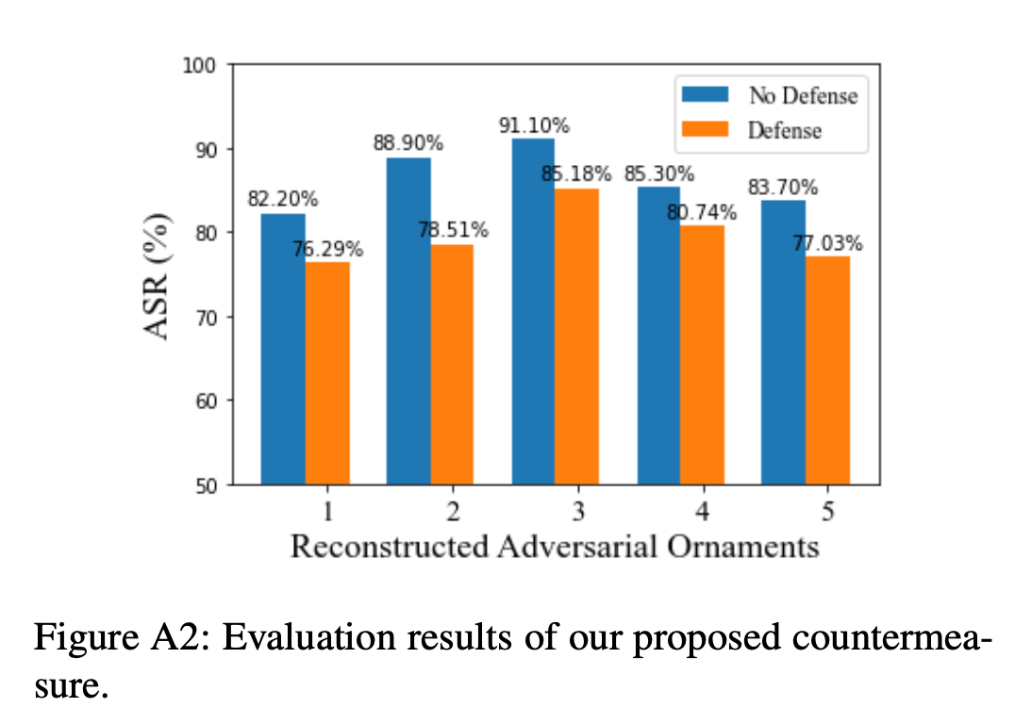
limitation
In the AE-Morpher approach, there are some limitations to consider. First, the method currently only works for a single LiDAR sensor, which means it may face challenges in multi-LiDAR scenarios.
Second, environmental complexity is also an important issue. In the real world, dynamic environments (such as pedestrians and other vehicles) may interfere with the effect of adversarial objects, resulting in a decrease in the success rate of the attack.
In addition, the resolution difference of LiDAR may also affect the performance of AE-Morpher, because different types of LiDAR sensors have different accuracy and level of detail when capturing point clouds.

Slide 29
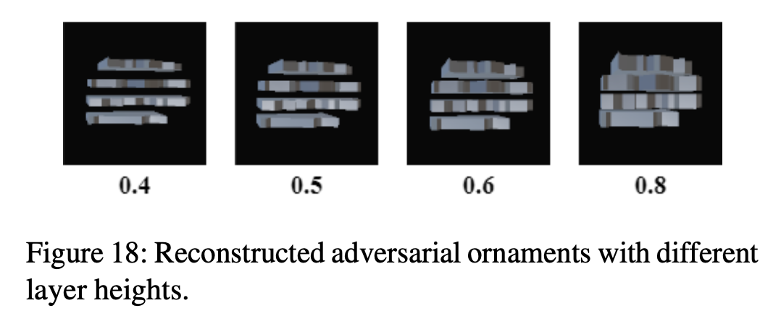
Future Work
First, explore the adaptability of multi-LiDAR systems to improve the effectiveness of attacks in complex scenarios. Researchers can consider how to coordinate information between multiple LiDAR sensors to reduce the differences in captured point clouds.
Second, develop adversarial strategies for dynamic environments to improve robustness against adversarial objects in the real world. This may involve real-time adjustment of adversarial objects to adapt to changing environments.
Finally, study the adaptability of LiDARs with different resolutions and optimize AE-Morpher to adapt to different types of LiDAR sensors, thereby increasing the possibility of its widespread application.

Slide 30
Reflection

Slide 31
Advantages and Disadvantages
Adversarial attacks in the past have focused on how to optimize point cloud data, but few studies have explored the impact of information loss during LiDAR physical capture.
The adversarial objects proposed in this paper not only improve the attack success rate in the simulated environment, but also achieve 71.4% (night) and 80.8% (day) attack success rates in the real physical environment.
The simulation environment used in the paper uses a 64-line LiDAR, while the real physical experiment uses a 16-line LiDAR.
Although AE-Morpher proposes a method to optimize the geometry of the adversarial object so that it can better deceive the LiDAR system, the method still relies on adversarial ornaments, that is, additional objects need to be added to the target vehicle.

Slide 32
Continuing Research
The current method is mainly aimed at specific LiDAR devices. If an adaptive adversarial object design method can be constructed based on the scanning characteristics of different LiDAR systems (such as solid-state LiDAR, MEMS LiDAR, etc.) in the future, the versatility of this method in different environments can be further improved.
The current method performs well in static environments and short-distance motion scenarios, but if the target vehicle is driving on a highway or in a complex urban environment, the attack object may fail due to changes in angle and distance.

Slide 33
Thanks for watching!
Any Questions?
G13
Hui Jin
Jiarui Zhu
Harshitha Bashyam
Apr 21, 2025
AE-Morpher: Improve Physical Robustness of
Adversarial Objects against LiDAR-based
Detectors via Object Reconstruction

