Slide 1
论文创新点评审报告
论文：级联双任务、感知损失、误差预测一致性创新点分析
Notes:
运行ID: vASdo9DIz1wiRpRz

Slide 2
级联双任务创新
TISS-net: Brain tumor image synthesis and segmentation using cascaded dual-task networks and error-prediction consistency Jianghao Wu a, Dong Guo a, Lu Wang a, Shuojue Yang a, Yuanjie Zheng b, Jonathan Shapey c,d,e, Tom Vercauteren c, Sotirios Bisdas f, Robert Bradford e, Shakeel Saeed e, Neil Kitchen e, Sebastien Ourselin c, Shaoting Zhang a,g, Guotai Wang a,h,⇑ a School of Mechanical and Electrical Engineering, University of Electronic Science and Technology of China, Chengdu, China b School of Information Science and Engineering, Shandong Normal University, Jinan, China c School of Biomedical Engineering & Imaging Sciences, King’s College London, London, UK d Wellcome/EPSRC Centre for Interventional and Surgical Sciences, University College London, London, UK e Department of Neurosurgery, National Hospital for Neurology and Neurosurgery, London, UK f Department of Neuroradiology, National Hospital for Neurology and Neurosurgery, London, UK g SenseTime Research, Shanghai, China h Shanghai Artiﬁcial Intelligence Laboratory, Shanghai, China a r t i c l e i n f o Article history: Received 11 October 2022 Revised 15 March 2023 Accepted 30 April 2023 Available online 5 May 2023 Communicated by Zidong Wang Keyword: Brain tumor Image synthesis Segmentation Deep learning Regularization a b s t r a c t Accurate segmentation of brain tumors from medical images is important for diagnosis and treatment planning, and it often requires multi-modal or contrast-enhanced images.
First, we propose a dual-task-regularized generator that simultaneously obtains a synthesized target modality and a coarse segmentation, which leverages a tumor-aware synthesis loss with perceptibility regularization to minimize the high-level semantic domain gap between synthesized and real target modalities.
Based on the synthesized image and the coarse segmentation, we further propose a dual-task segmentor that predicts a reﬁned segmentation and error in the coarse segmentation simultaneously, where a consistency between these two predictions is introduced for regularization.
First, to deal with missing modality for brain tumor segmentation, we propose a novel brain Tumor Image Synthesis and Segmentation Network (TISS-Net) based on a cascaded dual-task architecture for end-to- end training and inference, where the synthesis and segmentation models are learned synergistically with several novel high-level regularization strategies.
Notes:
详细评审点：级联双任务创新

Slide 3
感知损失创新
请参考论文中关于感知损失创新的具体描述
Notes:
详细评审点：感知损失创新

Slide 4
误差预测一致性创新
TISS-net: Brain tumor image synthesis and segmentation using cascaded dual-task networks and error-prediction consistency Jianghao Wu a, Dong Guo a, Lu Wang a, Shuojue Yang a, Yuanjie Zheng b, Jonathan Shapey c,d,e, Tom Vercauteren c, Sotirios Bisdas f, Robert Bradford e, Shakeel Saeed e, Neil Kitchen e, Sebastien Ourselin c, Shaoting Zhang a,g, Guotai Wang a,h,⇑ a School of Mechanical and Electrical Engineering, University of Electronic Science and Technology of China, Chengdu, China b School of Information Science and Engineering, Shandong Normal University, Jinan, China c School of Biomedical Engineering & Imaging Sciences, King’s College London, London, UK d Wellcome/EPSRC Centre for Interventional and Surgical Sciences, University College London, London, UK e Department of Neurosurgery, National Hospital for Neurology and Neurosurgery, London, UK f Department of Neuroradiology, National Hospital for Neurology and Neurosurgery, London, UK g SenseTime Research, Shanghai, China h Shanghai Artiﬁcial Intelligence Laboratory, Shanghai, China a r t i c l e i n f o Article history: Received 11 October 2022 Revised 15 March 2023 Accepted 30 April 2023 Available online 5 May 2023 Communicated by Zidong Wang Keyword: Brain tumor Image synthesis Segmentation Deep learning Regularization a b s t r a c t Accurate segmentation of brain tumors from medical images is important for diagnosis and treatment planning, and it often requires multi-modal or contrast-enhanced images.
Multi-Task Segmentor with Error-Prediction Consistency With the synthesized target modality image xt0 and the coarse segmentation yc, we concatenate them with the original input image xs and denote the concatenation result as ~x ¼ xsrxt0ryc.
Effectiveness of Fine Segmentation using Error-Prediction Consistency To further investigate the effectiveness of the proposed dual- task ﬁne segmentor based on error-prediction consistency, we compared it with three variants: 1) only using the ﬁne segmenta- tion decoder (Lfine), without the error prediction branch; 2) error prediction branch only (Lerr) without ﬁne segmentation and thus without consistency loss; 3) predicting ﬁne segmentation and error in the coarse segmentation simultaneously (Lfine and Lerr) but without consistency regularization.
The results in Table 2 show that our proposed error-prediction consistency strategy still performed better than the other three variants.
Notes:
详细评审点：误差预测一致性创新

Slide 5
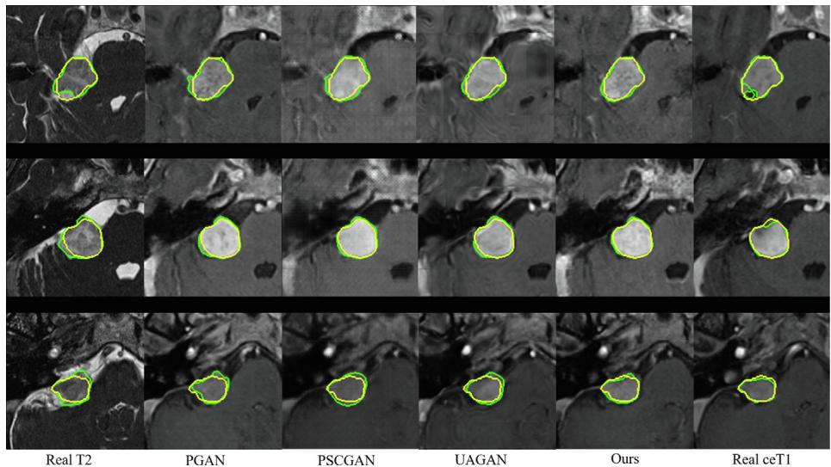
创新点总结与评价
级联双任务：创新性地将两个相关任务级联处理，可能提高模型效率与性能
感知损失：引入感知损失函数，使模型学习更符合人类感知的特征表示
误差预测一致性：通过误差预测一致性约束，增强模型的预测稳定性和可靠性
总体评价：本文提出的三个创新点相互补充，共同构建了一个更强大的模型框架
论文配图示例（来源：paper.pdf）

