Slide 1


CREATIVE AND INNOVATIVE PROJECT
2D SHOOTER GAME using unity & C#
project by,
1. ANANYA JAYA KUMAR - 2018115140
2. HARINI V.K - 2018115036
3. PRASANNA PRIYAN .K - 2018115072

Slide 2
Synopsis
The video game sector is immensely large. In fact, it is larger than the movie and music industry combined, and it is also growing. In this project, we are going to create a game called “The Flames” using Unity Game Engine.
This project is a game that is simple and fun to play. This game is a 2D shooter game. The gameplay is simple, the enemies are spawned in waves. If the player defeats all the enemies the next wave is spawned. When the player defeats all the enemies of the last wave the boss spawns. If the player defeats the boss then the player wins.
The game also presents different types of enemies, so the player has to change how they play to defeat each of the enemies. There are many different types of weapons in the game, they have different stats so they player can choose the weapon that best suits their gameplay style.

Slide 3
Hardware & Software Requirements
HARDWARE
SOFTWARE
Components | Minimum Requirements
Processor | Intel Core 2 Duo E5200 or above
RAM | 4 GB
HDD | 256 GB
Graphics | GeForce 9800GTX (1GB) or Intel HD 3000 or above
Basic Components | Mouse, Keyboard, Speakers.
Components | Minimum Requirements
Operating System | Windows 8 and above
Graphics | Nvdia or Intel HD Graphics

Slide 4
Player
The player will have two animations, walk animation and a wiggling animation (idle).
The wiggling animation is to give the player some life.
The player is controlled using W,A,S,D keys.
The player can shoot by pointing the cursor and pressing the LMB.
The player has 5 HP. Each is denoted as a heart in the UI.
The player can replenish their HP by picking up a Heart that is dropped when an enemy is defeated.
If the player health <= 0 then the scene transition to the lost scene.

Slide 5
Projectile
Weapons
There are 4 types of weapons in the game.
The weapons points in the direction where the cursor is placed. This is done by finding the tan(x, y) from where the cursor is placed on the screen.
As the enemies are defeated they drop new weapons.
Whenever LMB is clicked, the projectile object is instantiated.
When LMB is pressed, the projectile object is instantiated and is translated toward a specific direction based on the cursor’s position.
Each weapon has different projectiles and each projectiles have different damage points.
The Ranged enemy also finds the player position and instantiates the projectile. This projectile works the same way.

Slide 6
Enemies
Melee enemy :
This enemy moves towards the player and attacks. If an attack is successful the enemy moves back a calculated distance and moves again to attack.
Ranged enemy :
This enemy gets the player position and fires a projectile. This enemy maintains a distance from the player. If the projectile hits the player, the player health is reduced
Summoner :
This enemy stays away from the player and summons new melee enemies. The time between summoning is fed using a variable. The summoned enemy has the same behaviour as the Melee enemy. If the player gets close to the Summoner, it melees the player.

Slide 7
Wave Spawner
Wave spawner is a C# script that spawns enemies in the game. It spawns enemies in the form of waves.
The total no. of waves, enemies, enemy type and time between spawn is specified.
This script is completely dynamic. The values can be changed at any time and the script will run as usual.
Different types of enemies can be spawned in a single wave. For e.g., Melee enemy and Summoner enemy can be spawned in a single wave.
The specified enemies will spawn at a randomly selected predefined spawn points

Slide 8
Wave Size:
This is the total no. of waves. The value 4 is assigned so, it has 4 elements.
Count:
This is the total no. of enemies spawned in the current wave.
Enemies Size:
This is the total no. of enemy type. Notice the highlighted spot, value 2 is assigned so, it spawns two different enemy types. In this case, Melee enemy and Ranged enemy.
Time between spawn:
This is the time between an enemy is spawned in that wave.
Time between waves:
This is the time taken to start the next wave. In this case, 3 seconds.

Slide 9
Boss
When all the waves are completed, the boss is spawned at a predefined location.
The boss has two behaviour based on it’s health points.
If the boss’s health is > half health points, it follows patrol behaviour.
In patrol behaviour the boss moves towards a randomly selected predefined locations and spawns enemies.
If the boss’s health < half health, it follows chase behaviour
In chase behaviour, the boss chases the player and melees him. The boss’s attacks have a lot of damage points.
If the boss is defeated, the scene transitions to victory scene

Slide 10
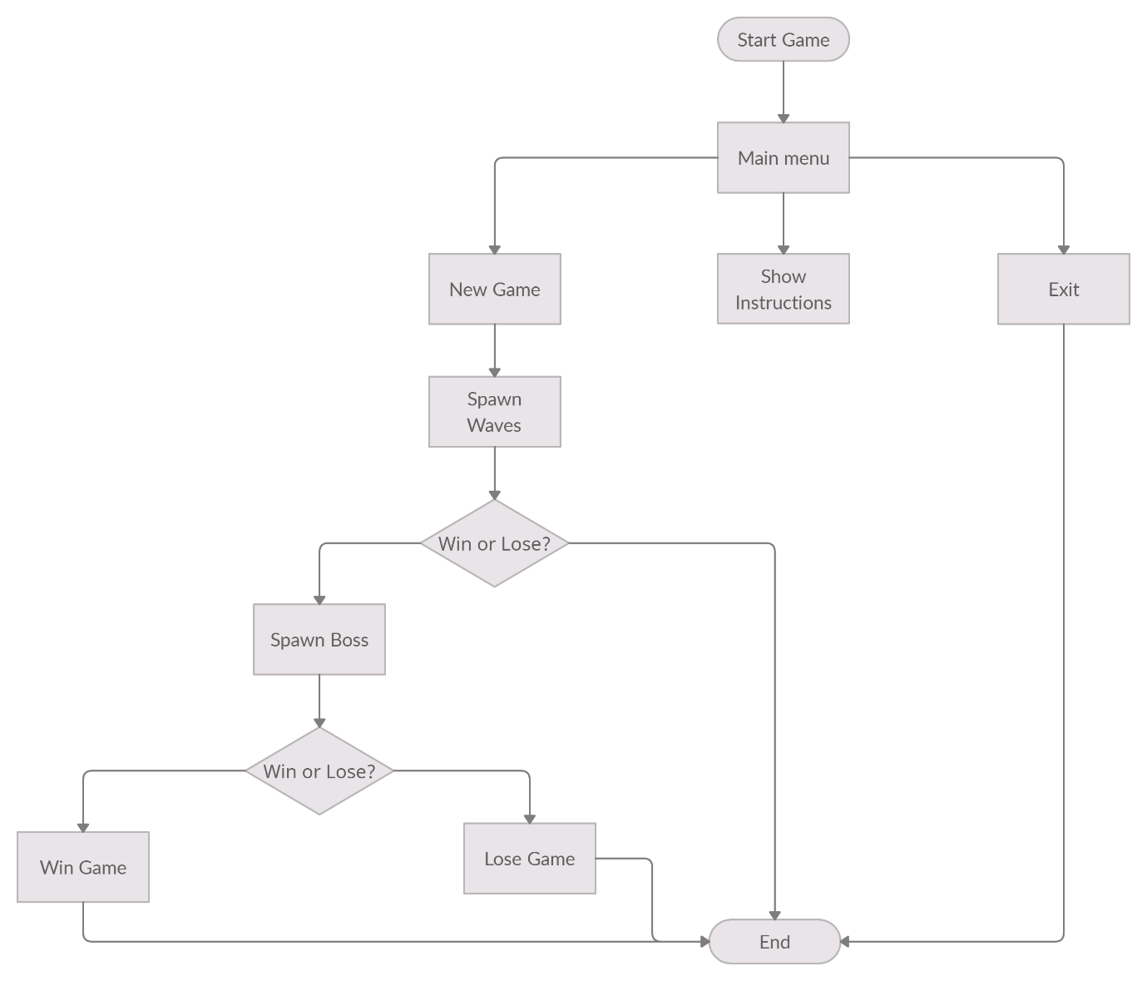
System Flow Diagram :

Slide 11
Scene Transitions
Pressed Play
Menu Scene
Game Scene
If Boss health <= 0
Victory Scene
If Player health <= 0
Losing Scene

Slide 12
Scope for further enhancement
Any game no matter how good it is developed can be enhanced or added new features and gameplay. This game has medium difficulty so it can be enhanced further more with time and some resources.
New enemies:
For now, there are only three class of enemies. But we can add new enemies with ease. The wave spawner module is completely dynamic, we can add more enemies with ease.
Enemy concepts:
Shielded enemy: This enemy has a shield upfront so the player has to go behind its back to defeat this enemy.
Splitting enemy: This enemy when defeated splits into 2 small enemies.

Slide 13
Scope for further enhancement
New Maps:
Currently this game has only one map. But we can add new maps with some platforming mechanics to enhance the gameplay.
New Pickups:
For now, the pickups are only health and weapons, but we can add new power up pickups like super speed, shield, increased attack power etc.
New Bosses:
We can add more bosses to add more fun. This will increase the player play time.
Achievement system:
We can add achievement systems like defeating the bosses, completing the game without talking any damage etc. This will motivate to player to play more.

Slide 14
Bibliography
Book Reference:
a. Jeremy Gibsion – “Introduction to Game Design, Prototyping, and Development”
b. Greg Lukosek – “Learning C# by Developing Games with Unity 5.x”
Website Reference:
11111a. h1111ttps://docs.unity3d.com/
b. https://learn.unity.com/
c. https://gamedev.stackexchange.com/

