Slide 1
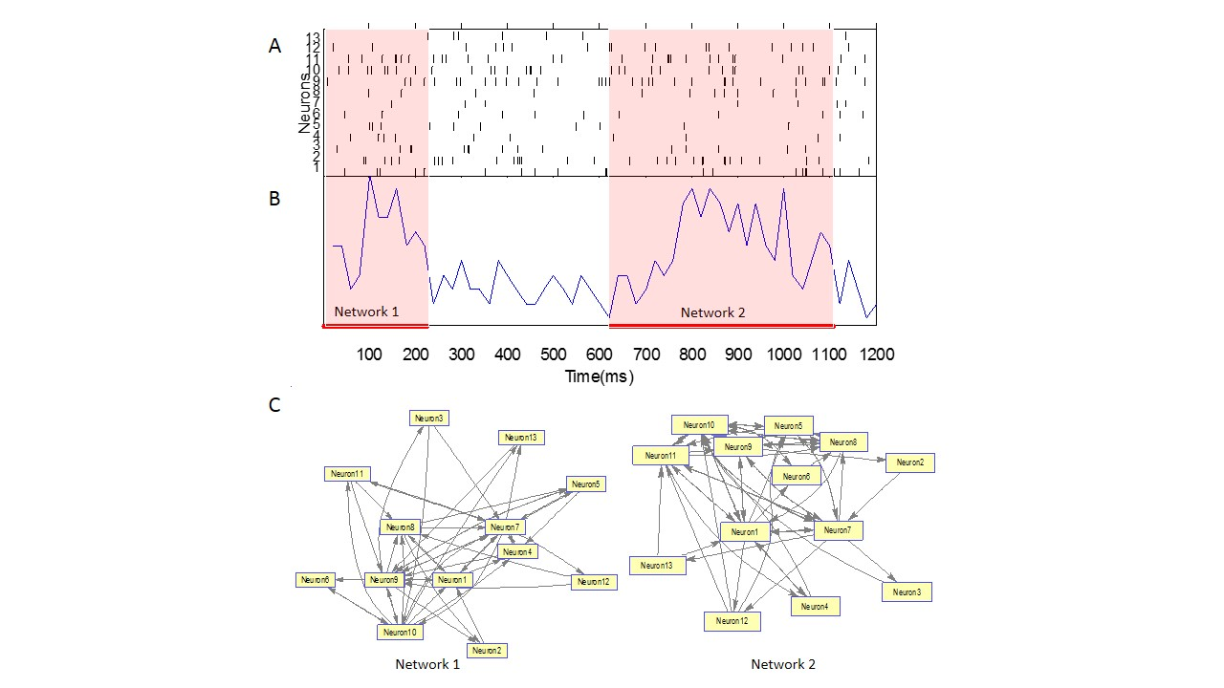
Figure 1. Schematic illustration of the constructed
networks using graph theory. (A) Spike trains of
1.2 seconds recorded from 13 neurons in a
freely-moving rat’s frontal cortex during sleep.
(B) The Multiunit Activity (MUA) firing rate per 20ms
of the neuronal group is used to detect microstates.
The criteria of a qualifying microstate are
1) microstate is at least 80ms in duration;
2) 75% or more of the neurons in the ensemble
have fired within each microstate; 3) Spikes occurred
within 20ms only are considered be to linked. (C) The
schematics of the two neuronal networks constructed
based on the temporal firing sequences of neurons
within each microstates.

Slide 2
Figure 2, Unweighted (binary) connectivity matrices of the two networks. The weightings of connections between neurons
can be remodelled based on inters-spike intervals (ISI) of consecutive spikes within each microstates.

Slide 3
Figure 3, Weighted connectivity matrices of the two networks. The weightings of connections between neurons
Is inversely related to inters-spike intervals (ISI).

Slide 4
Statistical measures applicable to Connectivity matrices (examples)
Matching Index – computes for any two neurons the amount of overlap in the connection patterns.
Clustering Coefficient – the fraction of neuron’s neighbours that neighbours of each other.
Paths and Distances – the reachability matrix describes whether pairs of neurons are connected by paths (reachable). The distance matrix contains lengths of shortest paths between all pairs of neurons.
Functional Motifs – subsets of connection patterns embedded within matrix structure. The frequency of functional motif occurrence around a neuron is counted.
Etc…

Slide 5
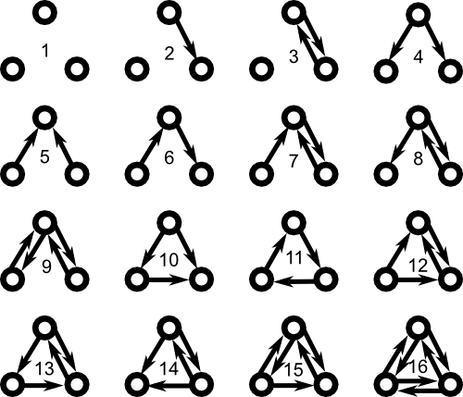
Figure 4, Possible functional motifs of a three-neuron sub-group.
Motifs 1, 2 and 3 are not considered in our analysis, since not all
three neurons are connected.

Slide 6
Figure 5, Frequency count of functional 3-motifs embedded in the connectivity matrix network structure.

Slide 7




Spatiotemporal dynamic changes in the cortical neuronal activity
Sleep Deprivation
Vs. Control
Spontaneous visual cortex
activity as Priori condition.
Effect of visual stimuli as Posteriori 1
Neural assembly activity during
subsequent sleep as Posteriori 2

