Slide 1

rw170-BSL3-VS2-TS-LFP-500ms-F-Epi1
Epoch number 12910:12924
One epoch = 4 seconds

Slide 2
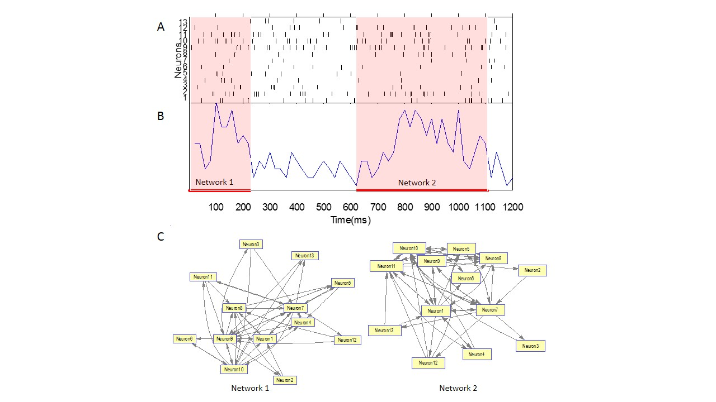
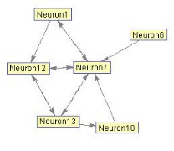
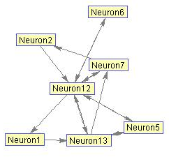
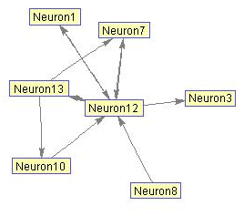
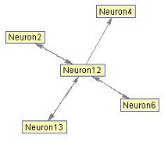
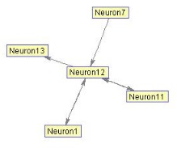
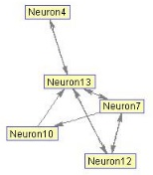
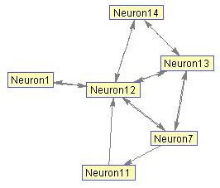
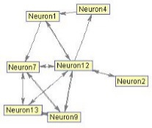
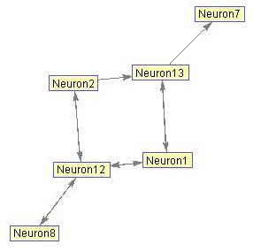
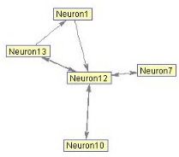
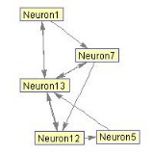
14
Qualified ON-periods. Criteria: >100ms duration; >$\frac{1}{3}$ of population fired.

Slide 3
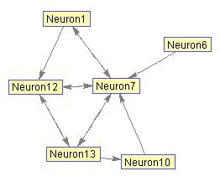

Slide 4
Weighted connectivity matrices of the two networks. The weightings of connections between neurons
Is inversely related to inters-spike intervals (ISI).

Slide 5
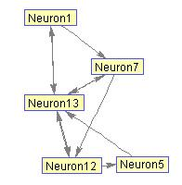
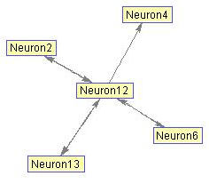

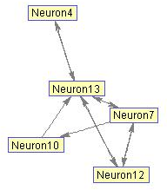
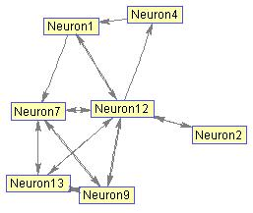
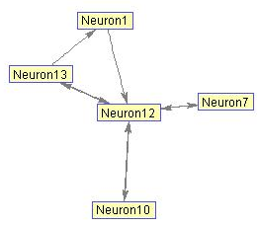

Slide 6
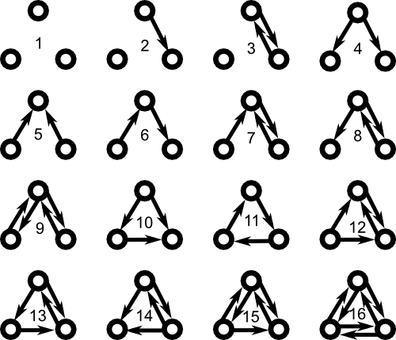
Possible functional motifs of a three-neuron sub-group.
Motifs 1, 2 and 3 are not considered in our analysis, since not all
three neurons are connected.

Slide 7
Functional Motifs – subsets of connection
patterns embedded within matrix structure.
The frequency of functional motif occurrence
around a neuron is counted.

Slide 8




Spatiotemporal dynamic changes in the cortical neuronal activity
Sleep Deprivation
Vs. Control
Spontaneous visual cortex
activity as Priori condition.
Effect of visual stimuli as Posteriori 1
Neural assembly activity during
subsequent sleep as Posteriori 2

