Slide 1
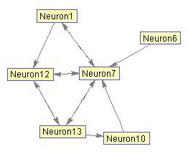
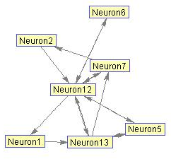

Slide 2
Weighted connectivity matrices of the two networks. The weightings of connections between neurons
Is inversely related to inters-spike intervals (ISI).

