Slide 1
HW1
助教： 吳秉諺 B11030037@mail.ntust.edu.tw 羅勻蔚 B10933033@mail.ntust.edu.tw 盧清珍 B11015012@mail.ntust.edu.tw

Slide 2
作業規定
分數：每題 4%，共 8%
作業密碼 : 09251009
OJ 網址: https://nlp.csie.ntust.edu.tw:2021/contest
OJ 截止日期：2023/10/16 10:00 (截止前無限制上傳次數)
請將上傳到OJ的程式碼壓縮成 zip 檔，並命名為「學號_姓名.zip」 (例如：b1234567890_王小明.zip)上傳至 Moodle，遲交 0 分。
程式語言開放使用 C (gcc 5.4)、C++ (g++ 5.4)，除了標準輸入輸出 (例如：stdio.h)和字串 (例如：string.h)相關的 library，請勿使用其他 library，請自行實作基礎資料結構。
請務必注意作業時限，超過時限或沒有在moodle和oj都繳交作業者皆以0分計算!
請勿抄襲他人程式碼

Slide 3
HW1-1 Taxi Loading Order

Slide 4
Description
A big family plans to go swimming and orders taxis to take them to the local swimming pool.
Each taxi can accommodate up to 200 kg of weight.
The taxis arrive at the family's house parking lot in a specific order, and the family members fill up each taxi starting from the front seat to the back seat.
After all the taxis are loaded, they exit the parking lot in the reverse order in which they entered. The taxis then arrive at the swimming pool in the same order they departed from the parking lot.
The family members exit the taxi at the swimming pool starting from the front seat to the back seat.
Given a list of each family member's weight in the order they enter the taxis, please print out how many taxis are needed and the order in which the family members exit the taxis at the swimming pool.

Slide 5
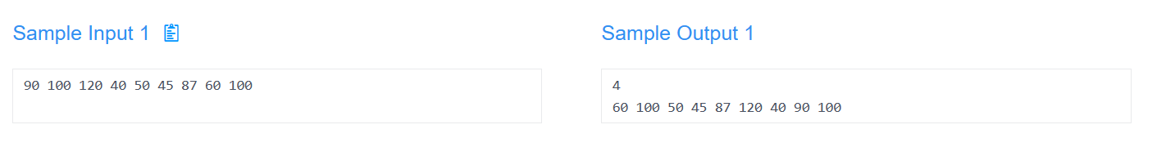
Input/output
Input:
A list of positive integers representing the weights of family members in kilograms, in the order they enter the taxis, separated by space. (Each weight will not exceed 200 kg)
Output:
An integer representing the number of taxis needed to transport the family.
A list of positive integers representing the weights of family members in the order they exit the taxi at the swimming pool.

Slide 6
Family members enter taxis
Input: 90 100 120 40 50 45 87 60 100
First taxi to arrive
Weight
90
100
120
40
50
45
87
60
100
Taxi 1
Taxi 2
Taxi 3
Taxi 4
Last taxi to arrive

Slide 7
Family members enter taxis
Input: 90 100 120 40 50 45 87 60 100
First taxi to be filled
Fill from front to back
Weight
90
100
120
40
50
45
87
60
100
Taxi 1
Front | Back
90 | 100
Taxi 2
Front | Back
120 | 40
Taxi 3
Front |  | Back
50 | 45 | 87
Taxi 4
Front | Back
60 | 100
Last taxi to be filled

Slide 8
Family members enter taxis
Input: 90 100 120 40 50 45 87 60 100
Last taxi to leave
Weight
90
100
120
40
50
45
87
60
100
Taxi 1
Front | Back
90 | 100
Taxi 2
Front | Back
120 | 40
Taxi 3
Front |  | Back
50 | 45 | 87
Taxi 4
Front | Back
60 | 100
First taxi to leave

Slide 9
Family members exit taxis
First taxi to arrive at swimming pool
Taxi 4
Front | Back
60 | 100
Taxi 3
Front |  | Back
50 | 45 | 87
Taxi 2
Front | Back
120 | 40
Taxi 1
Front | Back
90 | 100
Last taxi to arrive at swimming pool

Slide 10
Family members exit taxis
Exit first
Exit from front to back
End result
Taxi 4
Front | Back
60 | 100
Weight
60
100
50
45
87
120
40
90
100
Taxi 3
Front |  | Back
50 | 45 | 87
Taxi 2
Front | Back
120 | 40
Taxi 1
Front | Back
90 | 100
Output: 60 100 50 45 87 120 40 90 100
Exit last

Slide 11
HW1-2 Traversal

Slide 12
Description
Build a binary search tree according to two lists (infix and prefix / postfix), and print out the new list in the asking traversal way (postfix / prefix) and level order.

Slide 13
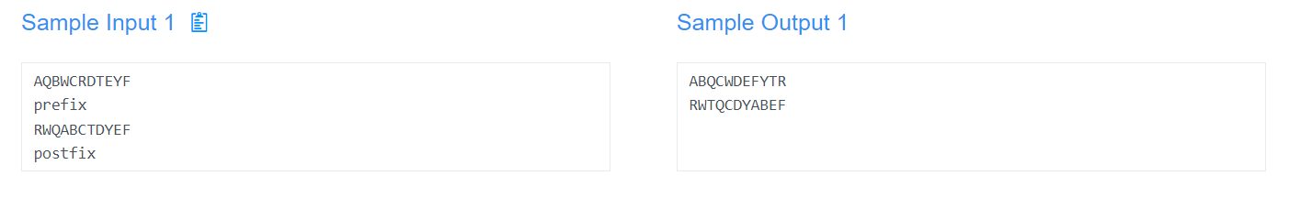
Input/output
Input:
The first line will be the list in infix order.
The second line will be the traversal way that the list is ordered now (prefix / postfix).
The third line will be the list that is in the traversal order (prefix / postfix).
The forth line will be the new traversal way you should turn the list into (postfix / prefix).
Output:
The first line should be the new list in the other traversal way.
The second line should be the new list in level order.

