Slide 1
HW2
TAs： 吳秉諺 B11030037@mail.ntust.edu.tw 羅勻蔚 B10933033@mail.ntust.edu.tw 盧清珍 B11015012@mail.ntust.edu.tw

Slide 2
作業規定
分數：8%
作業密碼 : 10301113
OJ 網址: https://nlp.csie.ntust.edu.tw:2021/contest
OJ 截止日期：2023/11/13 10:00 (截止前無限制上傳次數)
請將上傳到OJ的程式碼壓縮成 zip 檔，並命名為「學號_姓名.zip」 (例如：b1234567890_王小明.zip)上傳至 Moodle，遲交 0 分。
程式語言開放使用 C (gcc 5.4)、C++ (g++ 5.4)，除了標準輸入輸出 (例如：stdio.h)和字串 (例如：string.h)相關的 library，請勿使用其他 library，請自行實作基礎資料結構。
寄信詢問助教問題時，建議可以同時寄或副本給三位助教，有效加快回應速度
請務必注意作業時限，超過時限或沒有在moodle和oj都繳交作業者皆以0分計算!
請勿抄襲他人程式碼

Slide 3
HW2 Bank Account Password Encryptor

Slide 4
Description
To enhance the security of his bank account, Brian asks you to design an encryptor based on the properties of a red-black tree to generate a password.
Given a sequence composed of positive numbers or characters as input, this encryptor will produce an encrypted password.
You will need to construct a red-black tree using the input sequence and combine the information within that red-black tree according to specified rules to generate the encrypted password.

Slide 5
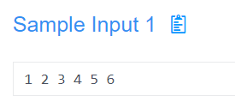
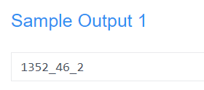
Input/output
Input:
A sequence composed of n positive numbers x or characters c, separated by spaces.
Output:
A sequence composed of positive numbers and underscores ('_') is constructed in the following order using the elements of a red-black tree:
All black nodes (positive numbers) using post-order traversal
All red nodes (positive numbers) using pre-order traversal
Number of rotations
Each set of elements is separated by underscores.

Slide 6
Hint
If there are characters in the sequence, convert them to decimal numbers using ASCII code table.
The process of constructing a red-black tree should follow the method explained by the professor during the lecture.
Please check your input and output processing, especially for spaces and \n.

Slide 7
Have a nice day ☺

