Slide 1








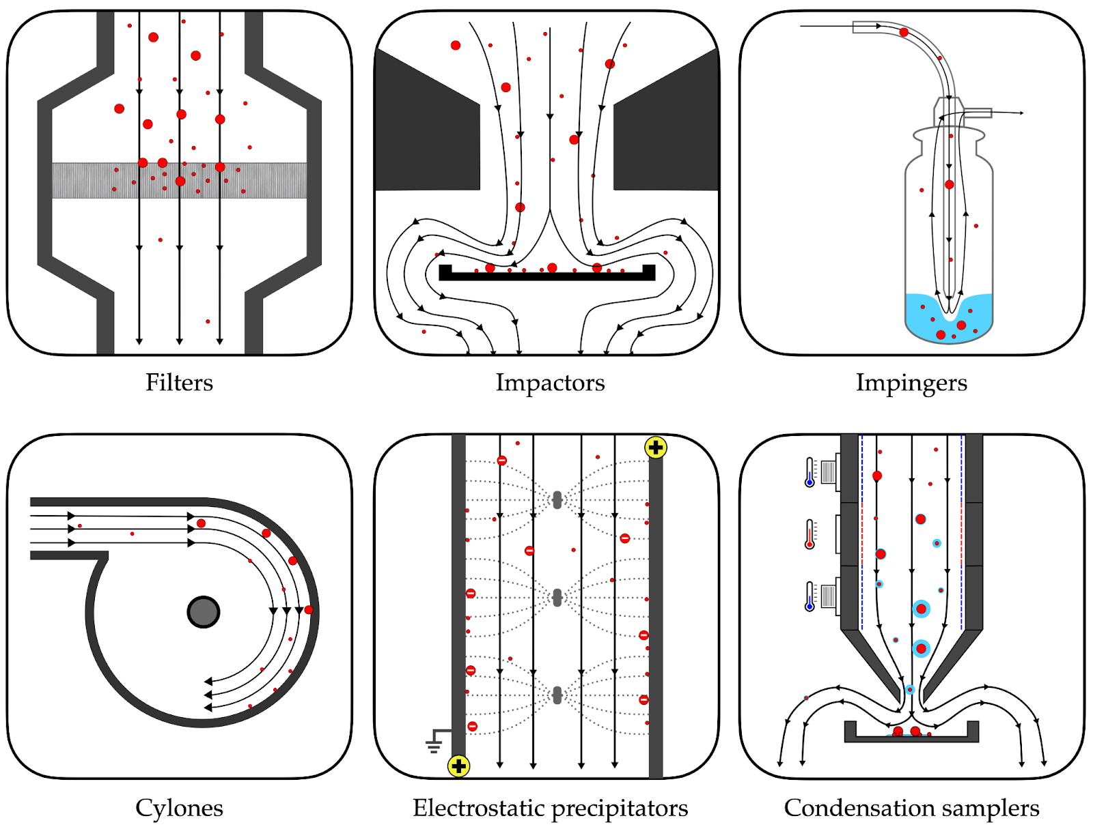




Biosurveillance Of Emerging Viral Threats Through Indoor Air Sampling: A Comprehensive Review
Lennart Justen^{1,2}, Simon Grimm^{1,3}, Harmon Bhasin^{1,3}, William Bradshaw^{1,3}, Kevin Esvelt^{1,3}
¹Massachusetts Institute of Technology, ²Draper Laboratories, ³SecureBio
ABSTRACT: Indoor air sampling presents a promising frontier for the early detection and surveillance of airborne viral threats. This comprehensive review explores the potential of indoor air sampling for viral bioaerosol detection, addressing key challenges in current U.S. government air sampling programs. We examine the viral content of indoor air, including sources, concentrations, and metagenomic profiles; compare various air sampling technologies; and assess strategic implementation in high-traffic locations. Our findings reveal that while viruses typically comprise less than 1% of metagenomic sequences in air samples, a diverse array of human-infecting viruses, including both respiratory and skin-associated pathogens, can be detected. We highlight the potential of HVAC systems and high-traffic areas like airports and hospitals as aggregators of viral bioaerosols from large populations. This research provides crucial insights for developing next-generation viral sampling techniques and biosurveillance networks, offering a foundation for enhanced biodefense capabilities and rapid response to emerging threats.
INTRODUCTION
AIR SAMPLING METHODS
VIRAL CONTENT OF INDOOR AIR
PROMISING LOCATIONS
Early detection of emerging viral threats is critical for national security and public health.
Air sampling is particularly promising for biosurveillance because airborne transmission is a hallmark of many high-risk pathogens.
Multiple U.S. government agencies, including DARPA, DHS, USPS, and ARPA-H, have invested in air sampling programs to detect biological threats.
Our review explores indoor air sampling for viral bioaerosol detection, aiming to inform the development of robust, real-time biosurveillance networks that can detect both known and emerging viral threats, ultimately strengthening our national biodefense posture and rapid response capabilities.
Active
Study | Sample type | Sample location | Collection device | Read pairs | NA type
Rosario 2018 | HVAC filter dust | Student dorms | MERV 8 HVAC filter | 18M | DNA + RNA
Prussin 2019 | HVAC filter dust | Daycare | MERV 14 HVAC filter | 470M | DNA + RNA
Leung 2021 | Air | Public transit | SASS 3100 Dry Air Samplers | 1.3B | DNA
Habibi 2022 | Air | Hospital | Custom air sampler | 18M | RNA†
Wang 2023 | Surface dust | Homes | DUSTREAM Collector | 330M | DNA
Crowded locations with steady flow of new people.
Areas enriched for epidemiologically significant demographics (e.g., international travelers, overseas military personnel, patients).
Employs powered air mover.
Provides snapshot of airborne microbial contents in the sampler's vicinity.
Passive
Collects airborne particles after gravitational settling (e.g., surface dust by vacuum).
Vacuum samples offer greater spatial and temporal coverage but may bias towards larger particles and robust pathogens.
† Habibi et al. (2022) performed hybrid capture enrichment of 39 virus strains across nine viruses using the Celemics Comprehensive Respiratory Virus Panel.
Airports
Commercial buildings
Hospitals
Military
bases
Public
transit
Table 1: Datasets included in our reanalysis of metagenomic sequencing data from air and dust samples. Note: NA = Nucleic acid.
CONCLUSION
HVAC
Indoor air sampling promises early detection of viral pathogens, including from asymptomatic carriers.
Challenges include low viral concentrations in air and need for improved submicrometer particle capture.
Strategic implementation in high-traffic areas could significantly enhance biosurveillance capabilities.
Future focus should include privacy-preserving techniques, optimizing HVAC and dust sampling, and integration with existing biodefense frameworks
Samples building HVAC filters or deploys active air samplers within ducts.
Facilitates unobtrusive access to building-wide samples, but environmental conditions may damage particles and lower recovery.
SOURCES OF VIRAL NUCLEIC ACID
Exhaled particles
Influenza, SARS-CoV-2, RSV, etc.
Skin particles
HPV, HSV-1, etc.
Figure 3: Kingdom-level composition of the metagenomic sequencing datasets described in Table 1. We use a custom taxonomic classification pipeline available from https://github.com/naobservatory/mgs-workflow.
Suspended dust
Robust pathogens (e.g., DNA viruses)
REFERENCES
Bagheri, Gholamhossein, et al. “Size, concentration, and origin of human exhaled particles and their dependence on human factors with implications on infection transmission.” Journal of Aerosol Science, 2023.
Rosario, Karyna, et al. “Diversity of DNA and RNA Viruses in Indoor Air As Assessed via Metagenomic Sequencing.” Environmental Science and Technology, 2018.
Prussin, Aaron, et al. “Seasonal dynamics of DNA and RNA viral bioaerosol communities in a daycare center.” Microbiome, 2019.
Leung, M. H. Y., et al. “Characterization of the public transit air microbiome and resistome reveals geographical specificity.” Microbiome, 2021.
Habibi, Nazima, et al. “SARS-CoV-2 in hospital air as revealed by comprehensive respiratory viral panel sequencing.” Infection Prevention in Practice, 2022.
Wang, Ziyue, et al. “Metagenomics reveals novel microbial signatures of farm exposures in house dust.” Frontiers in Microbiology, 2023.
Figure 1: Experimentally-determined size distribution of respiratory aerosols emitted by healthy volunteers (Bagheri et al., 2023). Y-axis represents the log-normalized concentration of respiratory particles, as a function of the particle diameter (arithmetic mean across all test subjects)
Figure 2: Capture mechanisms employed by different types of active air samplers.
Figure 4: Relative abundance of selected human-infecting viruses in each dataset.
December 8, 2024

