Slide 1
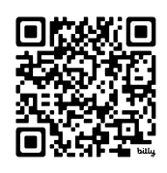
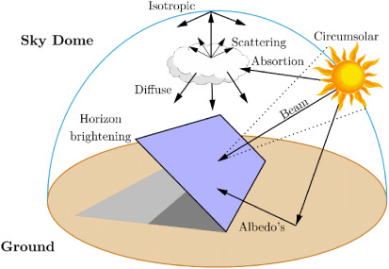
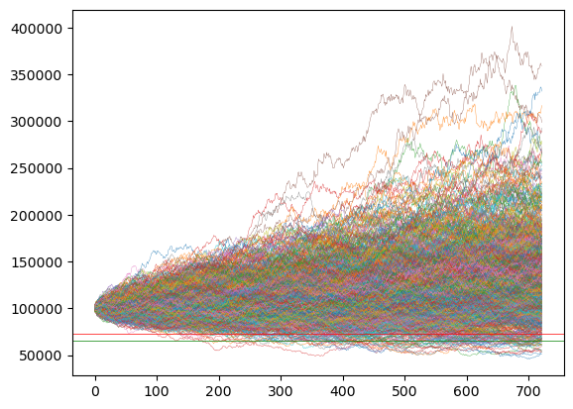
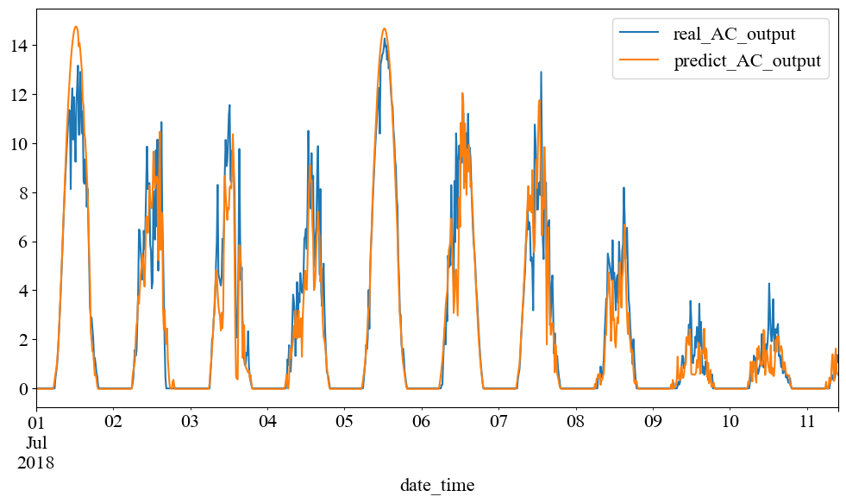
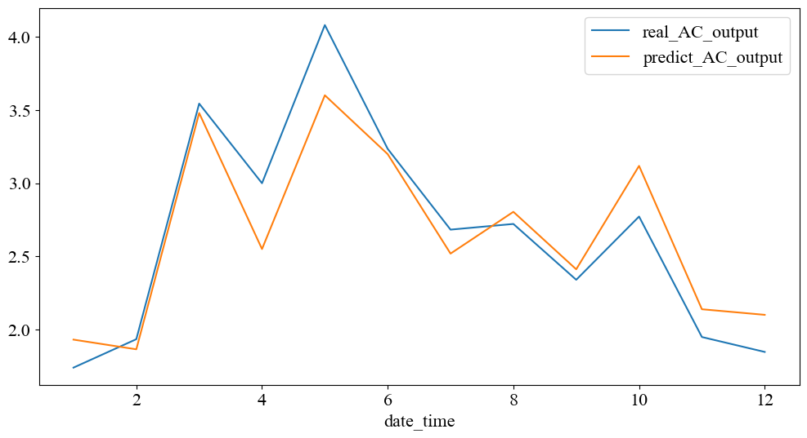
Solar Index Insurance – Reducing Basis Risk
naokic3.github.io/solar
Naoki Conning Stuyvesant High School
Abstract
Materials
Add your information, graphs and images to this section.
Add your information, graphs and images to this section.
Pricing risk via monte carlo simulation
Expected payout of the contract
Methodology
Add your information, graphs and images to this section.
Basis Risk
Why
Add your information, graphs and images to this section.
Why insurance?
Why index?
References
Carter, Michael et al. 2017. “Index Insurance for Developing Country Agriculture: A Reassessment.” Annual Review of Resource Economics 9 (Volume 9, 2017): 421–38.
F. Holmgren, et al. 2018. “Pvlib Python: A Python Package for Modeling Solar Energy Systems.” Journal of Open Source Software 3 (29): 884.
Villemin, Thomas, et al. 2024. “Monte Carlo Prediction of the Energy Performance of a Photovoltaic Panel Using Detailed Meteorological Input Data.” International Journal of Thermal Sciences 195 (January):108672.
Yao, Tiechui et al. 2021. “A Photovoltaic Power Output Dataset: Multi-Source Photovoltaic Power Output Dataset with Python Toolkit.” Solar Energy 230:122–30.

