Slide 1


Digital Signal Processing Course Project Image Category and Classification
Image Category and Classification

Slide 2
Image Category and Classification
Introduction
Digital image category and classification refers to the manipulation of image data which is motivated by conversion between Special and Frequency domains.
In this project we will try to see some application areas of DSP in image category and classification.
We used MATLAB® 2021 software for simulation.
Image Category and Classification

Slide 3
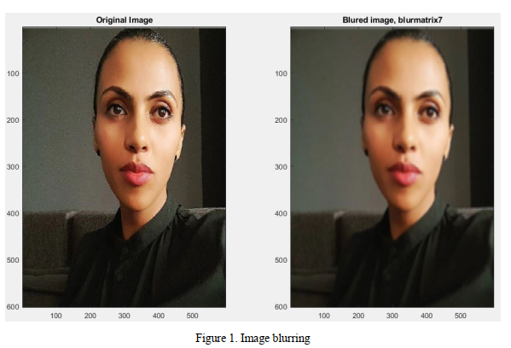
Image Category and Classification
Image Blurring
The Gaussian Filter Compressed higher frequencies of an image perfectly and we have got a blurred output image.
Figure 1. Image blurring
Image Category and Classification

Slide 4
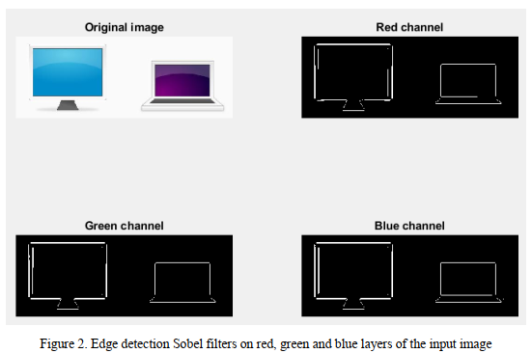
Image Category and Classification
Edge Detection
We have used Sobel filter and Kernel matrices for detecting edges in an image. It works by calculating the gradient of image intensity at each pixel within the image.
It finds the direction of the largest increase from light to dark and the rate of change in that direction. We can think of edge detection as a high pass filter operation.
Figure 2. Edge detection Sobel filters on red, green and blue layers of the input image
Image Category and Classification

Slide 5
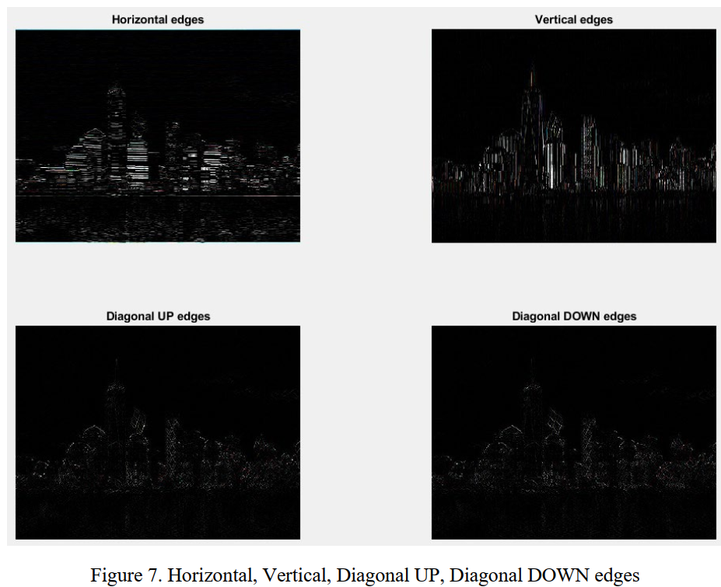
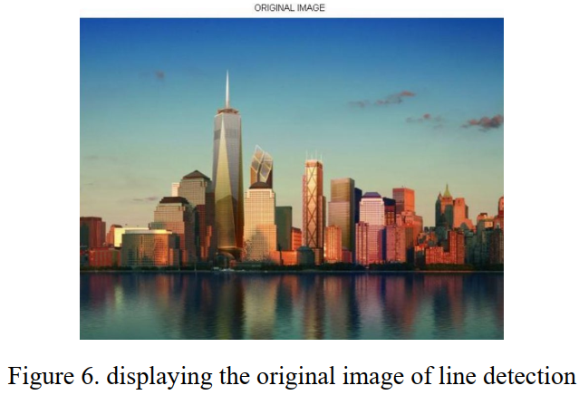

Image Category and Classification
Line Detection
Line detection is a special kind of edge detection. For line detection, the direction in which a color changes are considered is restricted. Common filter kernels used to detect horizontal, vertical and diagonal edges in the input image successfully.
Figure 3. The Original image Horizontal, Vertical, Diagonal UP, Diagonal DOWN edges
Image Category and Classification

Slide 6
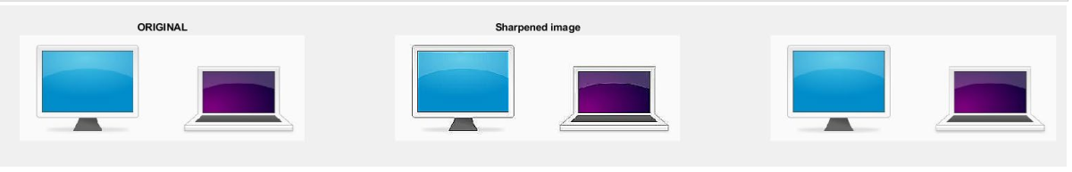
Image Category and Classification
Sharpening an Image
We have used a function using fspecial() for sharpening. Input image sharped using fspecial filter. Excessive sharpening however produces negative results.
Figure 4. Image sharpening
Image Category and Classification

Slide 7
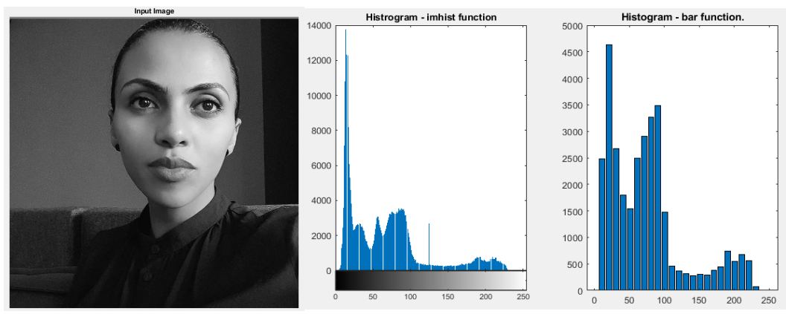
Image Category and Classification
Image Histogram
The imhist function creates a histogram plot by defining n equally spaced bins, each representing a range of data values, and then calculating the number of pixels within each range. We can use the information in a histogram to choose an appropriate enhancement operation.
Figure 5. Input image and Image Histogram graphs
Image Category and Classification

Slide 8
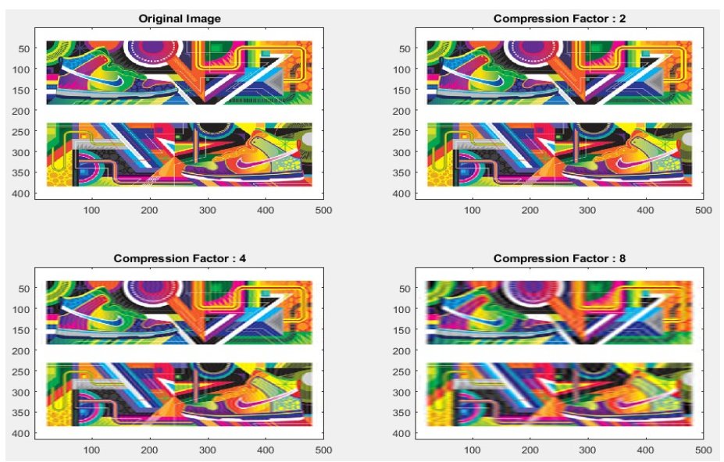
Image Category and Classification
Compressing an image
Our eyes only see low frequencies, so we can remove higher frequencies without affecting the image mush to the end user. Image compression: 50%, 25% and 12.5% done successfully on image.
Figure 6. Original image and images with increasing compression factor
Image Category and Classification

Slide 9
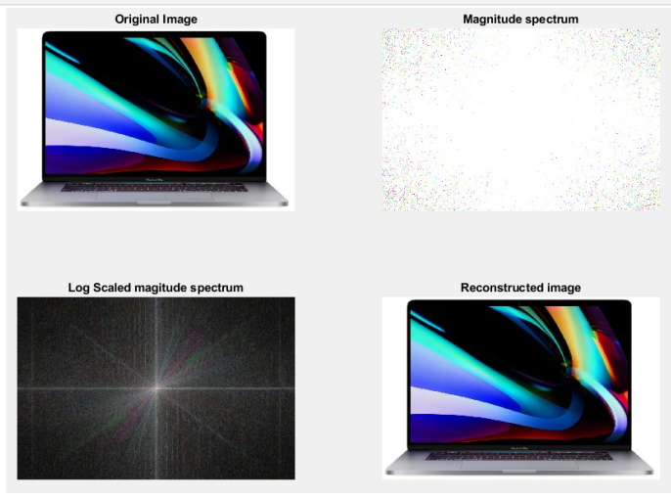
Image Category and Classification
Fast-Fourier Transform on Images
Fast-Fourier Transform of image produces the same results as Digital Fourier Transform, however it as faster in computations.
Figure 7. Original image magnitude spectrum and reconstructed image
Image Category and Classification

Slide 10
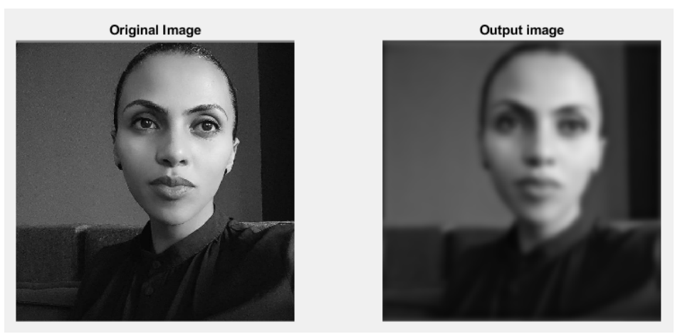
Image Category and Classification
Low-Pass Filter on Images
Low Pass Filter allows only low frequencies of the image, and bocks higher frequencies. As our eyes more sensitive to low frequencies, hence the output is not much different to the input.
Figure 8. The original image and an image out of the low-pass filter
Image Category and Classification

Slide 11
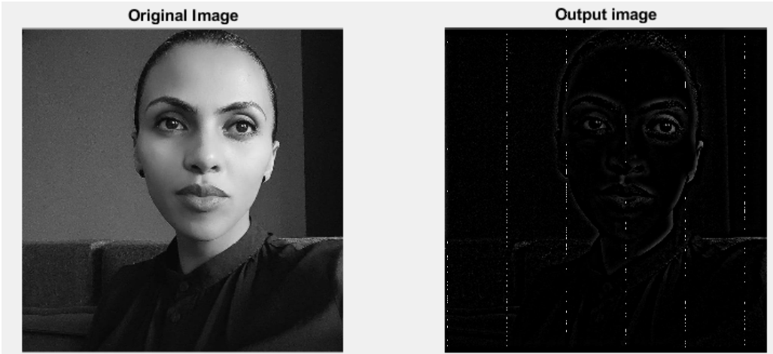
Image Category and Classification
High-Pass Filter on Images
A high pass filter tends to retain the high frequency information within an image while reducing the low frequency information.
The kernel of the high pass filter is designed to increase the brightness of the center pixel relative to neighboring pixels.
The High Pass Filter Blocks low frequencies on the image, hence the image loses its definitions.
Figure 9. The original image and an image out of high-pass filter
Image Category and Classification

Slide 12
Group Members
1) Olantu Ebisa....................ATR/8121/11 2) Akililu Wendie...........ATR/1547/11 3) Bereket Abate ...........ATR/0146/09 4) Zelalem Hailu............ATR/2456/10 5) Naol Abera ................ETR/6595/11 6) Muluken Tigabie…....ATR/6867/11
Submitted to Yiwab E. AAU,AAiT,SECE Sept 2021
Image Category and Classification

