Slide 2
MSc Project Presentation
Machine Learning Approaches for Reconstructing Phospho-Regulatory Networks in Mice
Naoman Tabassam
Supervisors: Caitlin Mellor, Dr Radu Zabet, Dr Peter Thorpe

Slide 3
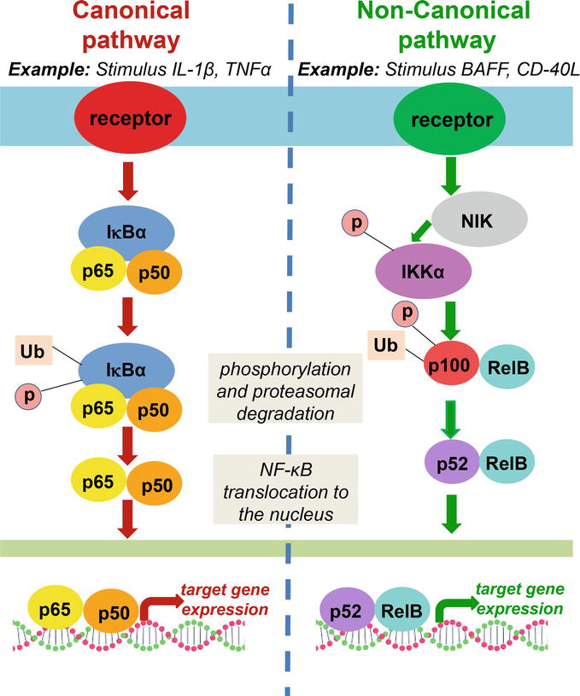
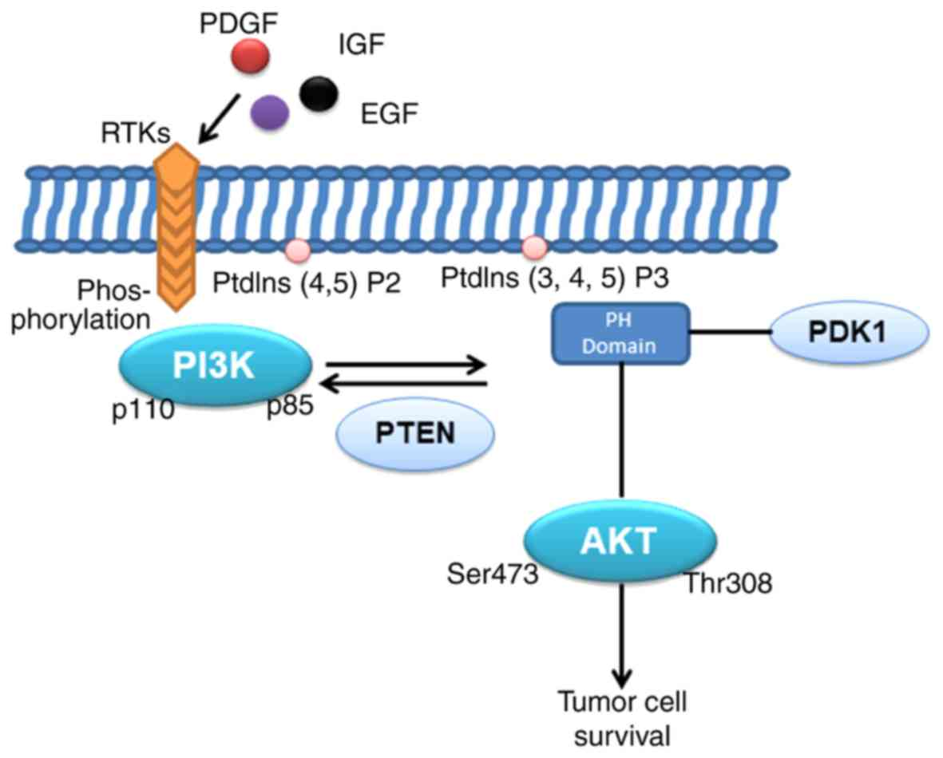
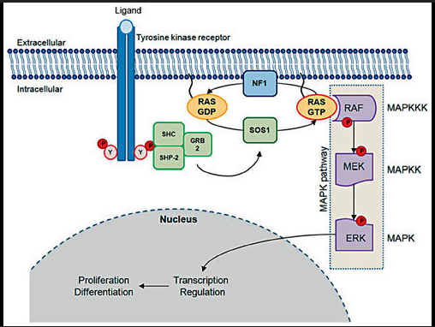
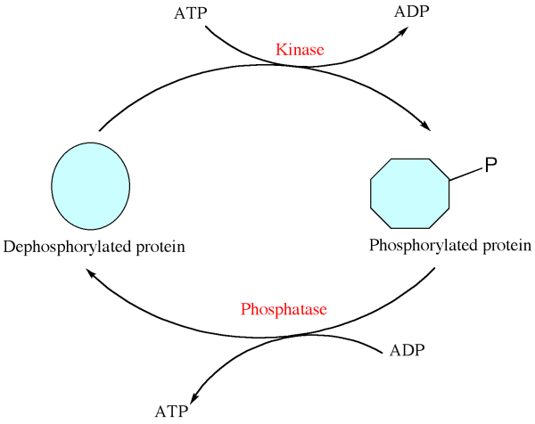
Phosphorylation
NF-κB
PI3K-AKT
Ras-MAPK
Anti-apoptosis, metabolism
Cell proliferation, differentiation
Immune response, inflammtion
Cancer
Neurodegenerative disorders
Cancer
Developmental disorders
Cancer
Autoimmune diseases
Notes:
Phosphorylation is a post-translational modification (PTM) where phosphate groups are added to proteins, often on serine, threonine, or tyrosine residues.
It is evolutionarily conserved and plays a central role in maintaining cellular homeostasis.
It's involved in key pathways like Ras-MAPK, PI3K-Akt, and NF-κB, which are crucial for things like cell proliferation, immune response, and survival.
However, when phosphorylation is disrupted, it can lead to diseases such as cancer, neurodegenerative conditions, and metabolic disorders.

Slide 4
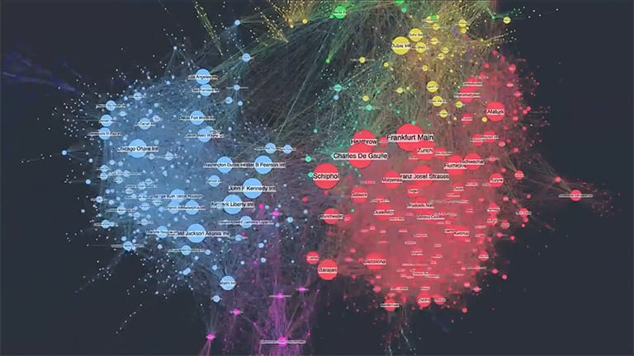
Network Inference
Aim: Reconstruct a phosphoregulatory network with ML
Mass-spectrometry Data captures a snapshot of intensity values at phosphosites, at a certain timepoint, of the specfic sample type, under a certain condition.
Complexity: We cannot capture the spatial (where in the cell) and temporal (how long the signal lasts) dynamics
So, we need machine learning algorithms to infer this complex data
Nodes
(molecules)
Edges
(interaction score)

Slide 5
Data preprocessing
Data Collection
Preprocessing steps
Searching on google scholar
List down the sources used, include their author and information on tissue sampled
Python Scripts for data wrangling
Merge all into one raw matrix
Notes:
Collected Data from mouse phosphoproteomics studies
Gathered the intensity/abundance values
Then passed it through python scripts to wrangle and clean
Merged all scripts into one

Slide 6
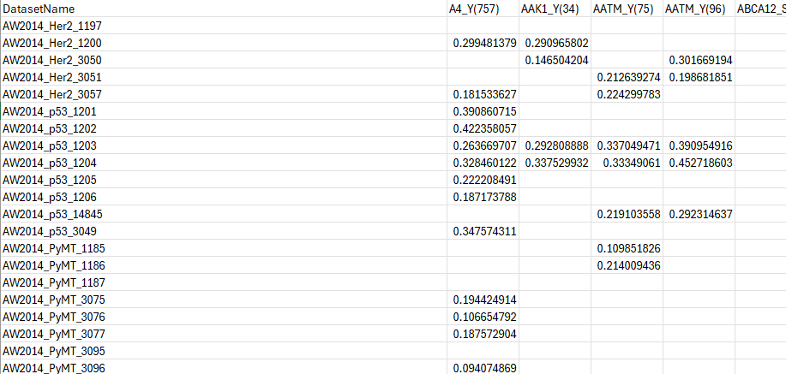
Matrix
Features
Gene_Residue(Position)
94,607 columns
Datasets
Dataset_Timepoint
1506 rows

Slide 7


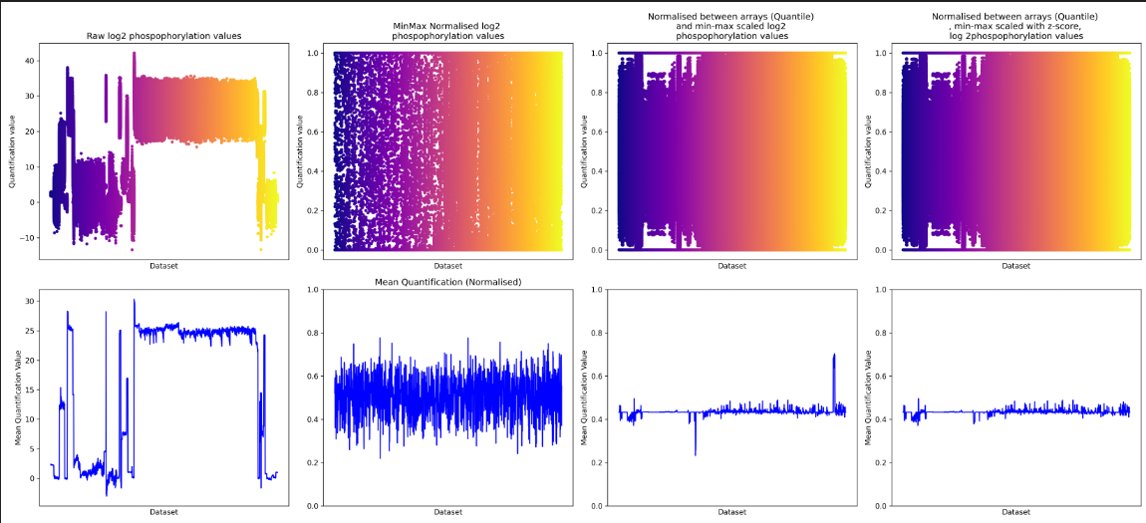
Normalisation
Raw log2 values
IQR + Min-Max
IQR + Min-Max
+ Quantile
IQR + Min-Max + Quantile + Z-score
Quantification
Values
Mean
Values
Notes:
Normalisation is the step where data is brought to the same scale so that all features contribute equally for optimal machine learning performance.
1. Interquartile Range (IQR) Normalization
Purpose: Reduces the effect of outliers and scales data based on the middle 50%.
2. NormalizeByArrays() / Quantile Normalization
Purpose: Forces the distribution of values across multiple arrays/samples to be the same.
When to use: Common in microarray or phosphoproteomics data, where you want to make sure each sample has the same overall distribution so they can be directly compared.
Effect: Adjusts each sample so that their quantiles (percentiles) match, removing technical variability across samples.
3. Min-Max Normalization
Purpose: Scales data to a fixed range, usually 0 to 1.
When to use: When you want all features or variables to be on the same scale, often required before applying machine learning algorithms sensitive to data magnitude.
4. Z-Score Normalization (Standardization)
Purpose: Centers data around zero with a standard deviation of one.
Effect: Transforms data by subtracting the mean and dividing by the standard deviation, making it easier to spot outliers or perform analyses assuming normality.

Slide 8
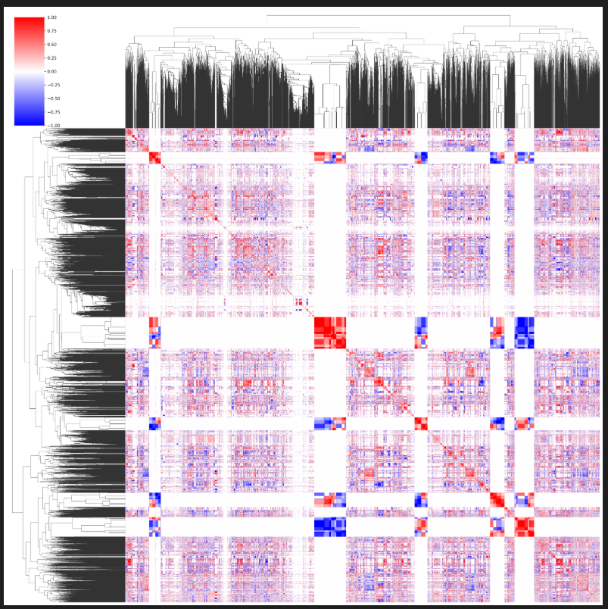
Protein correlation matrix
​Applied on protein level matrix ​
(all phosphosites on same protein merged together, averaged values)
Spearman correlation
Hierarchal clustering with dendogram
AAFK_S(120) AAFK_S(203) AAFK_S(50)
AAFK
Notes:
Protein correlation matrix shows how protein levels vary together across samples
Uses Spearman correlation, which measures rank-based relationships
Correlation values range from -1 to +1; +1 means perfect positive correlation
Positive correlation suggests proteins may be functionally linked or co-regulated and negative is opposing processes
Helps identify biological pathways, interactions, and potential biomarkers
Supports building protein interaction and signalling networks

Slide 9
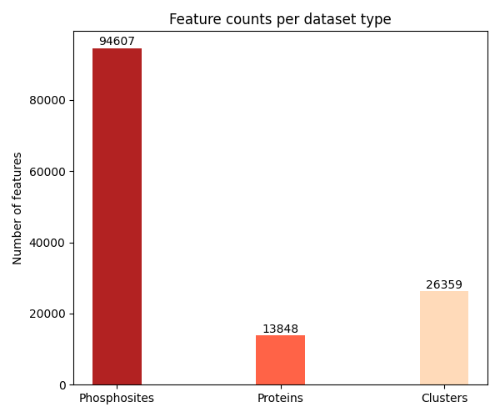

Features
Roughly 20,000 proteins in mice
Each protein has multiple phosphosites
Dimensionality reduction: Group similar phosphosites
Notes:
Captured 13k of 20k proteins
Each protein has multiple phosphosites
Dimensionality reduction.
Where theres 2 or more phosphosites, apply k-means clustering to phosphosites
To figure out the optimal number of clusters per protein:
Run k-means across 100 random seeds
Use silohouette score from skit learn to assess clustering quality
Take the most frequently occuring value
And if theres more than 1, get the averaged value

Slide 10
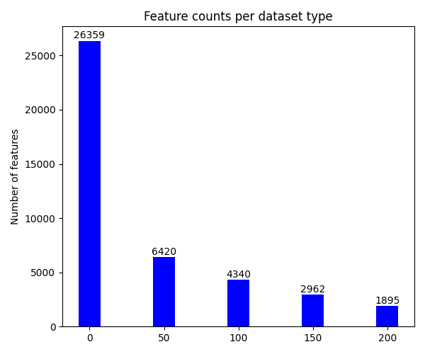
Dimensionality Reduction
Split the clustered matrix
50, 100, 150 and 200 thresholds
Larger to Smaller no. Of clusters due to cut off points
Why?
Reduce features for better ratio
Prevent overfitting
Notes:
Why?
The ratio of features to datasets is too different. For me its 26,000 to 1500.
Makes sure the model doesn’t learn from missing data but instead from strong signals

Slide 11
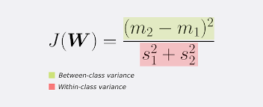
Feature Selection
Feature | Fisher Score | Target Feature
CDH8_S(795) | 13024.97154 | SPG20_S(126)
... | ... | ...
... | ... | ...
... | ... | ..
1:10
Pick the top 10%
of best features
Reduces no. Of features
Fischer scores: Used for
discriminative phosphosites
Notes:
Fisher’s criterion
Maximises distance between means and minimise within class variance
Pair a protein with all other proteins and gives it a score
Fisher scores are then ranked according to how well they differentiate between classes and how predictive that protein is
Higher fischer score is better
So to prevent overfitting
Pick up 10% of the features relative to the number of datasets, to get the strongest, most predictive features
End goal is to reduce the number of features so the ML model works better

Slide 12
Linear Regression
Each cluster
Global median Coefficient Value
+
R²
Linear Regression
20 : 80
Train : Test Split
Notes:
Using pythons skitlearn library, linear regression was applied
To each cluster, and the sub matrices were split over 5 non-overlapping train test splits
20% was training data : 80% test data
The regression coefficent and R2 was calculated for each predictive and target feature pair

Slide 13
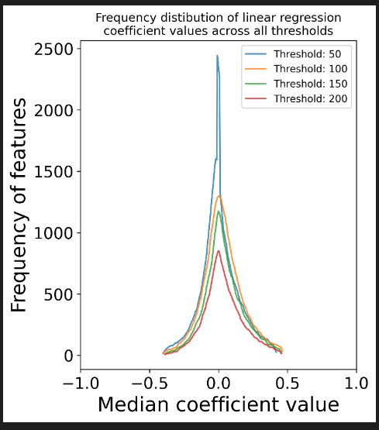
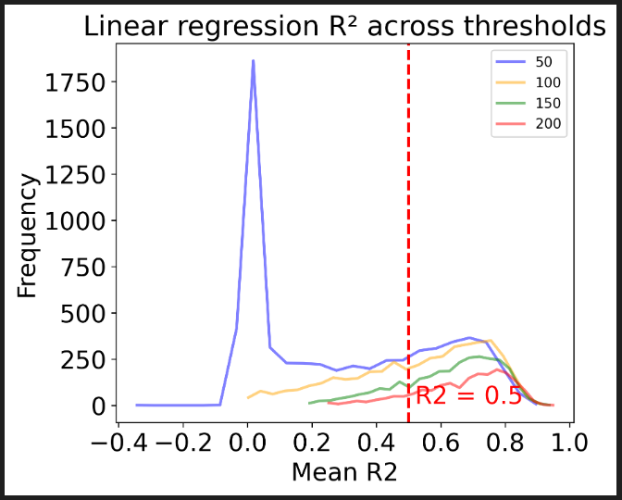
Linear Regression
Notes:
The first graph:
Assesses the stability and reliability of the ML model
This shows how often each feature I used across the different train-test splits of the mode;
The purpose of R² (R-squared) in linear regression is to measure how well the regression model explains
the variability of the outcome (dependent) variable
based on the predictor (independent) variables.
R² = 0 means the model explains none of the variability (no predictive power).
R² = 1 means the model explains all of the variability perfectly.

Slide 14
What is Next ?
Make the linear regression network
Machine learning: XGBoost
Model evaluation metrics
Compare reconstructed networks to reference network from online database.
Evaluate these.
Future implication: create new networks based on best performing model.

Slide 15
Thank You
Questions are welcome

Slide 16
Each cluster
Global median Coefficient Value
+
R²
Linear Regression

