Slide 1

Deep learning project
Pharmacist medical chatbot

Slide 2
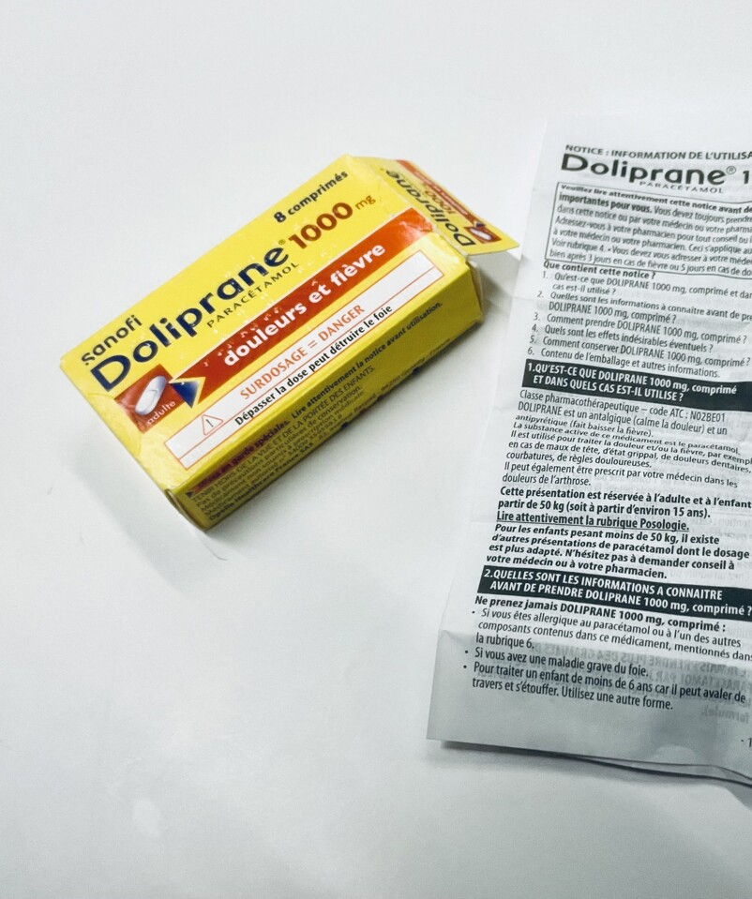
Aim of the project
Create a chatbot that can answers your questions about prescriptions instead of having to read the long notices and instructions.
A database with the most commonly used and prescribed medecine in France: Doliprane, Aspirin, Ventoline, Spasfon, etc...
Data from the French Ministry of Health’s « Base de données publique des médicaments »

Slide 3
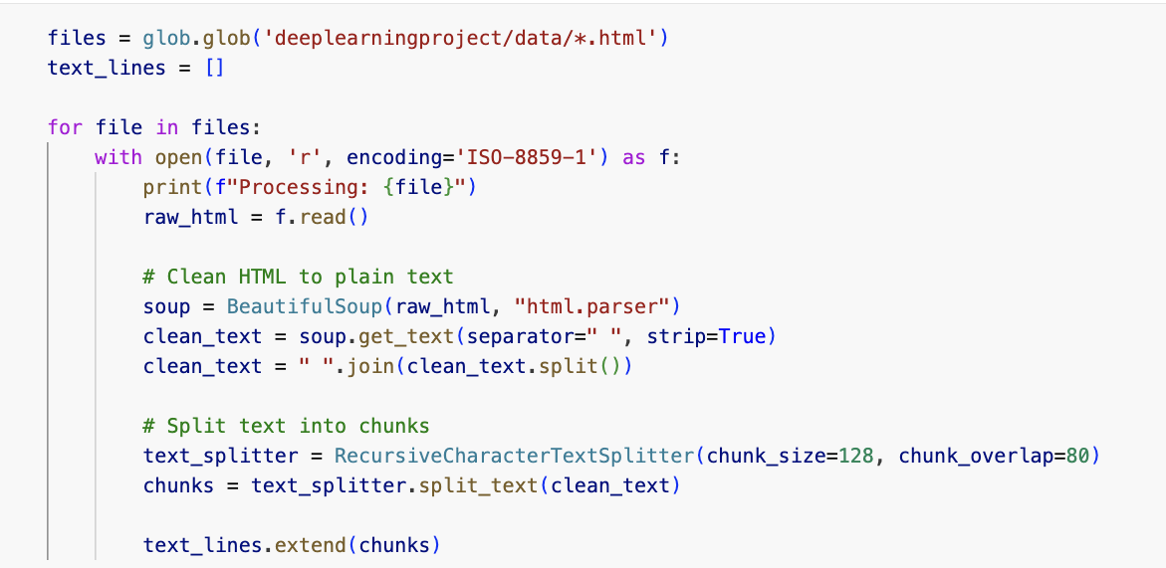
Development: Data cleaning

Slide 4
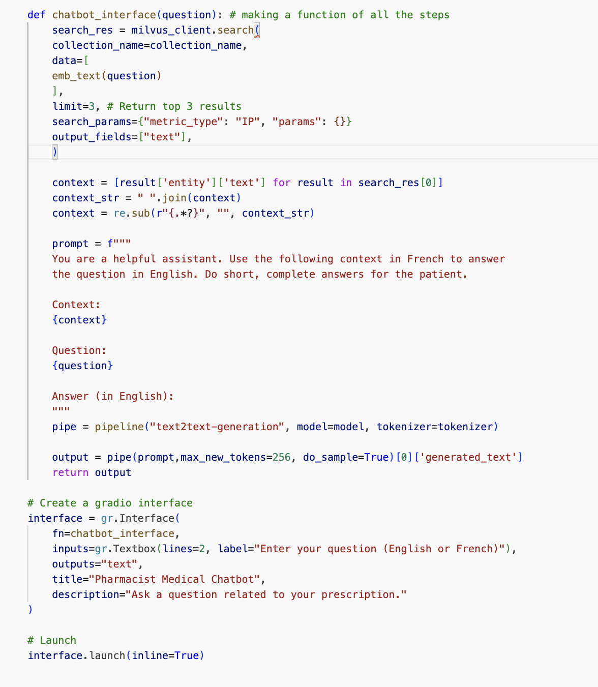
Development: Running the model

Slide 5
Process
Testing many different embedding models and LLMs (Question Answering and Text Generation)
Testing with variety of input data: in the number of chunks, the number of top results kept for context, etc...
Implementing the whole process with manual inputs
Finalizing by writing a function to use in interface launching.

Slide 6
Perfomance of the model
Model: "google/flan-t5-xl” text generation model
+
Performance is not perfect, best at answering the most basic questions on how to take the medicine.
-
Quite a short response time
Makes clear answers most of the time

Slide 7
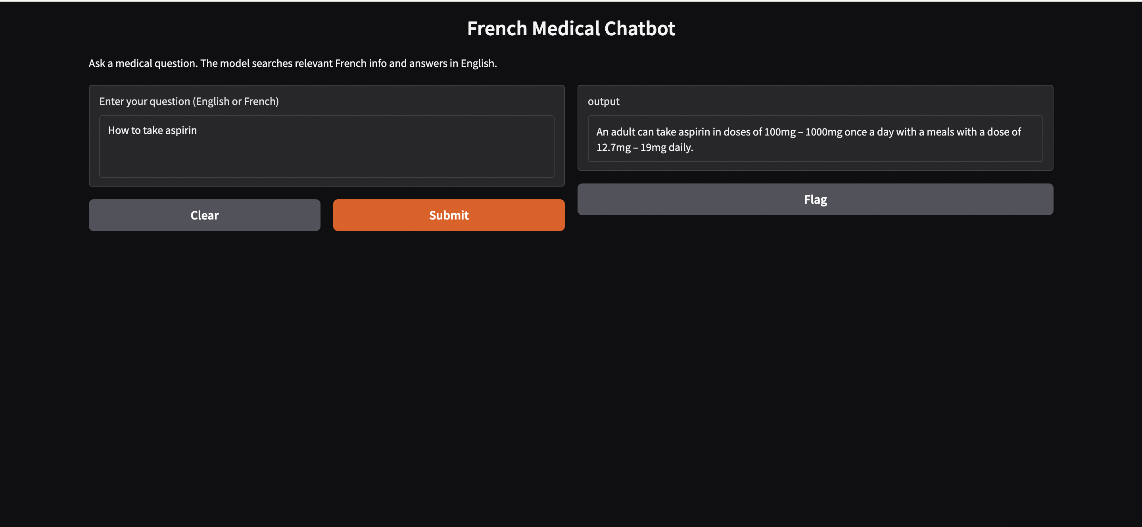

Slide 8
Challenges
Having sufficient RAM and storage: Compromise between model performance and memory
Data being html files, with all the formatting and code in between the relevant content, and the amount
Finding a model that would perform well in French

