Slide 1

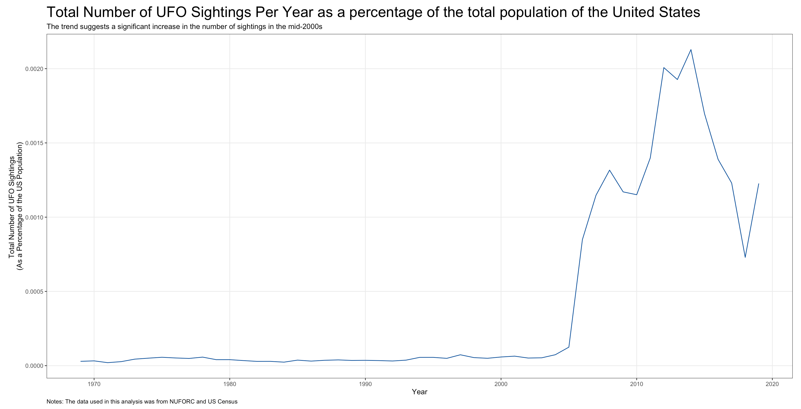
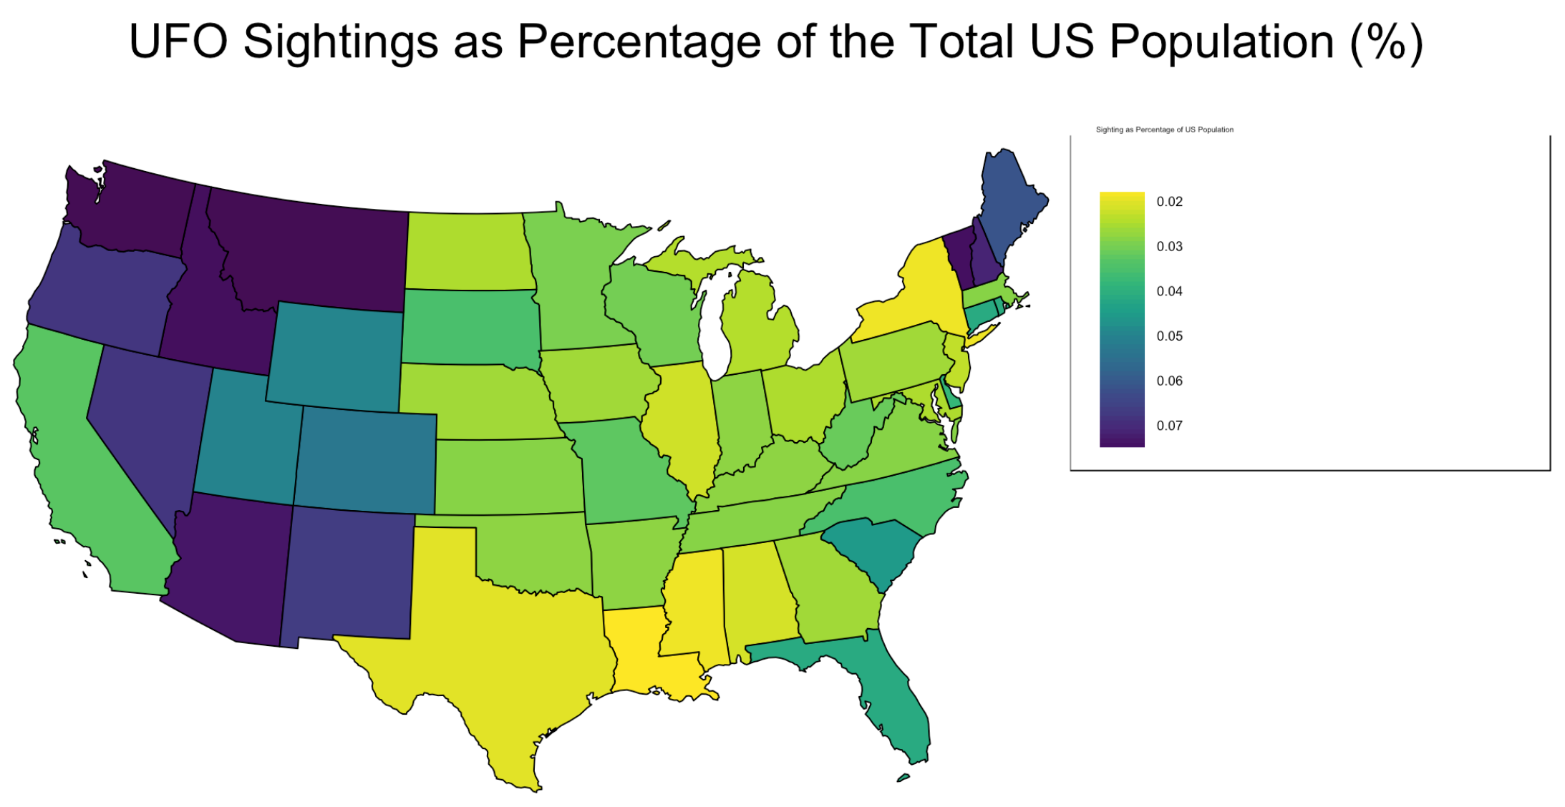
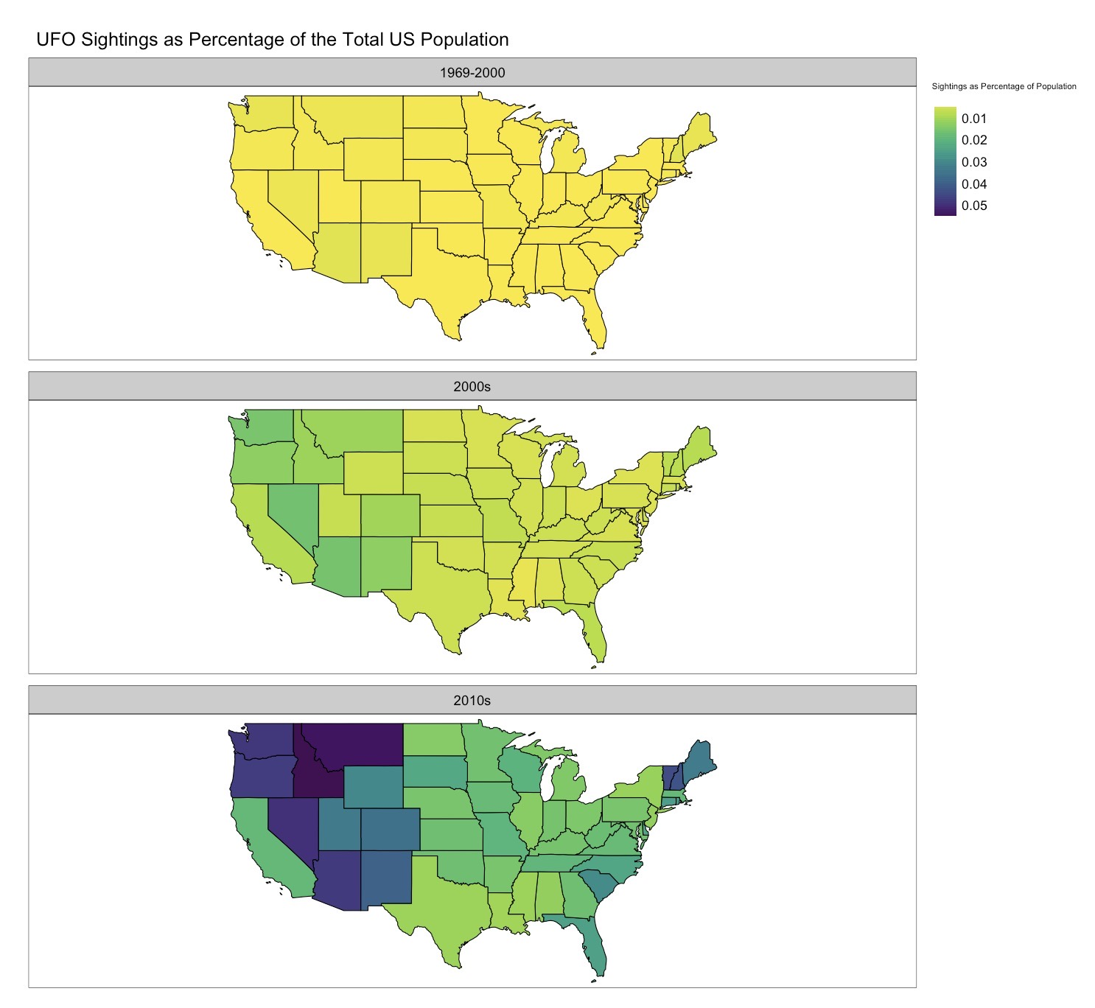
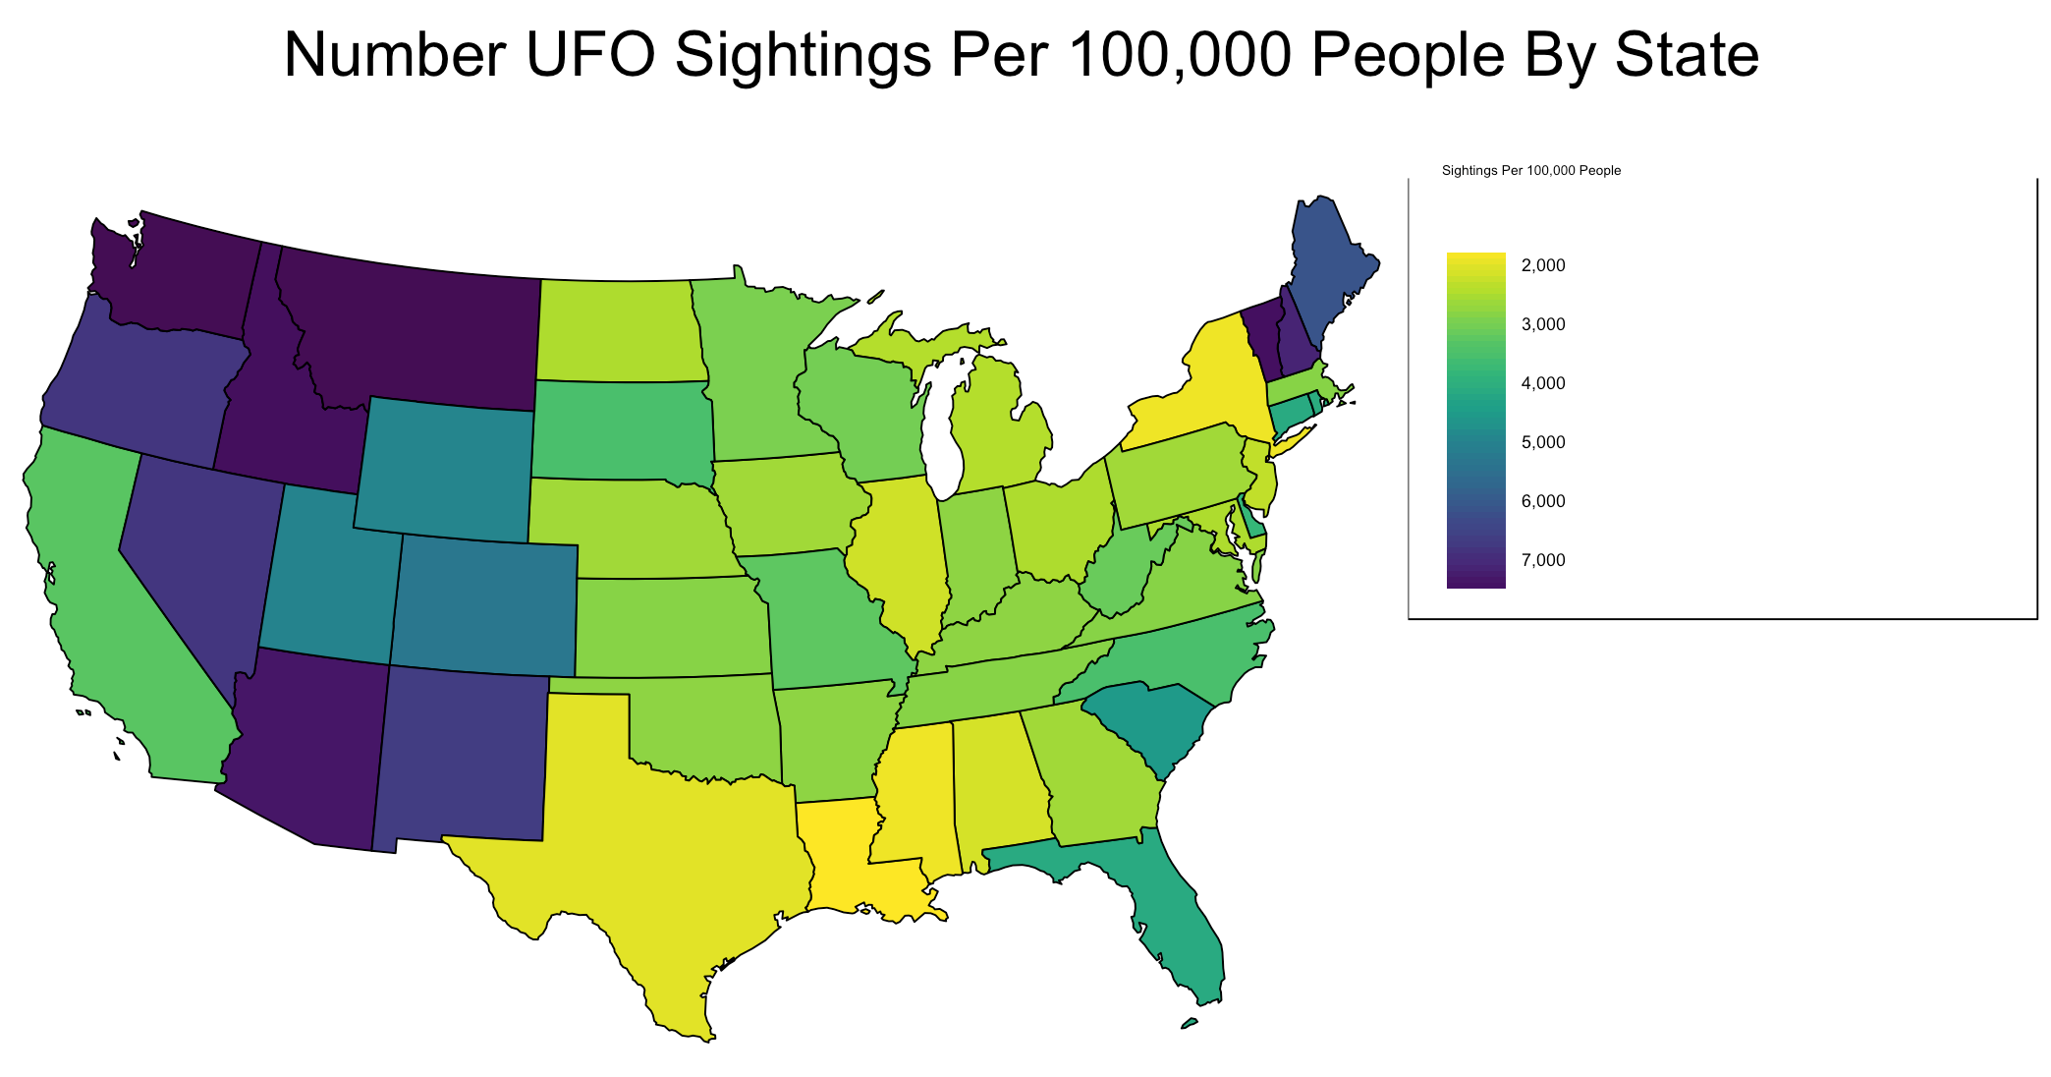
UFO Exploratory Research
UFO sightings as a percentage of the total population of the mainland United States has increased over time with certain regions having higher sighting rates.
Visualizations for the Hypotheses
Noah Jones
Evan Pickell
Hannah Kim
Naomi Golin
Zhiyu Yao
Dian Chen
UCLA Statistics
Introduction to the Data
The data analyzed was a CSV file obtained from the National UFO Reporting Center. It contains 88125 observations and 12 columns.
Hypotheses and Statistical Test
Null Hypotheses:
1. Time: UFO sightings as a percentage of the total population of the United States has not changed over time
2. Place: UFO sightings as a percentage of the total population of United States is the same all over the United States/among all the states.
3. Interaction: UFO sightings as a percentage of the total population of the United States is not impacted by the interaction between time and place.
Alternative:
1. Time: UFO sightings as a percentage of the total population of the United States has changed over time.
2. Place: UFO sightings as a percentage of the total population of United States differs among the 50 states.
3. Interaction: UFO sightings as a percentage of the total population of the United States is different when considering the interaction between time and place.
Statistical Test:
Linear Regression, ANOVA, and Chi-Square Goodness of Fit Test.
Results
Since the p-values for each hypothesis are all less than 0.05, we have enough evidence to reject the null hypotheses. Our evidence suggests that UFO sightings as a percentage of the total population of the United States mainland has increased over time. Its also suggests that certain geographic regions are more likely to sight UFOs. These trends are also impacted by the interaction between the year and geographic region of the sighting.
Other Background Info
Mail and telephone for report were the only methods used until 1994.
Internet report were added after 1994.
The graphs report the UFO sightings in each state over the time interval of 1969-2000, 2000s, and 2010s.

