Slide 1


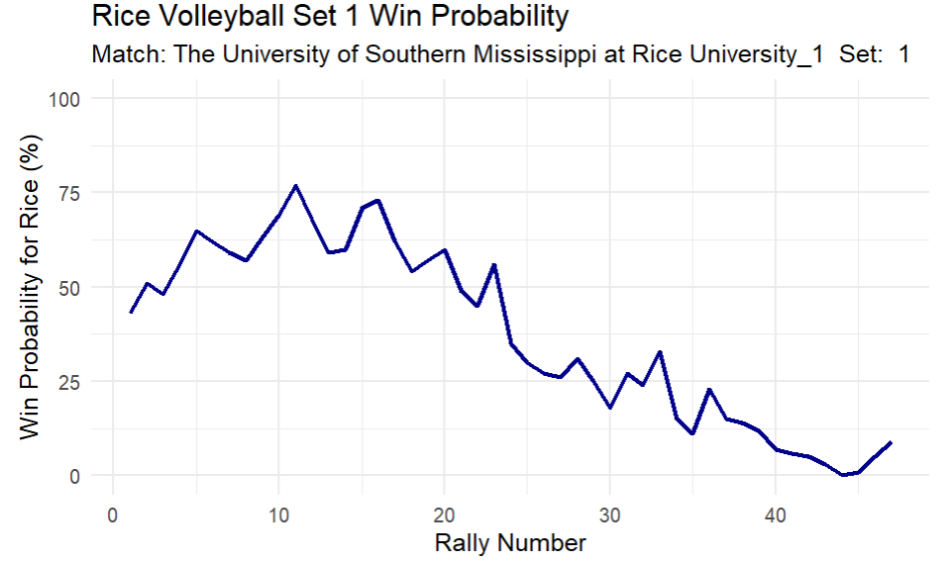
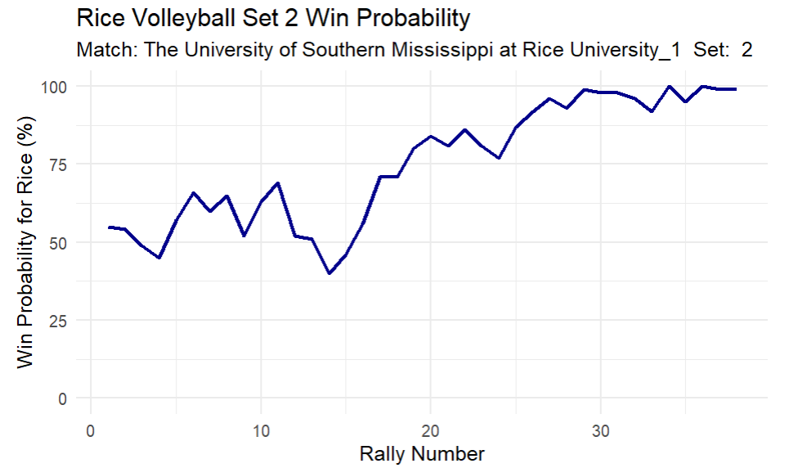
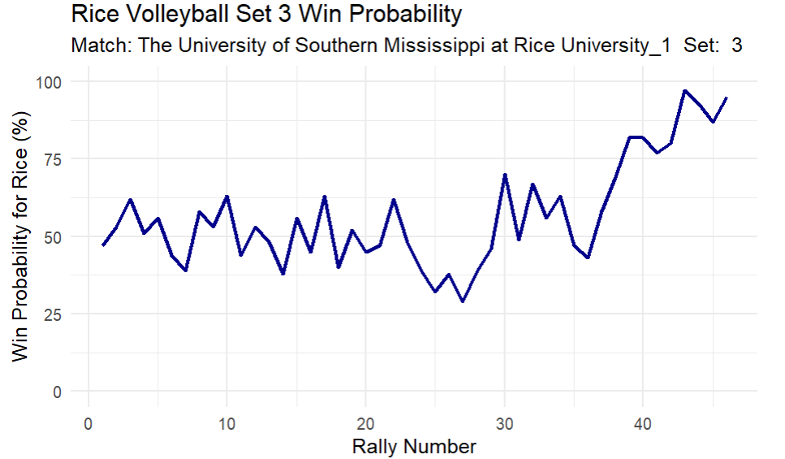
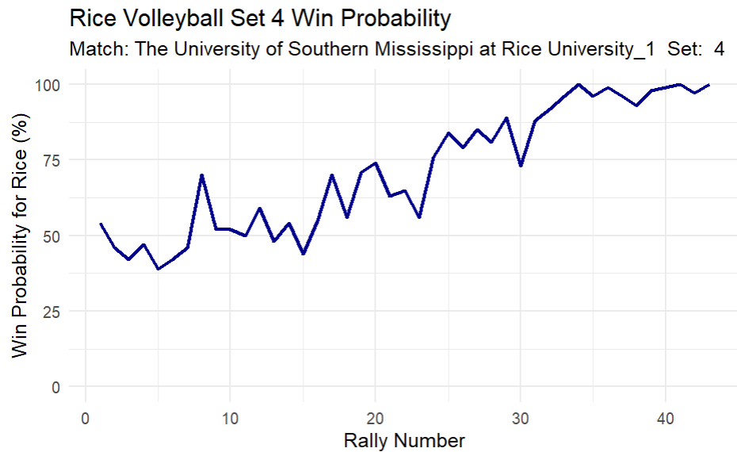
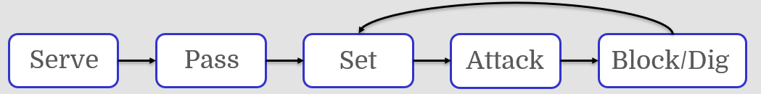
Modeling Volleyball Win Probability:
A Markov Chain Approach Using Contact-Level Data
Naomi Consiglio
Mentor: Rose Graves, PhD Student, Department of Statistics
Abstract
Methodology & Analysis
Results Continued
Volleyball is a fast-paced sport marked by frequent transitions between offense and defense, requiring teams to adapt quickly. This study develops a win probability model for individual sets using contact-level data from 2023 Rice University NCAA Division I matches. The model treats the game as a Markov process and uses Monte Carlo simulation to estimate real-time win probabilities. It processes over 36,000 contact records, classifying each by action type, quality, and team possession. A transition matrix based on historical data estimates the likelihood of moving between states and predicts the chance of winning the set at any moment. This approach offers insights into team strategy, momentum shifts, and the impact of individual plays, with applications for coaches, analysts, and fans.
The State-Based Markov Model is used to model volleyball rallies as sequences of states, where transitions between states depend probabilistically on the current state, following the Markov Property.
Defining the State
Each contact in a rally is classified into a state based on several factors: the Game Complex (Phase), which includes K0 (Serve), K1 (Serve Receive/Attack), K2 (Defense), and K5 (Freeball); the Contact Efficacy (Quality), ranging from 0 (Error) to 4 (Perfect); and Possession, which is classified as touchby1 for the Serving Team or touchby0 for the Receiving Team. Additionally, the Rally Outcome is considered for terminal states, where it is either pt1 (Serving Team Won Point) or pt0 (Receiving Team Won Point).
There are a total of 48 unique states in the dataset.
Example of a full rally:
Building the Model
Transition Matrix: Calculate the probabilities of moving from one state to the next using historical frequencies from the dataset. Transition counts were weighted by the score differential at the start of the rally and the rally number in the set.
Markov Chain Object: Formalize the states and weighted transitions
Monte Carlo Simulation:
From the current state, score, and serving team:
Simulate thousands of complete sets point-by-point using the Markov chain transitions.
Each simulation runs until a team wins the set
Win Probability = (Sets won by Rice) / (Total Simulations)
Transition Matrix
Below is a subset of the transition matrix created from historical data. Each value is the probability of going from the state in that row to the state in the column. The states featured in the rows are the same states seen in the example rally above.
The first match of Rice Volleyball’s 2023 season progression:
State | Interpretation
K0_3_touchby1 | A serve (K0) rated well (3) and contacted by serving team (touchby1)
K1_1_touchby0 | A reception (K1) rated poorly (1) by the receiving team (touchby0)
K1_4_touchby0 | A set (K1), rated perfectly (4), by the receiving team (touchby0)
K1_4_touchby0 | An attack (K1), rated perfectly (4), by the receiving team (touchby0)
K2_0_touchby1_pt0 | A defensive contact (K2), rated as an error (0) by the serving team (touchby1), ending the rally (pt0).
Introduction
Win Probability (WP) models offer real-time insights for evaluating performance and predicting outcomes.
Goal: Develop a set-level WP model using contact-level data.
Approach: Combine a Markov process (capturing rally sequences) with Monte Carlo simulation.
Why it matters: Provides data driven insights for coaches, analysts, and fans on game dynamics and momentum.
Key Volleyball Actions:
Data:
Source: Volleymetrics contact-level data
Dataset: 2023 Rice University matches (>36,000 contacts)
Key Variables:
Contact type (Serve, Attack, etc.)
Contact quality/efficacy (0-4 scale)
Team possession (Serving vs. Receiving)
Score differential
Point outcome
Prior Work:
Existing research falls into three categories: (1) Racket sport Markov models (Pfeiffer et al., 2010; Newton & Aslam, 2009) established state transition frameworks but lacked volleyball's multi-contact sequences; (2) Volleyball analytics are divided into team-level Bayesian models (Gabrio, 2021) and contact-level datasets (Bagley & Ware, 2017), with game complex frameworks (Hileno et al., 2020) providing partial Markov structures; (3) Win probability models in other sports (Brill et al., 2024) showed limitations of treating sequential actions as independent. The model combines these approaches while addressing volleyball-specific dependencies through contact-level states.
Biggest increase in WP during 4th set was during point 7, with a 26% increase in WP.
How Rice Built Momentum:
Rally 5 (FBSO): Clear first-ball side out → Stopped opponent’s run. WP up to 41%.
Rally 6 (Serve Pressure): Tough serve forced out-of-system pass → Opponent attack error. WP up to 46%.
Rally 7 (Ace): Unreturned serve → Immediate point. WP up to 70%.
Conclusion & Future Work
The model assumes that the Markov property holds, meaning that the probability of transitioning to the next state depends only on the current state and not on the sequence of preceding states.
This project integrates a state-based Markov model with simulation-based forecasting to estimate real-time win probabilities in volleyball. The combination of detailed contact-level data and probabilistic modeling offers a nuanced understanding of match dynamics and opens the door to richer, more strategic performance analysis. The results demonstrate the potential of this approach to enhance decision-making and provide deeper insights into the game of volleyball.
Future models will include adding additional covariates on top of the score differential and rally number. Other potential covariates can include the rotation each team is in (if some are known to be weaker than others) and run indicators to include momentum context.
 | K0_1_touchby1 | K0_3_touchby1 | K1_4_touchby0 | K1_1_touchby0 | K2_0_touchby1_pt0 | K2_3_touchby1
K0_3_touchby1 | 0 | 0 | 0 | 0.998 | 0 | 0
K1_1_touchby0 | 0 | 0 | 0.267 | 0.036 | 0.0005 | 0.404
K1_4_touchby0 | 0 | 0 | 0.230 | 0.321 | 0.137 | 0
K2_0_touchby1_pt0 | 0.434 | 0.297 | 0 | 0 | 0 | 0
Results
The model generates real-time win probabilities at the set level, providing coaches with actionable insights during competition. Sets can be considered independent of other sets in the match, so we applied the model to the set level for more realistic application to coaches and analysts in real time. As an example, we applied this model to actual volleyball sets from a match in the dataset: Rice University vs. The University of Southern Mississippi.
WP is calculated using the Markov chain model and Monte Carlo simulation based on the state entering each rally.
References
Bagley, C. and Ware, B. (2017), “Bump, Set, Spike: Using Analytics to Rate Volleyball Teams and Players,” MIT Sloan Sports Analytics Conference.
Brill, R. S., Yurko, R., and Wyner, A. J. (2024), “Exploring the Difficulty of Estimating Win Probability: a Simulation Study.”
Gabrio, A. (2021), “Bayesian Hierarchical Models for the Prediction of Volleyball Results,” Journal of Applied Statistics, 48, 301–321.
Gonzalez, D. L., Gonzalez-Cabrera, I., and Herrera, D. D. (2024), “Rally-Based Performance Evaluation Model for Highly Competitive Volleyball,” Hileno, R., Arasanz, M., and Garcıa-de Alcaraz, A. (2020), “The Sequencing of Game Complexes in Women’s Volleyball,” Frontiers in Psychology, 11, 739.
Looney, K. (2024), “Developing a Win Probability Model for Tennis,” Ph.D. thesis, The Graduate School at the College of Charleston.
Newton, P. K. and Aslam, K. (2009), “Monte Carlo Tennis: a Stochastic Markov Chain Model,” Journal of Quantitative Analysis in Sports, 5.
Pfeiffer, M., Zhang, H., and Hohmann, A. (2010), “A Markov Chain Model of Elite Table Tennis Competition,” International Journal of Sports Science & Coaching, 5, 205–222.

