Slide 1
Code Review Improvements
Bin Meng
VxWorks Engineering

Slide 2
Agenda
Best practices
Improvement plan

Slide 3


10 Best Practices for Code Review
From SMARTBEAR
8
© 2018 WIND RIVER. ALL RIGHTS RESERVED.

Slide 4
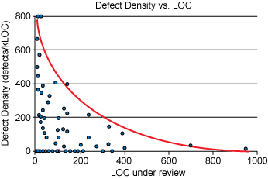
1. Review fewer than 400 lines of code at a time
A SmartBear study of a Cisco Systems programming team revealed that developers should review no more than 200 to 400 lines of code (LOC) at a time. The brain can only effectively process so much information at a time; beyond 400 LOC, the ability to find defects diminishes.
In practice, a review of 200-400 LOC over 60 to 90 minutes should yield 70-90% defect discovery. So, if 10 defects existed in the code, a properly conducted review would find between seven and nine of them.

Slide 5
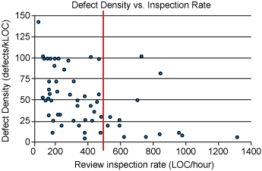
2. Inspection rates should under 500 LOC per hour
It can be tempting to tear through a review, assuming that someone else will catch the errors that you don´t find. However, SmartBear research shows a significant drop in defect density at rates faster than 500 LOC per hour. Code reviews in reasonable quantity, at a slower pace for a limited amount of time results in the most effective code review.

Slide 6
3. Do not review for more than 60 minutes at a time
Just as you shouldn´t review code too quickly, you also should not review for too long in one sitting. When people engage in any activity requiring concentrated effort over a period of time, performance starts dropping off after about 60 minutes. Studies show that taking breaks from a task over a period of time can greatly improve quality of work. Conducting more frequent reviews should reduce the need to ever have to conduct a review of this length.

Slide 7
4. Set goals and capture metrics
Before implementing a process, your team should decide how you will measure the effectiveness of peer review and name a few tangible goals.
Using SMART criteria, start with external metrics. For example, "reduce support calls by 15%," or "cut the percentage of defects injected by development in half." This information should give you a quantifiable picture of how your code is improving. "Fix more bugs" is not an effective goal.
It´s also useful to watch internal process metrics, including:
Inspection rate: the speed with which a review is performed
Defect rate: the number of bugs found per hour of review
Defect density: the average number of bugs found per line of code

Slide 8
5. Authors should annotate source code before the review
Authors should annotate code before the review occurs because annotations guide the reviewer through the changes, showing which files to look at first and defending the reason behind each code modification. Annotations should be directed at other reviewers to ease the process and provide more depth in context. As an added benefit, the author will often find additional errors before the peer review even begins. More bugs found prior to peer review will yield in lower defect density because fewer bugs exist overall.

Slide 9
6. Use checklists
It´s very likely that each person on your team makes the same 10 mistakes over and over. Omissions in particular are the hardest defects to find because it´s difficult to review something that isn´t there. Checklists are the most effective way to eliminate frequently made errors and to combat the challenges of omission finding. Code review checklists also provide team members with clear expectations for each type of review and can be helpful to track for reporting and process improvement purposes.

Slide 10
7. Establish a process for fixing defects found
Even after optimizing code review processes by time-boxing reviews, limiting LOC reviewed per hour and naming key metrics for your team, there´s still a key review step missing. How will the bugs be fixed? It seems obvious, but many teams do not have a systematic method for fixing the bugs they´ve worked so hard to find.
The best way to ensure that defects are fixed is to use a collaborative code review tool that allows reviewers to log bugs, discuss them with the author, and approve changes in the code. Without an automated tool, bugs found in review likely aren´t logged in the team´s usual defect tracking system because they are found before code is released to QA.

Slide 11
8. Foster a positive code review culture
Peer review can put strain on interpersonal team relationships. It´s difficult to have every piece of work critiqued by peers and to have management evaluating and measuring defect density in your code. Therefore, in order for peer code review to be successful, it´s extremely important that mangers create a culture of collaboration and learning in peer review.
While it´s easy to see defects as purely negative, each bug is actually an opportunity for the team to improve code quality. Peer review also allows junior team members to learn from senior leaders and for even the most experienced programmers to break bad habits.
Defects found in peer review are not an acceptable rubric by which to evaluate team members. Reports pulled from peer code reviews should never be used in performance reports. If personal metrics become a basis for compensation or promotion, developers will become hostile toward the process and naturally focus on improving personal metrics rather than writing better overall code.

Slide 12
9. Embrace the subconscious implications of peer review
The knowledge that others will be examining their work naturally drives people to produce a better product. This "Ego Effect" naturally incentivizes developers to write cleaner code because their peers will certainly see it. The SmartBear study of Cisco Systems found that "spot checking" 20% to 33% of the code resulted in lower defect density with minimal time expenditure. If your code has a 1-in-3 chance of being called out for review, that´s enough of an incentive to double-check your work.

Slide 13
10. Practice lightweight code reviews
Between email, over-the-shoulder, Microsoft Word, tool-assisted and hybrids of all types there are countless ways to collaboratively review code. However, to fully optimize your team´s time and to effectively measure its results, a lightweight, tool-assisted process is recommended.
The SmartBear study of Cisco Systems found that lightweight code review takes less than 20% the time of formal reviews and finds just as many bugs! Formal, or heavyweight, inspection averages nine hours per 200 LOC. While often effective, this rigid process requires up to six participants and hours of meetings paging through detailed code printouts.

Slide 14
Improvement Plan
8
© 2018 WIND RIVER. ALL RIGHTS RESERVED.

Slide 15
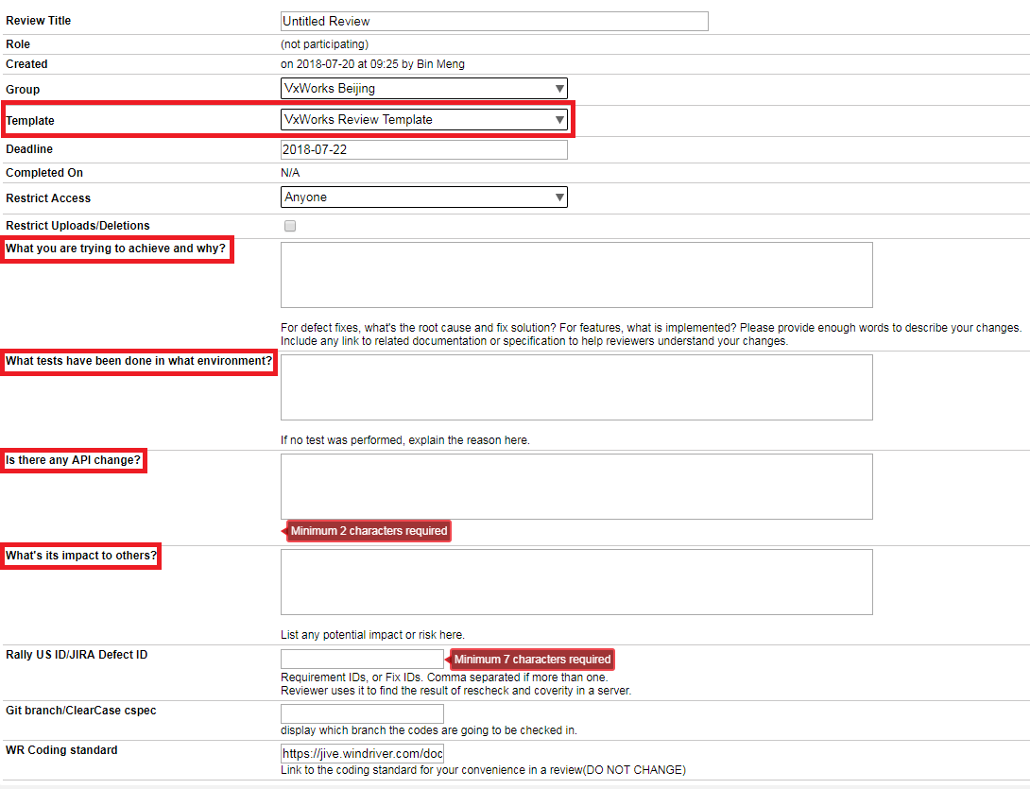
Improvement #1
Provide the context
Use “VxWorks Review Template” properly to communicate with reviewers
(Corresponding to best practice “5. Authors should annotate source code before the review”)

Slide 16
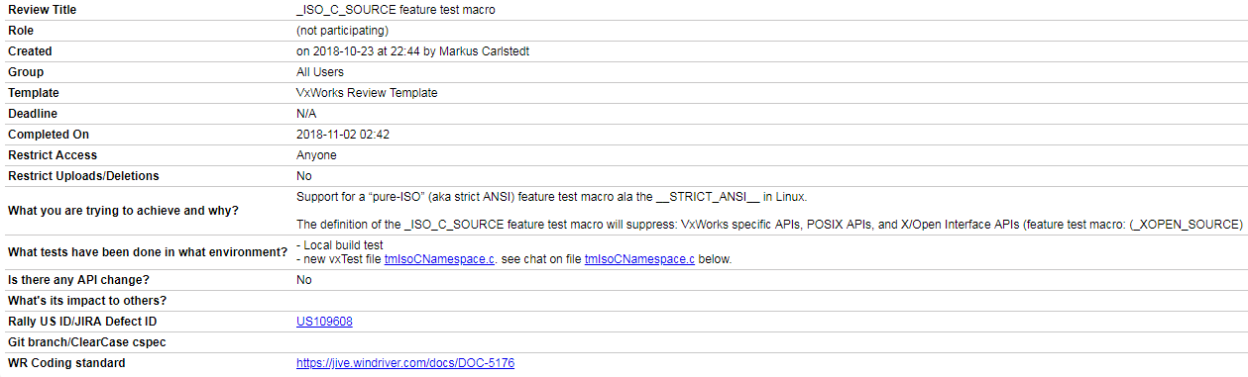
Improvement #1 – A Good Example

Slide 17
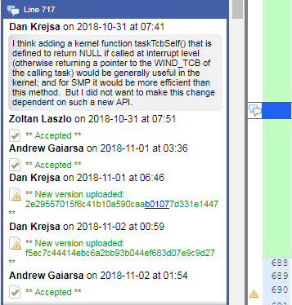
Improvement #1 – Another Good Example
Code authors should provide annotations against specific changes in the review that are potentially controversial, or at least likely to generate comments from the reviewers
For example, the right figure is a comment entered by DanK against his change to rtpShellCmd.c @ http://codereview.wrs.com/ui#file:review=57634/version=1472242
The above comment was added by DanK _before_ the review started in anticipation of reviewers potentially suggesting the usage of a new API.

Slide 18
Improvement #2
Use a checklist
Define a checklist that lists top 10 common mistakes that engineers tend to make (see next page for the checklist)
Before author starts the code review, do a self-inspection first
(Corresponding to best practice “6. Use checklists”)

Slide 19
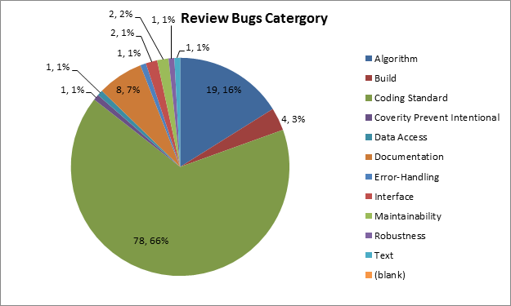
Top 10 Coding Standard Issues
Update layer version correctly
Update spec file version and changelog correctly
Update copyright notice year
Modification history rules
Extra spaces in one line
Alignment/indention issue
Max 80 chars in one line
Add comments for every functions
Delete unused codes
Delete empty lines

Slide 20
Improvement #3
Keep the codes small
The number of added/changed LOC in each code review should be no more than 400
In Code Collaborator, refer to “LOC Added” and “LOC Changed” in the report
If LOC is larger than 400, that probably means your US break-down is not optimal
Include UT cases in the same code review as the changed codes
LOC larger than 400 requires an explanation
However we do allow some exceptions, like
3rd party codes import to VxWorks (for the first time, see slide #21 for recommendation)
Changes related to type or macro renaming throughout the whole source tree. In such cases hundreds of files and thousands of lines of code may be changed and it is better to keep one review for them.
(Corresponding to “1. Review fewer than 400 lines of code at a time”)

Slide 21
Commit Break Down Guidelines
If your codes for entire user stories under review contains 400+ LOC, consider the following commit level break down practices
Separate each logical change into a separate commit
For example, if your changes include both bug fixes and performance enhancements for a single driver, separate those changes into two or more commits.
If your changes include an API update, and a new driver which uses that new API, separate those into two commits.
Separate code reviews on each of commits should be much easier
On the other hand, if you make a single change to numerous files, group those changes into a single commit
Thus a single logical change is contained within a single commit that can be reviewed
The point to remember is that each commit should make an easily understood change that can be verified by reviewers. Each commit should be justifiable on its own merits.
This is also a key principle in achieving continuous integration!

Slide 22
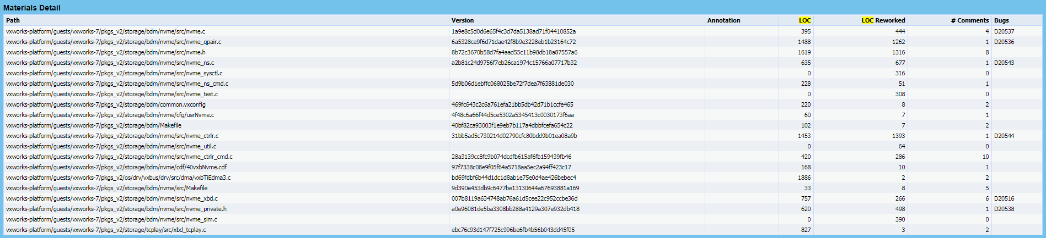
3rd Party Source Codes - How?
For any code changes related to 3rd party source codes, the recommendation is:
Create the 1st code review which only contains the original 3rd party source codes, without any VxWorks specific modifications
Use the “VxWorks Review Template” to describe this fact
This review can be closed very quickly, if it indeed does what it says in the template
Create the 2nd code review which only contains the modifications required by VxWorks
This is the review we should really pay our attention to

Slide 23
Improvement #4
Every line of source codes need to be reviewed
This includes features, bug fixes, test cases, scripts, etc
Someone who may have wrong assumption that only codes for products need to be code reviewed, which is wrong.
(Corresponding to best practice “9. Embrace the subconscious implications of peer review”)

Slide 24
Improvement #5
Follow code review process
See code review process: https://jive.windriver.com/docs/DOC-54469
Properly set reviewers and observers, eg: PA should be involved.
File bugs if you see something is wrong, otherwise it might get slipped away
Normally use comments to clarify something
(Corresponding to best practice “7. Establish a process for fixing defects found” and “10. Practice lightweight code reviews”)

Slide 25
Improvement #6
Treat code review an opportunity to improve
Don’t fear to file bugs (refer to code review process)
You can always learn something if you devoted yourself to the code review, either as author/reviewer/observer
Knowledge sharing for high quality code reviews within the team
Everyone can nominate high-quality code reviews
http://codereview.wrs.com/ui#file:review=57527/version=1469610/location=L104 (a good example shared by Dong)
Wider audience (eg: within scrum team) - group code review
Every scrum team nominates one code review and invites the team for group code review in each sprint
(Corresponding to “8. Foster a positive code review culture”)

Slide 26

™
26
© 2018 WIND RIVER. ALL RIGHTS RESERVED.

Slide 27
Document History
Date | Version | Author | Changelog
2018/11/05 | 0.1 | Bin Meng | Initial version for review
2018/11/14 | 0.2 | Bin Meng | Updated per Kun and Markus’s comments
2018/12/19 | 0.3 | Bin Meng | Minor update after internal discussion
2018/12/24 | 0.4 | Bin Meng | Incorporated Andrew’s comments

