Slide 1
Signed / Unsigned in C
Pingchuan Ma

Slide 2
Topics
To sign or not to sign, that is the question !
Promotion
Conversion
Conclusion

Slide 3
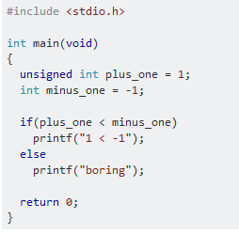
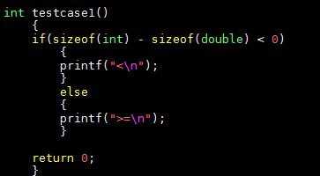
A quiz for Signed / Unsigned
What’s the result of “signed A + unsigned B”?
What’s the result of E1 << E2?
What’s the result of E1 >> E2?
int c = -1; int d = 1; int e = c << d; e=?
int c = -1; int d = 1; int e = c >> d; e=?
int c = 1; int d = -1; int e = c >> d; e=?
unsigned int c = 1; int d = 33; int e = c << d; e=?
Notes:
int c = -1; int d = 1; int e = c << d; e=? the behavior is undefined int c = -1; int d = 1; int e = c >> d; e=? the resulting value is implementation-defined int c = 1; int d = -1; int e = c >> d; e=? the behavior is undefined

Slide 4
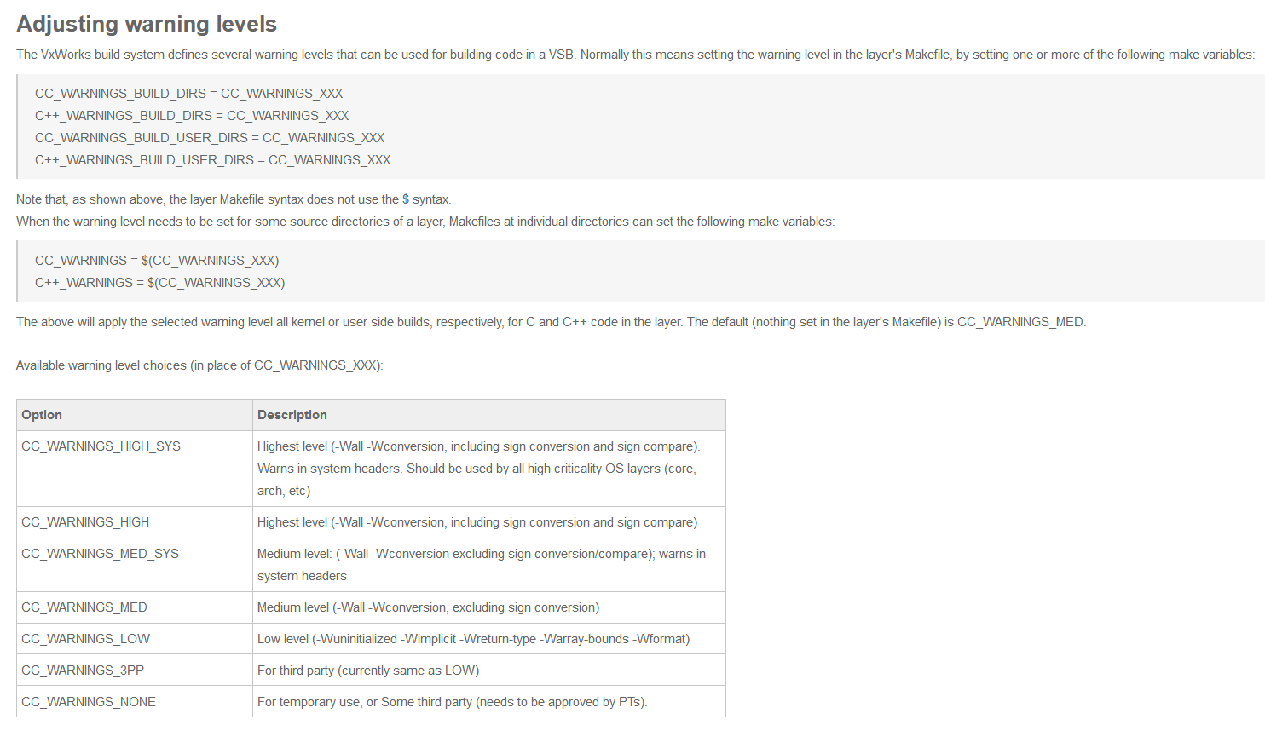
Build Options for signed/unsigned warnings
-Wsign-conversion
-Wsign-compare
-Wall (With this option, -Wsign-conversio and -Wsign-compare will be also enabled for C++)
-Wextra (With this option, -Wsign-conversio and -Wsign-compare will be also enabled for C)
https://jive.windriver.com/docs/DOC-73828

Slide 5
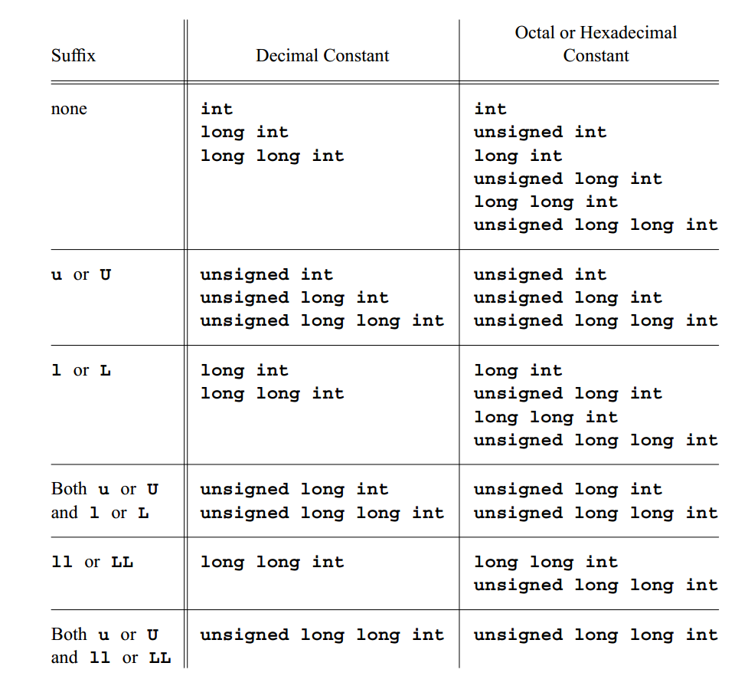
Integer constants
The type of an integer constant is the first of the corresponding list in which its value can be represented

Slide 6
Integer Promotion
The integer promotions are performed on both operands. Then the
following rules are applied to the promoted operands:
If both operands have the same type, then no further conversion is needed.
Otherwise, if both operands have signed integer types or both have unsigned
integer types, the operand with the type of lesser integer conversion rank is
converted to the type of the operand with greater rank.
Otherwise, if the operand that has unsigned integer type has rank greater or
equal to the rank of the type of the other operand, then the operand with
signed integer type is converted to the type of the operand with unsigned
integer type.
Otherwise, if the type of the operand with signed integer type can represent
all of the values of the type of the operand with unsigned integer type, then
the operand with unsigned integer type is converted to the type of the
operand with signed integer type.
Otherwise, both operands are converted to the unsigned integer type
corresponding to the type of the operand with signed integer type.

Slide 7
Integer Conversion
A op B = ?
signed/unsigned A op signed/unsigned A no conversion
signed/unsigned A op signed/unsigned B rank(A) > rank(B) ? B -> A : A -> B
signed A op unsigned B rank(B) >= rank(A) signed A -> signed B -> unsigned B
signed A op unsigned B rank(B) < rank(A) A can represent all values of B, B -> A
signed A op unsigned B rank(B) < rank(A) A can NOT represent all values of B, unsigned B -> unsigned A signed A -> unsigned A
e.g. signed long A op unsigned int B for 32-bit system. A/B -> unsigned long

Slide 8
Integer Conversion
--C89
3.2.1.2 Signed and unsigned integers
When an unsigned integer is converted to another integral type, if
the value can be represented by the new type, its value is unchanged.
When a signed integer is converted to an unsigned integer with
equal or greater size, if the value of the signed integer is
nonnegative, its value is unchanged. Otherwise: if the unsigned
integer has greater size, the signed integer is first promoted to the
signed integer corresponding to the unsigned integer; the value is
converted to unsigned by adding to it one greater than the largest
number that can be represented in the unsigned integer type. /22/
When an integer is demoted to an unsigned integer with smaller
size, the result is the nonnegative remainder on division by the
number one greater than the largest unsigned number that can be
represented in the type with smaller size. When an integer is demoted
to a signed integer with smaller size, or an unsigned integer is
converted to its corresponding signed integer, if the value cannot be
represented the result is implementation-defined.

Slide 9
Integer Conversion
--C99 / C11
6.3.1.3 Signed and unsigned integers
1 When a value with integer type is converted to another integer type other than _Bool, if
the value can be represented by the new type, it is unchanged.
2 Otherwise, if the new type is unsigned, the value is converted by repeatedly adding or
subtracting one more than the maximum value that can be represented in the new type
until the value is in the range of the new type.49)
3 Otherwise, the new type is signed and the value cannot be represented in it; either the
result is implementation-defined or an implementation-defined signal is raised.

Slide 10
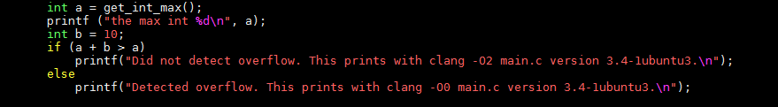
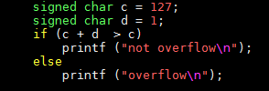
Integer Overflow
Signed integer overflow implementation-defined behavior.
Unsigned integer overflow is well defined
C’s unsigned integer types are ‘‘modulo’’ in the LIA−1 sense
in that overflows or out-of-bounds results silently wrap

Slide 11
Conclusion
Try to use unsigned integers whenever possible
Be careful to use signed integers because signed overflow is NOT well defined while unsigned overflow is well defined.
Bjarne Stroustrup (the creator of C++) says: "Use [signed] int until you have a reason not to. Use unsigned if you are fiddling with bit patterns, and never mix signed and unsigned.“
Rule 12.7 of MISRA C 'Bitwise operators shall not be applied to operands whose underlying type is signed.'

Slide 12
Thanks

