Slide 1
VxWorks SR0520+ Git Workflow
Shawn Ye

Slide 2
Agenda
Git Branch Model of SR0520+
Feature Branch Activities
What’s the Pain
But Why?
Goal - Clean Commits
How to Clean up Commits
New Git Workflow
Where do I Get More Information?

Slide 3
SR0520+ Git Branch Model
Private Branch
Master Branch
Contributor 1
Shared Branch
Contributor 2
Master Branch = vx7-integration
Private and Shared Branches
Derived from Master Branch and integrated via the “vx7_CI_launcher” pipeline
Shared branches may have submissions from multiple contributors
Branches should be based on the content of a single User Story
They should not contain an entire Feature (which may be very big)

Slide 4
Branch Merges
A
B
C
D
E
Master Branch
1
2
3
Private Branch
Branch off Master:
Perform a couple of commits on Private Branch:
Sync content from Master Branch:
Integrate into Master Branch:
are merge records
Merge records make it difficult to understand the flow of logic and troubleshoot problems
A
B
3
E
A
B
1
2
A
B
1
2
C
3
A
B
1
2
C
3
D
E

Slide 5
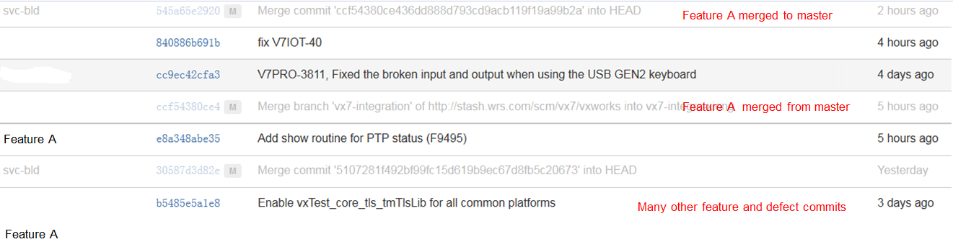
Merge Records in VxGit
Commits for features and defects are interwoven on the vx7-integration branch
No obvious way of seeing what’s happening on the main branch (i.e. history is out of order)
Difficult to revert or cherry-pick
Cannot troubleshoot a feature that is interwoven with many other commits
Creates unnecessary merge commits
Notes:
See commits history from vx7-integration:
http://vxgit.wrs.com/projects/VX7/repos/vxworks/commits?until=refs%2Fheads%2Fvx7-integration

Slide 6
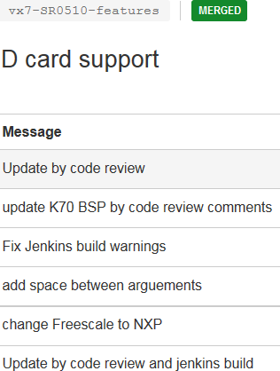
Why were merges allowed in VxWorks?
No established process or training for Git
Feature Release model made it difficult to maintain a “clean” master branch
Features are developed in their entirety on separate branches
Teams perform many commits without any formality
The long list of poorly structured commits are then integrated into the master branch
The CI model allows for multiple (well structured) commits into the master branch
Notes:
New CI model:
https://jive.windriver.com/community/engineering/vx7-engineering/vx7-development-processes-and-tools
https://jive.windriver.com/docs/DOC-61321

Slide 7
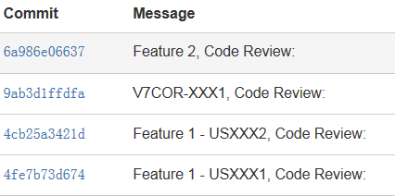

Goal: Maintain Formal and Structured Commits
Shared Branches (i.e. vx7-integration) must have formal and structured commits
Commits should be linear, atomic, and have a well documented commit message
Private Branches don’t have the same requirements
Developers can treat Private Branches as they wish
Private Branches need to be cleaned-up prior/during integration into a Public Branch
Notes:
Leave the clean of feature/defect branch along, it’s a choice by team/developer, somebody may want to keep detailed commit history using rebase.

Slide 8
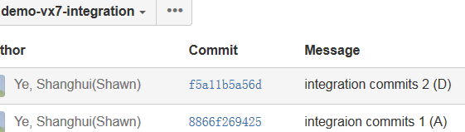
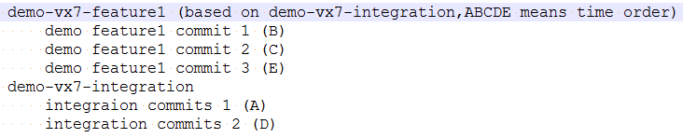
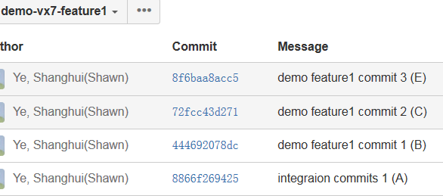
Demo: How to Avoid Merge Records
Notes:
Here we use demo-vx7-integration to represent the formal integration branch (vx7-integration)
Use demo-vx7-feature1 to represent any feature development branch.
You can just replace them in formal usage

Slide 9
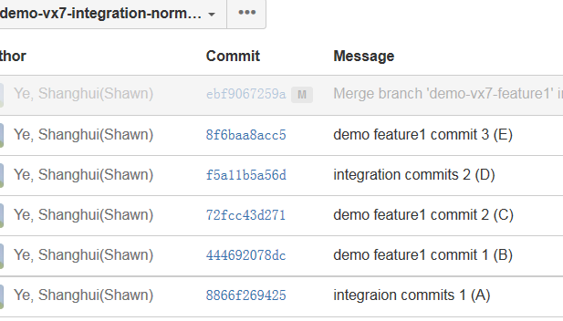
Demo: Normal Merge
Shell Commands:
git checkout demo-vx7-integration
git checkout -b demo-vx7-integration-normal-merge
git merge demo-vx7-feature1
git push origin demo-vx7-integration-normal-merge
Normal Merge
Commits are not “cleaned up” and the code is integrated using current CI pipeline
Resulting commits are interwoven and merge records are created
Private branch’s full history is carried into the vx7-integration branch
Notes:
Here we create a branch “demo-vx7-integration-normal-merge” just for demo show to represent demo-vx7-integration operation, so it will not break later demo show.
In normal operation, the merge happens directly on demo-vx7-integration

Slide 10
Demo: Avoiding Merge Records
Limit the number of commits per submission to Master Branch
User stories and defects should typically be captured in a single commit
Expectation is that every commit “works” (i.e. will pass Nightly Test)
General Steps:
Create Private Branch from Master Branch
Commit regularly, logically, and intentionally
i.e. avoid random commits that would break builds or Nightly Test
Perform a Code Review
Review and clean-up commits to show a logical progression of the work
Method 1: Interactive Rebase
Method 2: Merge Squash
Use the Jenkins pipeline to submit your Private Branch
Notes:
There is a great article that illustrates this model:
https://visual-assault.org/2015/08/03/when-to-use-git-merge-vs-git-rebase/
We may use below branch model:
Branch off – Rebase/Rebase -i (from master) - Merge/Merge Squash (to Master, maybe fast forward so without an useless merge commit)
Branch off - Merge (from master) -- Merge Squash (on Master, and from feature branch)

Slide 11
Demo: Rebase
A Rebase will change the history of your commits
Puts local commits on top of the Master Branch’s current commits
It does not create merge records
Master Branch
Before Rebase
Private Branch
Master Branch
After Rebase
Private Branch
Notes:
http://twiki.wrs.com/PBUeng/ViperDevEnv#How_To_Do_Rebases_To_Prevent_Merge_Commits

Slide 12
Demo: Rebase
Master Branch
Before Merge Squash
Private Branch
Master Branch
After Merge Squash
Private Branch
Notes:
http://twiki.wrs.com/PBUeng/ViperDevEnv#How_To_Do_Rebases_To_Prevent_Merge_Commits

Slide 13
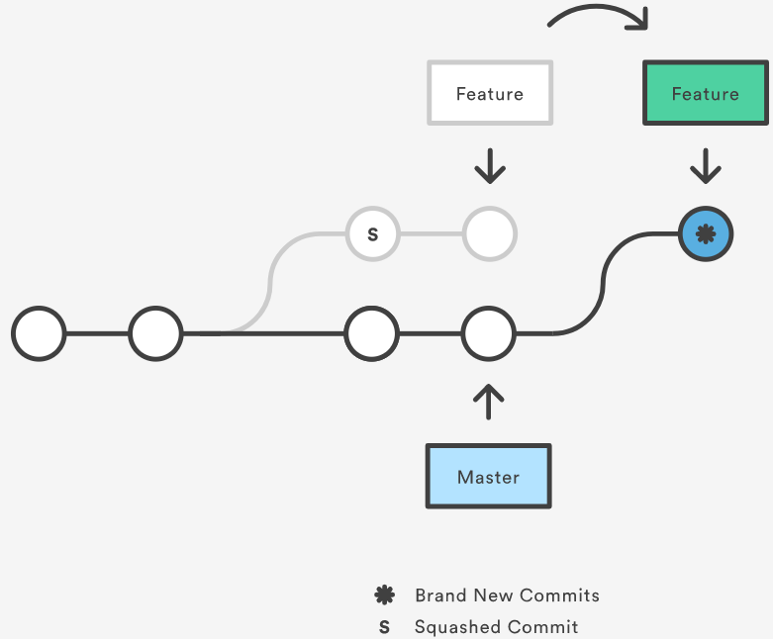
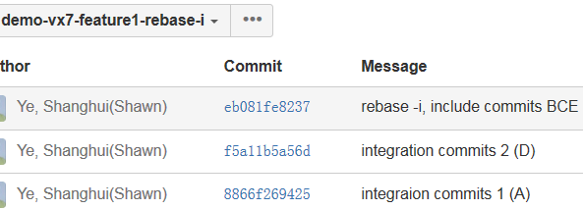
Demo: Interactive Rebase
Similar to Rebase
squashes all commits into one
atomic git action
Happens on the feature branch
Creates a new squashed commit
Shell Commands:
git checkout -b demo-vx7-feature1-rebase-i
git rebase -i demo-vx7-integration
git push origin demo-vx7-feature1-rebase-I
Notes:
Based on demo-vx7-feature1, create a temporary branch demo-vx7-feature1-rebase-I to represent demo-vx7-feature1 so not break later demo show, normally, will use demo-vx7-feature1 directly
Ignored possible conflicts here
https://jwiegley.github.io/git-from-the-bottom-up/1-Repository/8-interactive-rebasing.html

Slide 14
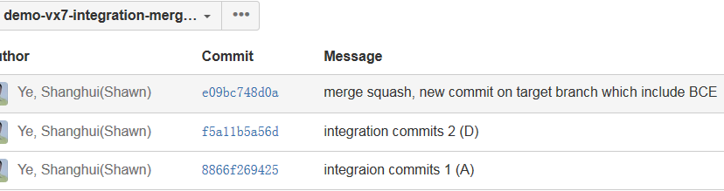
Demo: Merge Squash
Squashes all commits together onto the Master Branch
Similar to a new patch commit
Action takes place on the Master Branch, NOT on the Private Branch
Commit message can be modified during the action
Master Branch
Before Merge Squash
Private Branch
Master Branch
After Merge Squash
Private Branch
Shell Commands:
git checkout demo-vx7-integration
git checkout -b demo-vx7-integration-merge-squash
git merge --squash demo-vx7-feature1
git commit
git push origin demo-vx7-integration-merge-squash
Notes:
Based on demo-vx7-integration, create a temporary branch demo-vx7-integration-merge-squash to represent demo-vx7-integration, normally, will use demo-vx7-integration directly
https://blog.bitbucket.org/2017/01/31/git-squash-commits-merging-bitbucket/
A squash merge takes all the file changes and adds them to a single new commit on the target master branch, it's like a patch commit.
A simple way to think about this is that squash merge gives you just the file changes, and a regular merge gives you the file changes and the commit history.

Slide 15
Upcoming Workflow: Merge Squash via Jenkins Pipeline
Jenkins Pipeline will provide different integration methods
Developers may use merge squashes or traditional merges
Makes it easier for developers to quickly squash commits on their branch into a single discrete logical submission
Allows developers to directly submit their “cleaned” commit message (to be used during the squash)
Traditional merges will be kept for larger branches
Developers will be responsible for ensuring their branch has logical, clean, and linear commits
Notes:
The only changes are:
the CI pipeline to add “merge --squash” when integrate
The squashed branch commits will no longer existed on vx7-integration branch, but replaced by a new commit with all changeset.

Slide 16
Upcoming Workflow: Prohibiting all Merge Records
Jenkins Pipeline will eventually reject all submissions that contain merge records
Probation period will give teams time to get in the habit of using “clean” commits and avoiding merges
Jenkins Pipeline will give the option of Merge Squashes or Rebase
Depends on whether the branch and its history need to be preserved
For large feature branches:
Teams will need to carefully manage their branch and keep it linear and ensure commits are “clean”
When it’s time to integrate, the branch is locked, rebased on top of vx7-integration
Notes:
For long time off-train development of rebasing, it needs a pilot

Slide 17
THANKS!

Slide 18
References
https://jive.windriver.com/docs/DOC-58638
http://documentup.com/skwp/git-workflows-book
https://www.atlassian.com/git/tutorials/merging-vs-rebasing
https://blogs.msdn.microsoft.com/devops/2016/03/15/squash-a-whole-new-way-to-merge-pull-requests/
https://www.visualstudio.com/en-us/docs/git/merging-with-squash
http://twiki.wrs.com/PBUeng/ViperDevEnv#How_To_Do_Rebases_To_Prevent_Merge_Commits
http://gitready.com/advanced/2009/02/10/squashing-commits-with-rebase.html
https://stackoverflow.com/questions/16449029/is-squashing-commits-into-one-best-practice-for-this-particular-workflow
https://visual-assault.org/2015/08/03/when-to-use-git-merge-vs-git-rebase/
https://www.atlassian.com/blog/git/git-team-workflows-merge-or-rebase

Slide 19

™
19
© 2017 WIND RIVER. ALL RIGHTS RESERVED.

