Slide 1
Release
Notes:
Owner: Doina

Slide 2
Release Guidelines
Every release going to a customer is evaluated against standard Release Criteria.
Exceptions to the standard Release Criteria are approved by the Product Manager and documented in the Panorama checklists.
The Engineering Program Manager is responsible for declaring the release as complete. The Product Manager is responsible for declaring the conditions for release are satisfied.
The results of the release decision, including the completed release criteria templates, are recorded in the appropriate checklists.
Release Planning Guidelines
https://jive.windriver.com/docs/DOC-84026
Reference: https://jive.windriver.com/community/engineering/operations/engineering-program-managers-epm
Notes:
Panorama:
SR0640: http://panorama.wrs.com/#/release/view/3050/
SR0650: http://panorama.wrs.com/#/release/view/3167/
Jira Dashboards:
SR0640: https://jira.wrs.com/secure/Dashboard.jspa?selectPageId=20409
SR0650: https://jira.wrs.com/secure/Dashboard.jspa?selectPageId=20904#

Slide 3
Release Decision Process
Release Criteria are documented for each release via Panorama checklists
Release Criteria differentiate between an Early Access Release (EAR) and a Product Release (different quality expectations)
Panorama checklists for RTO / GA are used to ensure release criteria are met

Slide 4
Sample Release Criteria
For Release to Operations (RTO)
All requirements committed for the release are implemented.
All fixes committed for the release are fixed.
Documents are present in the release per the documentation plan.
All planned testing is complete.
Bug reports are filed for all test failures in a defect tracking system such as Jira.
Bug fix testing is complete.
Testing of product bundles using files supplied by Release Operations is complete.
Records exist in the defect tracking system for all known defects.
All priority P1 defects have been fixed. Exceptions documented
All open priority P2 defects have been reviewed and sign off provided by PM/CSO

Slide 5
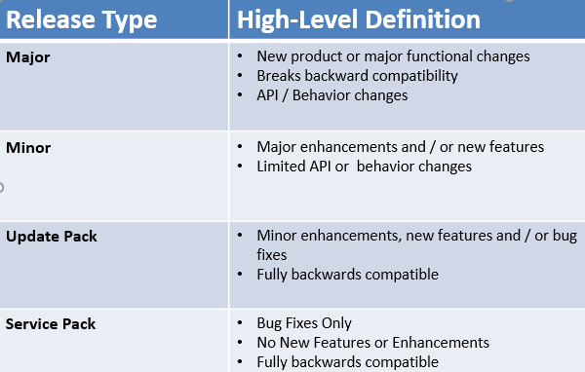
Release Types
Notes:
Releases tracking by EPM: https://jive.windriver.com/docs/DOC-35285
PDLC Overview: https://jive.windriver.com/docs/DOC-83615

