Slide 1

Computer Price Prediction
Presenters:
Naor Abudi
Rani Gamzu

Slide 2
Table of Contents
Data Collection
Data Cleaning
EDA Visualization
Machine Learning
Conclusion

Slide 3
Research question
Is it possible to predict the price of a computer based on computer specifications (RAM, SSD, PROCESSOR...)

Slide 4
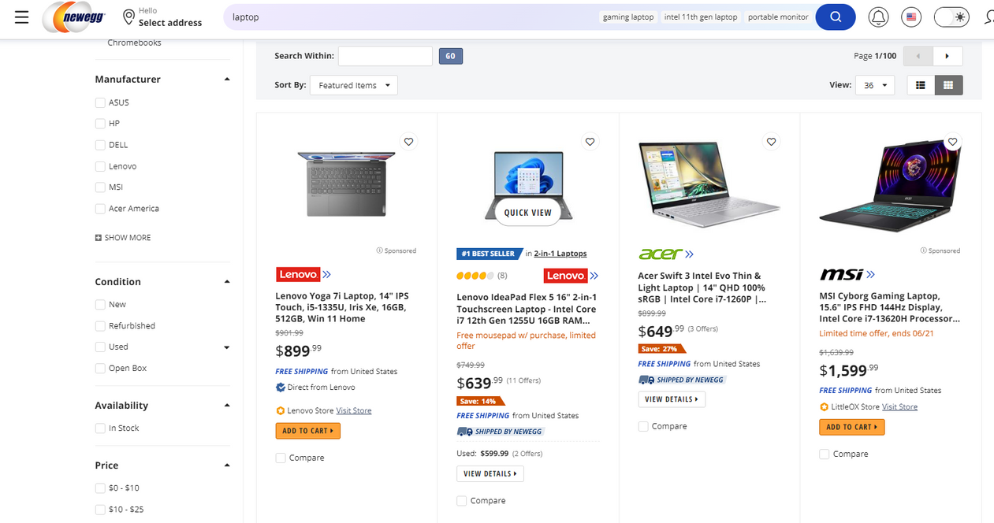
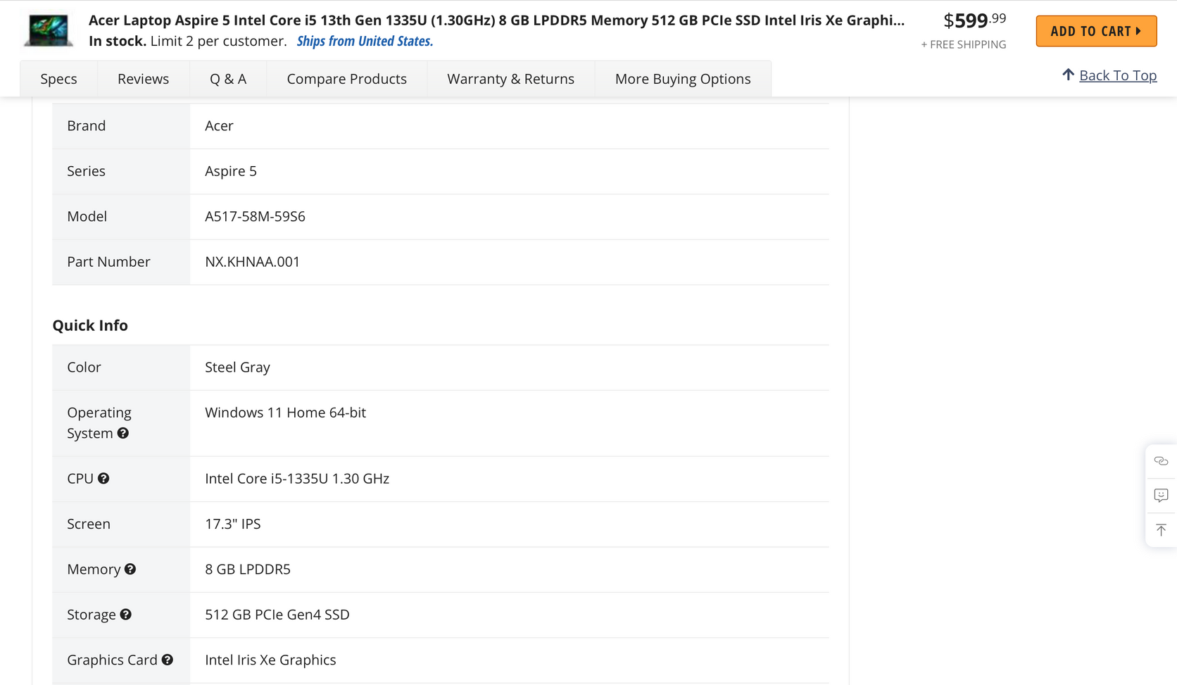
Data Collection
Source:https://www.newegg.com/
found what we needed by clicking on the computer link and the specs panel
Used Pupeeter to do so. Extracted all the computer's links to their data with their names to a CSV file using pandas

Slide 5
Data source Example

Slide 6
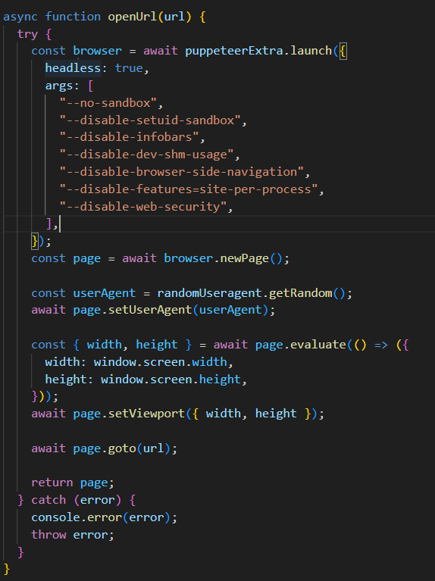
crawling
We encountered several problems:
1. We were blocked by the site because it thought we were a robot
solution:
This line sets a random user agent for the Puppeteer page, which helps disguise the automated browsing activity and makes it more similar to a real user's browsing behavior.

Slide 7
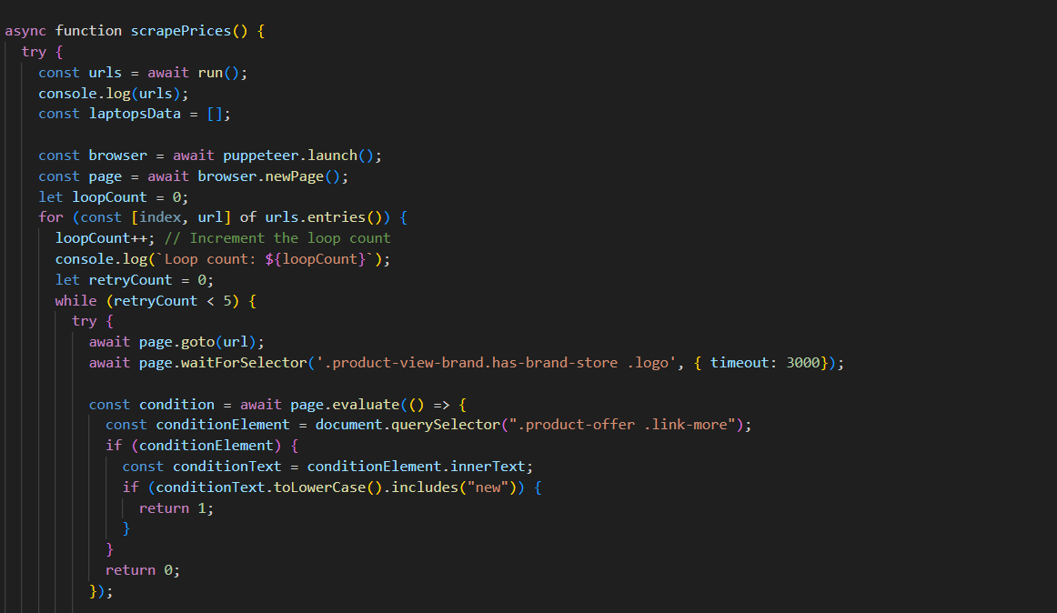
2. Some of the links did not contain computer links
solution:
The waitForSelector() function waits until at least one element matching the specified CSS selector is found on the page. It returns a promise that resolves when the element is present or rejects with a timeout error if the element is not found within the specified timeout period.

Slide 8
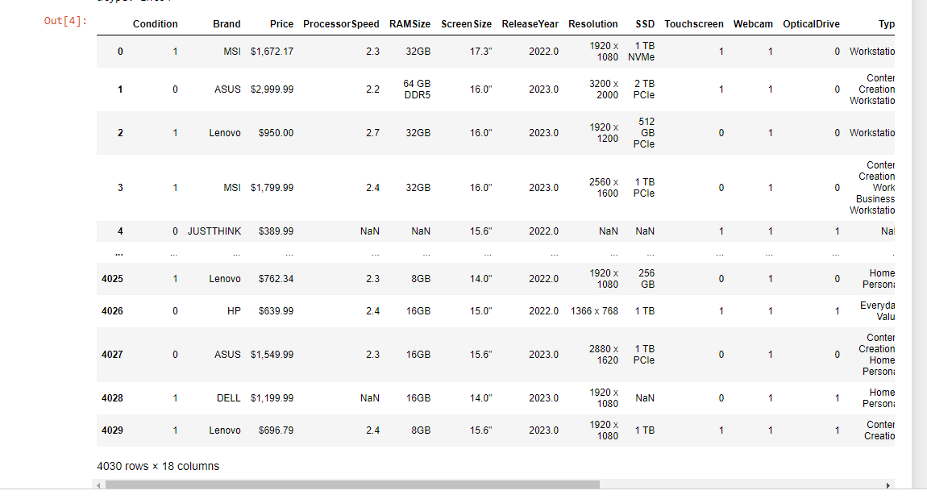
The DataFrame (before cleaning)

Slide 9

Data Cleaning
Deleting irrelevant columns
Remove duplicated data
Filling and Removing missing values
Converting string to a numeric value

Slide 10
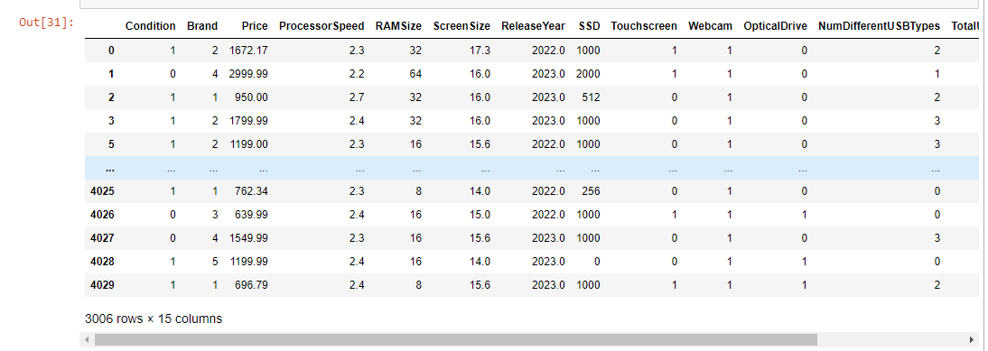
The DataFrame (after cleaning)

Slide 11
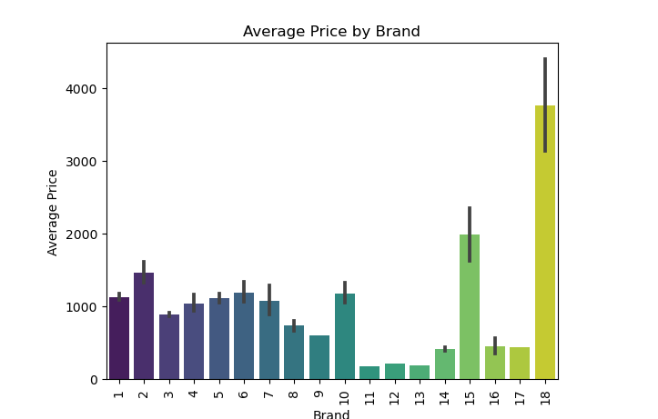
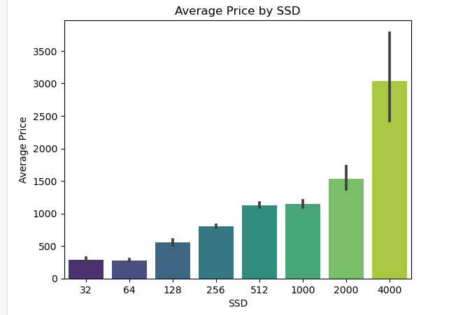
EDA Visualization
You can see the relationship connection the brand of the computer and the price
It can be seen that as the amount of SSD increases, the price increases accordingly

Slide 12
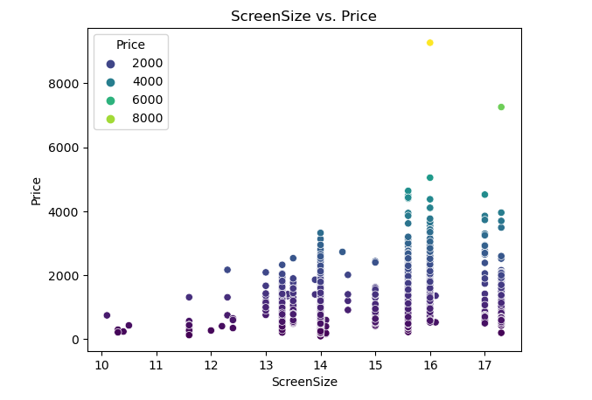
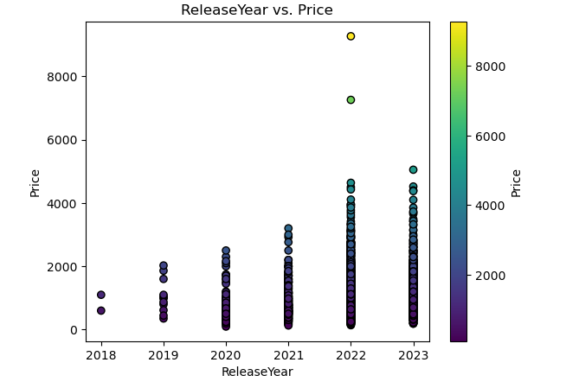
More Examples:

Slide 13
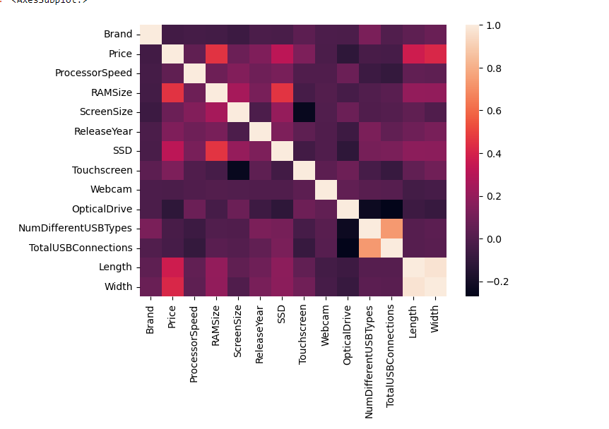

Heatmap
Found a high correlation between Length and width
Found a high correlation between Num different USB types and Total USB connections
Dropped the 'Length' and 'Num different USB types'

Slide 14
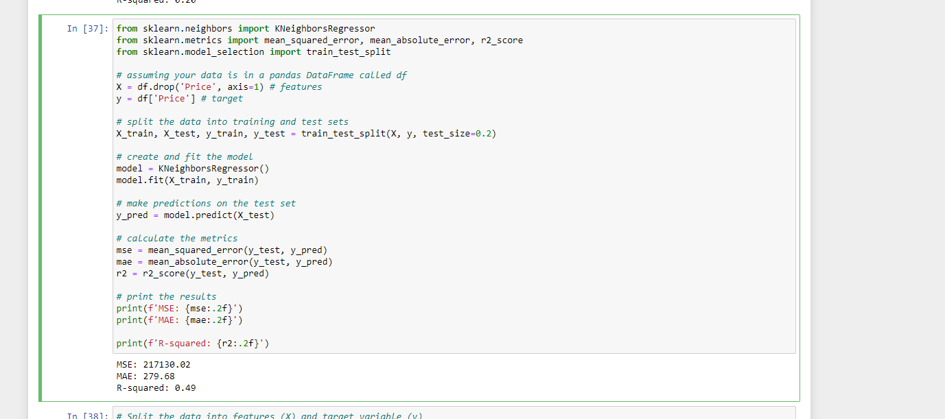
Machine Learning
An example of running the 'Sklearn' algorithm

Slide 15
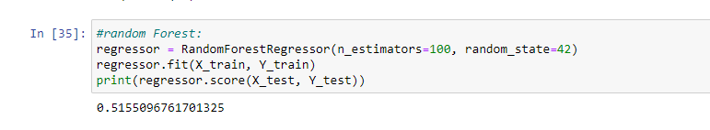
An example of running the 'Random Forest' algorithm
to improve price forecasting

Slide 16
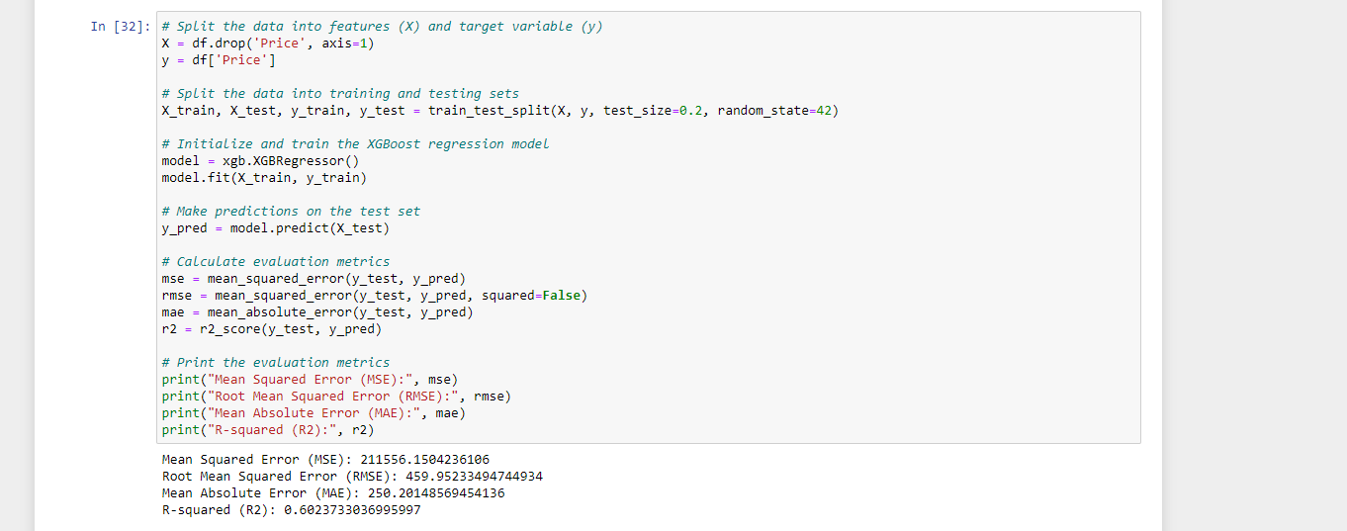
An example of running the 'Xboost' algorithm
It can be seen that there is a 10% improvement

Slide 17
Conclusion
Our research question was:
Is it possible to predict computer prices based on technical specifications?
During We collected information about 140 pages of computers from the 'Newegg' website which contains technical specifications of various computers,
Since we only got 60% accuracy, it is not enough to predict the price of the computer.
Accuracy percentages can be improved by following several steps:
Collect more diverse data on computer specifications.
Running additional models for forecasting.
Collecting feedback from various sources such as users or domain experts.

