Slide 1
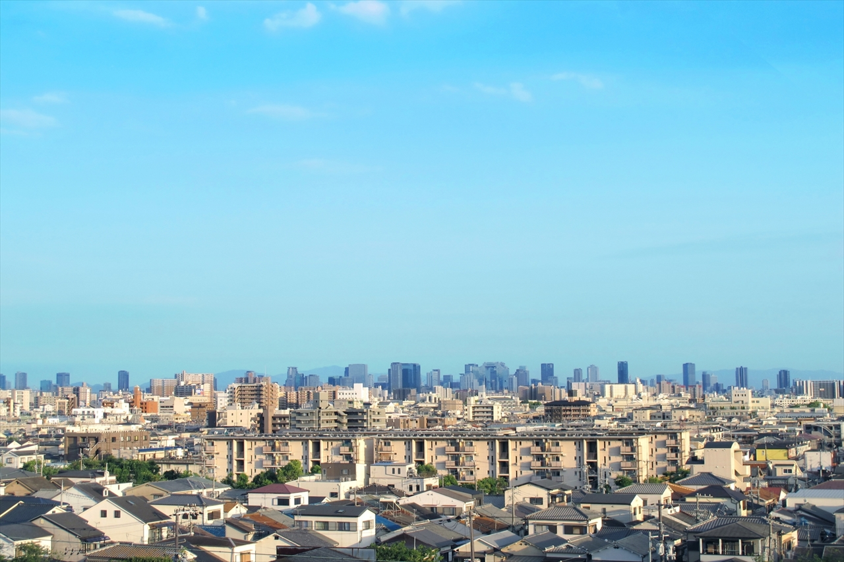
DOCO
SUM

