Slide 1

Baby Hut System
requirements analysis and design

Slide 2
FINAL REPORT PART II
REQUIREMENTS ANALYSIS AND DESIGN
Lecturer: Mr. Pham Thai Ky Trung
Authors:
- Truong Tuan Nhan - 519H0208

Slide 3
Baby Hut Information
A growing baby equipment sales and rental chain
Provide extra services: pickup and delivery
Personal assistance to customers about selections
Provide extensive selection of baby equipment for sale or hire from around the world
Melbourne and go on
Five store in Melbourne and has oppotunity to expand
Each store has knowledgeable managers with suitable casual staff
A BRIEF DESCRIPTION

Slide 4
Baby Hut Information
PROBLEM: The software to manage the hire and sale of each store is limited and not directly linked. For management purposes each store prepares its own individual reports and has a list of titles available through the company but not held in other stores.
NEED: Website - a must be improvement in the information systems to monitor performance and provide support if the owners are to expand the Baby Hut chain to other cities and states.
PROBLEM - NEED

Slide 5
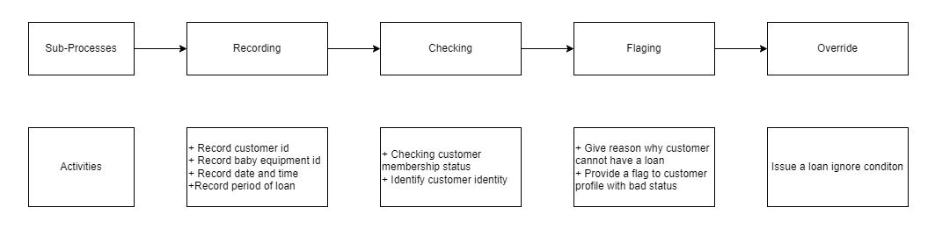
BABY HUT INFORMATION SYSTEM
Have a loan
Business process

Slide 6
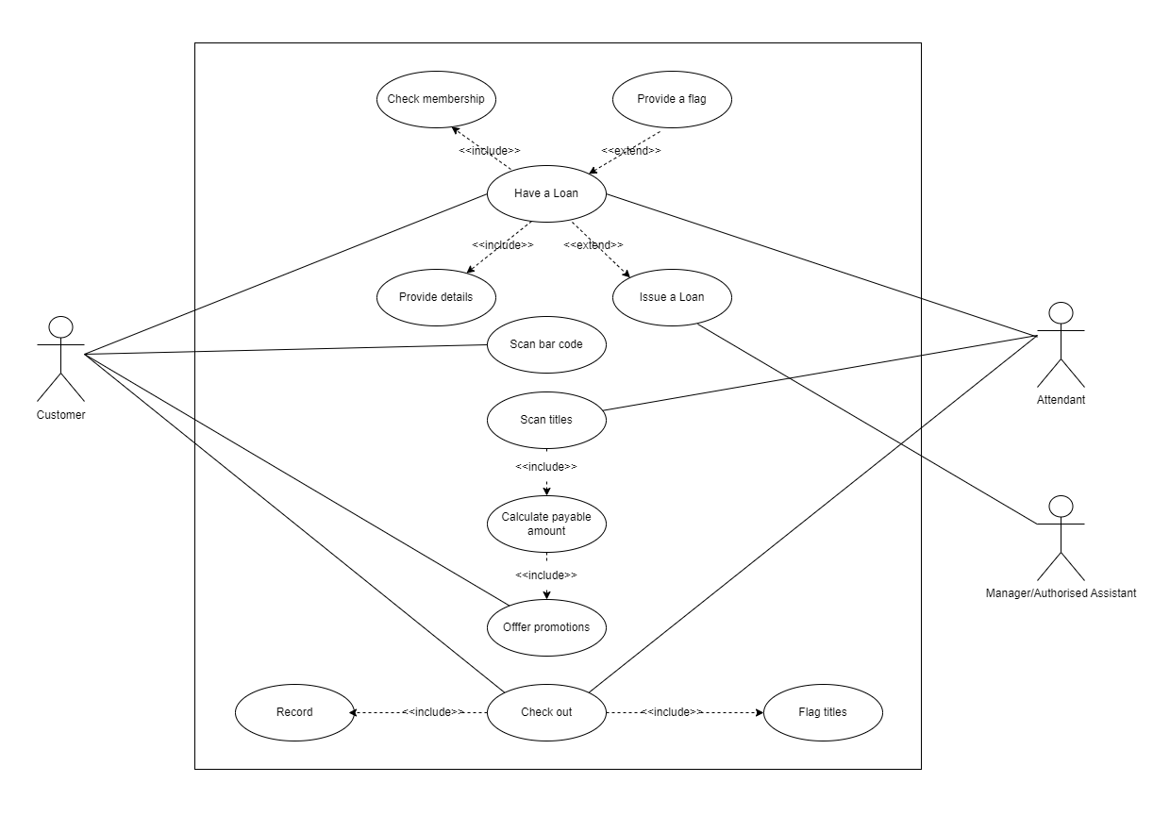
BABY HUT INFORMATION SYSTEM
PROCESS LOAN SUBSYSTEM
USE CASE DIAGRAM
Process Loan

Slide 7
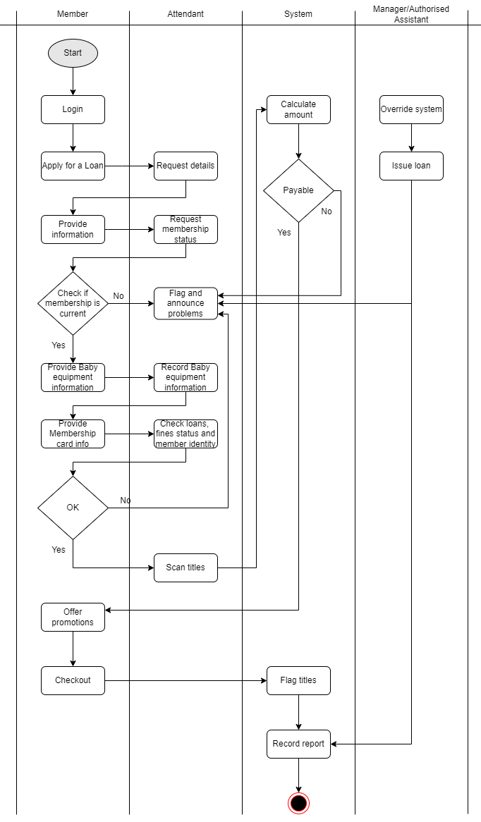
BABY HUT INFORMATION SYSTEM
PROCESS LOAN SUBSYSTEM
Process Loan
Workflow
WORKFLOW

Slide 8
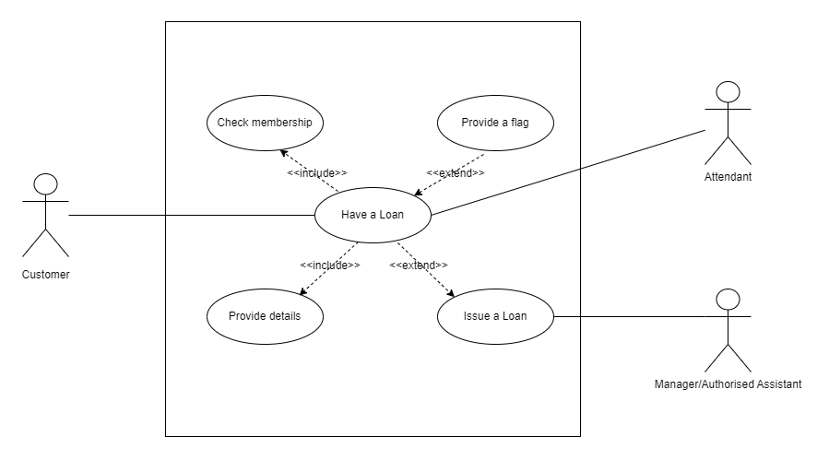
BABY HUT INFORMATION SYSTEM
Have a loan
USE CASE
Have a Loan

Slide 9
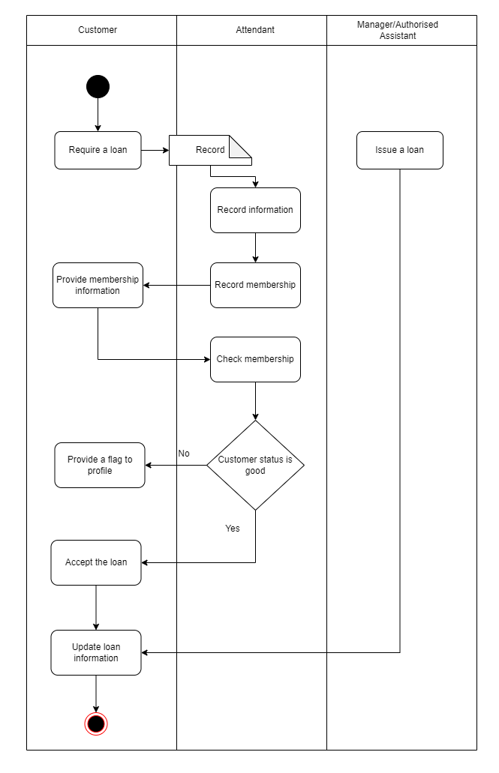
BABY HUT INFORMATION SYSTEM
Have a loan
Activity diagram
Have a Loan

Slide 10
List of Requirements
Requirements | Functional | Non-Functional
The system allow customers to have a loan | X
The system provide quick reply |  | X
The system announce the reason why customer loan is not approved | X
Customers information is secured |  | X
The loan record must be updated in the database | X
DATABASE SCHEMA

Slide 11
List of Requirements
Requirements | Functional | Non-Functional
Customber membership status must be changed after expired | X
System must provide camera feature for Membership card and customer identification | X
Customer can report the issue to attendant |  | X
Customber with bad status must be flagged | X
DATABASE SCHEMA

Slide 12
List of Requirements
Requirements | Functional | Non-Functional
Customers with overdue loans or fine must be updated in profile | X
System must change the customer status to default and remove flag after customer complete all the debt and bad conditions | X
The manager can override the system to issue the loan ignore conditions | X
DATABASE SCHEMA

Slide 13
System Requirements Analysis
System Narrativelysi
Customer have a bad finance or they want to use to service:
The customer choose Have a loan service when purchasing the item. Then, taken to an attendant.
The attendant requires information about the customer and the baby equpment they want.
The customer provide Membership card information.
After checking, the attendant approve the loan and update the loan information.
Customer profile update with the loan status and period of loan.
Altenate scenario - Customer has bad status and be flagged in profile. The attendent announces reason why the loan is not approved.
- Manager/Authorised Assistant override the system to issue the loan.
Translate from business Use Case

Slide 14
System Requirements Analysis
User and their goalslysi
USER/ACTOR | USER GOAL
Customer | Successfully have a loan
Attendant | Identify customer Record loan information Record customer information Approve/Deny the loan
Manager/Authorised Assistant | Manage the loan Issue the loan
Translate from business Use Case

Slide 15
System Requirements Analysis
List of actorslysi
Customer: interacts with the system to rent and purchase baby equipment include using extra services. There are three types of member.
+ Local
+ Suburban and global
+ New (after registration successfully)
Attendant: the representative from the Baby Hut chains that communicate with customers in rental, payment and extra services.
Manager: manage the employee and work of the Baby Hut chains include reports and incomes.
Authorised Assistant: Be able to override the system(issue loans, reports,...) like Manager. ysi
Translate from business Use Case

Slide 16
BABY HUT INFORMATION SYSTEM
Have a loan
USE CASE
Have a Loan

Slide 17
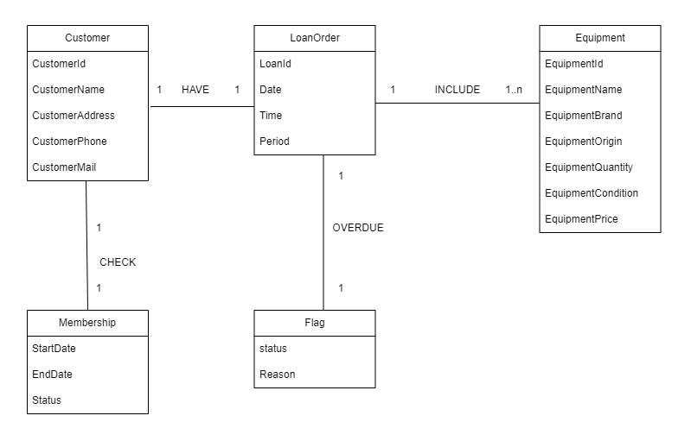
Domain Class Model Diagram

Slide 18
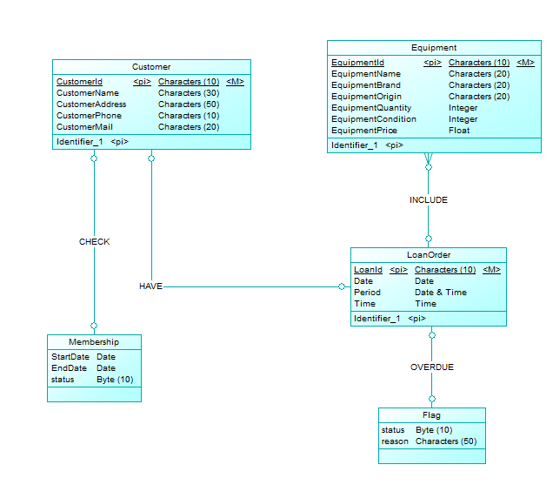
Domain Class Model Diagram

Slide 19
DATABASE SCHEMA
Table Name | Attributes
Customer | CustomerId: Char(size) {key} CustomerName: Char(size) CustomerAddress: Char(size) CustomerPhone: Char(size) CustomerMail: Char(size)
DATABASE SCHEMA
Domain Class Model Diagram

Slide 20
DATABASE SCHEMA
Table Name | Attributes
Equipment | EquipmentId: Char(size) {key} EquipmentName: Char(size) EquipmentBrand: Char(size) EquipmentOrigin: Char(size) EquipmentQuantity: Char(size) EquipmentCondition: int EquipmentPrice: float
DATABASE SCHEMA
Domain Class Model Diagram

Slide 21
DATABASE SCHEMA
Table Name | Attributes
LoanOrder | LoanId: Char(size) {key} Date: DATE Time: TIME Period: DATETIME CustomerId: Char(size) {foreign key} EquipmentId: Char(size) {foreign key}
DATABASE SCHEMA
Domain Class Model Diagram

Slide 22
DATABASE SCHEMA
Table Name | Attributes
Membership | CustomerId: Char(size) {foreign key} StartDate: DATE EndDate: DATE Status: Char(size)
DATABASE SCHEMA
Domain Class Model Diagram

Slide 23
DATABASE SCHEMA
Table Name | Attributes
Flag | LoanId: Char(size){foreign key} status: Char(size) Reason: Char(size)
DATABASE SCHEMA
Domain Class Model Diagram

Slide 24
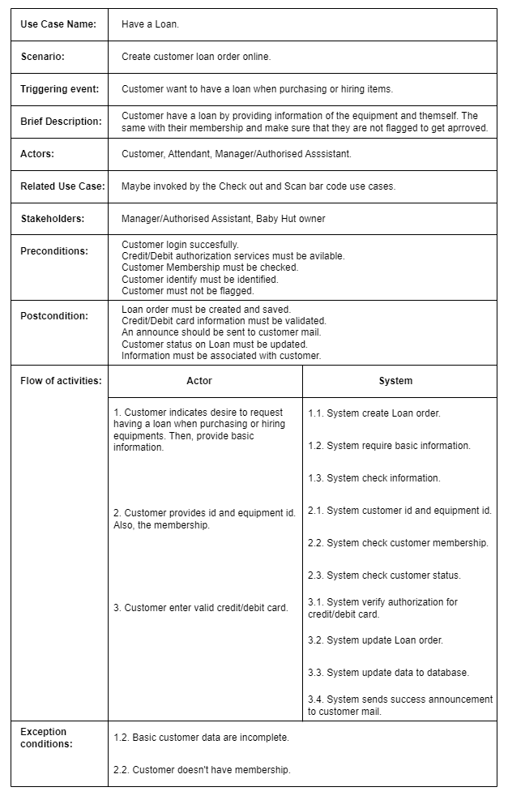
USE CASE DESCRIPTION
Have a Loan

Slide 25
UML ACTIVITY DIAGRAM
Have a Loan

Slide 26
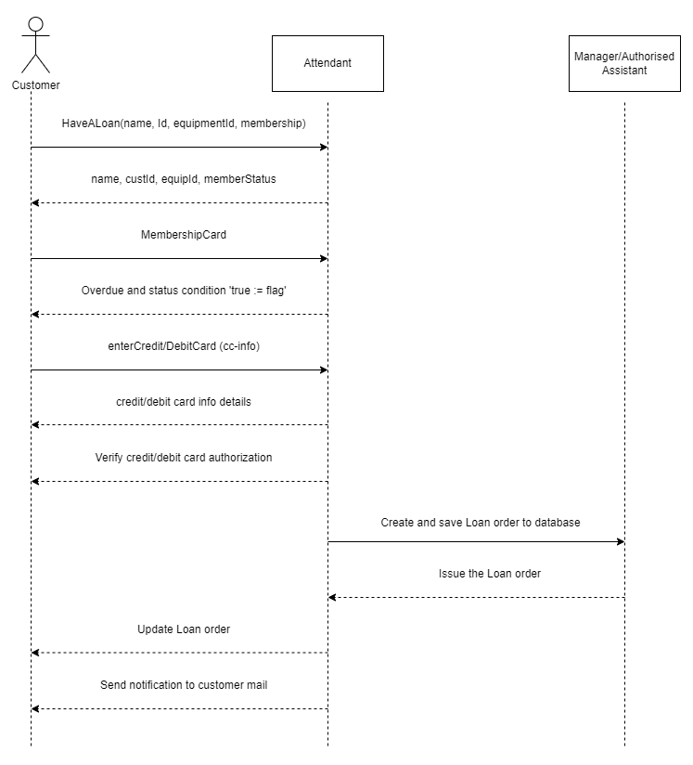
SYSTEM SEQUENCE DIAGRAM
System
Have a Loan

Slide 27
DESIGN CLASSES IN DETAILED DESIGN
Convert Domain Class to Design Class
Domain Class

Slide 28
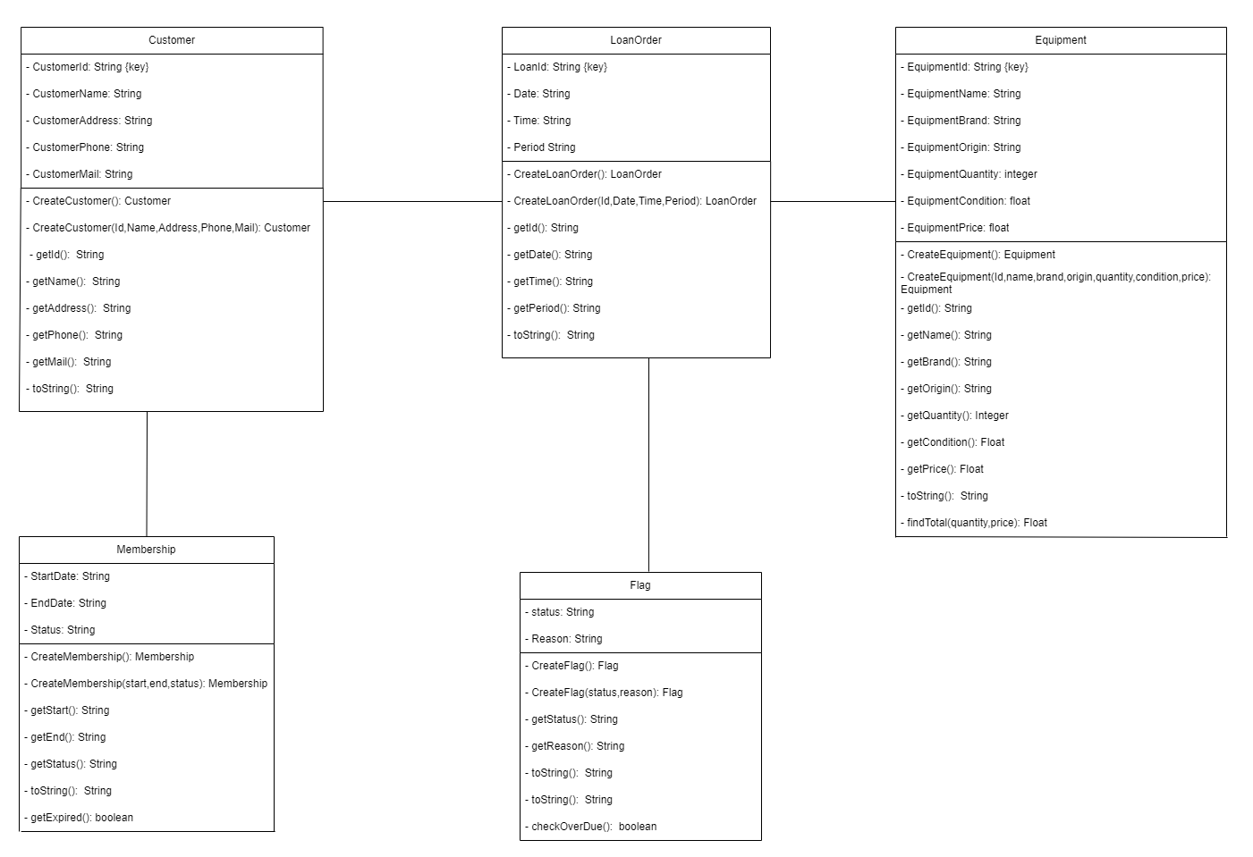
DESIGN CLASSES IN DETAILED DESIGN
Convert Domain Class to Design Class
Detailed Design

Slide 29
DESIGN CLASS DIAGRAM
LoanHandler
Have a Loan | Customer
Customer
Controller
Controller

Slide 30
DESIGN CLASS DIAGRAM
CustomerInfoScreen
Accept customer info | CustomerHandler
MembershipInfoScreen
Accept membership info | CustomerHandler
CreditCardScreen
Accept CC info | CustomerHandler
LoanHandler
Create Loan order Check Membership info Check Flag status | Customer
UI
Customer
Create Loan order Check Membership info Check flag status | Loan info Membership Info Loan order info

Slide 31
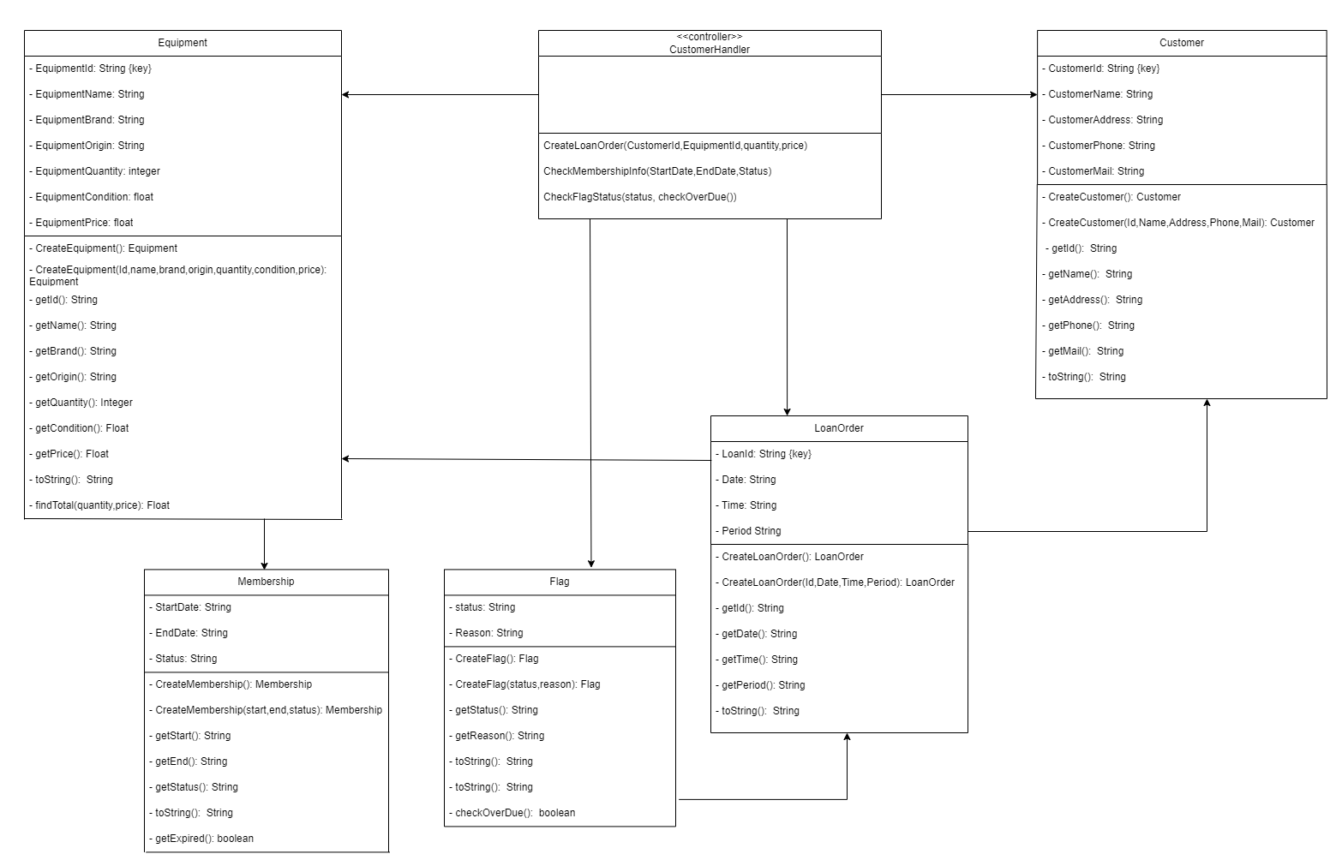
DESIGN CLASS

Slide 32
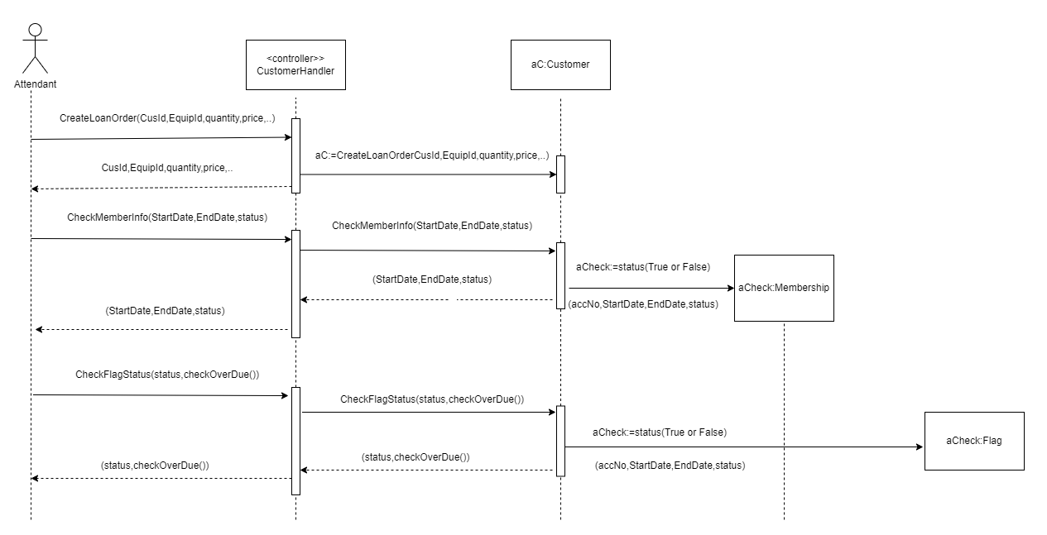
OOD WITH SEQUENCE DIAGRAM
<<controller>>
LoanHandler

Slide 33
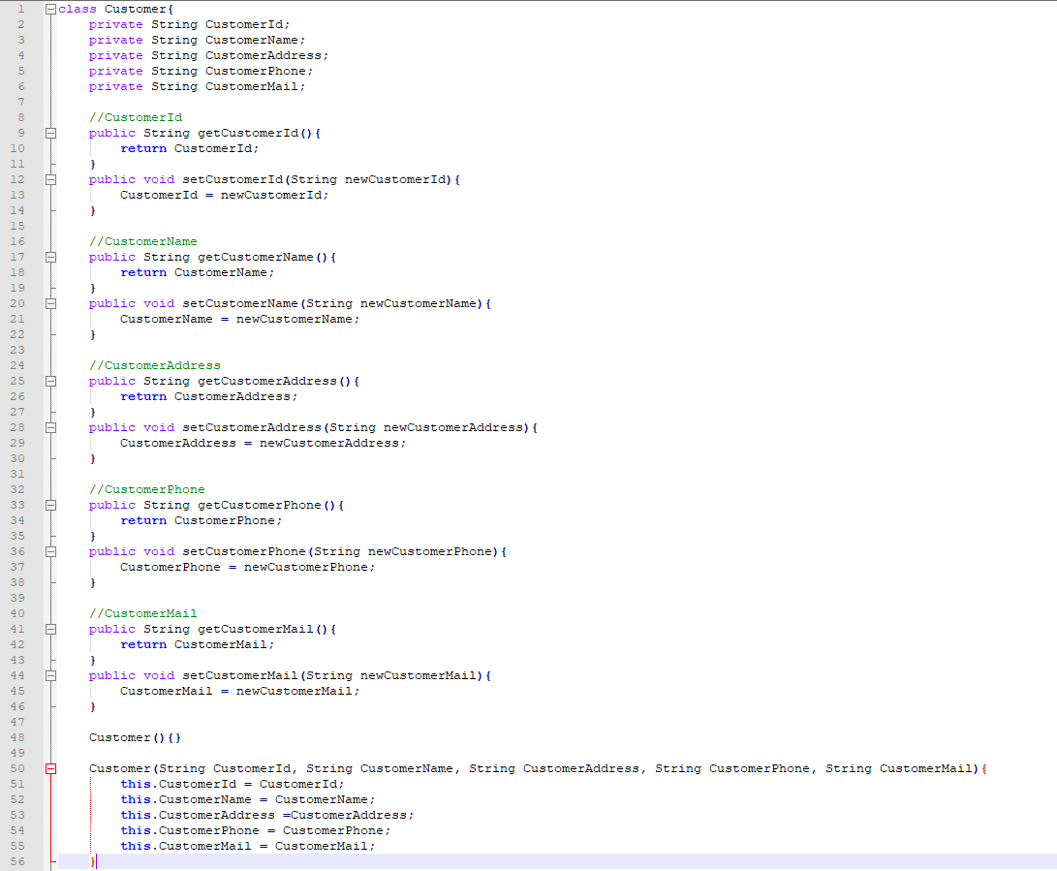
Example Code
Customer

Slide 34
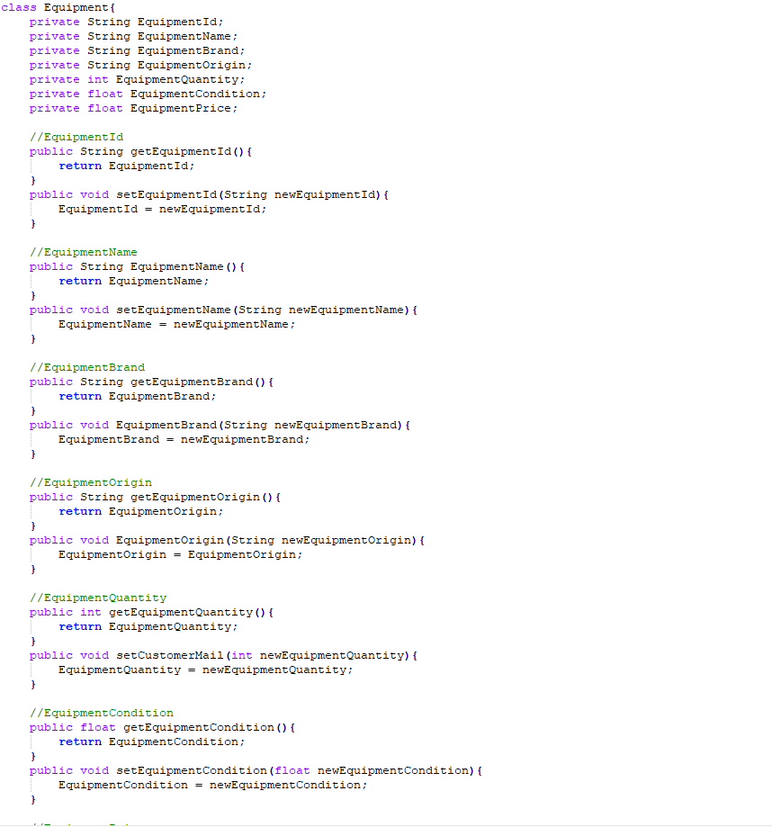
Example Code
Equipment

Slide 35
THANKS FOR LISTENING

