Slide 1
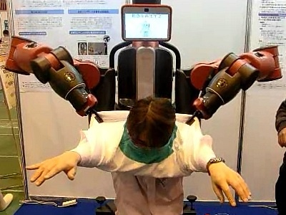

Introduction to Deep Learning
Vishal Gaurav,
PhD Student, Shibata Lab

Slide 2
Deep Learning
Artificial Intelligence
What is AI?
Symbolic AI
Machine learning
Machine Learning
Deep Learning
Rules
Classical Programming
Answers
Data
Data
Machine Learning
Rules
Answers
Notes:
It developed in 1950s
With a ques if machine can think?

Slide 3
Learning representation from data
For ML
Input data points
Examples of the expected output
A way to measure weather the algorithm is doing a good job
DL is a mathematical framework for learning representation from data

Slide 4
Introduction
Imagine you work for a bank
Need to predict how many transaction each customer will make next year
Age
Bank Balance
Number of transactions
Retirement status
….

Slide 5
Interaction
Neural Networks account for interactions really well
Deep learning uses especially powerful neural networks
Application
Text
Images
Videos
Audio
Source code

Slide 6
Course structure
First we focus on conceptual knowledge
Debug and tune deep learning models on conventional prediction problems
Lay the foundation for progressing towards modern applications

Slide 7
Deep learning models capture interactions
Input layer
Hidden layer
Output layer
Age
Bank Balance
Retirement status
Number of transactions
….
…
….
….

Slide 8
Quiz?
Model 1
Input layer
Hidden Layer
Prediction
# Accounts
Output
# Children
Model 2
Input layer
Hidden Layer
Prediction
#Accounts
Output
# Children

Slide 9
Forward Propagation
Bank transaction example
Only using #children and # Accounts
Input
Hidden layer
2
1
5
# Children
Output
1
2
9
-1
# Transactions
3
1
-1
# Accounts
1

Slide 10
Forward Propagation
Multiply-add process
Dot product
Forward propagation for one data point at a time
Output is the prediction for that data point

Slide 11
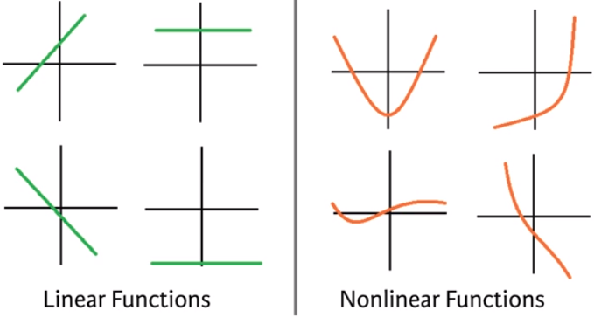
Activation Functions
Linear vs Non-linear

Slide 12
Activation function
Applied to node inputs to produce node output
Eg. Sigmoid, tanh, relu, leakyRelu etc..
2
1
tanh(2+3)
# Children
Output
1
2
9
# Transactions
-1
-1
# Accounts
3
tanh(-2+3)
1

Slide 13
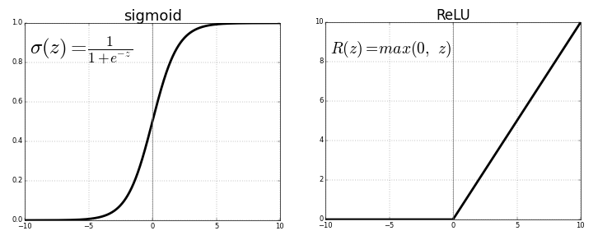
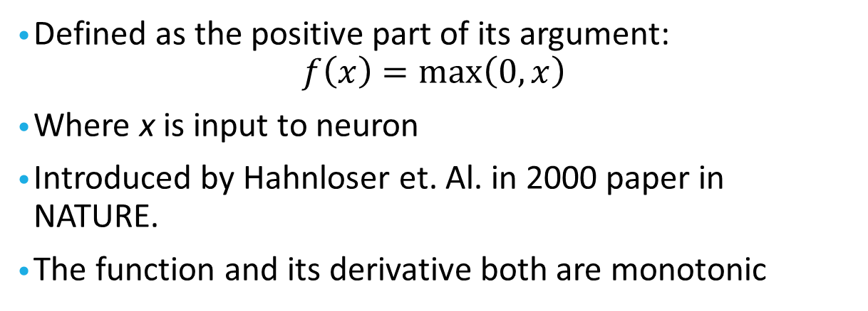
ReLU (Rectified Linear Units)
Defined as the positive part of its argument:
$$f\left(x\right)=\max\left(0,x\right)$$
Where x is input to neuron
Introduced by Hahnloser et. Al. in 2000 paper in NATURE.
The function and its derivative both are monotonic

Slide 14
Deeper Networks
3
2
26
0
-1
-3
4
1
364
4
2
5
0
52
7
-5
2
Calculated with RELU activation function

Slide 15
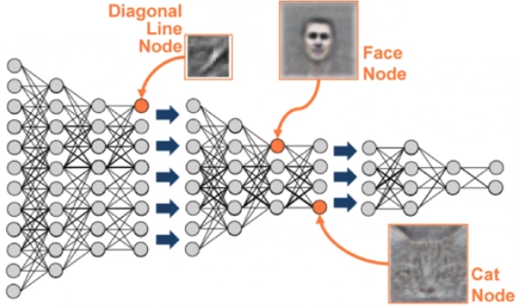
Representation learning
Deep networks internally build representation of patterns in the data
Partially replace the need for feature engineering
Subsequent layers build increasingly sophisticated representation of raw data

Slide 16
Deep Learning
Modeler doesn’t need to specify the interactions
When you train the model, the neural network gets weights that find the relevant patterns to make better predictions

Slide 17
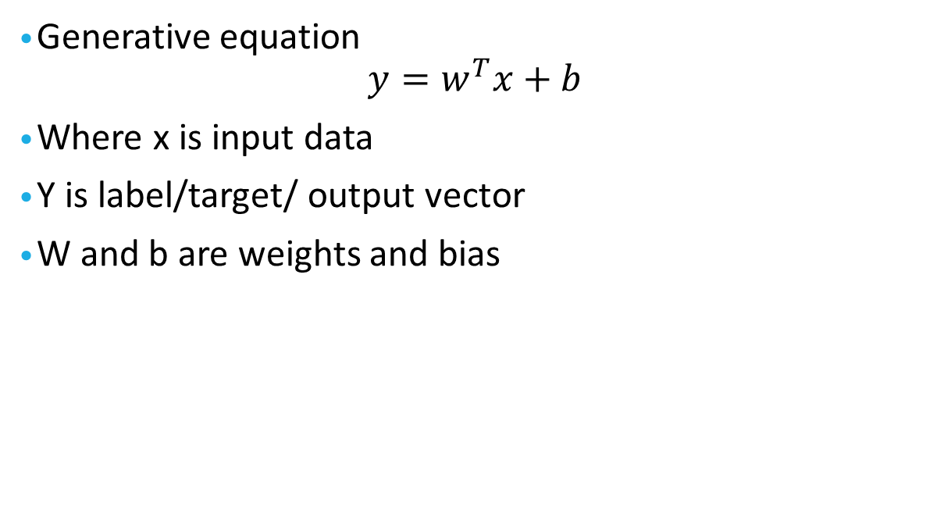
Back Propagation
Generative equation
$$y=w^{T}x+b$$
Where x is input data
Y is label/target/ output vector
W and b are weights and bias

Slide 18
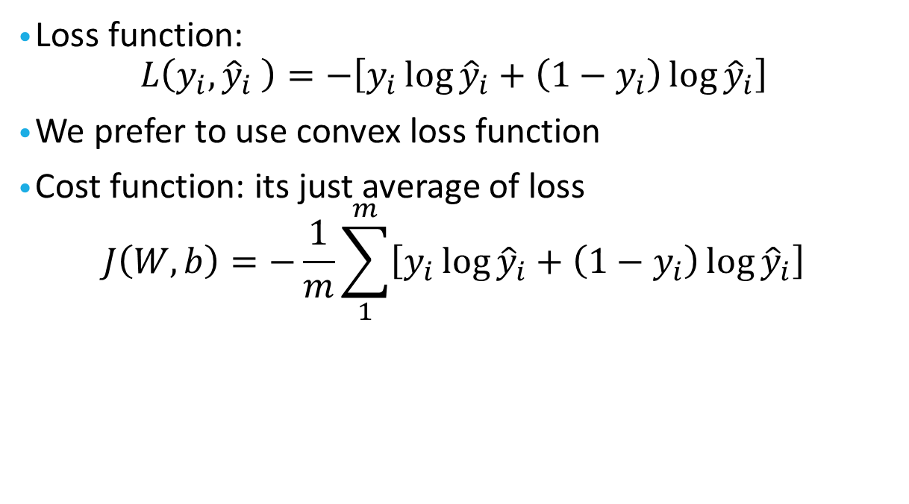
Gradient Decent
Loss function:
$$L\left(y_{i},{\hat{y}}_{i} \right)=−\left[y_{i}\log{{\hat{y}}_{i}}+\left(1−y_{i}\right)\log{{\hat{y}}_{i}}\right]$$
We prefer to use convex loss function
Cost function: its just average of loss
$$J\left(W,b\right)=−\frac{1}{m}\sum_{1}^{m}{\left[y_{i}\log{{\hat{y}}_{i}}+\left(1−y_{i}\right)\log{{\hat{y}}_{i}}\right]}$$

Slide 19

Gradient Decent
Parameter Update:
$$W=W−α\frac{δJ}{δW}$$
$$b=b−α\frac{δJ}{δb}$$
Where α is learning rate.

Slide 20
Assignments
Implement CNN classification for MNIST dataset. You can either use Keras or tensorflow or Pytorch
Visualize the activation output of each layer.

Slide 21
Hyper parameter Tuning
Parameters: W, b
Hyper Parameters:
α
#iteration
#hidden layers
#hidden units
Choice of activation function

Slide 22
Training/Dev/Test
Training Set | Hold/Dev Set | Test
Prev- 70/30
Or 60/20/20
Big Data: 1,000,000
98/1/1 %
Or
99.5/0.4/0.1%
Q: What to do if train/test distribution are different?
Note:
Make sure dev and test come from same distribution

Slide 23

Bias/Variance Tradeoff
Human Performance $≈0\%$
Example 1
Train error: 1% good
Dev error: 11% poor
High Variance
Example 2
Train error: 15%
Dev Error: 16%
High Bias
Overfitting
Under fitting

Slide 24
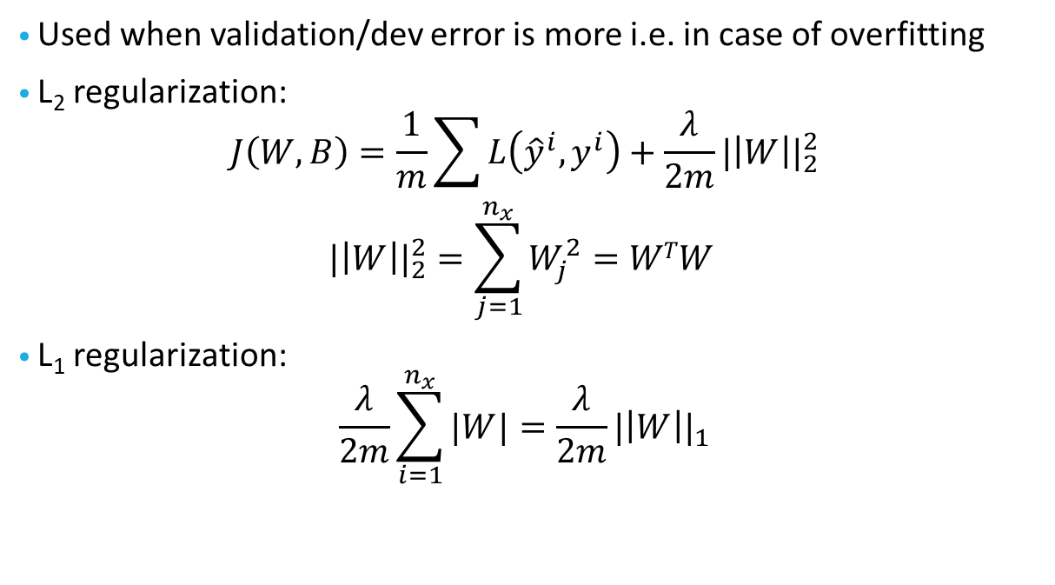
Regularization
Used when validation/dev error is more i.e. in case of overfitting
L₂ regularization:
$$J\left(W,B\right)=\frac{1}{m}\sum{L\left({\hat{y}}^{i},y^{i}\right)+\frac{λ}{2m}{|\left|W\right||}_{2}^{2}}$$
$${|\left|W\right||}_{2}^{2}=\sum_{j=1}^{n_{x}}{W_{j}^{2}=WTW }$$
L₁ regularization:
$$\frac{λ}{2m}\sum_{i=1}^{n_{x}}{|W|}=\frac{λ}{2m}{|\left|W\right||}_{1}$$

Slide 25
Dropout Regularization
Example: with layer 3
KeepProb =0.8
d3 = np.random.rand(a3.shape[0],a3.shape[1])<KeepProb
d3 will be a Boolean array but in python the multiply works
a3 = np.multiply(a3,d3) #a3*=d3
Element wise multiply
At test time : no dropout
Cons: cost function is no longer well defined
It is no longer monotonically decreasing

Slide 26
Other regularization techniques
Data Augmentation
Early stopping
Normalization of Input
Weighted initialization

Slide 27
Optimizers
Moment
RMSprop
ADAM

Slide 28
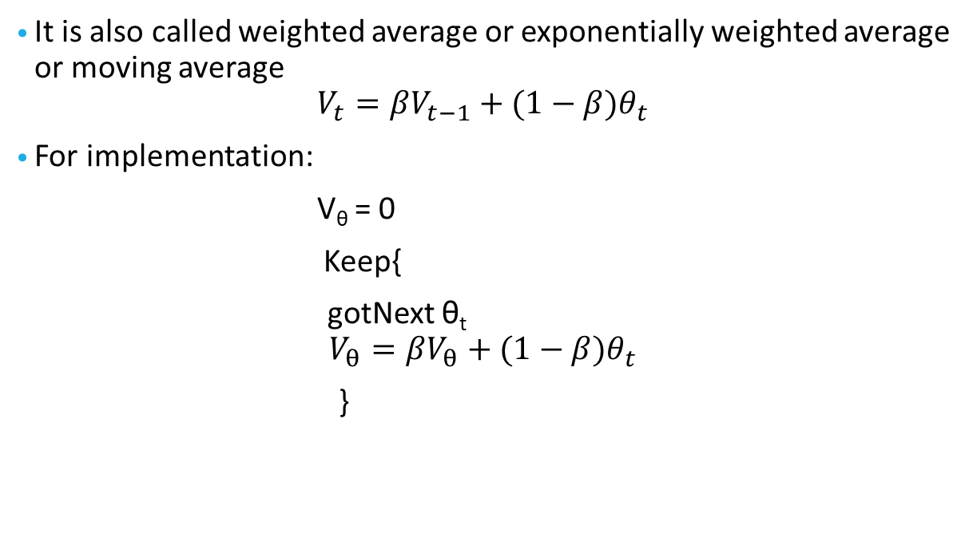
Weighted/Exponential/moving average
It is also called weighted average or exponentially weighted average or moving average
$$V_{t}=βV_{t−1}+(1−β)θ_{t}$$
For implementation:
V_{θ} = 0
Keep{
gotNext θ_{t} $$V_{θ}=βV_{θ}+(1−β)θ_{t}$$
}
Note: It is memory efficient. No need to keep track of every input

Slide 29

Bias correction
$V_{t}=βV_{t−1}+(1−β)θ_{t}$
V₀ = 0
V₁ = 0 + 0.02$θ_{1}$
V₂ = 0.98 V₁ + 0.02$θ_{2}$
= 0.0196$θ_{1}$+ 0.02$θ_{2}$
Bias correction
$$\frac{V_{t}}{1−β^{t}}$$
Note: Use only when t is small

Slide 30
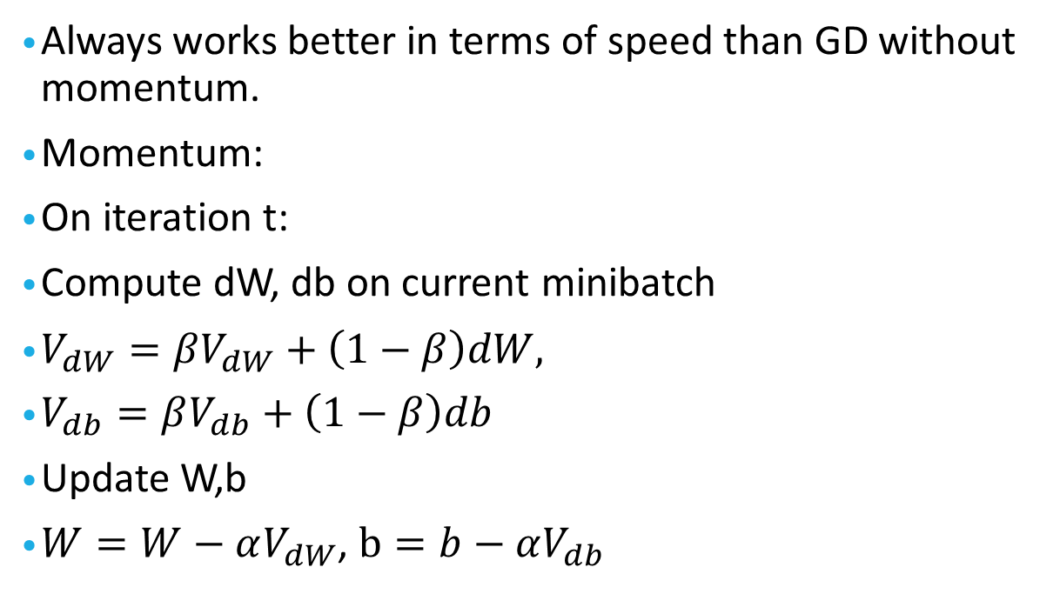
GD with momentum
Always works better in terms of speed than GD without momentum.
Momentum:
On iteration t:
Compute dW, db on current minibatch
$V_{dW}=βV_{dW}+\left(1−β\right)dW,$
$V_{db}=βV_{db}+\left(1−β\right)db$
Update W,b
$W=W−αV_{dW}$, $b=b−αV_{db}$

