Slide 1
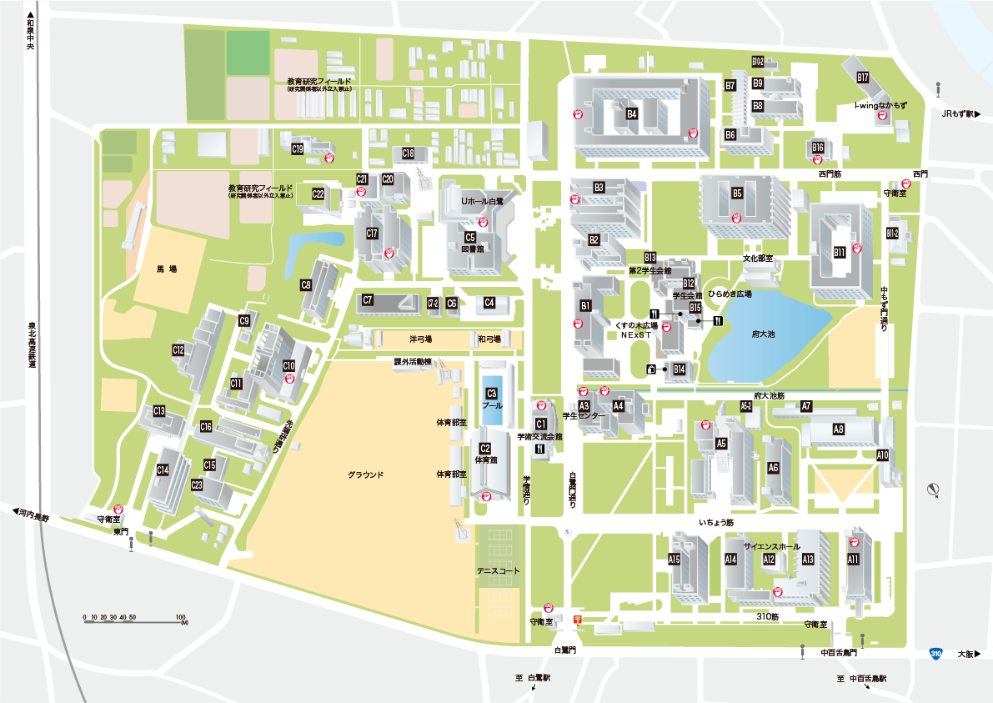
⑮~⑰
㉑
⑬
⑭
⑪
⑫
⑩
⑦⑧
㊳
⑨
㊱㊲
⑮
⑱~⑳
㉒㉓
㉔
㉕~㉗
㉞
㉘~㉝
①②
③
㉟
⑤
④

Slide 2
⑮~⑰
㉑
⑬
⑭
⑪
⑫
⑩
⑦⑧
⑨
⑮
⑱~⑳
㉒㉓
㉔
㉕~㉗
㉞
㉘~㉝

Slide 3
①②
③
⑤
④

Slide 4
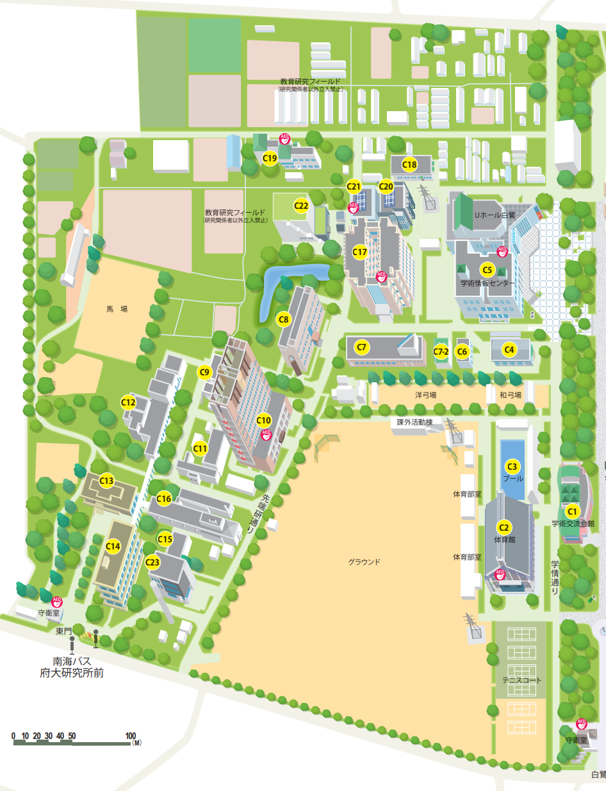
㊳
㊱㊲
㉟

