Slide 1
AMERICAN EXPRESS
DEFAULT PREDICTION
A Transformer-Based Approach
By: Mohamed Naoufal Mahfoudi
1

Slide 2


PREDICTING CREDIT CARD DEFAULTS
Objective:
Develop a predictive model to estimate the likelihood of a customer defaulting on their credit card payments
2

Slide 3
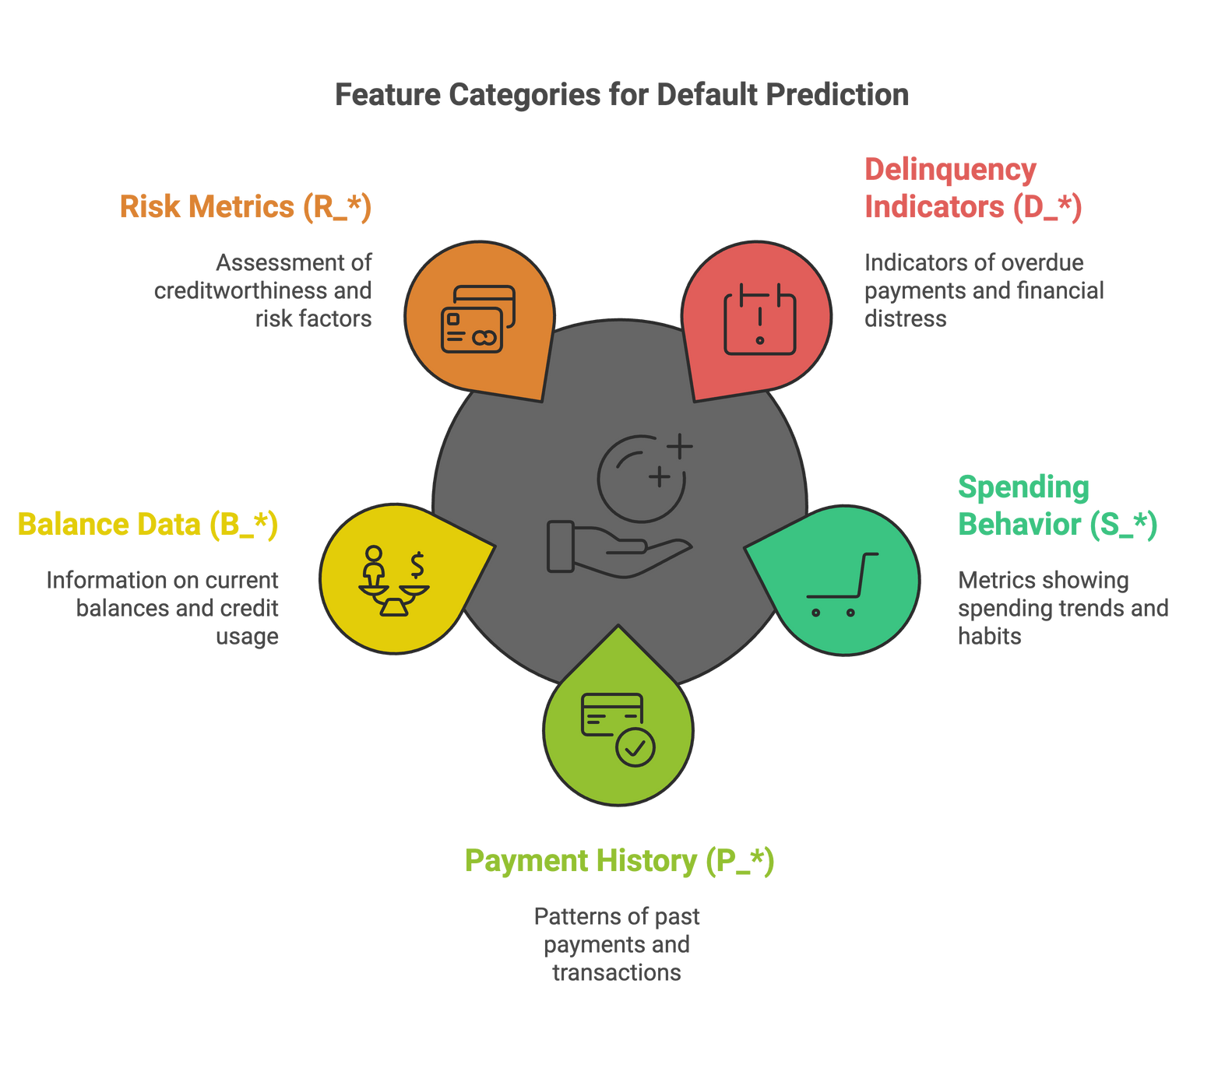
DATASET OVERVIEW FOR DEFAULT PREDICTION
Customer Count: 458,913 unique customers.
Target Variable:
1 = Default
0 = No Default
Analysis Period: 18 months of customer activity.
Default Definition: No payment within 120 days of the latest statement.
3

Slide 4
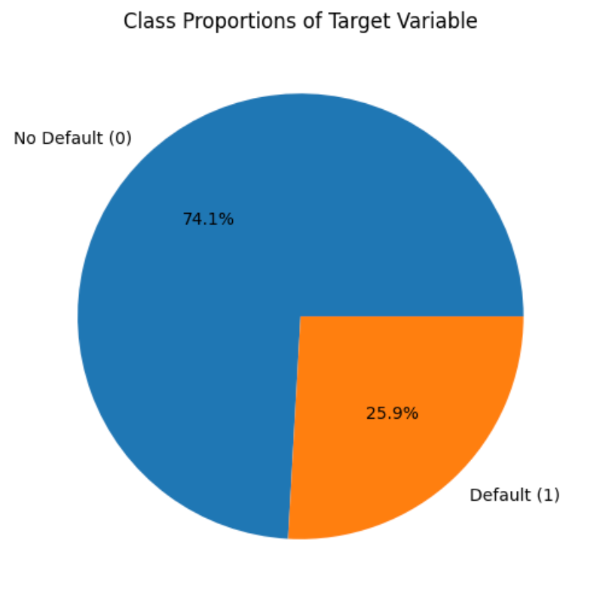
DATASET IMBALANCE
Bias towards predicting non-defaults.
Potential Solutions:
Focus on precision, recall, and F1-score to evaluate performance.
Use techniques like resampling, or class weights to address imbalance.
4

Slide 5
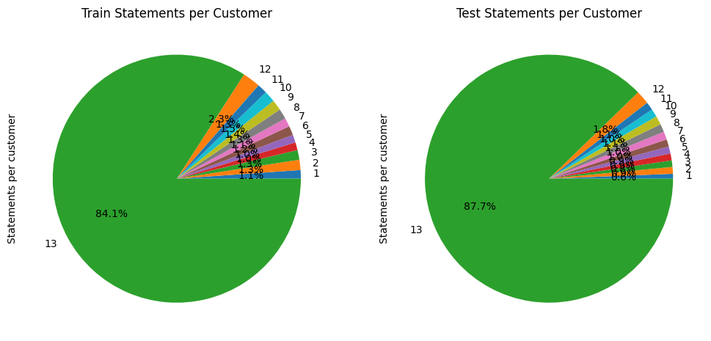
TIME SERIES INSIGHTS: CUSTOMER STATEMENTS
84.1% of customers have 13 statements.
Irregular data lengths can disrupt training for time-sensitive models like transformers.
Homogenization using Padding.
5

Slide 6
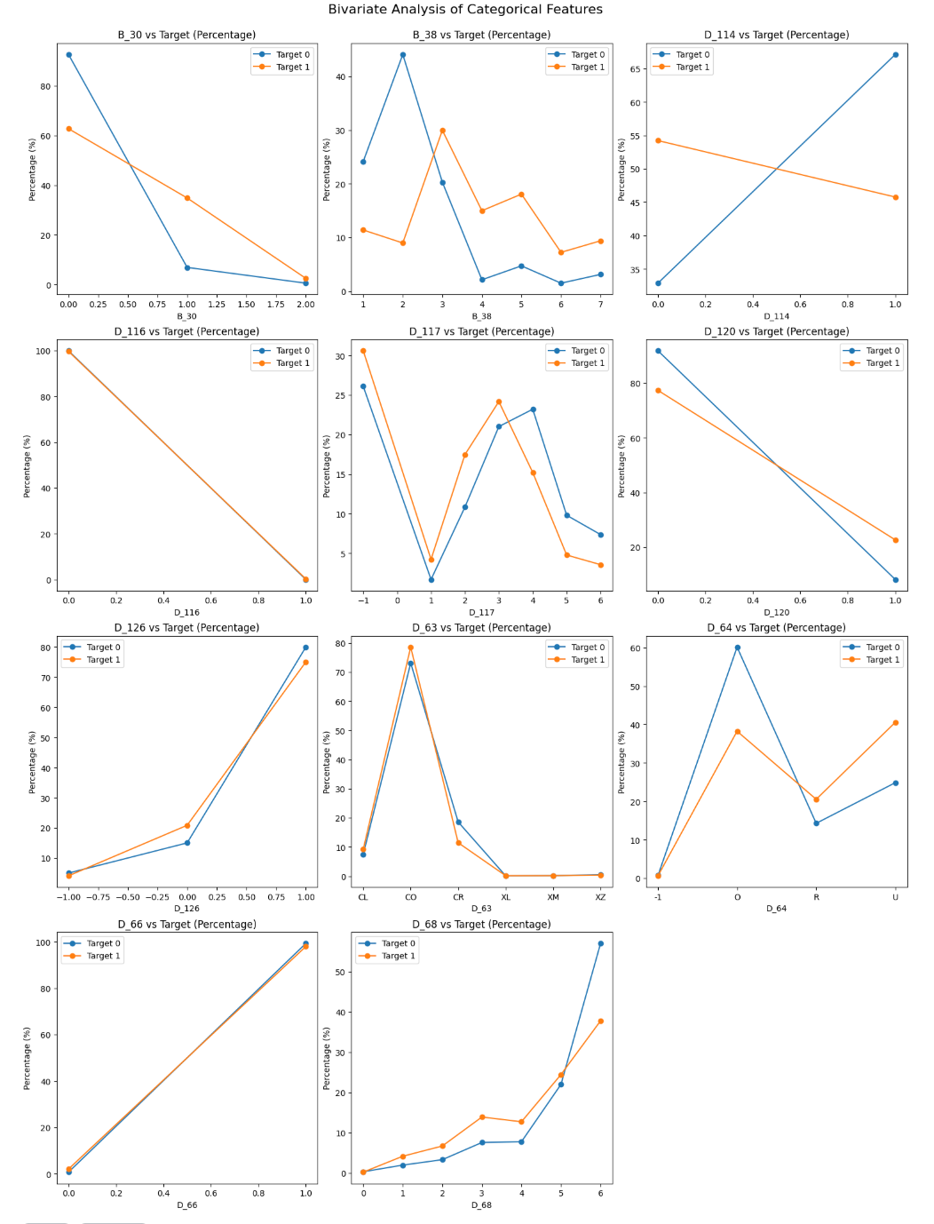
EXPLORING CATEGORICAL PATTERNS IN DEFAULTS
Relationships between features and the target variable.
Examples:
B_30, B_38, and D_114 clear separations, indicating strong predictive potential.
D_117 presents overlapping shapes offers moderate discriminatory power.
D_116 displays limited distinction between targets -> low predictive utility.
6

Slide 7
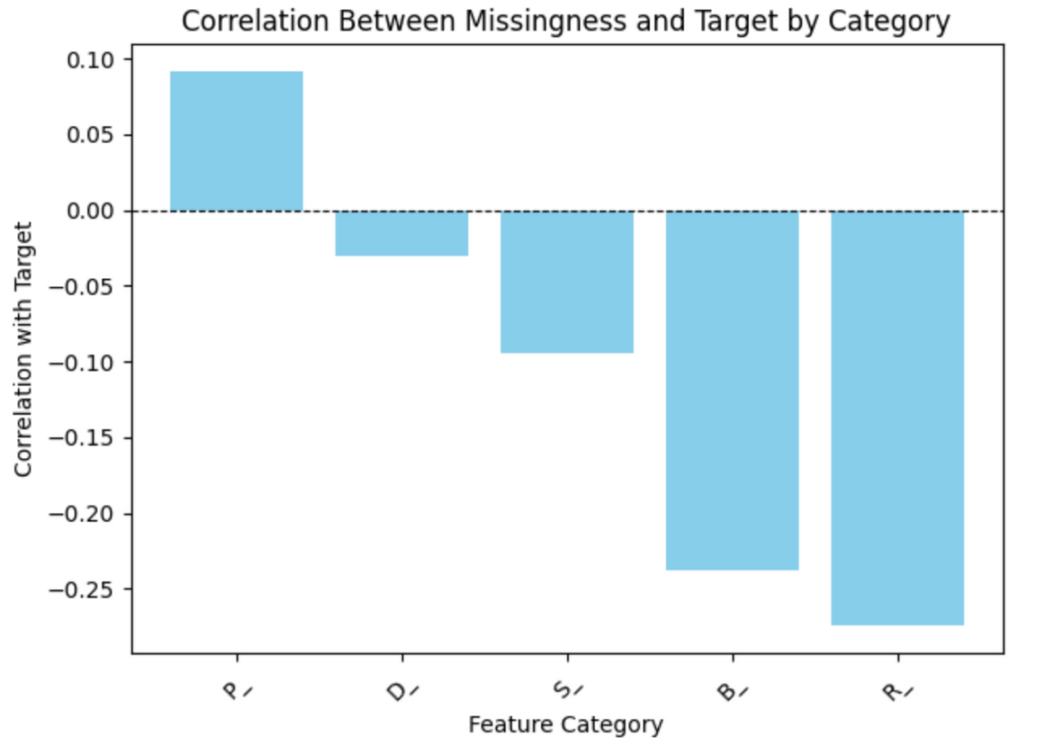
WHAT DOES MISSING DATA TELL US ABOUT DEFAULTS?
Missingness of data potential impact on prediction:
Delinquency (D_*): Minimal impact on predictions.
Spend (S_*): Slightly linked to non-defaults.
Payment (P_*): Indicates a small risk of default.
Balance (B_*): Moderately tied to non-defaults.
Risk (R_*): Strongly signals non-defaults.
Leverage missingness to capture these patterns effectively.
7

Slide 8
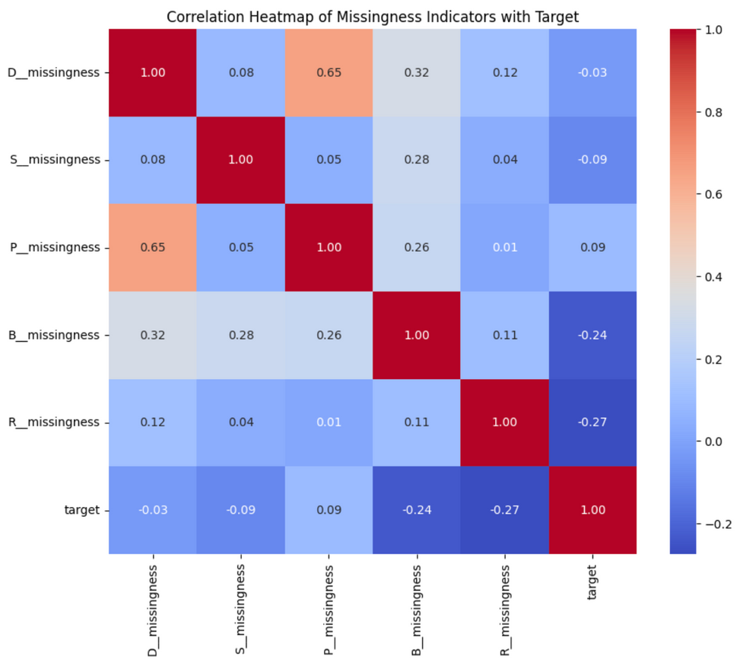
MAPPING CONNECTIONS IN MISSING DATA PATTERNS
Payment & Delinquency (0.65) missed payments <-> delinquent behavior.
Balance & Delinquency (0.32) could indicate shared account challenges.
Balance & Spend (0.28) and Balance & Payment (0.26) could help understand patterns in spending, payments, and balances reveal common financial habits
Balance (-0.24) and Risk (-0.27) data are strongly correlated with default risk.
8

Slide 9
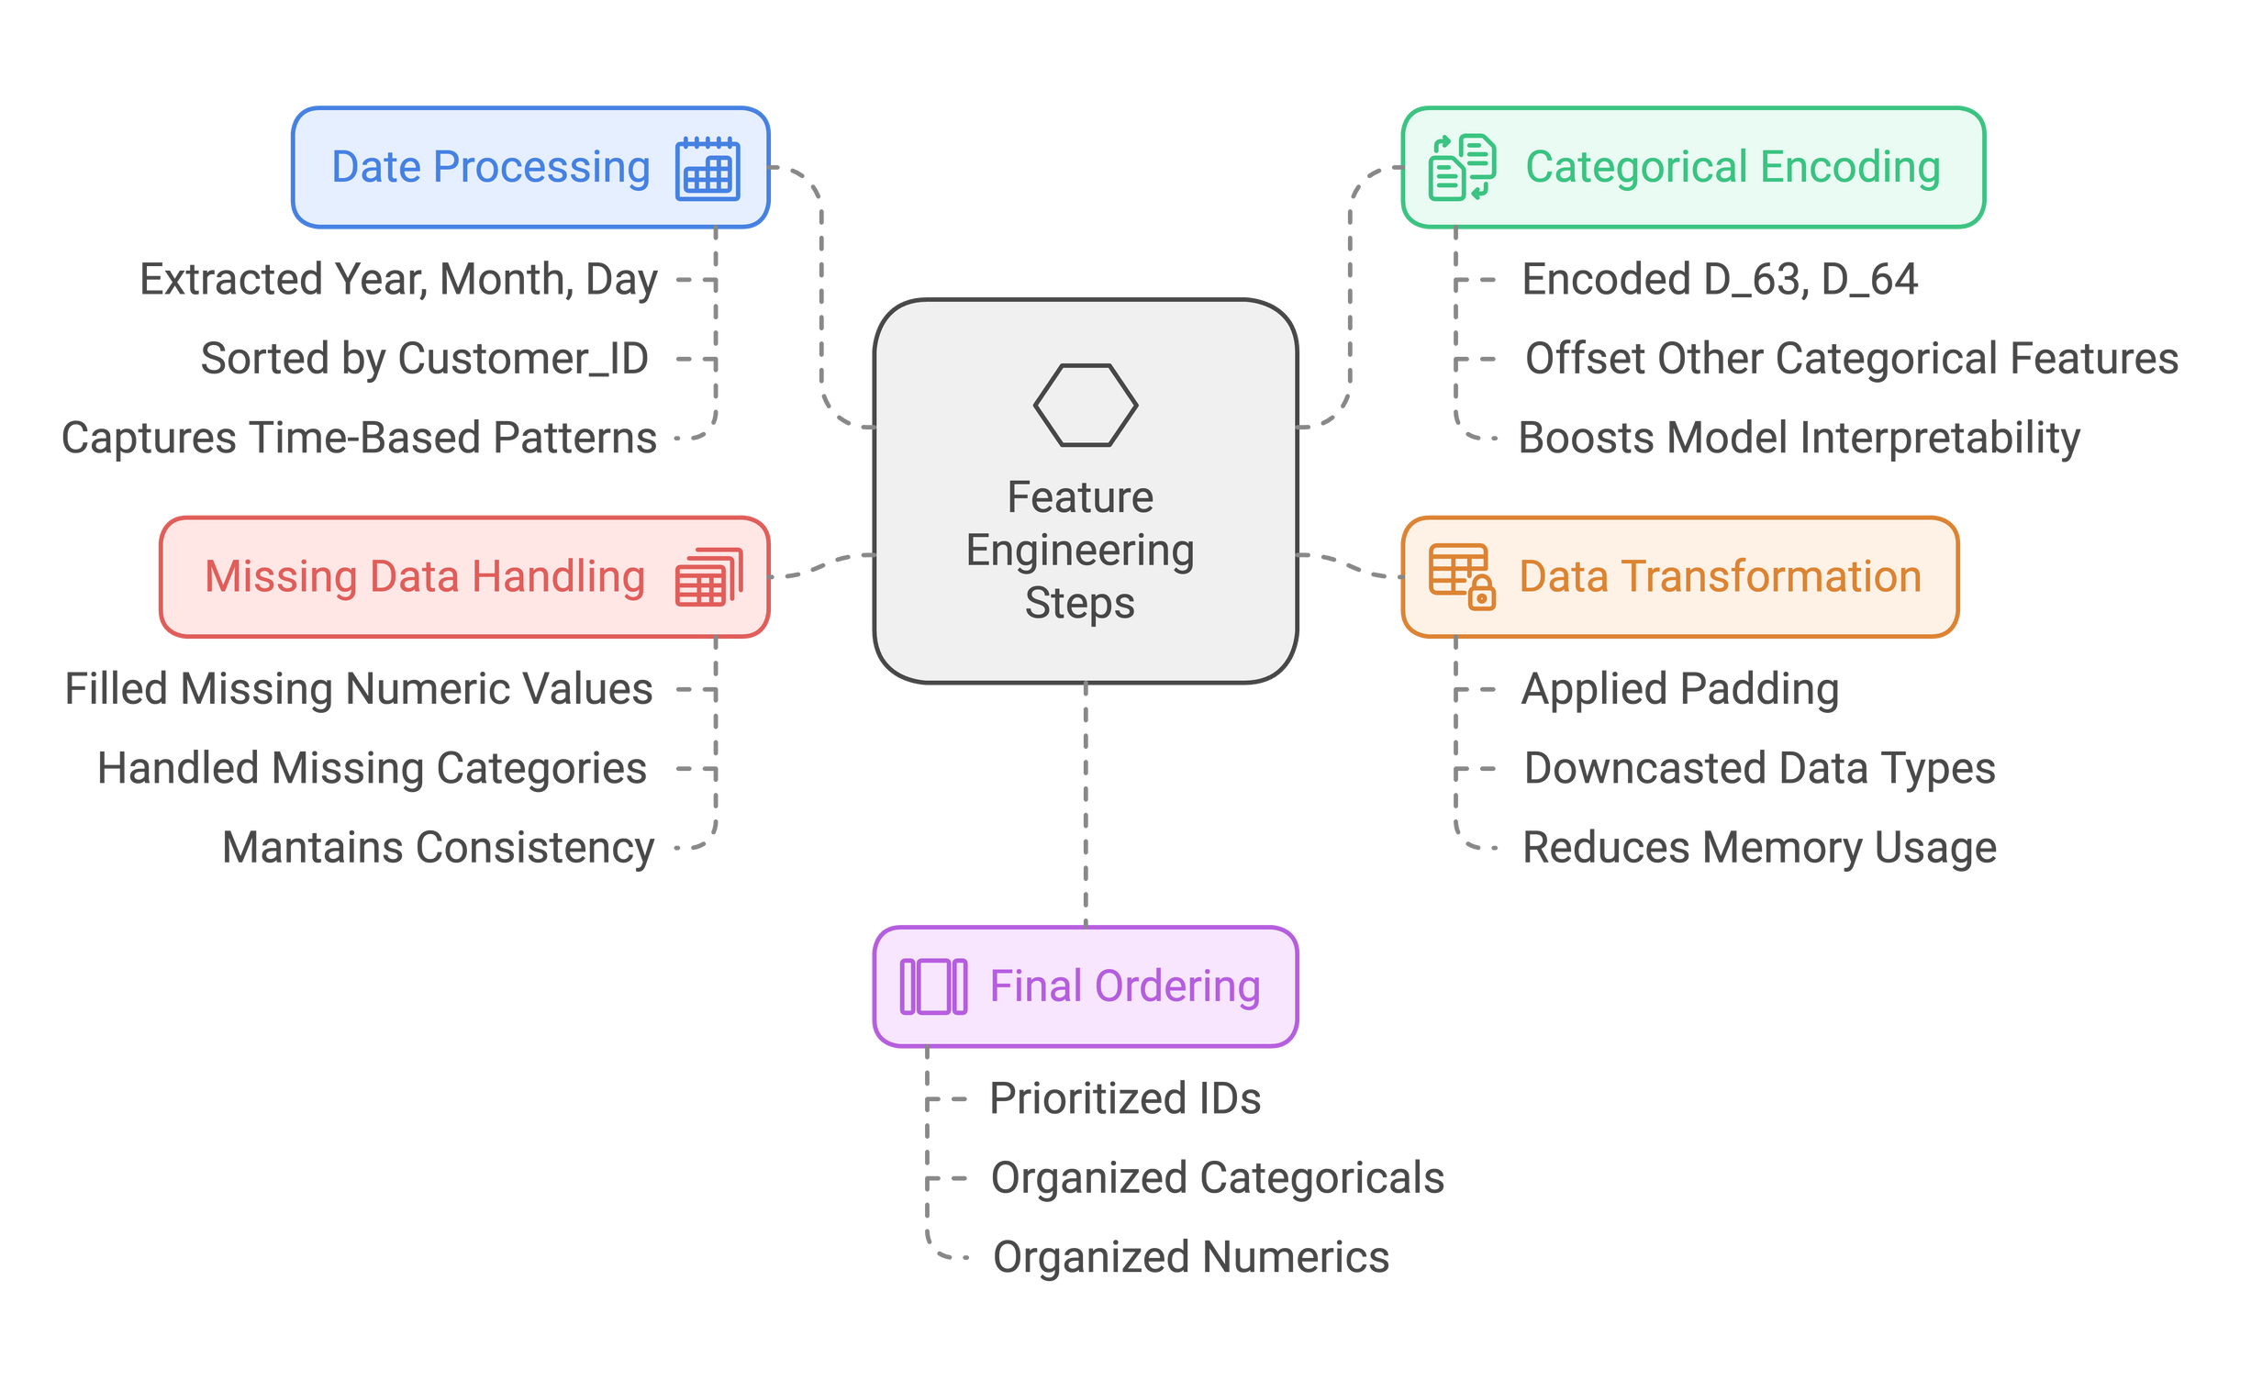
Feature Engineering & Preprocessing
9

Slide 10
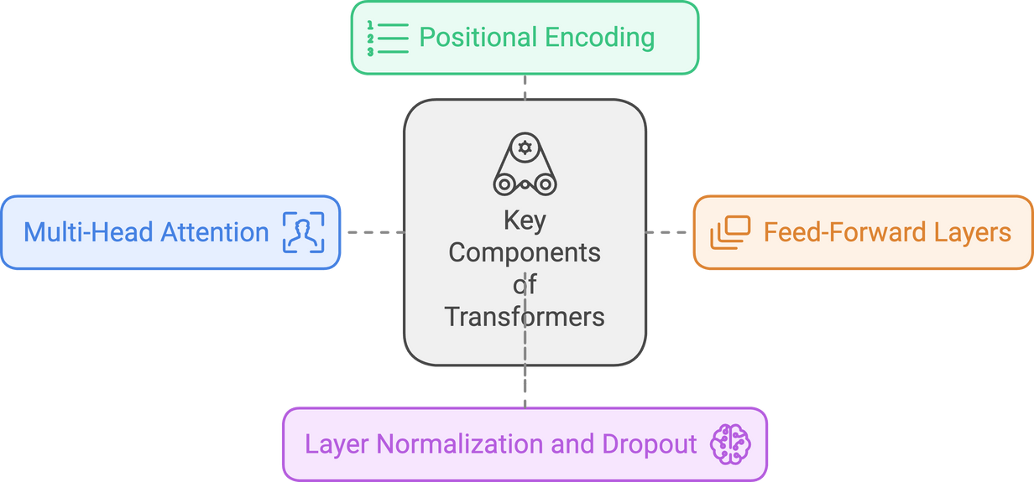
UNDERSTANDING TRANSFORMERS
What Are Transformers?
A type of neural network designed to handle sequential data efficiently.
They are particularly good at capturing long-range relationships in data.
Why Use Them?
Ideal for modeling temporal dependencies in customer behavior.
Excellent at capturing complex relationships in high-dimensional data.
10

Slide 11

Output
Classifier
MODEL DESIGN
Add & Residual Scaling
Transformer Architecture:
Transformer Blocks: Multi-head attention with feed-forward networks for capturing sequential dependencies.
Positional Encoding: Adds temporal context for time-series data.
Embedding Layers:
To convert categorical features into numerical representations.
Classifier Network:
Fully connected layers with ReLU activations and dropout for regularization.
Output: A sigmoid layer predicting default probabilities.
Dropout
Norm and
Feed Forward
ff_dim: 512
4 x
Add & Residual Scaling
Dropout
Multi-Head Attention
num_heads: 4
Pre-Norm
Positional Encoding
embed_dim = 256
Dense Layer
Categorical Features Embeddings
11 embedding layers
Vector size 4
Numerical Features
Categorical Features
Inputs
(Batch_Size, 13, 188)
11

Slide 12
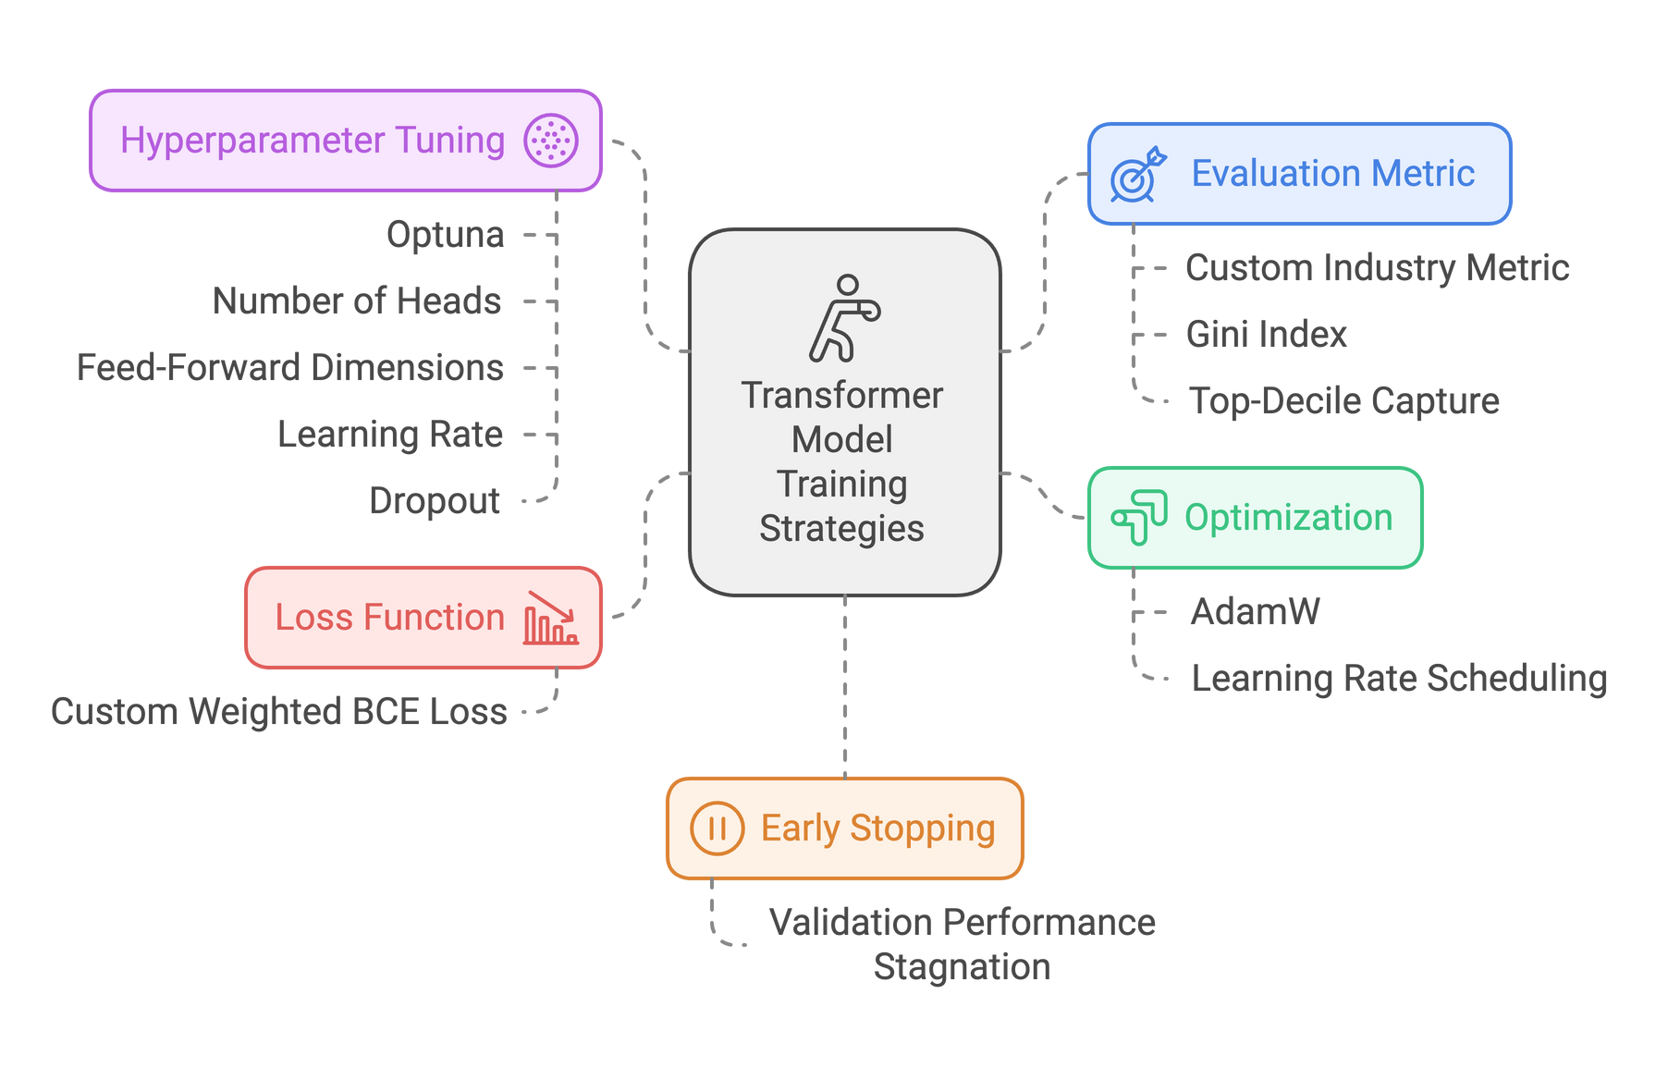
TRAINING AND TUNING THE TRANSFORMER MODEL
12

Slide 13
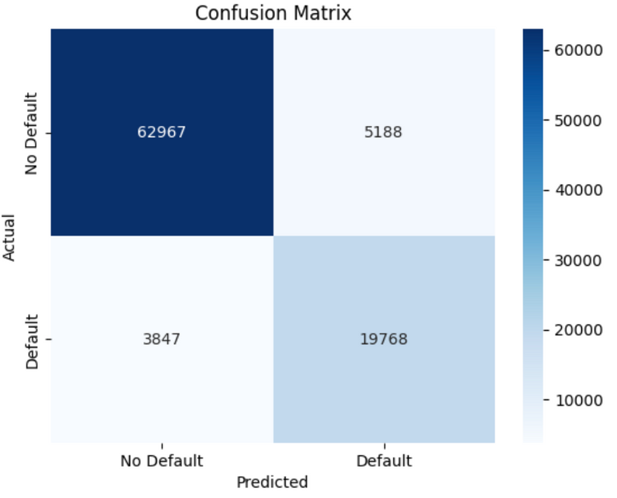
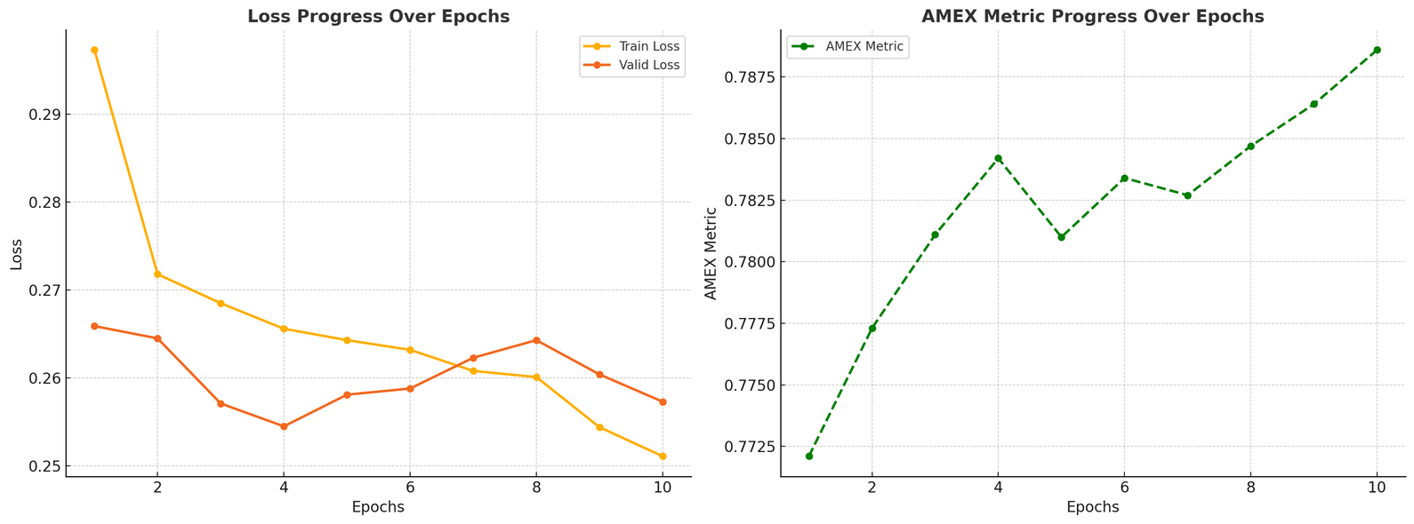
RESULTS
Performance Metrics
AMEX Metric: 0.7886
Precision: 79.21%
Recall: 83.71%
F1-Score: 81.40%
Possibility to improve recall and capture more missed defaulters.
13

Slide 14




CONCLUSION
We Built a Transformer-based model for credit card default prediction.
We achieved 0.7846 in AMEX Metric.
We captured data patterns, handled class imbalance, and optimized performance.
We plan to enhance recall by either by integrating data augmentation or trying ensemble methods.
14

