Slide 1
SSD Detection Efficiency

Slide 2
Case 1: From the MCP surface
Corresponding to the beam produced at V_{A} = 3000 V, V_{C} = 2810 V

Slide 3
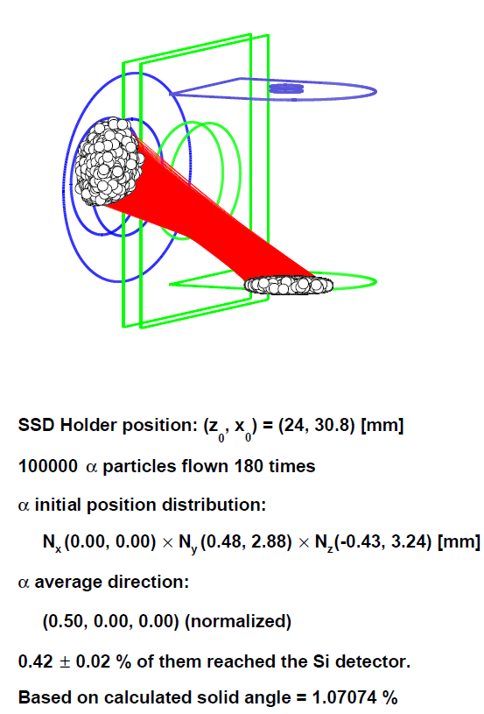
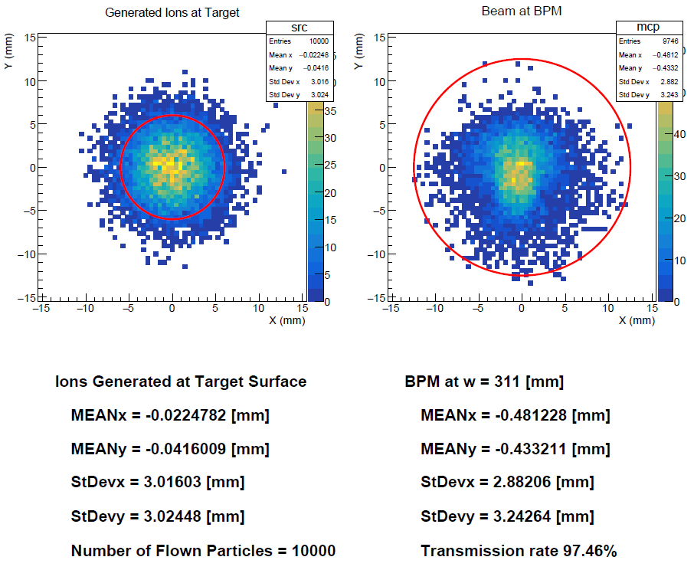

Slide 4
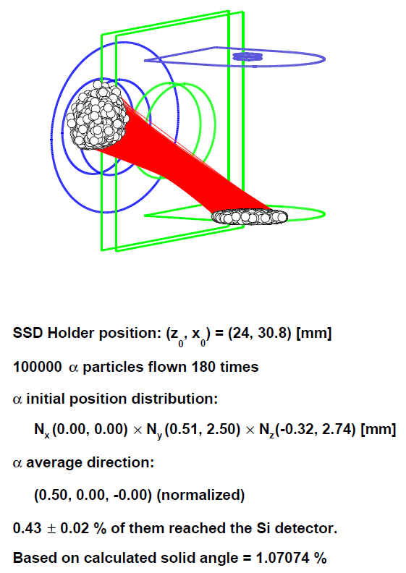
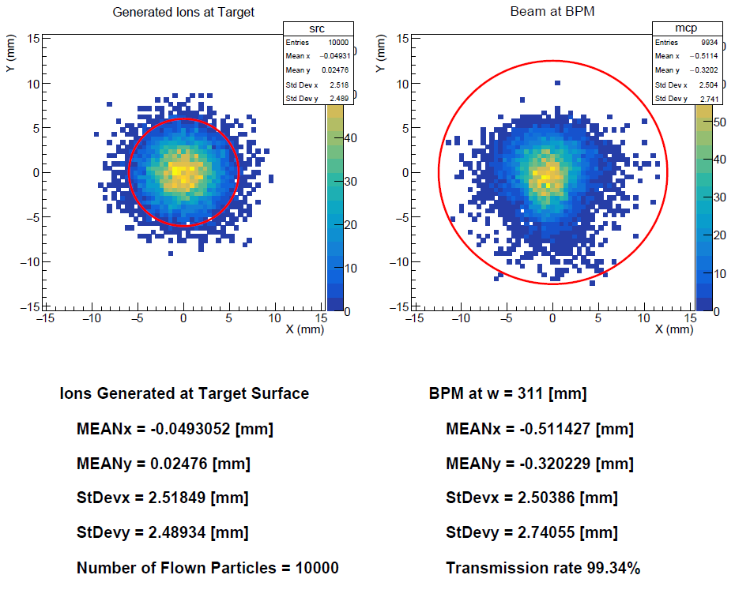

Slide 5
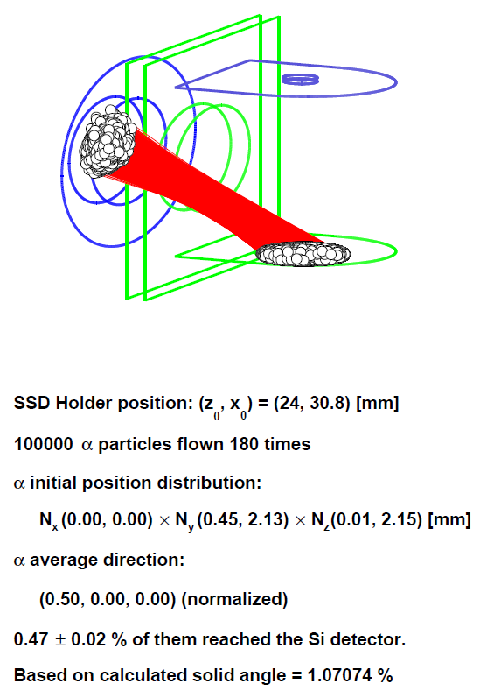
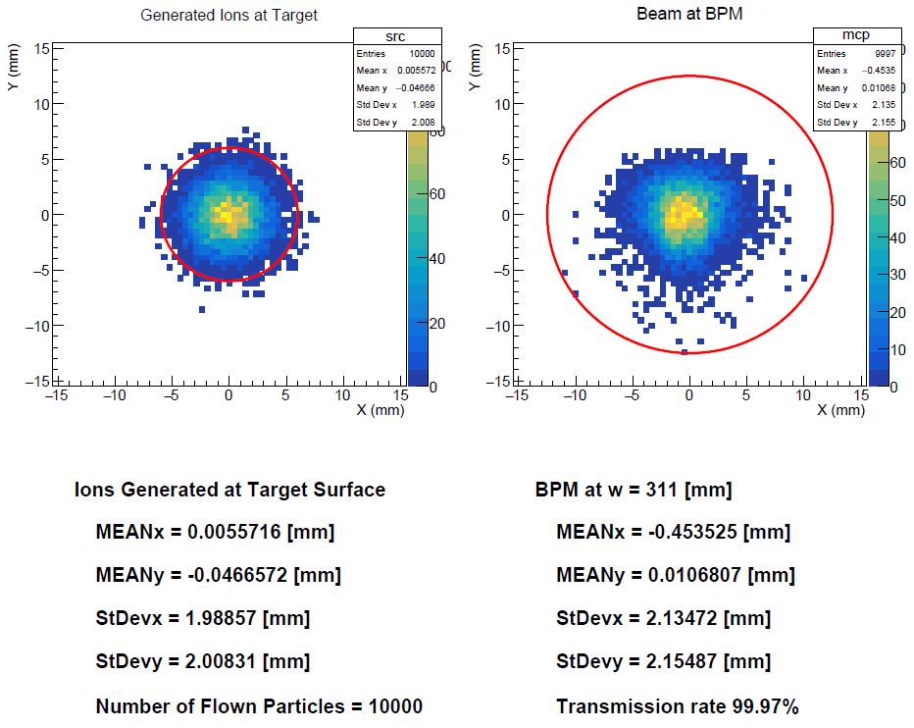

Slide 6
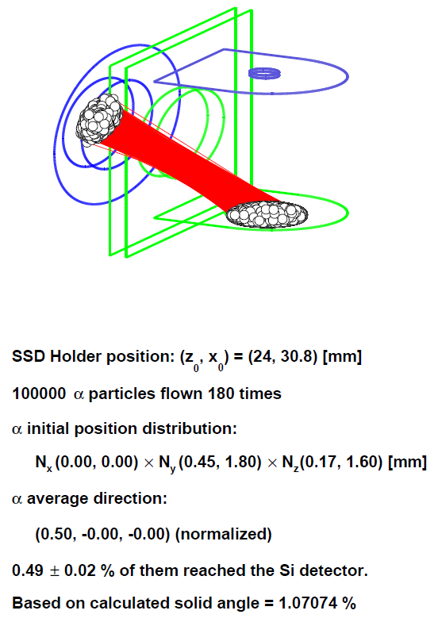
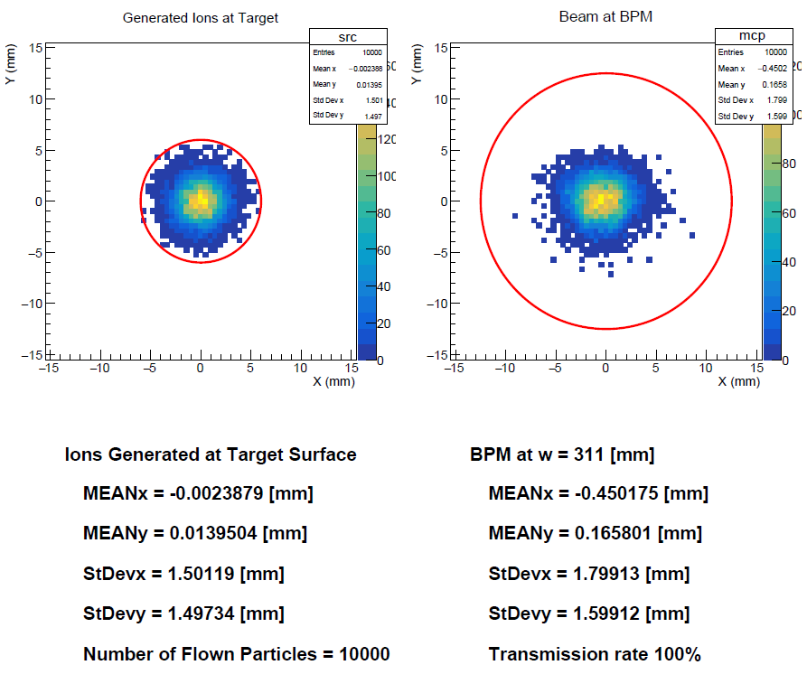

Slide 7
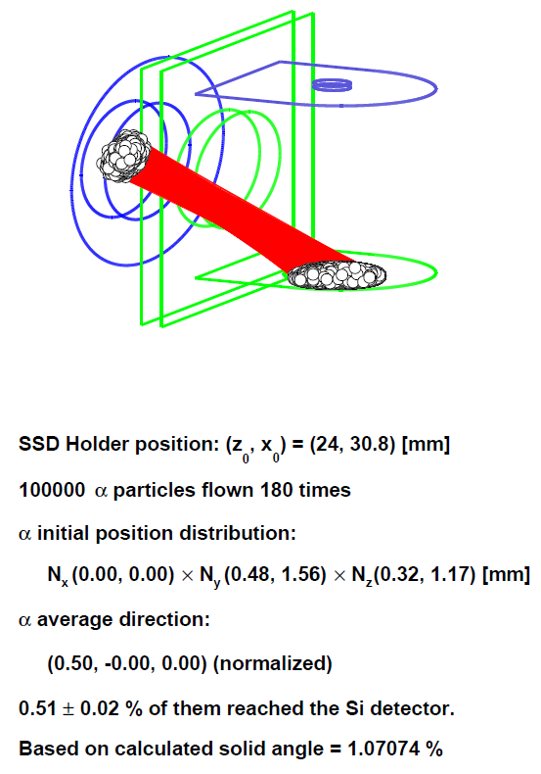
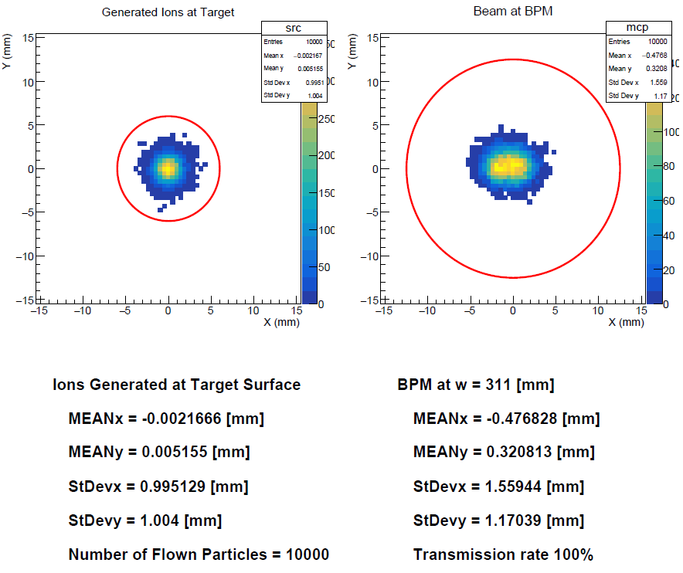

Slide 8

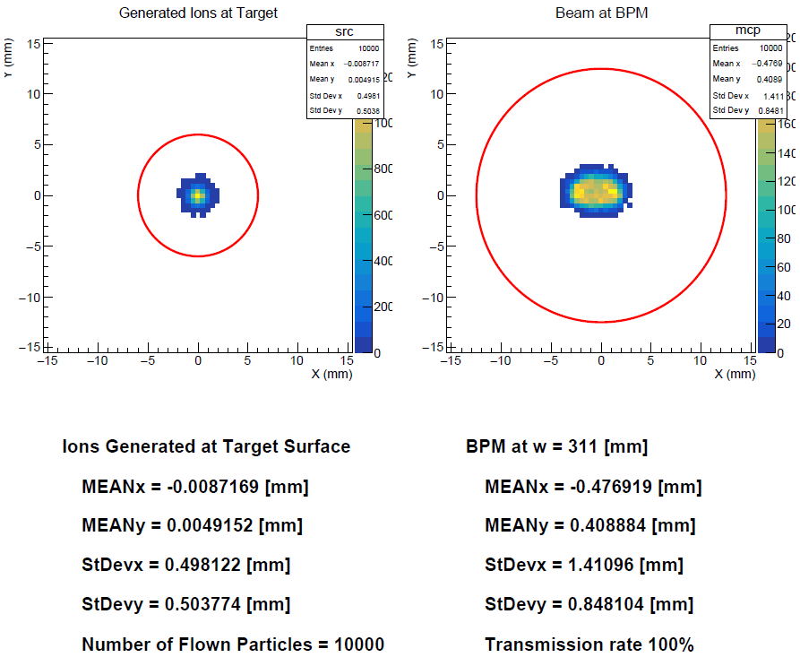

Slide 9
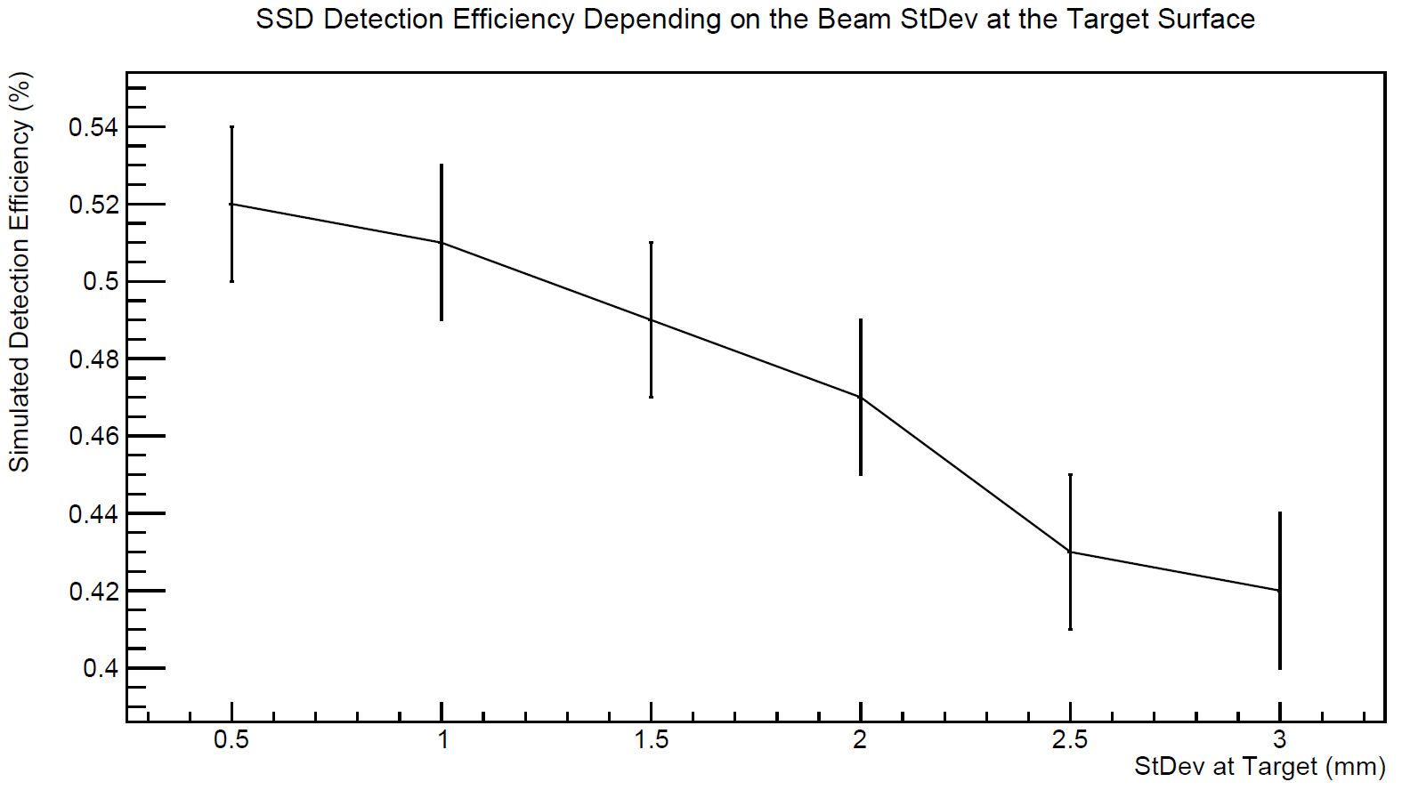

Slide 10
Case 2: From the MCP lid surface

Slide 11
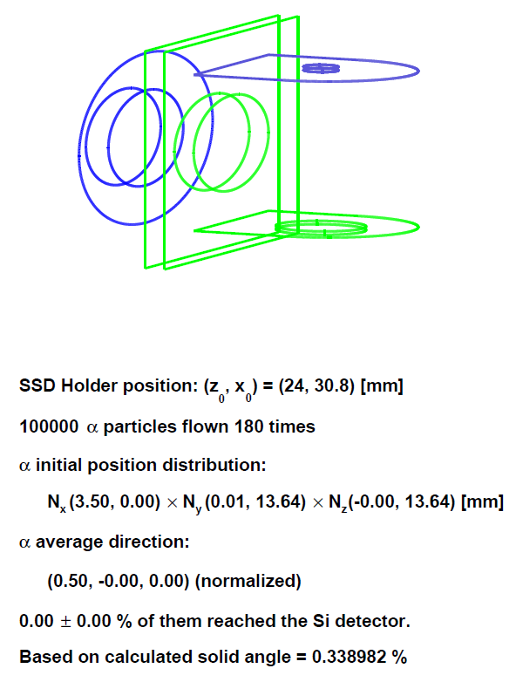

Slide 12
Case 3: From the SSD Holder Plate Surface

Slide 13
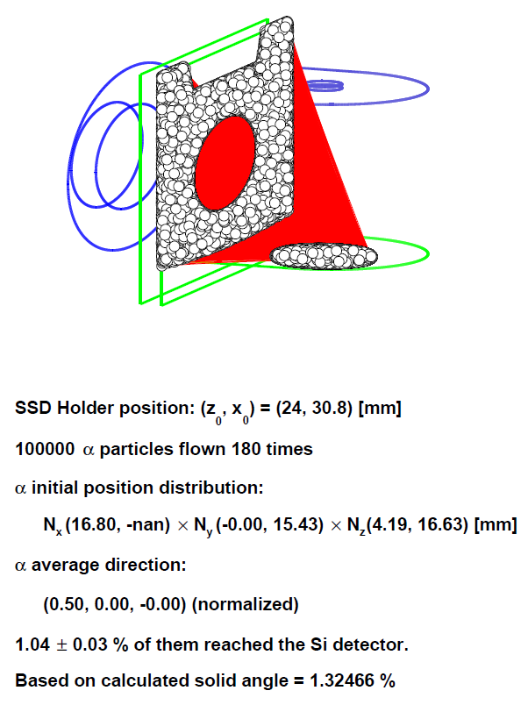

Slide 14
Case 4: From the Am Box Lid Surface

Slide 15
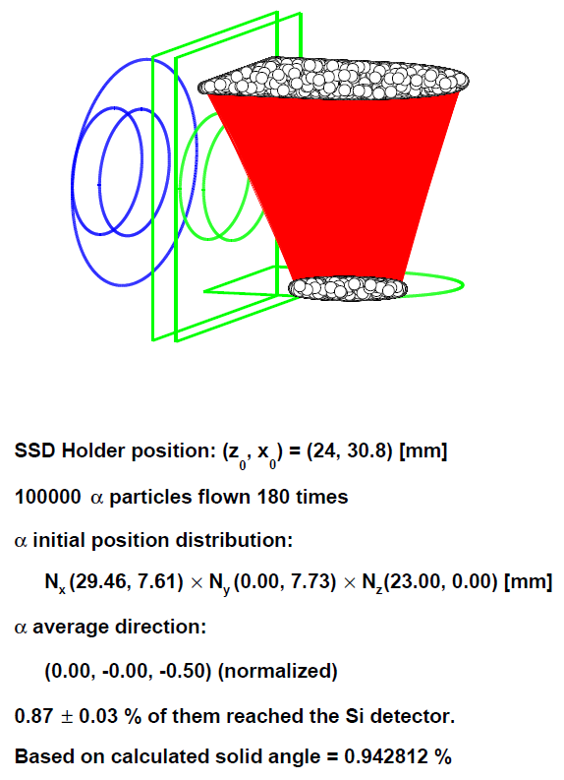

Slide 16
Case 5: From the Am Source

Slide 17
