Slide 1
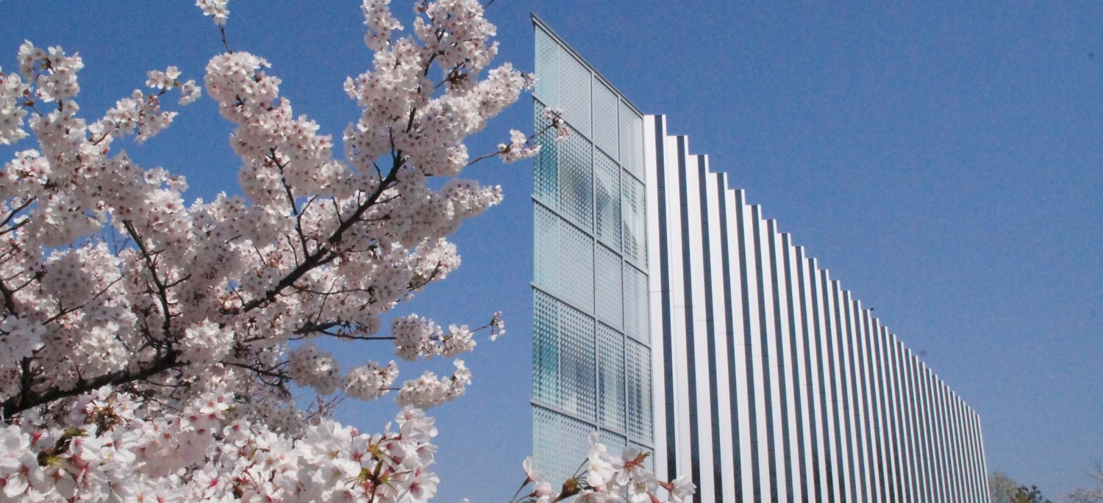

Network Analysis
～Facebook users’ relationship～
Notes:
Hai, my name is Naoya Miyazaki.
Today, I’m going to talk about my analysis of network.

Slide 2
Analysis Target
Notes:
When I first heard of ‘network analysis’ , I came up with SNS.

Slide 3
Analysis Target
SNS – Social Networking Service
Notes:
Formal name of SNS is social networking service.
Today, most of people use SNS everyday, every time.

Slide 4


Analysis Target
SNS – Social Networking Service
Use a dataset of Facebook friends lists
Notes:
Especially, Facebook has the most users in the world.
That means we may get some interesting data by analyzing it.

Slide 5
Analysis Target
SNS – Social Networking Service
Use a dataset of Facebook friends lists
https://snap.stanford.edu/data/ego-Facebook.html
Notes:
That’s why I chose Facebook data to analyze.

Slide 6
Details of the Facebook network
Nodes : 4039
Edges : 88234
Average degree : 43.6910
Notes:
Network I analyzed have 4 thousands 39 nodes, and 88 thousand 2 hundred 34 Edges.
This network has a lot of nodes and Edges , so that I had to wait for about 5 minutes per 1 execution of programs.

Slide 7
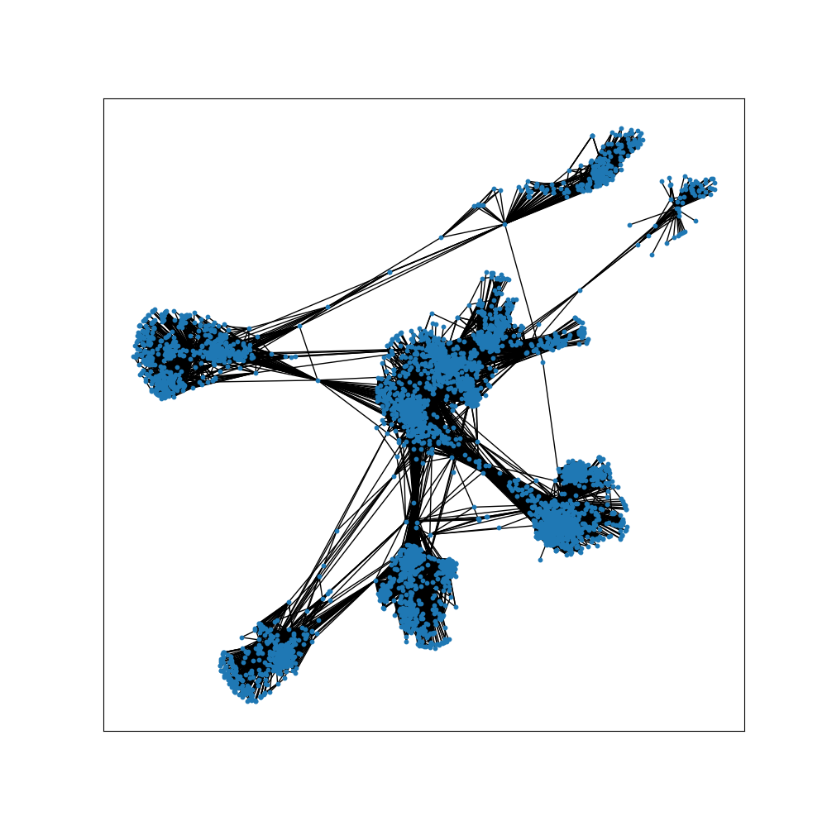
Details of the Facebook network
Notes:
This figure visualizes the network.

Slide 8
Details of the Facebook network
Notes:
This figure visualizes the network.
As you can see, there are mass groups of nodes in each circle.
Also, some nodes make bridge between groups.
From this figure, I conducted centrality analysis and community separation.

Slide 9
Centrality
Degree Centrality
Good : show many connections
Bad : do not consider value of each node
Betweenness Centrality
Good : detect nodes which connect groups
Bad : Low degree node may have a high betweenness centrality
Notes:
In centrality, I especially investigated in degree centrality and betweenness centrality.
Every centrality detections have both good and bad parts.
We have to note these points.
Degree centrality show many connections but do not consider value of each node.
Betweenness centrality detect nodes which connect groups but low in degree may have high in betweenness.
I picked up these two method.

Slide 10
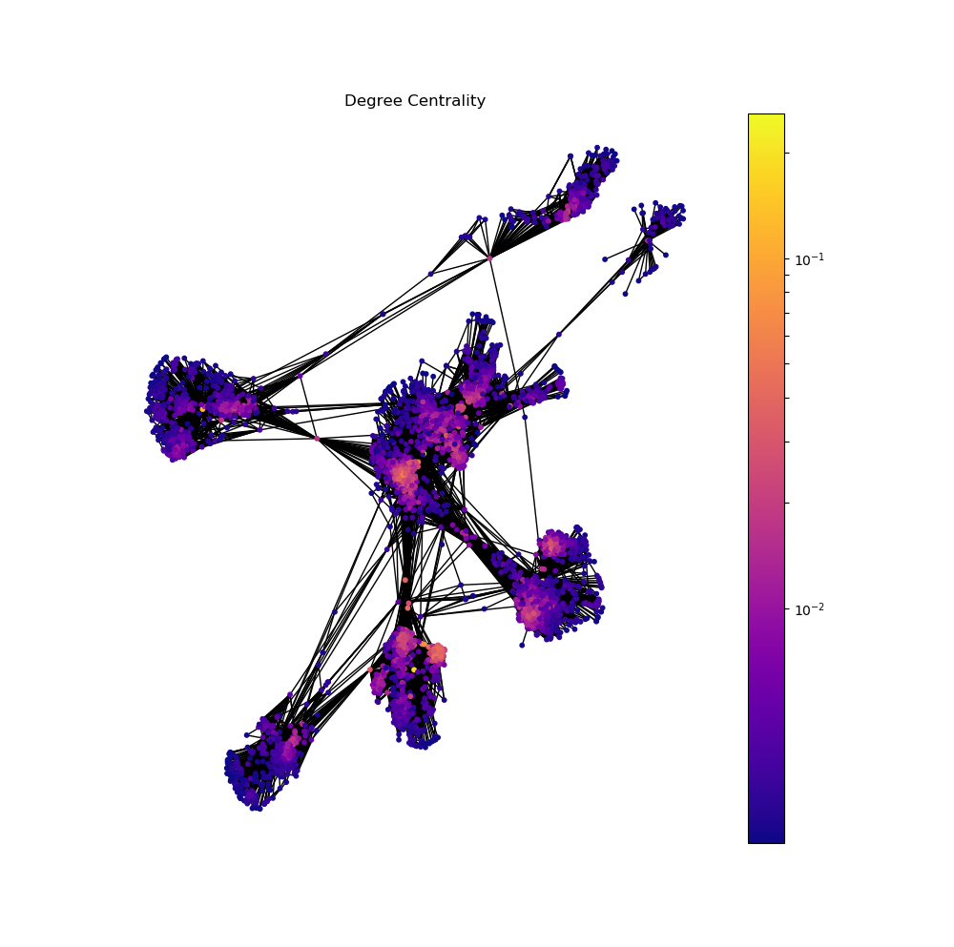
Degree Centrality
Notes:
In this Facebook network, degree centrality indicates the degree of being famous of each node.
The higher the degree centrality is, the more the person known by many people.
Nodes which have high degree centrality may be important people in the groups they belong to.
When you look at this figure, Each group has some nodes which have high degree centrality.

Slide 11
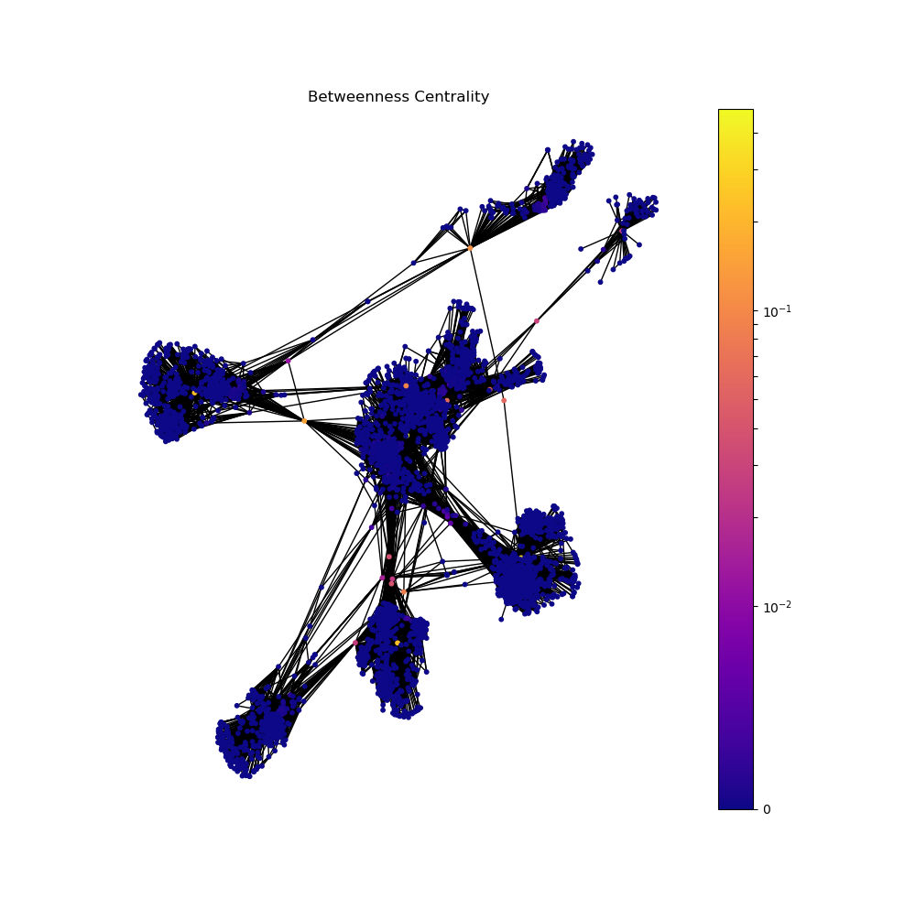
Betweenness Centrality
Notes:
While betweenness centrality indicates how a node have a roll of bridge between different communities.
By separating this network by nodes which have high betweenness centrality, communities can be extracted from the network.
As you can see in this figure, yellow and orange nodes connect one group to another.
These nodes may be the borders of each communities.
So, let’s see communities in this network.

Slide 12
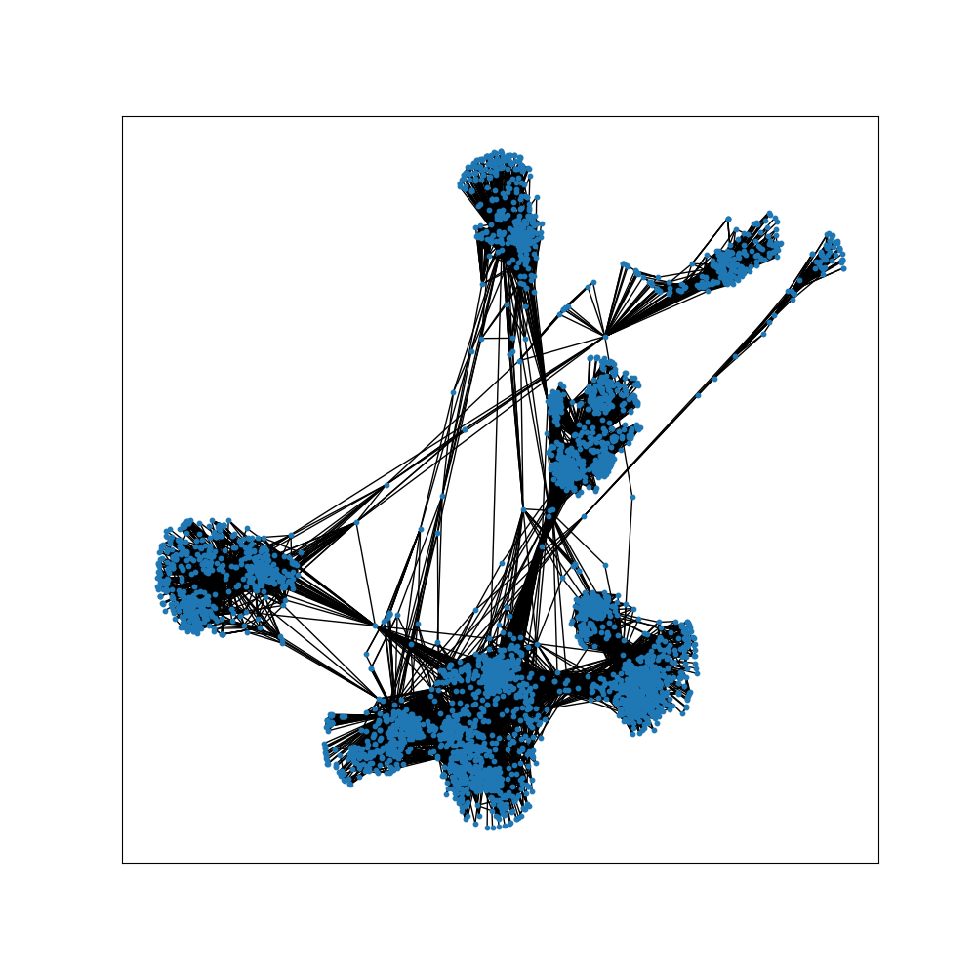
Extraction of Communities
You can see mass groups of nodes in this network

Slide 13
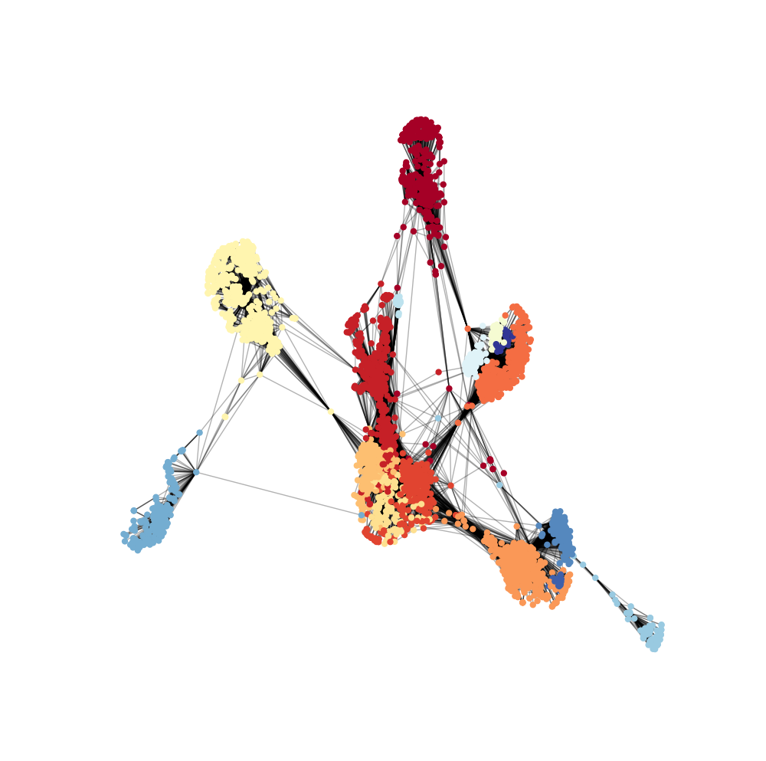
Extraction of Communities

Slide 14
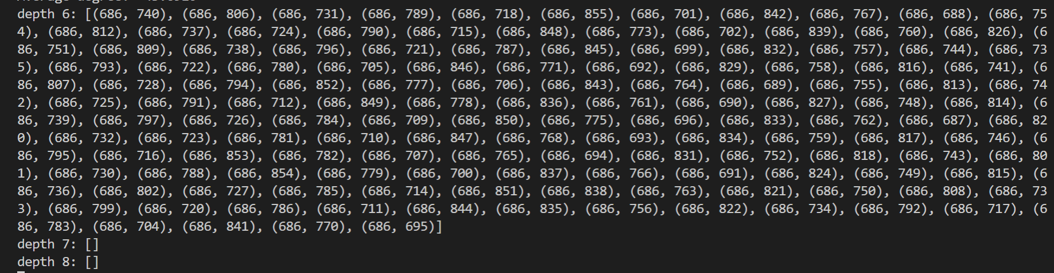
Six degree of separation ???
According to the BFS search, depth 8 is the maximum distance between nodes
➡ It may be true in this network

Slide 15
Link prediction
Using network embedding, you can predict who will connect to who.
This technology can apply to the Suggestion of new friends
By using vector, calculate distance between nodes
Top 5 probability to link
[(3096, 3146, 0.040353734), (2989, 3032, 0.06527955), (2944, 3125, 0.06642463), (3018, 3265, 0.06787003), (3135, 3146, 0.06807642)] 値が小さいほど近い

Slide 16
広告について
ネットワーク分析を行いグループ抽出すること、および中心性を利用することでより効果の高い広告を打つことができる。各グループの属性を割り出して、それぞれに沿ったものを流す。誰に打つかについても中心性を利用できるが必ずしも中心性の高い人（ノード）に広告を打てばいいわけではないらしい。この先までは及ばなかった。

Slide 17
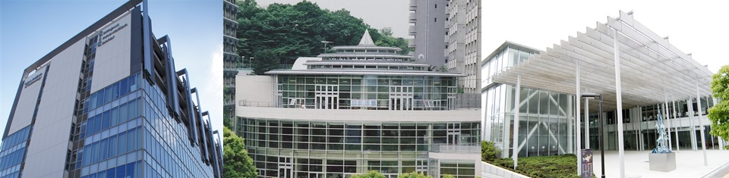
Thank you for Listening

