Slide 1



01AI0506 - Design and Analysis of Algorithms
Unit - 1
Introduction
Prepared by
Prof. Abhishek Chauhan
CSE- AI, ML & DS Department

Slide 2


OUTLINE
The Role of Algorithms in Computing
Algorithm, Designing Algorithms
Analysing Algorithms - Time and space complexity
Asymptotic Notations and its properties
The efficiency of algorithm-Best case, Worst case and average case analysis

Slide 3

Introduction of algorithm
Informally, an algorithm is any well-defined computational procedure takes some value, or set of values, as input produces some value, or set of values, as output.
Formally, “The algorithm is defined as a collection of unambiguous instructions occurring in some specific sequence and produce output for given set of input in finite time.”

Slide 4
Algorithm - Example 1
Input: Ingredients(water/milk, sugar, coffee powder)
Output: A cup of coffee
Steps:
Pour drinking water into electric kettle
Plug electric kettle and wait for it to boil
While waiting, prepare coffee cup
Add instant coffee powder into cup
Check boiling water
If water is boiled, unplug kettle and pour water into cup
If water is not boiled, press the “on” switch to continue and wait until boiled
Refer back to step 6
Stir coffee mix
Drink!

Slide 5
Algorithm - Example 2
Write down the steps for making peanut butter and jelly sandwich.
Steps for making a peanut butter and jelly sandwich: Step 1: Take 2 slices of bread. Step 2: Apply peanut butter on one side of a slice. Step 3: Apply jelly on one side of the other slice. Step 4: Press both the slices of bread together.

Slide 6
Design and Analysis
ALGORITHM - DESIGN AND ANALYSIS
Algorithmic is a branch of computer science that consists of designing and analyzing computer algorithms.
The “design” pertain to
The description of algorithm at an abstract level by means of a pseudo language
Proof of correctness that is, the algorithm solves the given problem in all cases.
The “analysis” deals with performance evaluation (complexity analysis).

Slide 7
Characteristics of Algorithm
Unambiguous − Algorithm should be clear and unambiguous. Each of its step (or phases), and their input/outputs should be clear and must lead to only one meaning.
Input − An algorithm should have 0 or more well defined inputs.
Output − An algorithm should have 1 or more well defined outputs, and should match the desired output.
Finiteness − Algorithms must terminate after a finite number of steps.
Feasibility − Should be feasible with the available resources.
Independent − An algorithm should have step-by-step directions which should be independent of any programming code.

Slide 8
Role of Algorithm in Computing
Algorithms are used to find the best possible way to solve a problem, based on data storage, sorting and processing.
Algorithms play a crucial role in computing by providing a set of instructions for a computer to perform a specific task. They are used to solve problems and carry out tasks in computer systems.

Slide 9
Role of Algorithm in Computing
Algorithms are widely used in various industrial areas to improve efficiency, accuracy, and decision-making. Some of the key applications include:
Manufacturing
Finance
Healthcare
Retail
Transportation
Energy

Slide 10
Role of Algorithm in Computing
Algorithms are fundamental to computing and play a crucial role in many aspects of the field. Some of the key needs and applications of algorithms in computing include:
Data processing
Problem solving
Computer graphics
Artificial Intelligence
Database management
Network communication
Operating systems

Slide 11
Role of Algorithm in Computing
Algorithms play a critical role in networking and communication systems, enabling efficient and reliable data transfer and communication. Some of the key applications of algorithms in networking include:
Routing
Error correction
Data compression
Network security
Quality of Service
Wireless networks
Network topology

Slide 12
Algorithm Specification
Algorithm can be described in three ways.
Natural language like English:
When this way is chorused care should be taken, we should ensure that each & every statement is definite.
Graphic representation called flowchart:
This method will work well when the algorithm is small& simple.
Pseudo-code Method:
In this method, we should typically describe algorithms as program,
which resembles language like Pascal.

Slide 13
Pseudo-Code Conventions
1. Comments begin with // and continue until the end of line.
2. Blocks are indicated with matching braces {and}.
3. An identifier begins with a letter. The data types of variables are not
explicitly declared.
4. Compound data types can be formed with records.
Example:
Node. Record
{
data type – 1 data-1;
.
.
data type – n data – n;
node * link;
}

Slide 14
Pseudo-Code Conventions
5. Assignment of values to variables is done using the assignment statement.
<Variable>= <expression>;
6. There are two Boolean values TRUE and FALSE.
Logical Operators AND, OR, NOT
Relational Operators <, <=,>,>=, =, !=
7. The looping statements are employed with algorithms.
Like for, while and repeat-until

Slide 15
Pseudo-Code Conventions
8. A conditional statement has the following forms.
If <condition> then <statement>
If <condition> then <statement-1>
Else <statement-1>
9. Input and output are done using the instructions read & write.
10. There is only one type of procedure:
Algorithm, the heading takes the form,
Algorithm Name (Parameter lists)

Slide 16
Algorithm in description
Euclid’s algorithm for computing gcd(m, n)
Step 1: If n = 0, return the value of m as the answer and stop; otherwise, proceed to Step 2.
Step 2: Divide m by n and assign the value of the remainder to r.
Step 3: Assign the value of n to m and the value of r to n. Go to Step 1.

Slide 17
Algorithm in Pseudo-Code
ALGORITHM Euclid(m, n)
//Computes gcd(m, n) by Euclid’s algorithm
//Input: Two nonnegative, not-both-zero integers m and n
//Output: Greatest common divisor of m and n
while n = 0 do
r ←m mod n
m←n
n←r
return m

Slide 18
Designing and analyzing an algorithm
A sequence of steps one typically goes through in designing and analyzing an algorithm for solving the problems.
Understand the problem
Decision making on:
Ascertaining the capabilities of a computational device
Choosing between exact and approximate problem solving
Deciding on appropriate data structures
Algorithm design techniques

Slide 19
Designing and analyzing an algorithm
4) Methods of specifying an algorithm
5) Proving an algorithm's correctness
6) Analysing an algorithm
7) Coding an algorithm

Slide 20
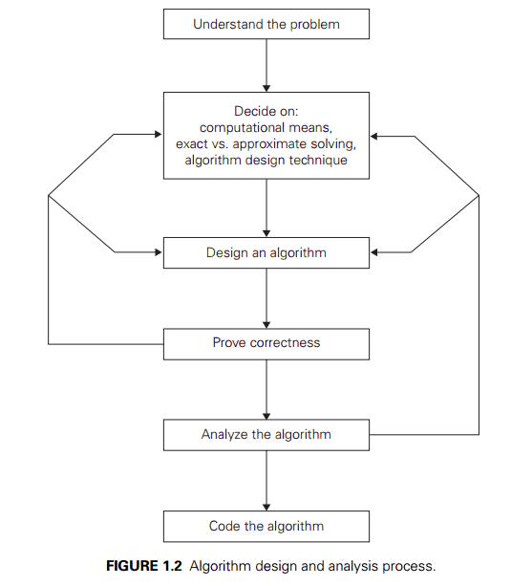
Designing and analyzing an algorithm

Slide 21
1.Understanding the Problem
This is the first step in designing of algorithm.
Read the problem’s description carefully to understand the problem statement completely.
Ask questions for clarifying the doubts about the problem.
Identify the problem types and use existing algorithm to find solution.
Input (instance) to the problem and range of the input get fixed.

Slide 22
2. Decision making
The Decision making is done on the following
a) Ascertaining the Capabilities of the Computational Device
In random-access machine (RAM), instructions are executed one after another. Accordingly, algorithms designed to be executed on such machines are called sequential algorithms.
In newer computers, operations are executed concurrently, i.e., in parallel. Algorithms that take advantage of this capability are called parallel algorithms.
Choice of computational devices like Processor and memory is mainly based on space and time efficiency.

Slide 23
2. Decision making(Conti…)
b) Choosing between Exact and Approximate Problem Solving:
The next principal decision is to choose between solving the problem exactly or solving it approximately.
An algorithm used to solve the problem exactly and produce correct result is called an exact algorithm.
If the problem is so complex and not able to get exact solution, then we have to choose an algorithm called an approximation algorithm. i.e., produces an Approximate answer.
E.g., extracting square roots, solving nonlinear equations

Slide 24
2. Decision making(Conti…)
c) Algorithm Design Techniques
An algorithm design technique (or “strategy” or “paradigm”) is a general approach to solving problems algorithmically that is applicable to a variety of problems from different areas of computing.
Algorithms+ Data Structures =Programs
Though Algorithms and Data Structures are independent, but they are combined together to develop program. Hence the choice of proper data structure is required before designing the algorithm.

Slide 25

2. Decision making(Conti…)
c) Algorithm Design Techniques(Conti…)
Implementation of algorithm is possible only with the help of Algorithms and Data Structures
Algorithmic strategy / technique / paradigm are a general approach by which many problems can be solved algorithmically.
E.g., Brute Force, Divide and Conquer, Dynamic Programming, Greedy Technique and soon.

Slide 26
3.Designing an Algorithm and Data Structures
After deciding the design techniques, we need to decide the approaches. There are two approaches for designing an algorithm. These approaches include
Top-Down Approach
Bottom-up approach
Top-Down Approach: In the top-down approach, a large problem is divided into small sub-problem. and keep repeating the process of decomposing problems until the complex problem is solved.

Slide 27
3.Designing an Algorithm and Data Structures
Bottom-up approach: The bottom-up approach is also known as the reverse of top-down approaches. In approach different, part of a complex program is solved using a programming language and then this is combined into a complete program.
Methods of Specifying an Algorithm is also required. Those methods are,
Natural language like English
Graphic representation called flowchart
Pseudo-code Method

Slide 28
4. Proving an Algorithm’s Correctness
Once an algorithm has been specified then its correctness must be proved.
An algorithm must yield a required result for every legitimate input in a finite amount of time.
For Example, the correctness of Euclid’s algorithm for computing the greatest common divisor stems from the correctness of the equality gcd(m, n) = gcd(n, m mod n).

Slide 29
4. Proving an Algorithm’s Correctness
A common technique for proving correctness is to use mathematical induction because an algorithm’s iterations provide a natural sequence of steps needed for such proofs.
The notion of correctness for approximation algorithms is less straightforward than it is for exact algorithms.
The error produced by the algorithm should not exceed a predefined limit.

Slide 30
5. Analyzing an Algorithm
For an algorithm the most important is efficiency. In fact, there are two kinds of algorithm efficiency.
They are:
Time efficiency, indicating how fast the algorithm runs.
Space efficiency, indicating how much extra memory it uses.
The efficiency of an algorithm is determined by measuring both time efficiency and space efficiency.

Slide 31
5. Analyzing an Algorithm
So factors to analyze an algorithm are:
Time efficiency of an algorithm
Space efficiency of an algorithm
Simplicity of an algorithm
Generality of an algorithm

Slide 32
6. Coding an Algorithm
The coding / implementation of an algorithm is done by a suitable programming language like C, C++,etc.
The transition from an algorithm to a program can be done either incorrectly or very inefficiently. Implementing an algorithm correctly is necessary. The Algorithm power should not reduce by in efficient implementation.
Standard tricks like computing a loop’s invariant (an expression that does not change its value) outside the loop, collecting common

Slide 33
6. Coding an Algorithm
subexpressions, replacing expensive operations by cheap ones, selection of programming language and so on should be known to the programmer.
Typically, such improvements can speed up a program only by a constant factor, whereas a better algorithm can make a difference in running time by orders of magnitude. But once an algorithm is selected, a 10–50% speedup may be worth an effort.
It is very essential to write an optimized code (efficient code) to reduce the burden of compiler.

Slide 34
Efficiency of algorithm
The efficiency of an algorithm is a measure of the amount of resources consumed in solving a problem of size 𝑛.
An algorithm must be analyzed to determine its resource usage.
Two major computational resources are execution time and memory space.
Memory Space requirement can not be compared directly, so the important resource is computational time required by an algorithm.

Slide 35
Efficiency of algorithm
To measure the efficiency of an algorithm requires to measure its execution time using any of the following approaches:
Empirical Approach: To run it and measure how much processor time is needed.
Theoretical Approach: Mathematically computing how much time is needed as a function of input size.

Slide 36
Time complexity
Time complexity of an algorithm quantifies the amount of time taken by an algorithm to run as a function of the length of the input.
Running time of an algorithm depends upon,
Input Size
Nature of Input
Generally time grows with the size of input, for example, sorting 100 numbers will take less time than sorting of 10,000 numbers.

Slide 37
Time complexity
So, running time of an algorithm is usually measured as a function of input size.
Instead of measuring actual time required in executing each statement in the code, we consider how many times each statement is executed.
So, in theoretical computation of time complexity, running time is measured in terms of number of steps/primitive operations performed.

Slide 38
Space complexity
Space complexity, also called Space efficiency, refers to the amount of memory units required by the algorithm in addition to the space needed for its input and output.
When an algorithm is run on a computer, it necessitates a certain amount of memory space.
The amount of memory used by a program to execute it is represented by its space complexity.
Because a program requires memory to store input data and temporal values while running, the space complexity is auxiliary and input space.

Slide 39
How to Analysis of Algorithms
What is Analysis of an Algorithm?
Analyzing an algorithm means calculating/predicting the resources that the algorithm requires.
Analysis provides theoretical estimation for the required resources of an algorithm to solve a specific computational problem.
Two most important resources are computing time (time complexity) and storage space (space complexity).
Why Analysis is required?
By analyzing some of the candidate algorithms for a problem, the most efficient one can be easily identified.

Slide 40
How to Analysis of Algorithms
Goal of analysis of algorithms?
To compare algorithms mainly in terms of running time but also in terms of other factors (e.g., memory requirements, programmer's effort etc.)
Running time analysis?
Determine how running time increases as the size of the problem increases.
Input size
No. of elements in the array
No. of elements in a matrix
No. of bits in the binary representation of the input vertices and edges in a graph, etc.

Slide 41
Types of analysis
Types of analysis:
Best case Time complexity
Worst case Time complexity
Average case Time complexity
Best case Time complexity:
If an algorithm takes minimum amount of time to run to completion for a specific set of input is called best case time complexity.
Provides a lower bound on running time.

Slide 42
Types of analysis
Worst case Time complexity:
If an algorithm takes maximum amount of time to run to completion for a specific set of input is called worst case time complexity.
Provides an upper bound on running time.
Average case Time complexity:
If an algorithm takes average amount of time to run to completion for a specific set of input is called average case time complexity.
Provides a prediction about the running time.

Slide 43
Asymptotic Notations
The theoretical (priori) approach of analyzing an algorithm to measure the efficiency does not depend on the implementation of the algorithm.
In this approach, the running time of an algorithm is describes as Asymptotic Notations.
Computing the running time of algorithm’s operations in mathematical units of computation and defining the mathematical formula of its run-time performance is referred to as Asymptotic Analysis.

Slide 44
Asymptotic Notations
An algorithm may not have the same performance for different types of inputs. With the increase in the input size, the performance will change.
Asymptotic analysis accomplishes the study of change in performance of the algorithm with the change in the order of the input size.
Using Asymptotic analysis, we can very well define the best case, average case, and worst case scenario of an algorithm.

Slide 45

Asymptotic Notations
Asymptotic notations are mathematical notations used to represent the time complexity of algorithms for Asymptotic analysis.
Following are the commonly used asymptotic notations to calculate the running time complexity of an algorithm.
$Ο$ Notation (Big 𝐎 notation)
$Ω$ Notation (Omega notation)
$θ$ Notation (Theta notation)

Slide 46
Asymptotic Notations
Asymptotic Notations are used,
To characterize the complexity of an algorithm.
To compare the performance of two or more algorithms solving the same problem.

Slide 47
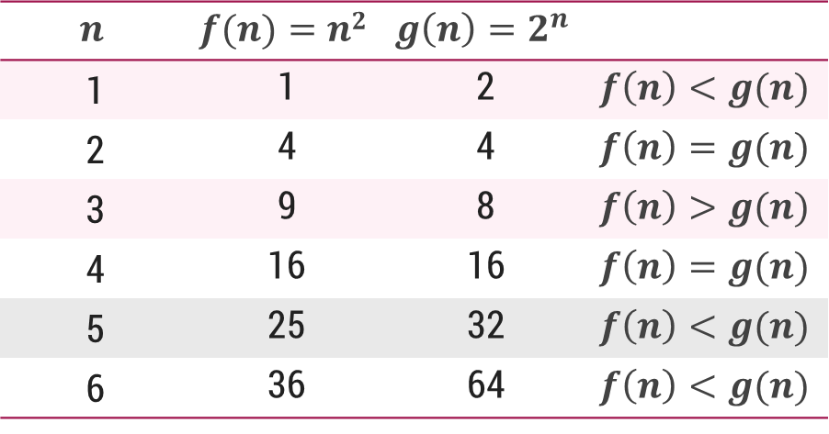

𝐎-Notation (Big 𝐎 notation)
The notation $Ο(n)$ is the formal way to express the upper bound of an algorithm's running time.
It measures the worst case time complexity or the longest amount of time an algorithm can possibly take to complete.
For a given function $g(n)$, we denote by $Ο(g(n))$the set of functions,
$Ο(g(n))$= {$f(n)$ : there exist positive constants $c$ and $n0$ such that $0≤f(n)≤cg(n)$for all $n0≤n$}

Slide 48
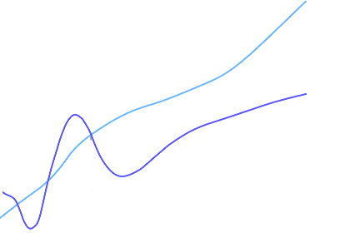






𝐎-Notation (Big 𝐎 notation)
$g(n)$ is an asymptotically upper bound for $f(n)$.
$f(n)=O(g(n))$implies:
$$f\left(n\right)“≤” c.g(n)$$
An upper bound $g(n)$ of an algorithm defines the maximum time required, we can always solve the problem in at most $g(n)$ time.
Time taken by a known algorithm to solve a problem with worse case input gives the upper bound.
$$c.g(n)$$
$$f(n)$$
$$n$$
$$n_{0}$$
$$f(n)=O(g(n))$$

Slide 49

𝛀-Notation (Omega notation)
Big Omega notation ($Ω$) is used to define the lower bound of any algorithm or we can say the best case of any algorithm.
This always indicates the minimum time required for any algorithm for all input values, therefore the best case of any algorithm.
When a time complexity for any algorithm is represented in the form of big-Ω, it means that the algorithm will take at least this much time to complete it's execution. It can definitely take more time than this too.
For a given function 𝑔(𝑛), we denote by $Ω($𝑔(𝑛)) the set of functions,
$Ω(g(n))=\{f(n):$there exist positive constants $c$ and $n_{0}$ such that $0≤cg\left(n\right)≤f\left(n\right)$for all $n_{0}≤n\}$

Slide 50
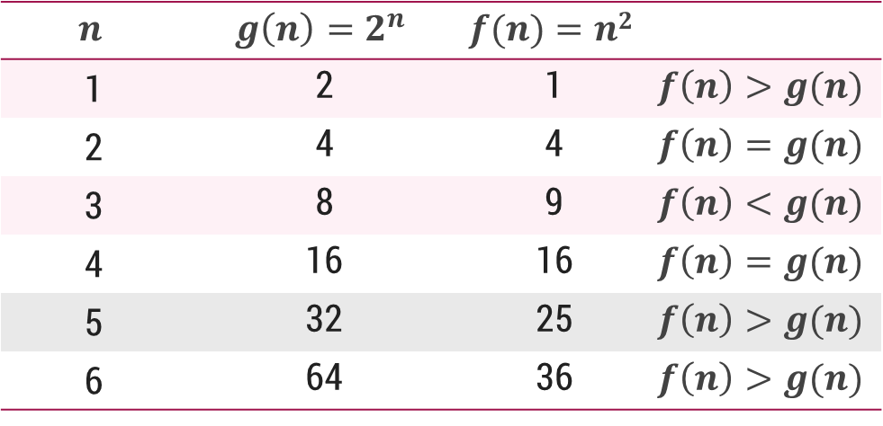
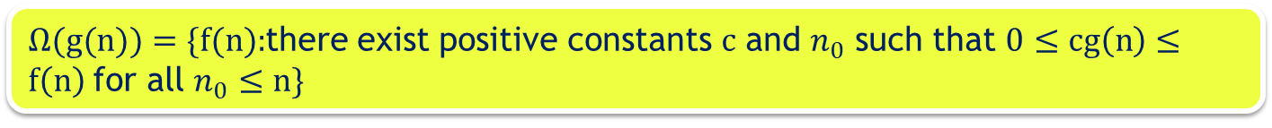

𝛀-Notation (Omega notation)
For a given function 𝑔(𝑛), we denote by $Ω($𝑔(𝑛)) the set of functions,
$Ω(g(n))=\{f(n):$there exist positive constants $c$ and $n_{0}$ such that $0≤cg\left(n\right)≤f\left(n\right)$for all $n_{0}≤n\}$

Slide 51
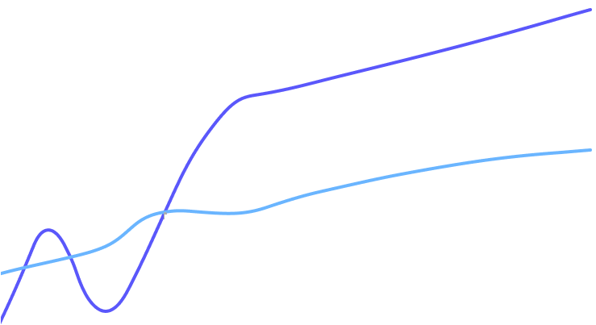




𝛀-Notation (Omega notation)
$g(n)$is an asymptotically lower bound for $f(n).$
$f(n)= Ω(g(n))$implies:
$$f(n)“≥” c.g(n)$$
A lower bound $g(n)$of an algorithm defines the minimum time required, it is not possible to have any other algorithm (for the same problem) whose time complexity is less than $g(n)$ for random input.
$$f(n)$$
$$c.g(n)$$
$$n$$
$$n_{0}$$
$$f(n)=Ω(g(n))$$

Slide 52

𝛉-Notation (Theta notation)
The notation $θ(n)$is the formal way to enclose both the lower bound and the upper bound of an algorithm's running time.
Since it represents the upper and the lower bound of the running time of an algorithm, it is used for analyzing the average case complexity of an algorithm.
The time complexity represented by the Big-$θ$ notation is the range within which the actual running time of the algorithm will be.
So, it defines the exact Asymptotic behavior of an algorithm.
For a given function 𝑔(𝑛), we denote by θ(𝑔(𝑛)) the set of functions,
$θ(g(n)) = \{f(n) :$there exist positive constants $c_{1}, c_{2} and n0 such that 0≤c_{1}g\left(n\right)≤f\left(n\right)≤c_{2}g\left(n\right) for all n0≤n\}$

Slide 53
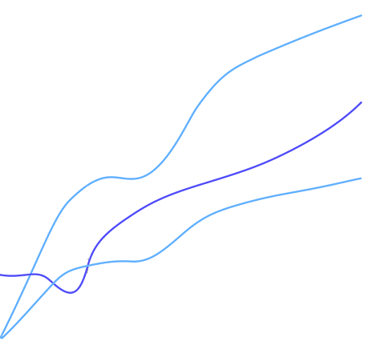



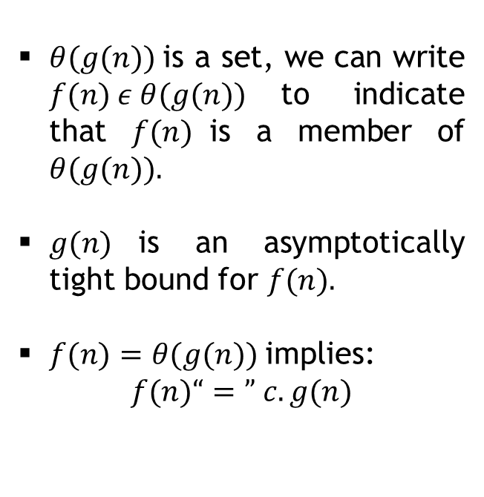



𝛉-Notation (Theta notation)
$$c_{2}.g(n)$$
$θ(g(n))$is a set, we can write $f(n) ε θ(g(n))$to indicate that $f(n)$is a member of $θ(g(n)).$
$g(n)$is an asymptotically tight bound for $f(n).$
$f(n)=θ(g(n))$implies:
$$f(n)“=” c.g(n)$$
$$f(n)$$
$$c_{1}.g(n)$$
$$n$$
$$n_{0}$$
$$f(n)=θ(g(n))$$

Slide 54
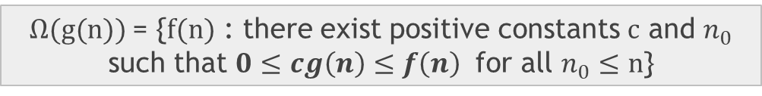

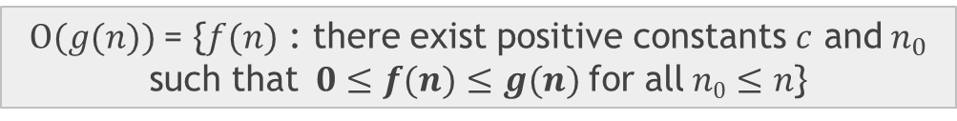


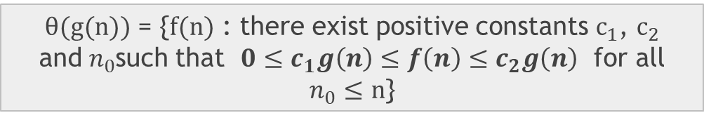
Asymptotic notations – Cases
O-Notation (Big O notation) (Upper Bound)
Ω-Notation (Omega notation) (Lower Bound)
θ-Notation (Theta notation) (Same order)
$Ο(g(n))$= {$f(n)$ : there exist positive constants $c$ and${ n}_{0}$ such that$0≤f(n)≤g(n)$for all$n0≤n$}
$$f(n)=O(g(n))$$
$Ω(g(n))$= {$f(n)$ : there exist positive constants $c$ and $n_{0}$ such that $0≤cg\left(n\right)≤f\left(n\right)$ for all $n_{0}≤n$}
$$f\left(n\right)=Ω(g(n))$$
$θ(g(n))$ = {$f(n)$ : there exist positive constants $c_{1}$, $c_{2}$ and${ n}_{0}$such that $0≤c_{1}g\left(n\right)≤f\left(n\right)≤c_{2}g\left(n\right)$ for all $n_{0}≤n$}
$$f(n)=θ(g(n))$$

Slide 55
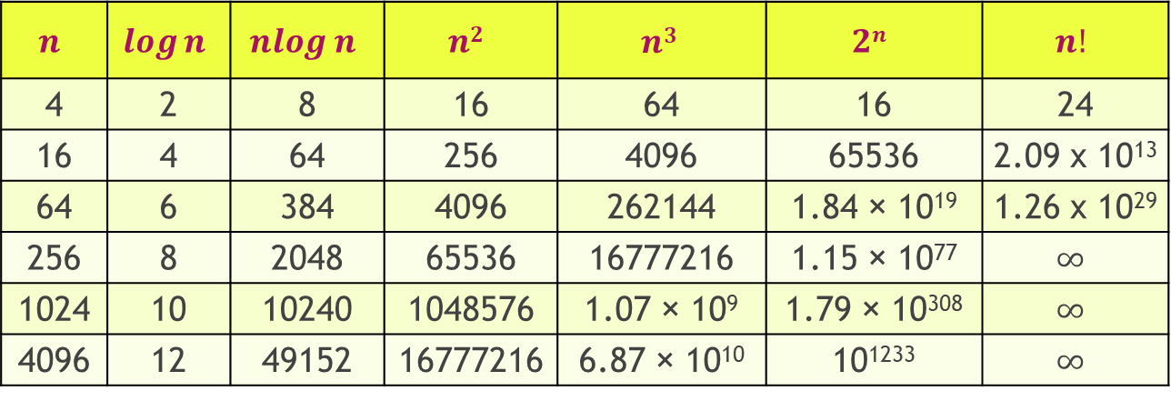
Common orders of magnitude
$$n$$ | $$\log{n}$$ | $$nlog n$$ | $$n2$$ | $$n3$$ | $$2n$$ | $$n!$$
4 | 2 | 8 | 16 | 64 | 16 | 24
16 | 4 | 64 | 256 | 4096 | 65536 | 2.09 x 10¹³
64 | 6 | 384 | 4096 | 262144 | 1.84 × 10¹⁹ | 1.26 x 10²⁹
256 | 8 | 2048 | 65536 | 16777216 | 1.15 × 10⁷⁷ | $$∞$$
1024 | 10 | 10240 | 1048576 | 1.07 × 10⁹ | 1.79 × 10³⁰⁸ | $$∞$$
4096 | 12 | 49152 | 16777216 | 6.87 × 10¹⁰ | 10¹²³³ | $$∞$$
Growth of function
$$n!$$ | $$en$$ | $$2n$$ | $$n3$$ | $$n2$$ | $$nlogn$$ | $$n$$ | $$\sqrt{n}$$ | $$logn$$ | $$1$$

Slide 56
Thank you!!

