Slide 1
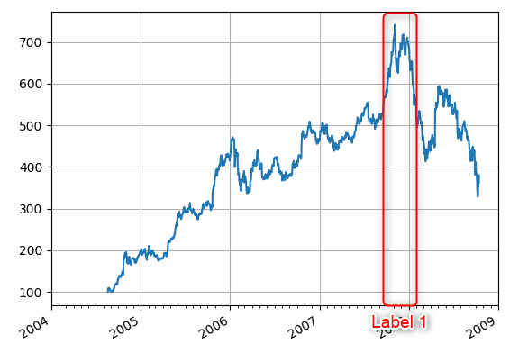
Project Restitution
Time Series LAbelling
TSLA
Charly MARTIN-AVILA
July 2022

Slide 2
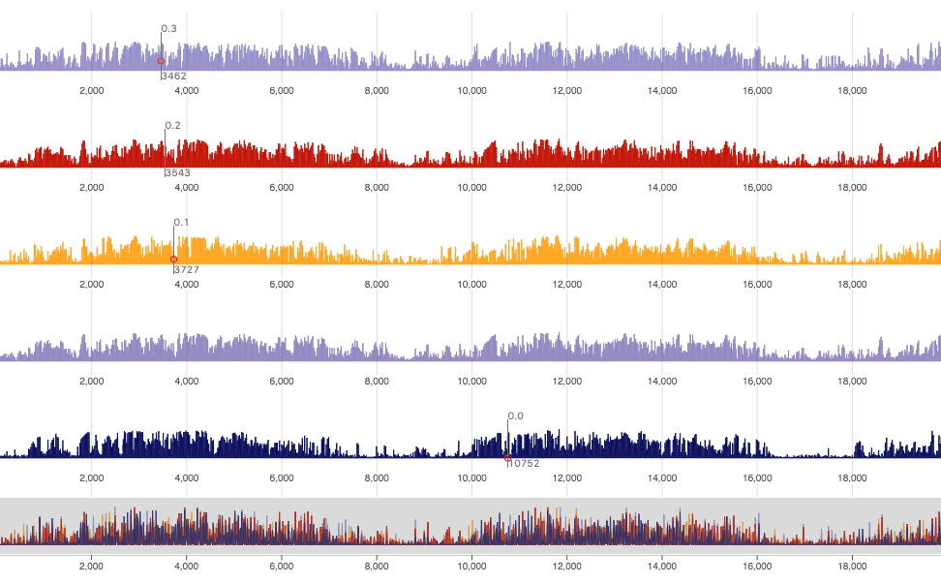

Table of contents
1
Project Description
1
2
The app
12
3
Conclusion
22
4
Perspectives
33

Slide 3
Project
Description

Slide 4
Labelling and AI
In any AI project, data issues are some of the sticking points. Sometimes, data needed for a project may not exist at all. What makes data suitable or unsuitable for feeding into the computers? The answer lies in data labeling.

Slide 5
Labelling
Process of identifying raw data (images, text files, videos, etc.) and adding one or more meaningful and informative labels to provide context so that a machine learning model can learn from it.

Slide 6
Time allocated to AI Labelling Task
25%
Other tasks like: data identification, aggregation, etc.
Labelling
On average, the labelling process can take more that 25% of time to machine learning projects/tasks
75%
Other AI tasks

Slide 7
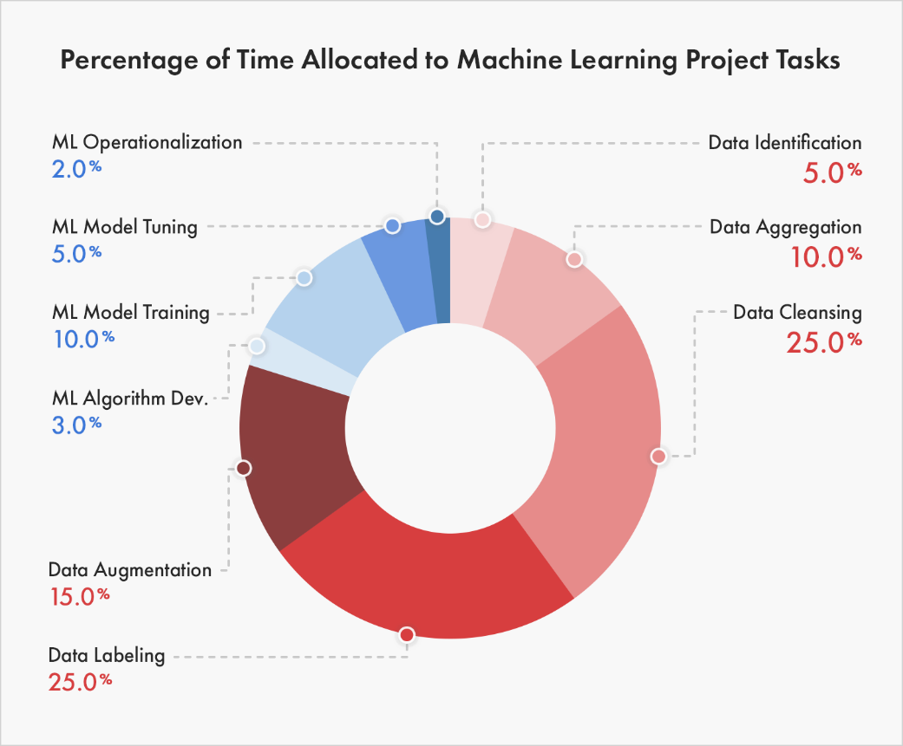
Time allocated to AI Labelling Task

Slide 8
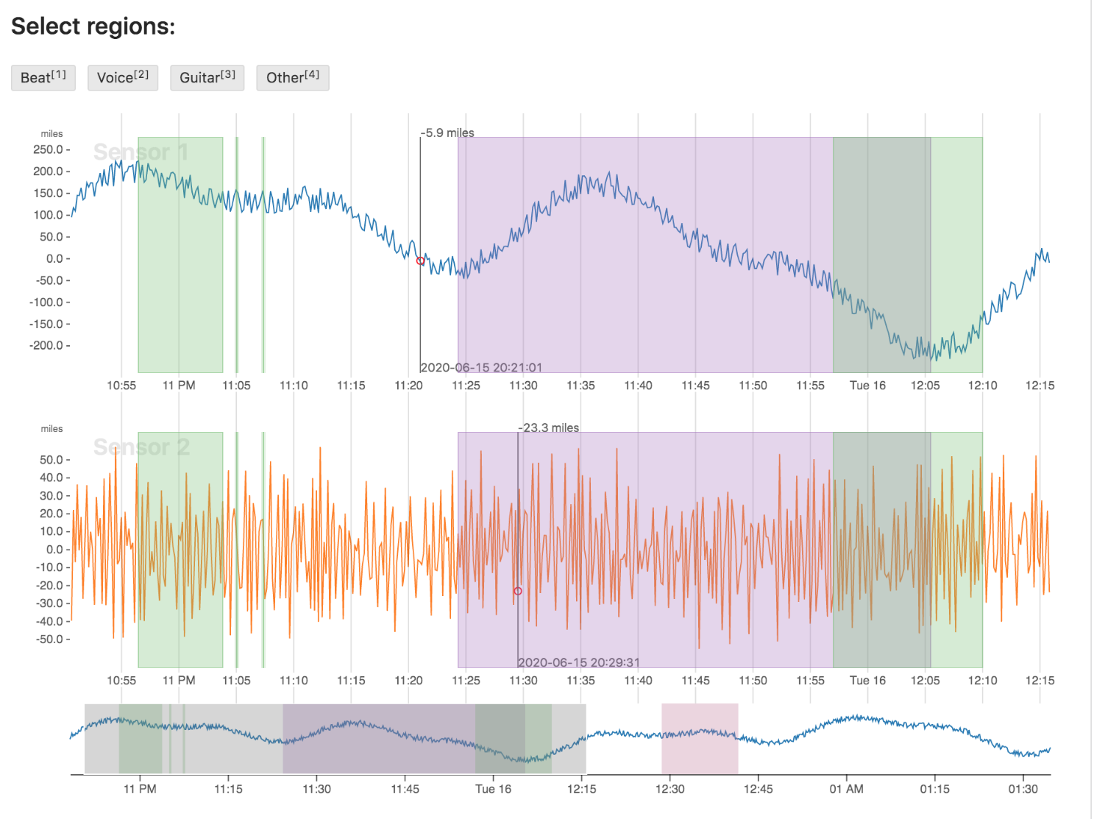
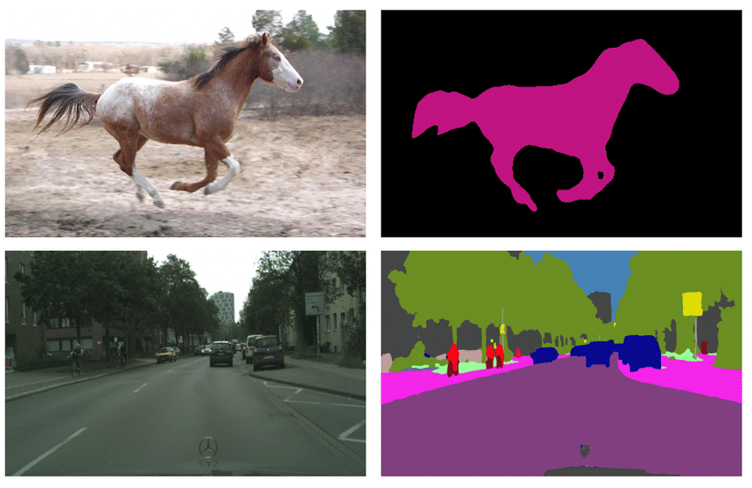
What are the most important labelings types ?
Computer Vision (image segmentation)
Time series labelling
It comes from modelling image processing using the techniques of machine learning. It applies machine learning to recognise patterns for interpretation of images.
Labelling process with data (sensors, events, signals ..)
Tagging ML data by events happening in the time

Slide 9
Labeling Process : Our Target
€
Manually
Expensive
Our use case demand a visualisation video frame by frame in order to assign a label
The labelling utils are (really) rare. And the most part, the doesn’t support video files (signals/data only).
Target
€
Accelerate
Automate
The labelling process
The labelling process through the util

Slide 10
Labeling Process: ressources & costs
Our use case is based on the labelling of time series data.
Most labelling tools are not made to display a video synchronised with the flux of data

Slide 11
Labeling Process: ressources & costs
€
Manually
Expensive
Our use case demand a visualisation video frame by frame in order to assign a label
The labelling utils are (really) rare. And the most part, the doesn’t support video files (signals/data only).

Slide 12
Project Goals
€
Accelerate
Automate
The labelling process
The labelling process through the util

Slide 13
The App

Slide 14
Project tree
video-desktop-app
├─ documentation
│ ├─ browserWindow.md
│ ├─ instructions.md
│ ├─ labelsWindow.md
│ ├─ mainWindow.md
│ └─ signalsWindow.md
├─ extras
│ ├─ images
│ │ ├─ icon.png
│ │ ├─ labels-example.PNG
│ │ ├─ labelswindow.PNG
│ │ ├─ main-window-beta-2.PNG
│ │ ├─ main-window-beta.PNG
│ │ ├─ button-players.jpg
│ │ ├─ signalsWindow.PNG
│ │ ├─ button-player2.jpg
│ │ └─ video-welcome.PNG
│ ├─ import
│ │ └─ savesSignals.csv
│ └─ setup.py
├─ launcher.py
├─ README.md
├─ src
│ ├─ core
│ │ ├─ connexion.py
│ │ ├─ label.py
│ │ ├─ model.py
│ │ ├─ signal.py
│ │ └─ video.py
│ └─ ui
│ ├─ assets
│ │ ├─ labelUI.py
│ │ ├─ signalUI.py
│ │ └─ videoUI.py
│ ├─ browserFileWindow.py
│ ├─ labelsWindow.py
│ ├─ mainWindow.py
│ └─ signalsWindow.py
└─ tests
├─ core
├─ data
├─ ui
├─ VehicleData.csv
└─ VehicleData_labeled9.csv

Slide 15
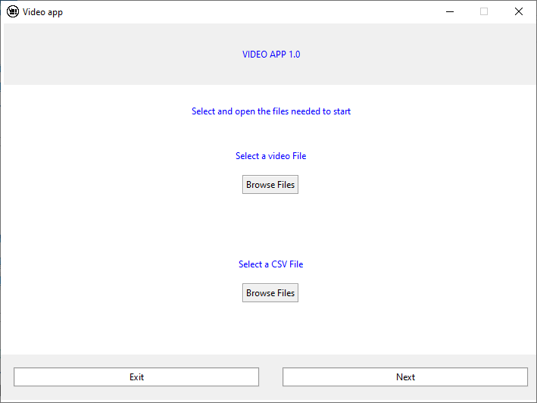
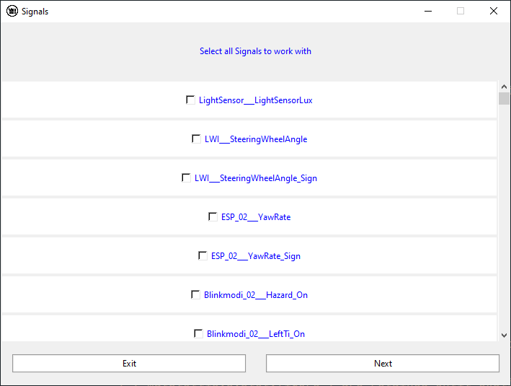
Signal & browser windows
The Browser window allows to select the video and csv/excel file in order to read them
In the signal window , all signals from the csv/file will be displayed to chose the ones to work with

Slide 16
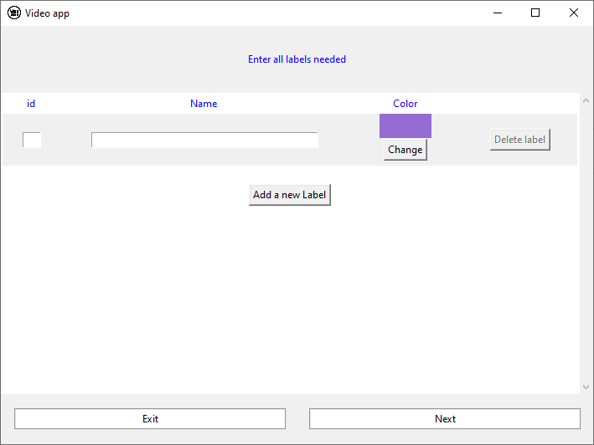
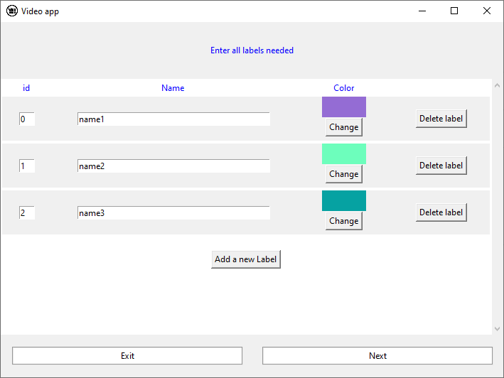
Label windows
On the label Window, you enter the labels you will work with
In this example, there are 3 labels with differents colors and IDs

Slide 17
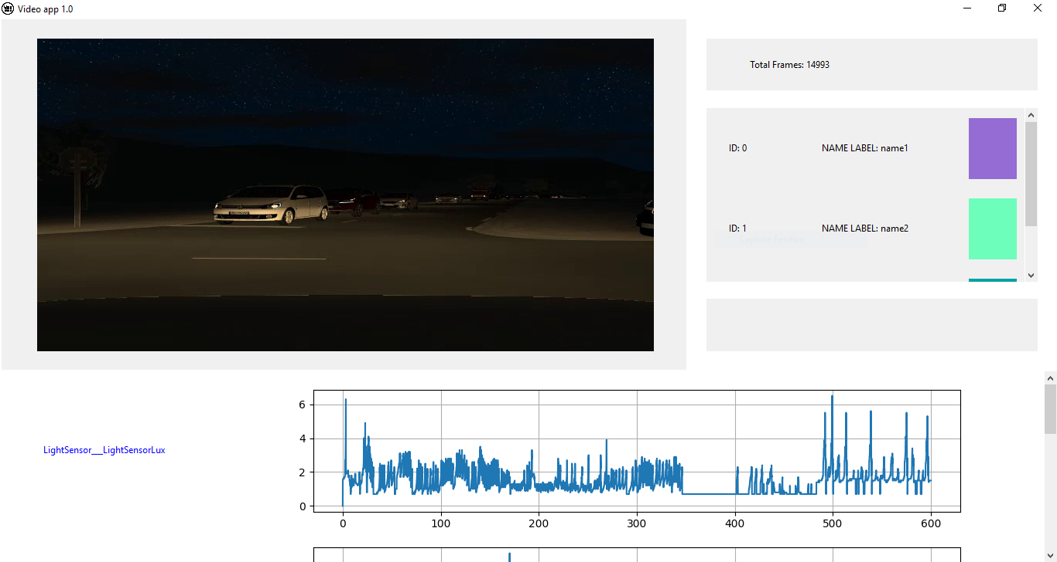
Main Window
Work space for labeling the signals file (csv)

Slide 18
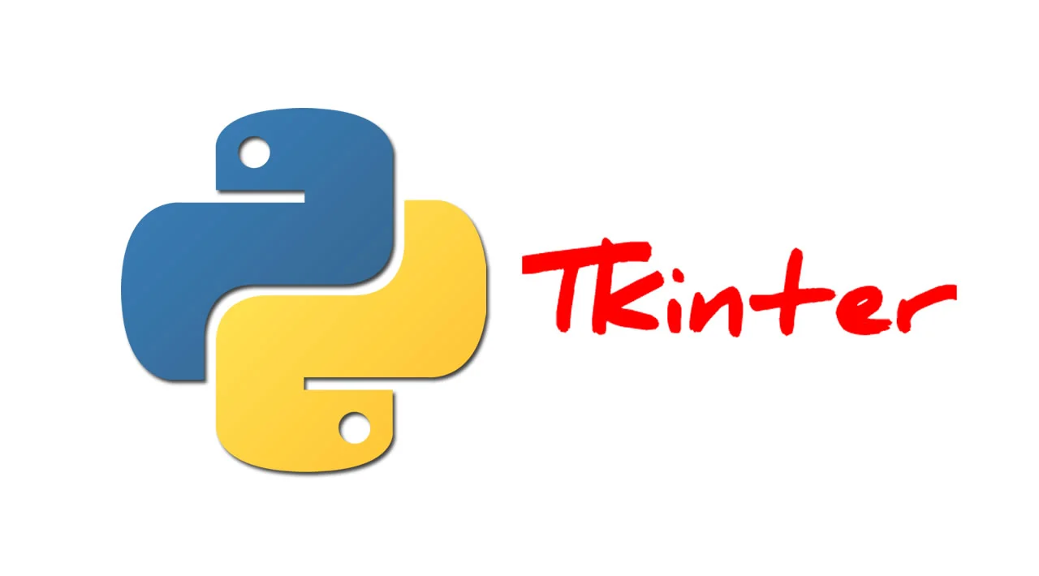





Choice of libraries

Slide 19
Description:
Integrated python library for creating GUIs. It’s the Python's de facto standard GUI.
Licence:
Berkeley Software Distribution (BSD)

Slide 20
Description:
Integrated python library that offers data structures and operations for manipulating numerical tables and time series
Licence:
Berkeley Software Distribution (BSD)

Slide 21
Description:
Python library that offers data structures and operations for manipulating numerical tables and time series
Licence:
Matplotlib Licence (compatible with BSD)

Slide 22
Description:
Python library that supports for large, multi-dimensional arrays and matrices, along with a large collection of high-level mathematical functions to operate on these arrays
Licence:
Berkeley Software Distribution (BSD)

Slide 23
Description:
Python library that supports opening, manipulating, and saving many different image file formats
Licence:
Python Imaging Library license

Slide 24
Description:
Python library that display and save images and videos, control mouse events and create trackbar
Licence:
Apache and BSD

Slide 25
04
Conclusion

Slide 26
The labelling process is one of the most important tasks for any AI project
Time series data are so variant shapes, so we have a specific need to annotate our data for power consumption
A tool is implemented to accelerate and automate the labelling process
As a limited period, most of principal components of interface were made, but some features are still remained to do

Slide 27
Perspectives

Slide 28
To do implementations
1
2
3
4
Synchronisation
Connexion
Events
Synchronisation
For the signals zoom.
Between the video and the video graphical controllers and the keybindings
For assign the labelling graphically (visual on the signals) and in the csv file
The slider signals and the video timer

Slide 29
Ideas implementations
An undo/redo buttons for editing the csv file
A ‘save’ option in order to save the current state of the labelling and a ‘open file’ to take over the labelling edition
Import automatically signals preferences for a same file: Not to select all labels multiple times

