Slide 1
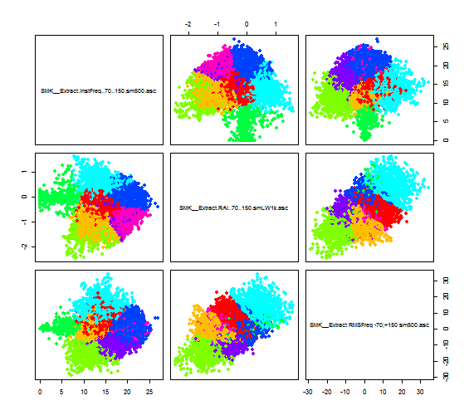
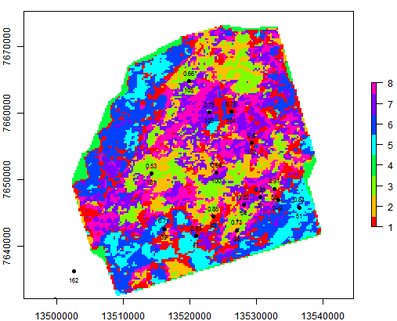
K-means clustering

Slide 2
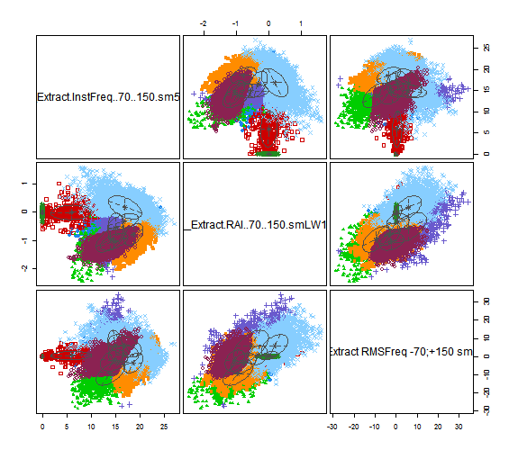
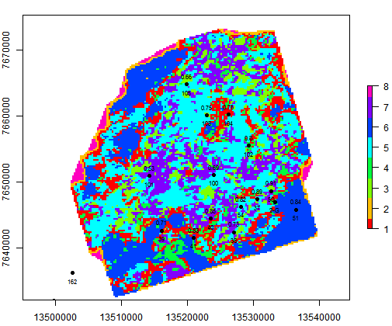
GMM clustering

Slide 3
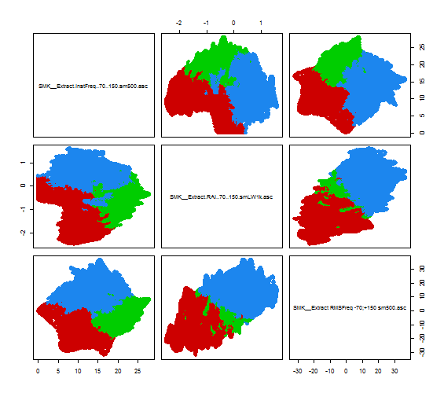
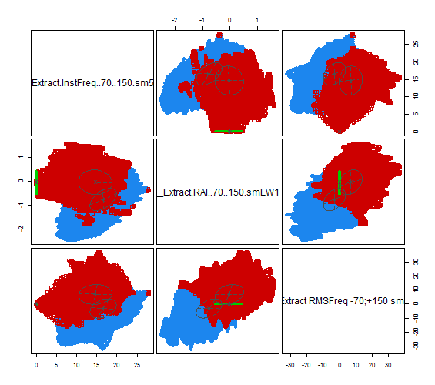
Key difference
K-Means:
fuzzy and sometimes illogical splitting of the classes especially when number of classes is low.
GMM K-Means:
Even statistically small classes with significant distribution difference are successfully separated from background data.

Slide 4
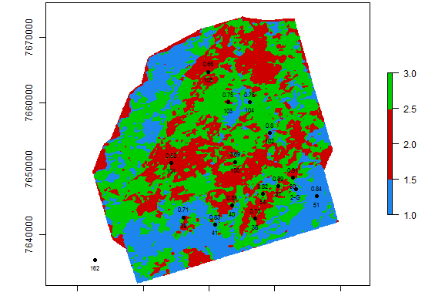
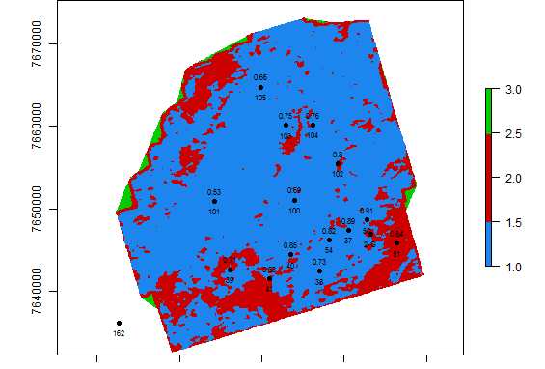
Key difference – Instantaneous attributes with artifacts
K-Means:
Border/edge artifacts were incorporated in the possibly meaningful cluster (red)
GMM K-Means:
Border/edge artifacts are successfully separated from the meaningful data

Slide 5
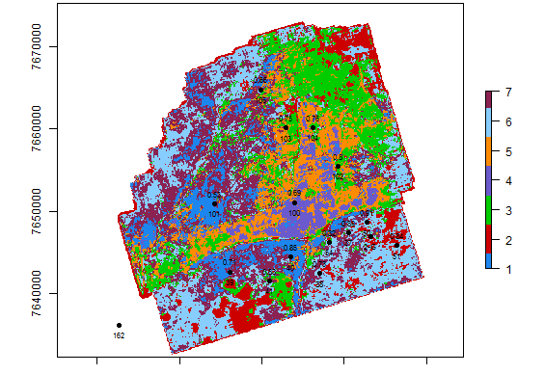
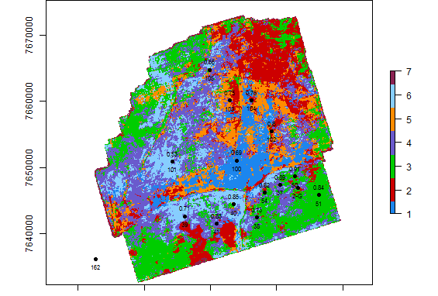
Key difference – spectral decomposition clustering
K-Means 7 classes:
GMM K-Means 7 classes:

Slide 6
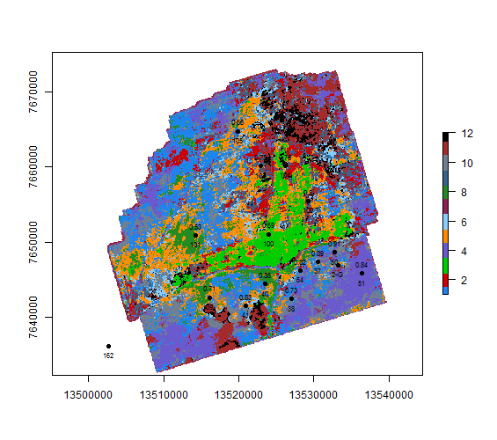
Key difference – spectral decomposition clustering
K-Means:
GMM K-Means (automatic classes):

Slide 7
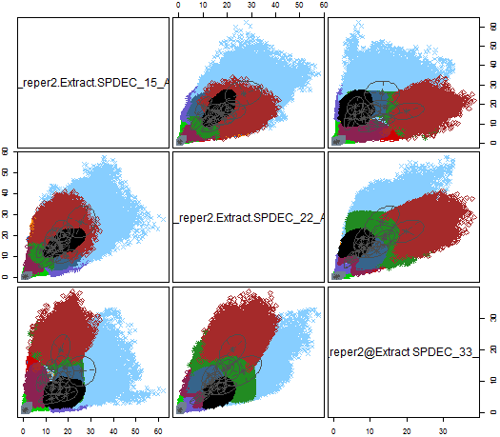
Key difference – spectral decomposition clustering

Slide 8
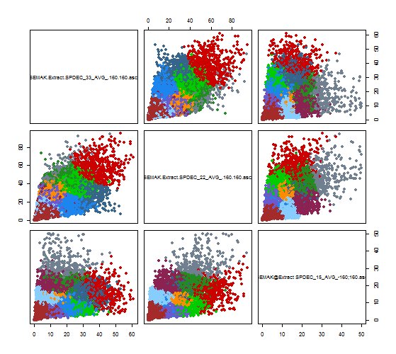
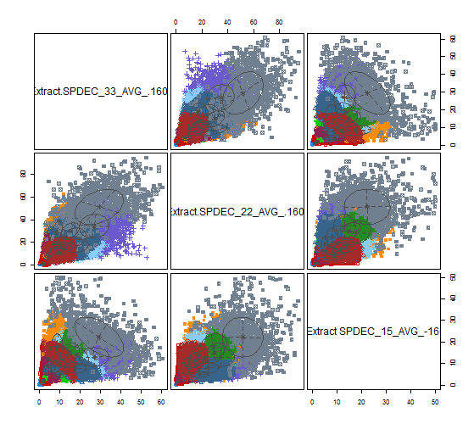
Key difference – spectral decomposition clustering

Slide 9
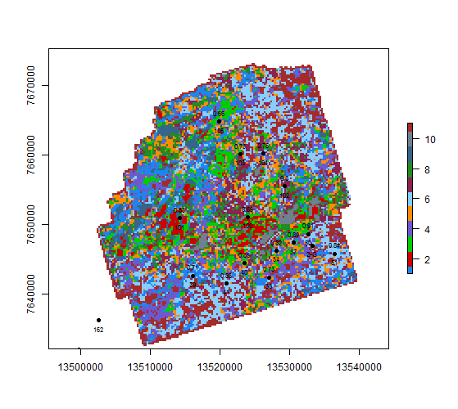
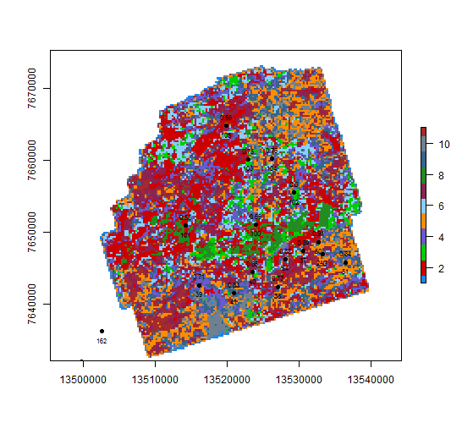
Key difference – spectral decomposition clustering

Slide 10
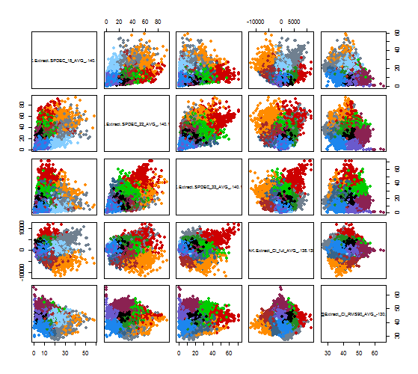
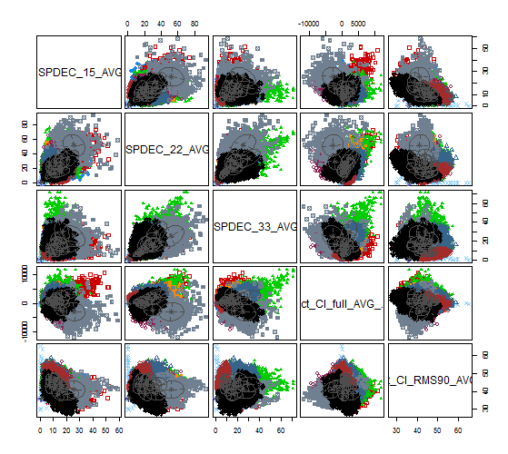
Key difference – PK_r2 + 140ms

Slide 11
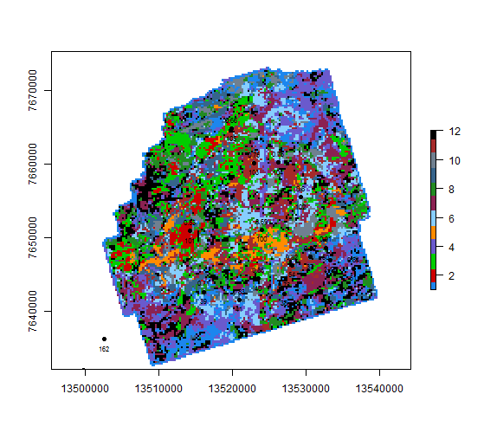
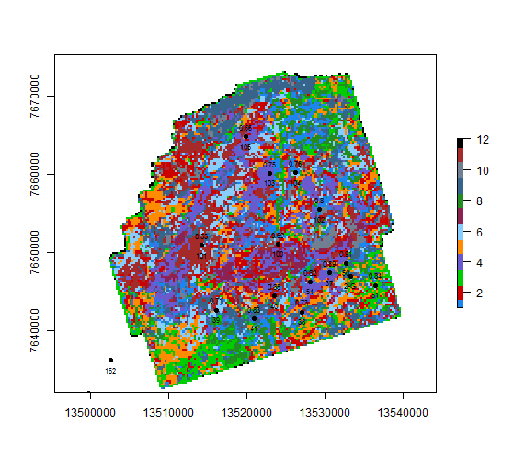
Key difference – PK_r2 + 140ms

Slide 12
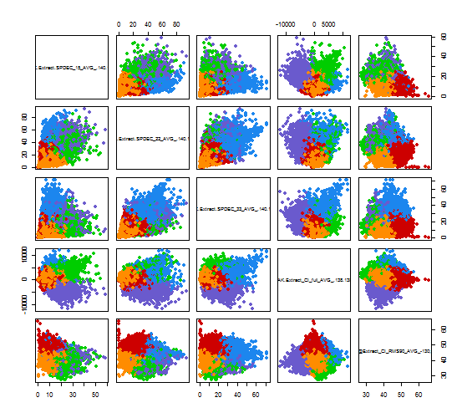
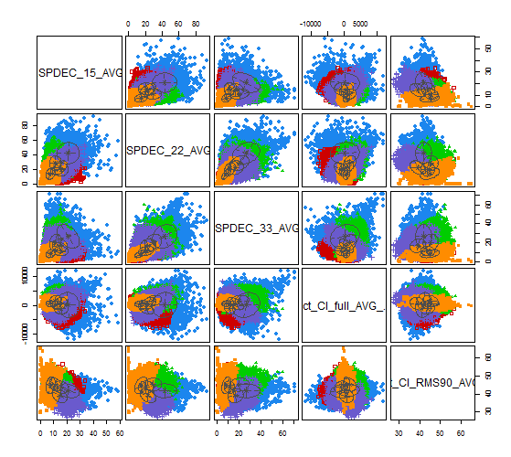
Key difference – PK_r2 + 140ms

Slide 13
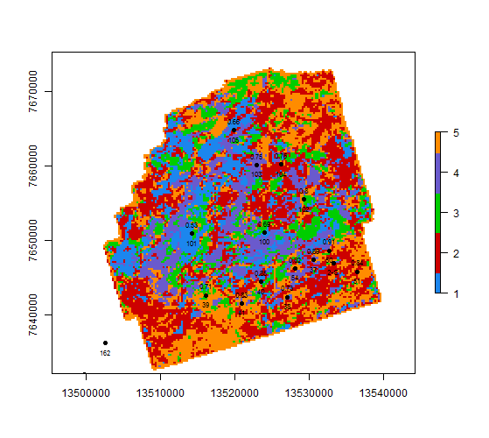
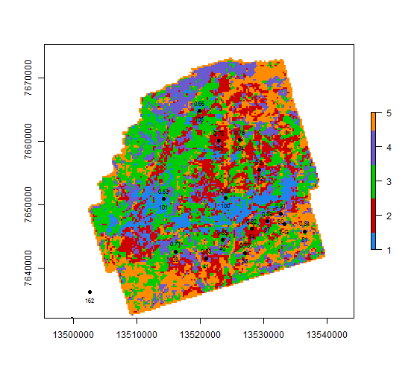
Key difference – PK_r2 + 140ms

Slide 14
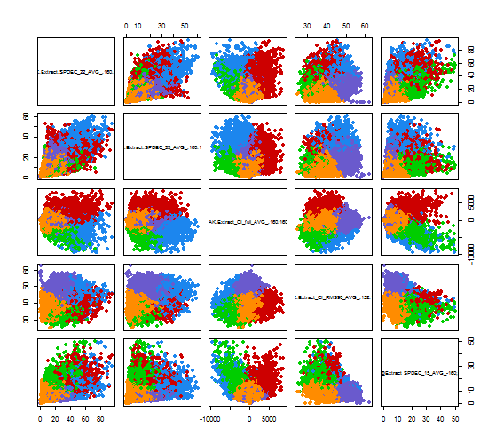
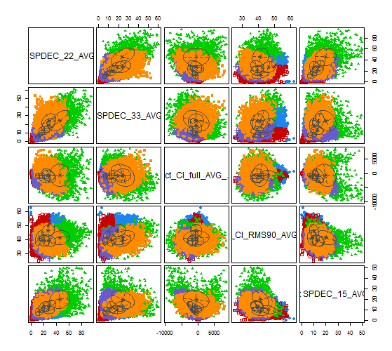
Key difference – PK_r2 + 160ms

Slide 15
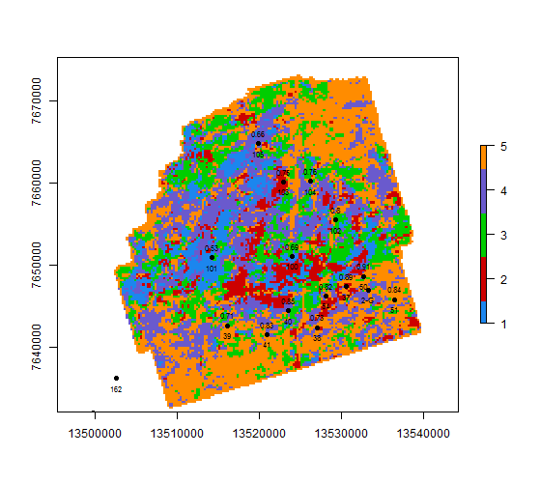
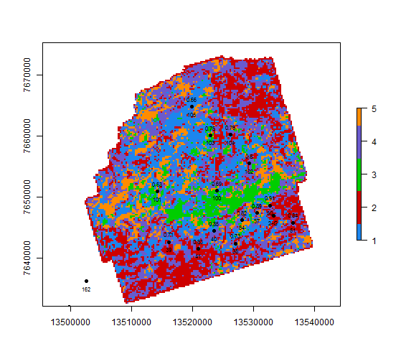
Key difference – PK_r2 + 160ms

Slide 16
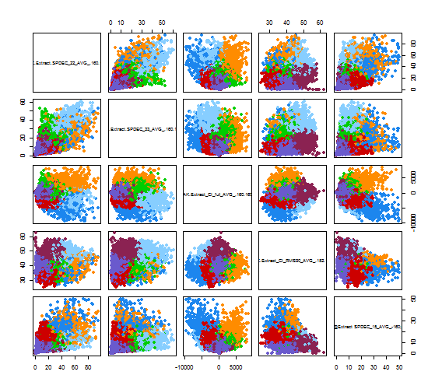
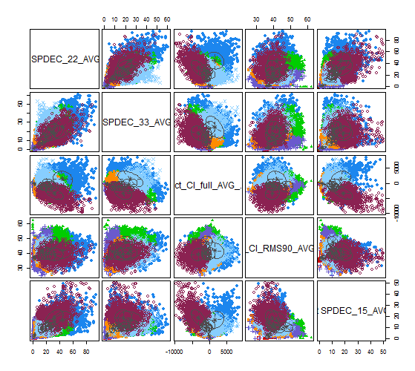
Key difference – PK_r2 + 160ms

Slide 17
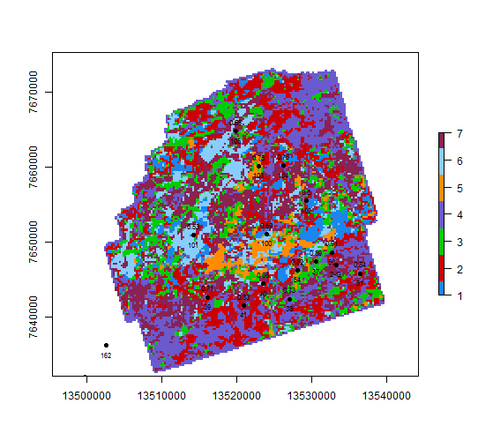
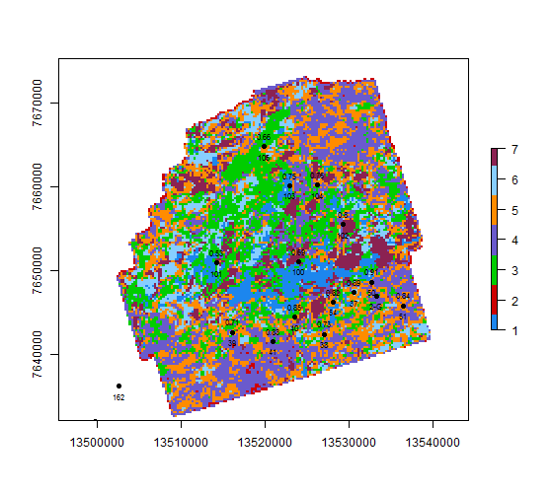
Key difference – PK_r2 + 160ms

Slide 18
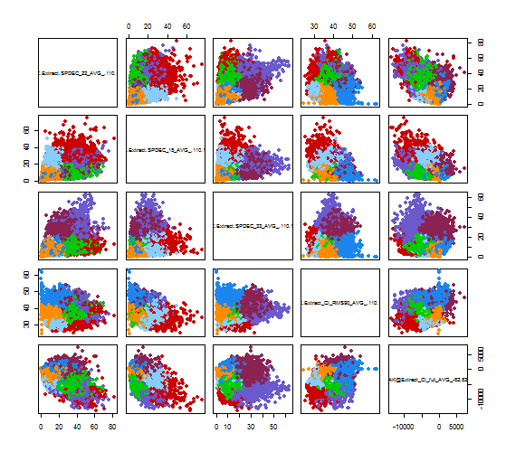
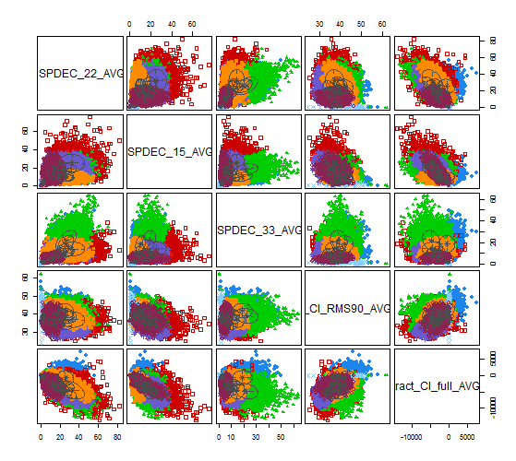
Key difference – PK_r2 + 120ms

Slide 19
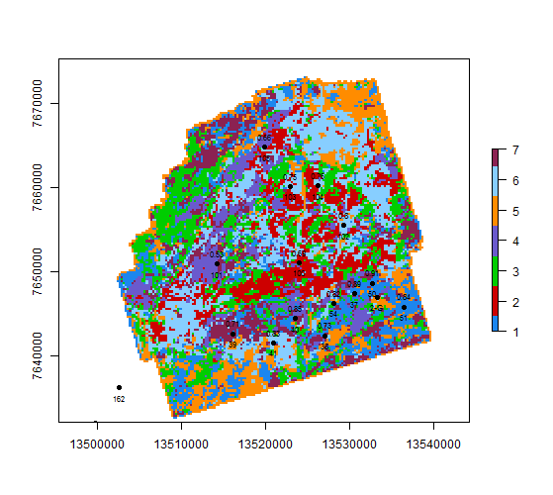
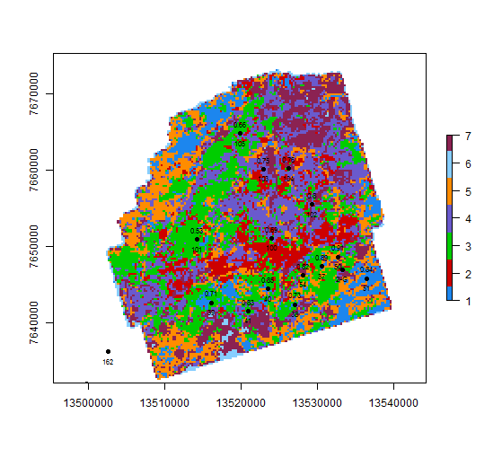
Key difference – PK_r2 + 120ms

Slide 20
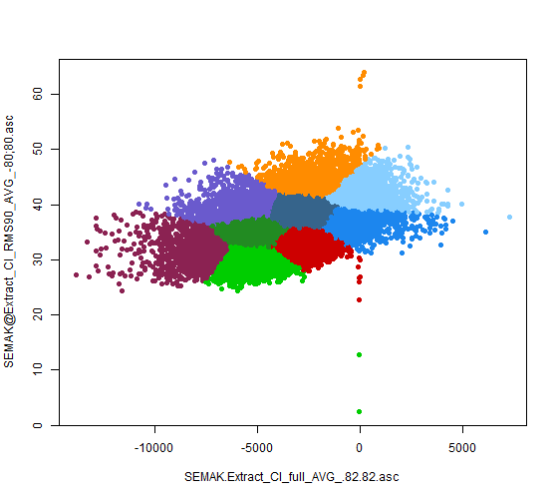
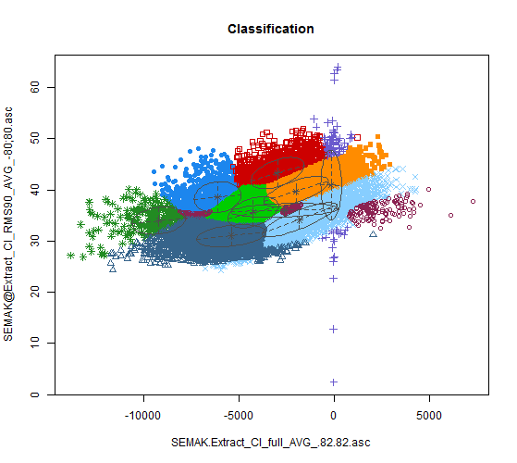
Key difference – PK_r2 + 80ms

Slide 21
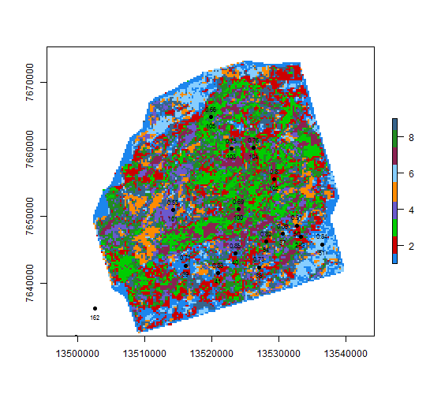
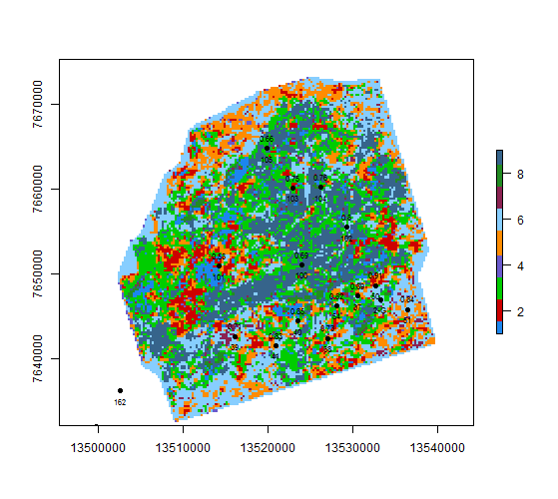
Key difference – PK_r2 + 80ms

Slide 22
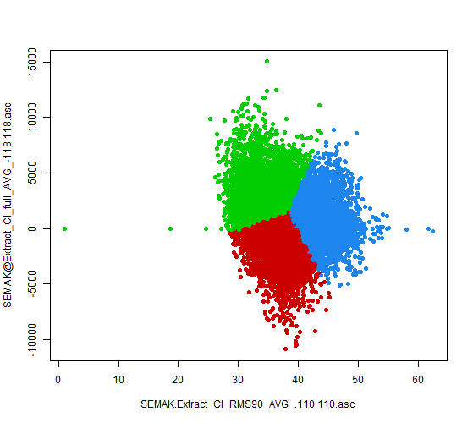
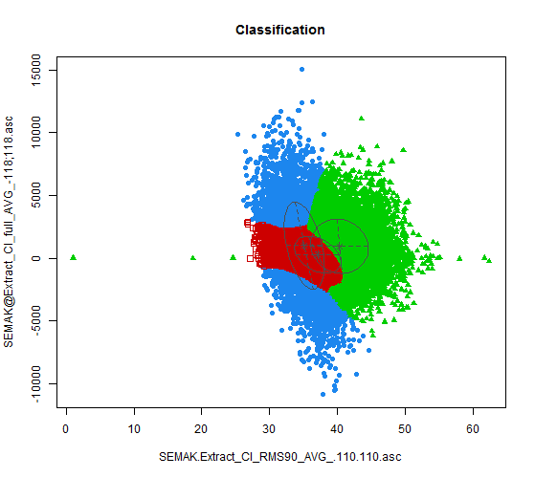
Key difference – PK_r2 + 80ms

Slide 23
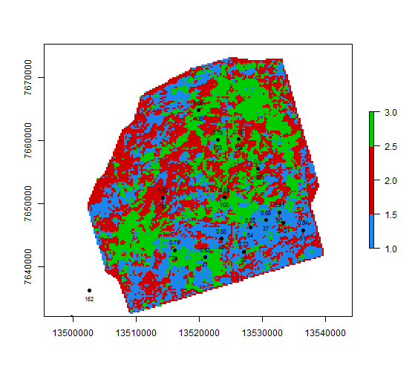
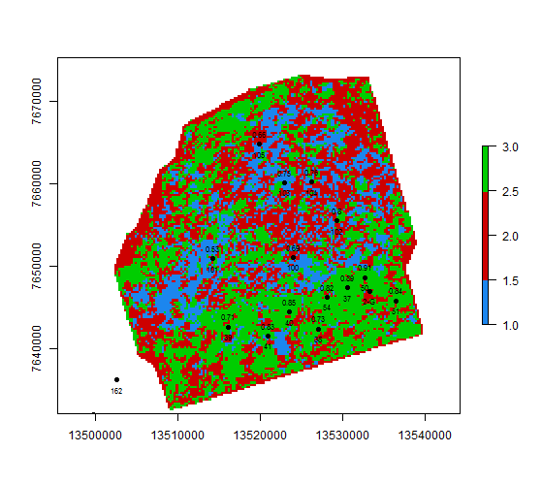
Key difference – PK_r2 + 80ms

