Slide 1
Course AI
Team Members
Assistant
杜冰焱 2450319
黄茂军 2452776
李一芃 2454326
董泽福 2451201
CST3492 — Java Enterprise Application Development
Group C — Team 12
Notes:
Introduce the IntelliJ course assistant and the four team members. F0 covers course-grounded questions and F2 covers reviewed modifications.
Source: report/Project-Report.md; ppt/PPT-Outline.md. Screenshots: report/images/. Slide 3 diagram: ppt/assets/system-architecture.svg.

Slide 2
Plugin Features
Course Assistance
Code Context
Reviewed Changes
• PDF/PPTX course materials
• Answers with source evidence
• Select Java code
• Ask about the selection
• Generate a proposal
• Review, approve or cancel
F0: Course-grounded assistance
F2: Reviewed single-file changes
Notes:
Students use the assistant without leaving the IDE. It supports course questions, explicit code selections and reviewed source changes.
Source: report/Project-Report.md; ppt/PPT-Outline.md. Screenshots: report/images/. Slide 3 diagram: ppt/assets/system-architecture.svg.

Slide 3
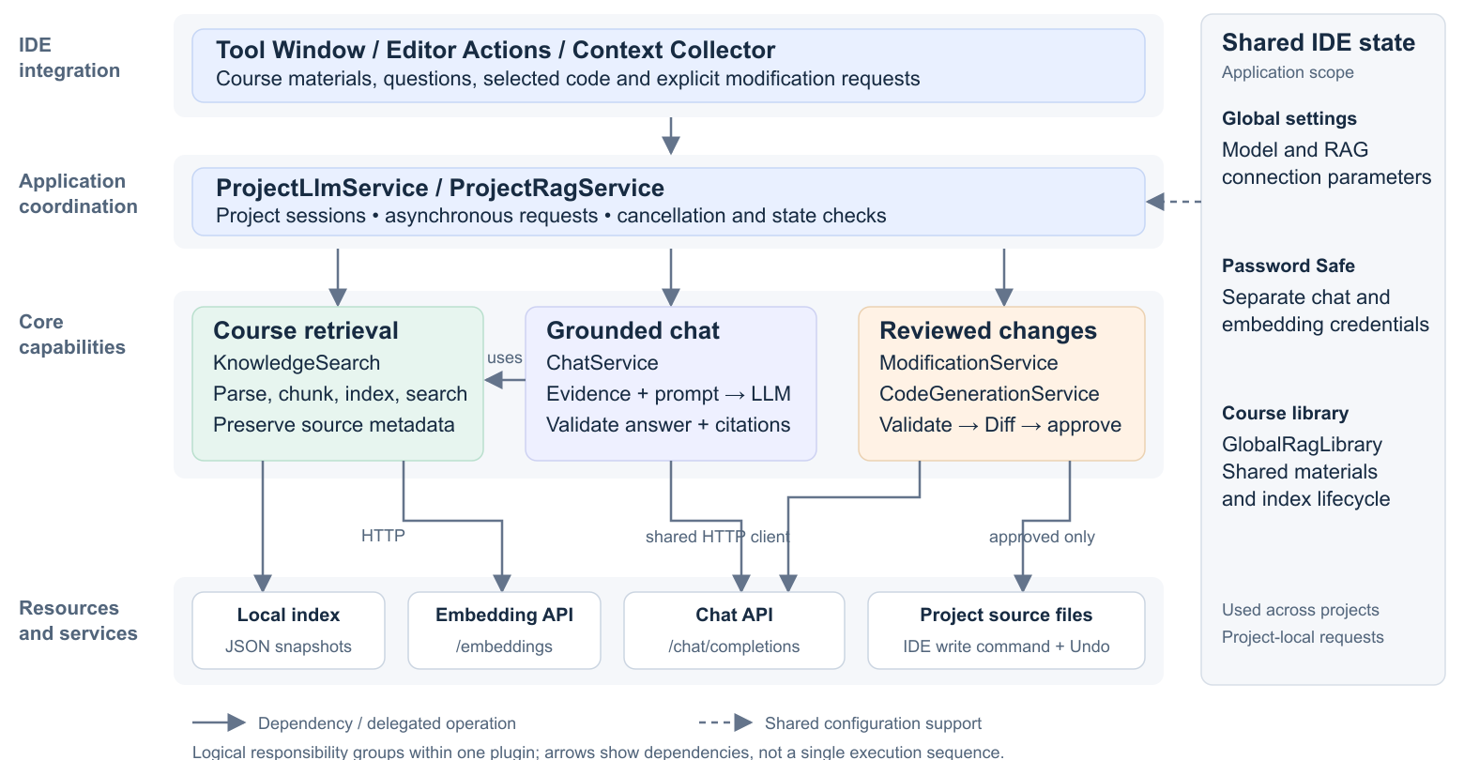
System Architecture
Notes:
The application layer coordinates requests. Retrieval supplies evidence, the model generates content, and the modification workflow controls whether a change is applied. The diagram shows logical responsibilities within one plugin.
Source: report/Project-Report.md; ppt/PPT-Outline.md. Screenshots: report/images/. Slide 3 diagram: ppt/assets/system-architecture.svg.

Slide 4
Course Material Indexing
1. Source
2. Extract
3. Chunk
4. Embed
5. Index
PDF / PPTX
Page / slide text
800 code points
Text → Vector
JSON snapshot
Chunking Strategy
Source Traceability
• Preserve paragraph/sentence boundaries
• Maximum 800 code points per chunk
• Overlap budget: up to 120
• Retain document and page/slide
• PDF text: Apache PDFBox
• PPTX text: Apache POI
Notes:
Each page or slide is split independently. Preserve paragraphs, then sentences and words; fall back to Unicode code points for oversized indivisible text. The 800/120 limits are code points, not tokens, and overlap is a maximum budget.
Source: report/Project-Report.md; ppt/PPT-Outline.md. Screenshots: report/images/. Slide 3 diagram: ppt/assets/system-architecture.svg.

Slide 5
Knowledge Storage and Retrieval
File Registry
Chunk + Vector + Source
Index Manifest
• Original file paths
• Corpus ID / format version
• Text + vector
• Document + page/slide
• Model/config fingerprints
• Snapshot integrity
Retrieval Flow
Question → Embedding → Similarity search → Filter → Up to 5 chunks
• Reuse stored document vectors
• Local vector store saved as JSON
• Default threshold: 0.70; not calibrated
Notes:
The registry records original paths, corpus identity and format version. The manifest records index configuration fingerprints and integrity metadata. Query once for the question embedding; reuse stored document vectors. The default score threshold 0.70 is not calibrated and is not accuracy.
Source: report/Project-Report.md; ppt/PPT-Outline.md. Screenshots: report/images/. Slide 3 diagram: ppt/assets/system-architecture.svg.

Slide 6
Course Q&A Workflow
Question
Selected code
(optional)
Prompt + LLM
Current question + context
Answer + citations
Document / page / excerpt
Retrieved course chunks
with source metadata
Successful search, no match
Answer with a general-knowledge notice
Retrieval failure
Show an error; no silent fallback
Notes:
The current question, optional selected code and retrieved passages form the model input. Successful empty retrieval uses general knowledge with an explicit notice; retrieval failure is an error. Source expansion uses saved evidence without another request. Conversation history and the full project are not sent.
Source: report/Project-Report.md; ppt/PPT-Outline.md. Screenshots: report/images/. Slide 3 diagram: ppt/assets/system-architecture.svg.

Slide 7
LLM Integration and Source Validation
Prompt Rules
Local Checks
• Use supplied evidence
• Treat code/evidence as data
• Return structured answer + IDs
• Validate current evidence IDs
• Match body markers to citation list
• Invalid citations → response error
Citation Chain: Source → Display
Source Metadata
Evidence ID
Validated Citation
Visible Marker
doc + page + excerpt
Supplied reference ID
Validate ID + markers
[1]
Valid reference IDs do not prove that every claim is supported.
Notes:
The prompt requests structured JSON. Local validation checks the internal [[cite:referenceId]] markers against the citations list and current evidence. Invalid citations cause a model-response error; they never trigger general-knowledge fallback. The UI subsequently assigns numeric display labels. Identifier validity cannot prove semantic support.
Source: report/Project-Report.md; ppt/PPT-Outline.md. Screenshots: report/images/. Slide 3 diagram: ppt/assets/system-architecture.svg.

Slide 8
Reviewed Code Modification
Instruction +
original snapshot
LLM proposal
Path + full file + summary
Validate proposal
Target + replacement
Built-in Diff
Review both versions
Cancel
Keep the original file
Approve
Recheck current snapshot
Write + save
Undoable IDE command
One Java file per proposal. Generation and preview never write source files.
Notes:
The model proposes a single-file replacement. Generating and previewing do not write source files. Explicit approval is followed by current-state and snapshot checks. Only then does an undoable IDE command write and save. Selected-code Q&A and full-file modification snapshots have different purposes.
Source: report/Project-Report.md; ppt/PPT-Outline.md. Screenshots: report/images/. Slide 3 diagram: ppt/assets/system-architecture.svg.

Slide 9
Design Decisions and Efficiency
Problem
Design Response
Effect
Repeated parsing/embedding
Persist and reuse vectors
Reduce repeated work
Problem
Design Response
Effect
Slow requests / stale replies
Background work + state checks
Keep IDE responsive
Problem
Design Response
Effect
File edited during review
Recheck snapshot before write
Avoid overwriting edits
Additional Efficiency Measures
• Shared settings and course library across projects
• Request sessions remain project-local
Notes:
Reusing vectors avoids repeated parsing and embedding. Background tasks and request identities keep the IDE responsive and suppress obsolete results. Snapshot checks prevent overwriting intervening edits. Global configuration is shared in this IDE, while requests are project-local. Cancelling locally does not guarantee stopping remote execution or billing.
Source: report/Project-Report.md; ppt/PPT-Outline.md. Screenshots: report/images/. Slide 3 diagram: ppt/assets/system-architecture.svg.

Slide 10
Team Collaboration
Module Responsibilities
Integration Approach
UI, editor context
and integration
Shared contracts
↓
Feature branches
↓
Incremental integration
杜冰焱
Document pipeline
and retrieval
黄茂军
LLM chat and
code generation
李一芃
Diff review and
controlled writes
董泽福
Notes:
Shared contracts for knowledge chunks, source references and proposals connected feature branches. Members developed modules separately, then integrated retrieval, chat and reviewed modifications incrementally.
Source: report/Project-Report.md; ppt/PPT-Outline.md. Screenshots: report/images/. Slide 3 diagram: ppt/assets/system-architecture.svg.

Slide 11
Limitations and Future Work
Current Limitation
Current Limitation
Current Limitation
No OCR for image-only
materials
Exhaustive local vector
search
Generated code not
automatically compiled
Future Direction
Future Direction
Future Direction
Add text recognition
Scalable local indexing
Optional compile checks
Traceable course answers.
Reviewed single-file changes.
Questions?
Notes:
The listed improvements are future work: OCR, scalable indexing and optional compilation checks. Current functionality provides traceable course sources and explicitly reviewed single-file changes. Invite questions.
Source: report/Project-Report.md; ppt/PPT-Outline.md. Screenshots: report/images/. Slide 3 diagram: ppt/assets/system-architecture.svg.

