Slide 1
TOPOOPT
Co-optimizing Network Topology and Parallelization Strategy for Distributed Training Jobs
Shuyao Qi
Paper Sharing: NSDI 2023
16/03/2023

Slide 2
Background
Previous proposals about Auto Parallel focus on co-optimizing computation and communication plan in distributed DNN training(FlexFlow, GSPMD, Automap, msr-fiddle, MindSpore)
Training workloads do not satisfy common assumptions about datacenter traffic that underlie the design of Fat-tree interconnects.

Slide 3
Background -Distributed DNN training workload
The DNN training jobs are long-lasting and the traffic distribution can be pre-computed.
MP transfers: the network traffic created by the activations and gradients computed during the Forward and Backpropagation steps
AllReduce transfers: the network traffic created by synchronizing the model weights across accelerators in one iteration

Slide 4
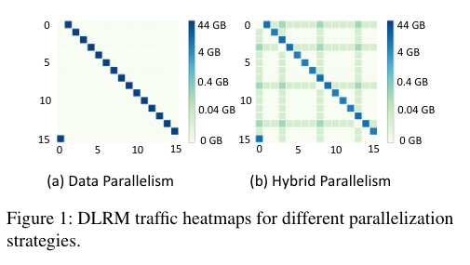
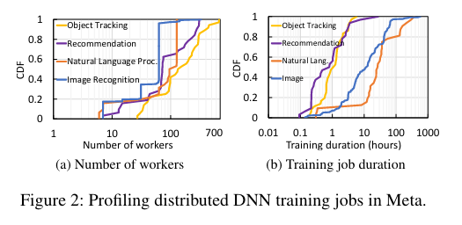
Background -Distributed DNN training workload

Slide 5
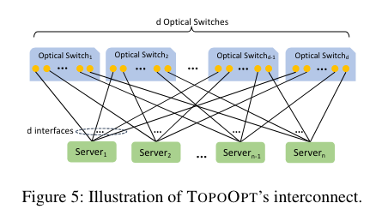
System Design -TOPOOPT’s interconnect
Degree of each server: the number of interfaces on each server (denoted by d)
Direct-connect topology: optical switches connect the servers directly.
Host-based forwarding: The degree of each server is typically smaller than the total number of neighbors to communicate during training. Hosts can act as switches and forward incoming traffic towards the destination.
One-shot reconfiguration.

Slide 6
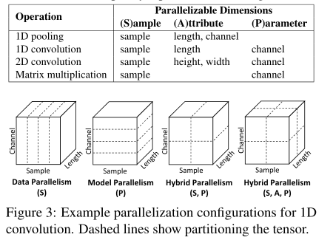
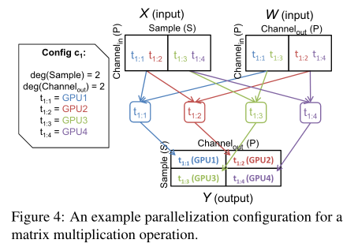
System Design -Simple Introduction of Parallelization Strategy
SOAP: 4 parallelizable dimensions of DNN training

Slide 7
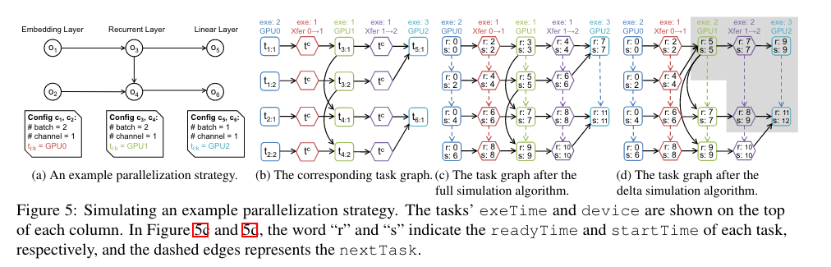
System Design -Simple Introduction of Parallelization Strategy
Taskgraph

Slide 8
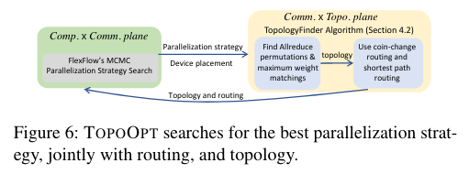
System Design -Co-optimizing Parallelization Strategy and Network Topology
Alternating optimization
Finding the optimal parallelization strategy alone is an NP-complete problem. Let alone add network topology and routing to it
The search space is divided into 2 planes: Comp. ×Comm. and Comm. × Topo.
Comp. ×Comm. optimization is handled with Flexflow’s MCMC search algorithm

Slide 9
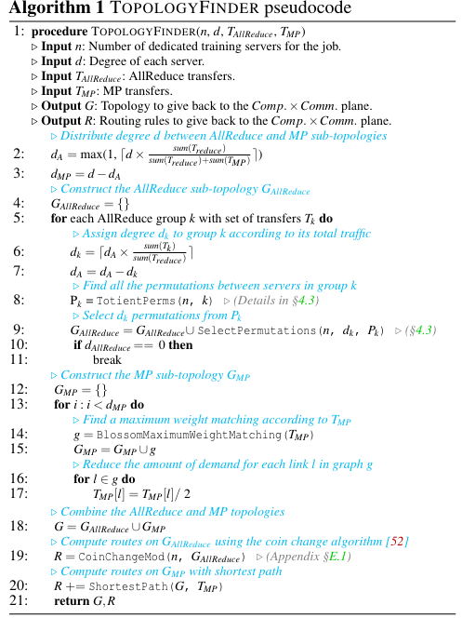
System Design -Co-optimizing Parallelization Strategy and Network Topology
4 steps to optimize the comm.×topo. plan
Distribute the degree d between AllReduce and MP sub-topologies based on their share of total traffic
Construct the AllReduce sub-topology
Construct the MP sub-topology
Final topology and routing

Slide 10
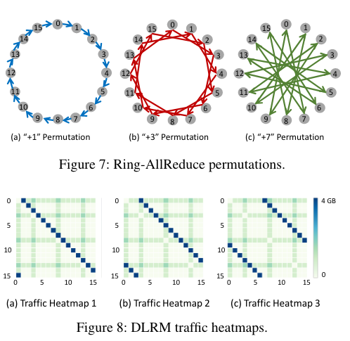
System Design -Construct the AllReduce sub-topology
Traffic Mutability and AllReduce Topology
AllReduce transfers are mutable whereas MP transfers are notConstruct the AllReduce sub-topology
simply permuting the label of the servers gives another ordering that will finish the AllReduce operation with the same latency while potentially providing a smaller hop-count for MP transfers.

Slide 11
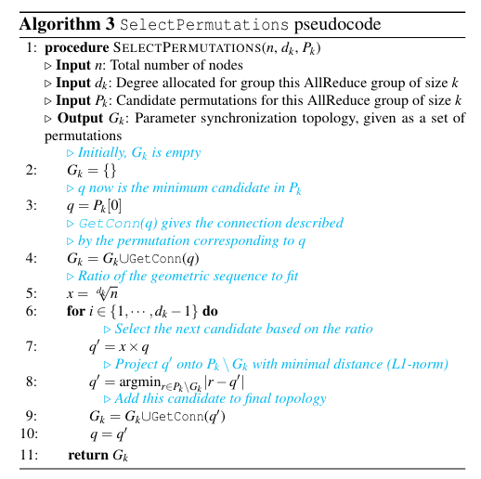
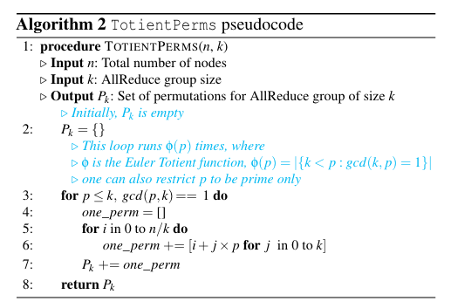
System Design -Construct the AllReduce sub-topology
Algorithm for building AllReduce sub-topology

Slide 12
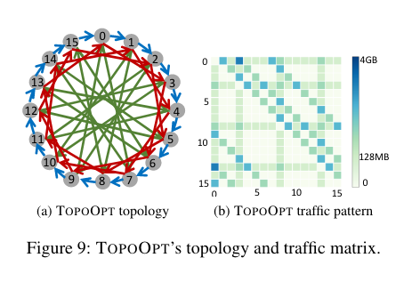
System Design -Construct the AllReduce sub-topology
TOPOOPT combines the three ring-AllReduce permutations to load-balance the AllReduce transfers while providing a short hop-count for MP transfers.

Slide 13
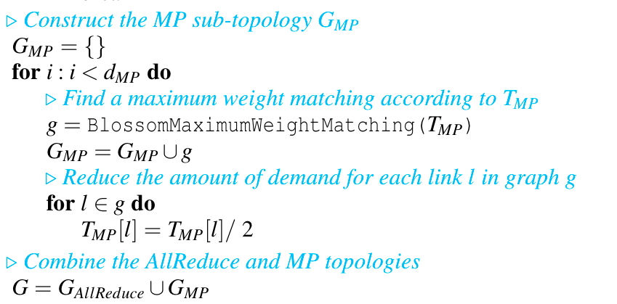
System Design -Construct the MP sub-topology
Algorithm for building MP sub-topology

Slide 14
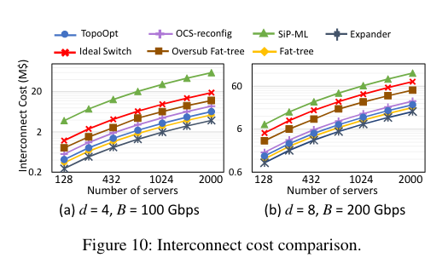
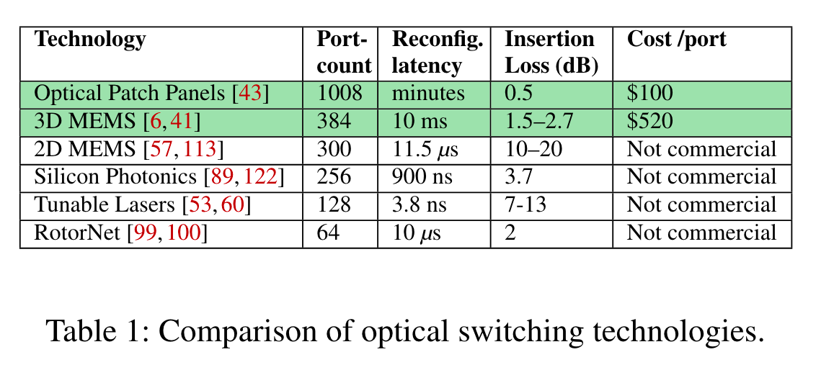
Large Scale Simulation -Comparison with multiple topologies
Estimated cost of simulated topologies

Slide 15
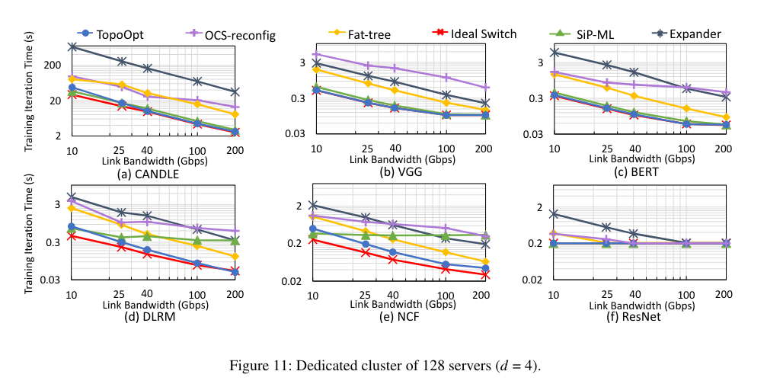
Large Scale Simulation -Comparison with multiple topologies
Performance of each topologies (single task)

Slide 16
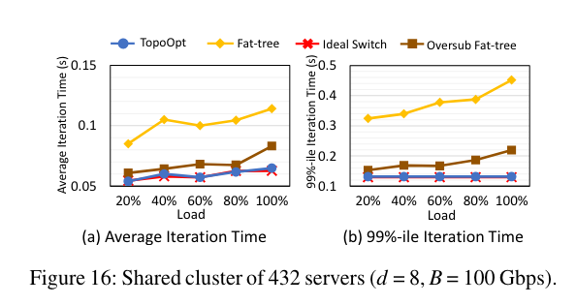
Large Scale Simulation -Comparison with multiple topologies
Performance of each topologies (multiple tasks)
number of tasks:
5,10,15,20,27
40% DLRM
30% BERT
20% CANDLE
10% VGG16
Faster than

Slide 17
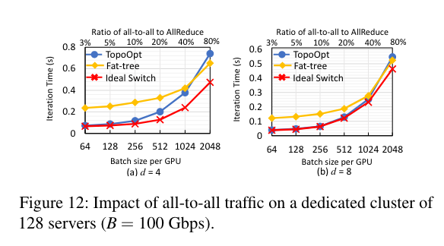
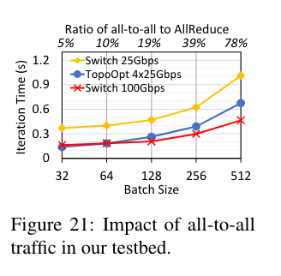
Impact of All-to-all traffic
TOPOOPT’s hostbased forwarding approach incurs bandwidth tax.
Happens in worst cases: large embedding tables are distributed on each server.

Slide 18
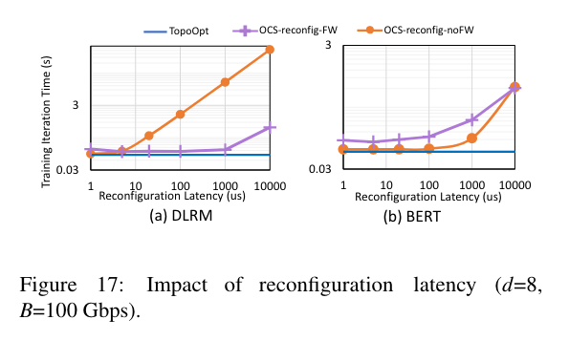
Impact of Reconfiguration Latency
Reducing the reconfiguration latencyto 1 μs enables OCS-reconfig-noFW to match the performance of TOPOOPT. However, OCS-reconfig-FW still suffers from inaccurate demand estimations.

