Slide 1

nappydevelopment
von Manuel Bothner, Marc Mahler,
Marvin Zerulla und Mehmet Ali Incekara

Slide 2
AGENDA
Vision
Software Requirements Specifications
UseCase Diagram & UseCase‘s
UseCase Gamemode 1
RUP & Gantt-Chart
JIRA & Burndown-Diagramm
Software Architecture Document
Class Diagramm & Architektur
Database Architektur
Algorithmus Gamemode 1
Live Demo
Ausblick
Links

Slide 3






VISION
Notes:
MANU

Slide 4
Software Requirements Specification
Notes:
ALI

Slide 5
Non-functional Requirements

Slide 6
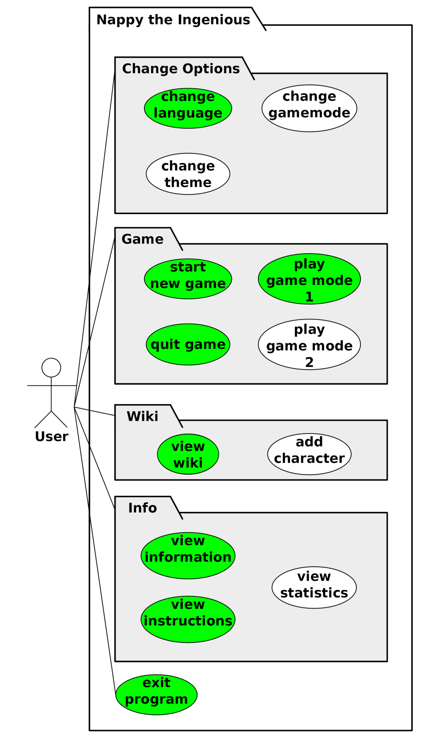
USECASE DIAGRAM & USECASE‘S
1. UseCase: Gamemode 1
2. UseCase: View Wiki
3. UseCase: View Instruction
4. UseCase: Change Settings
5. UseCase: View Info
6. UseCase: Gamemode 2
7. UseCase: Extend Wiki
8. UseCase: View Statistic
9. UseCase: Extend Settings
Notes:
MARVIN

Slide 7
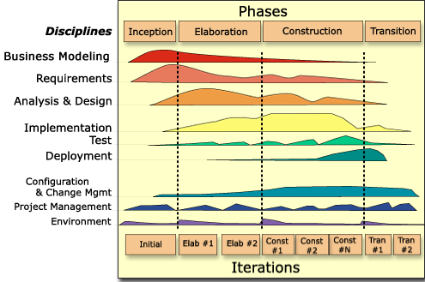
RUP

Slide 8
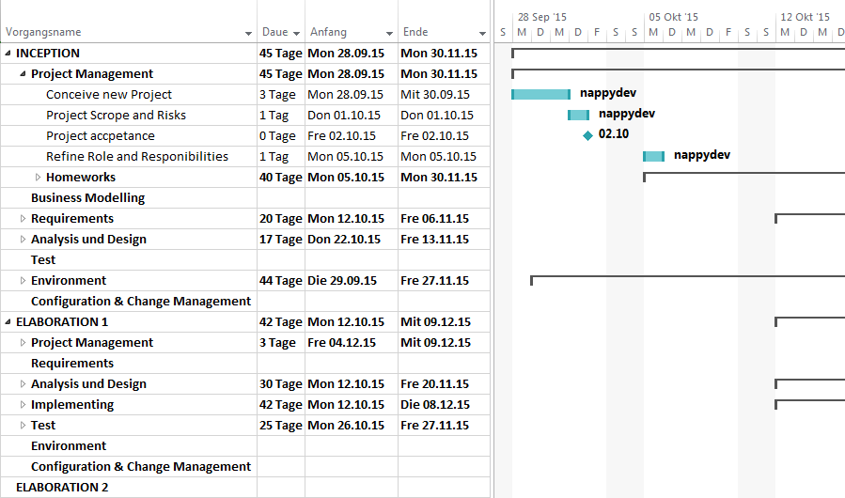
GANTT-CHART
https://github.com/nappydevelopment/docs/blob/master/pdfs/SE_GanttChart_UntilMidterm.pdf

Slide 9
FUNCTION POINTS

Slide 10

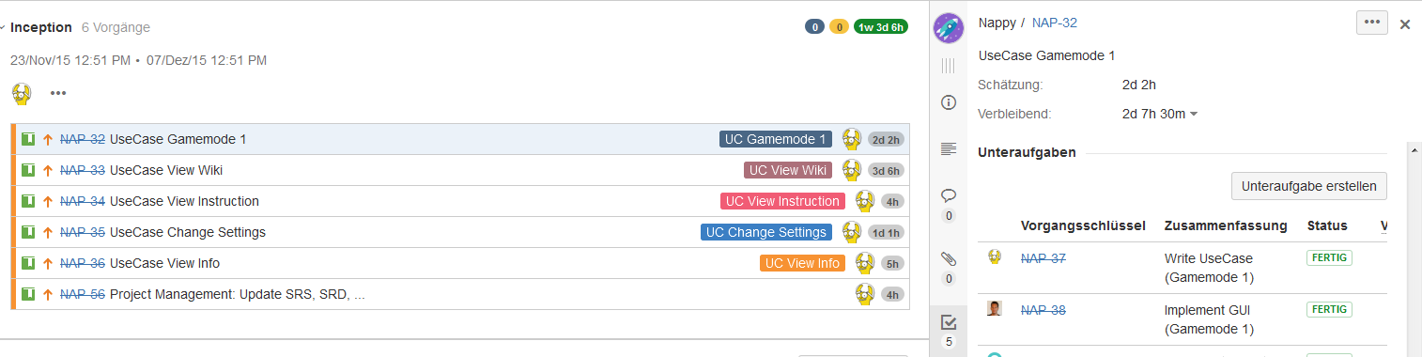
JIRA
http://193.196.7.27:8080/secure/RapidBoard.jspa?rapidView=8&projectKey=NAP&view=planning.nodetail

Slide 11
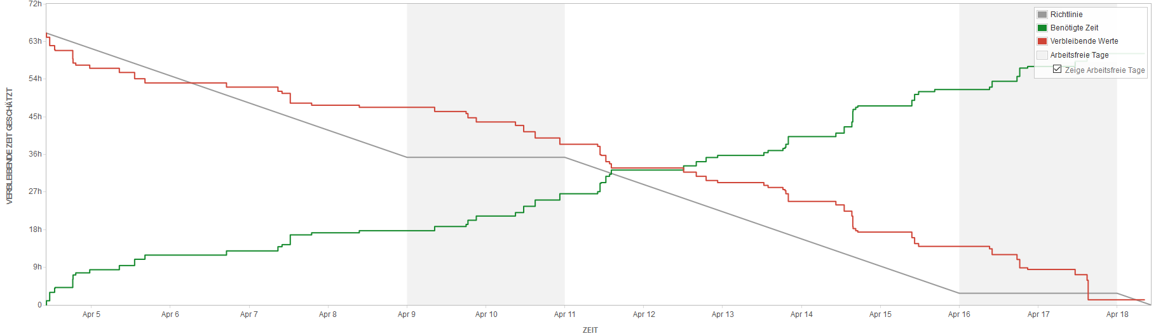
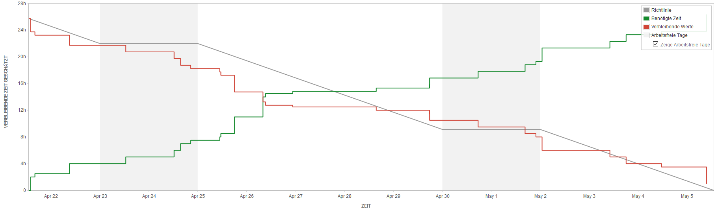
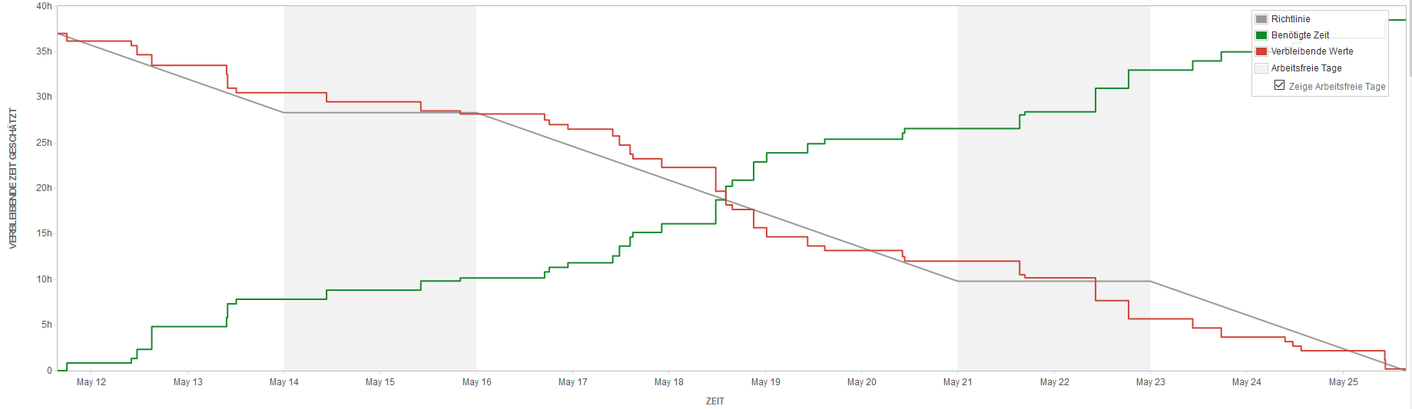
BURNDOWN-DIAGRAMM

Slide 12
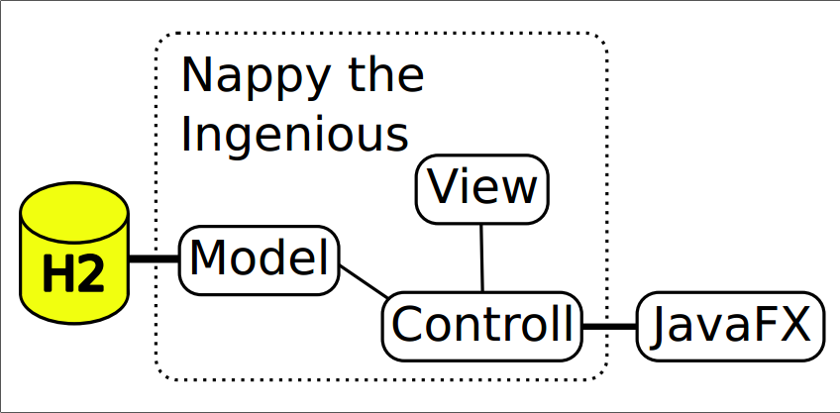
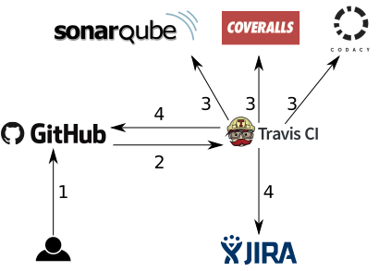
CLASS DIAGRAM & ARCHITEKTUR
Notes:
MARC

Slide 13
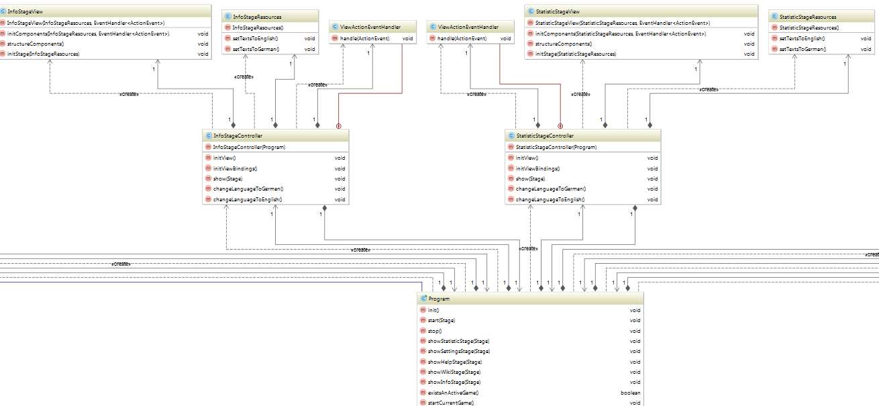
CLASS DIAGRAM & ARCHITEKTUR
Class diagram: https://github.com/nappydevelopment/docs/blob/master/svg/New%20Classdiagram.svg
Notes:
MARC

Slide 14
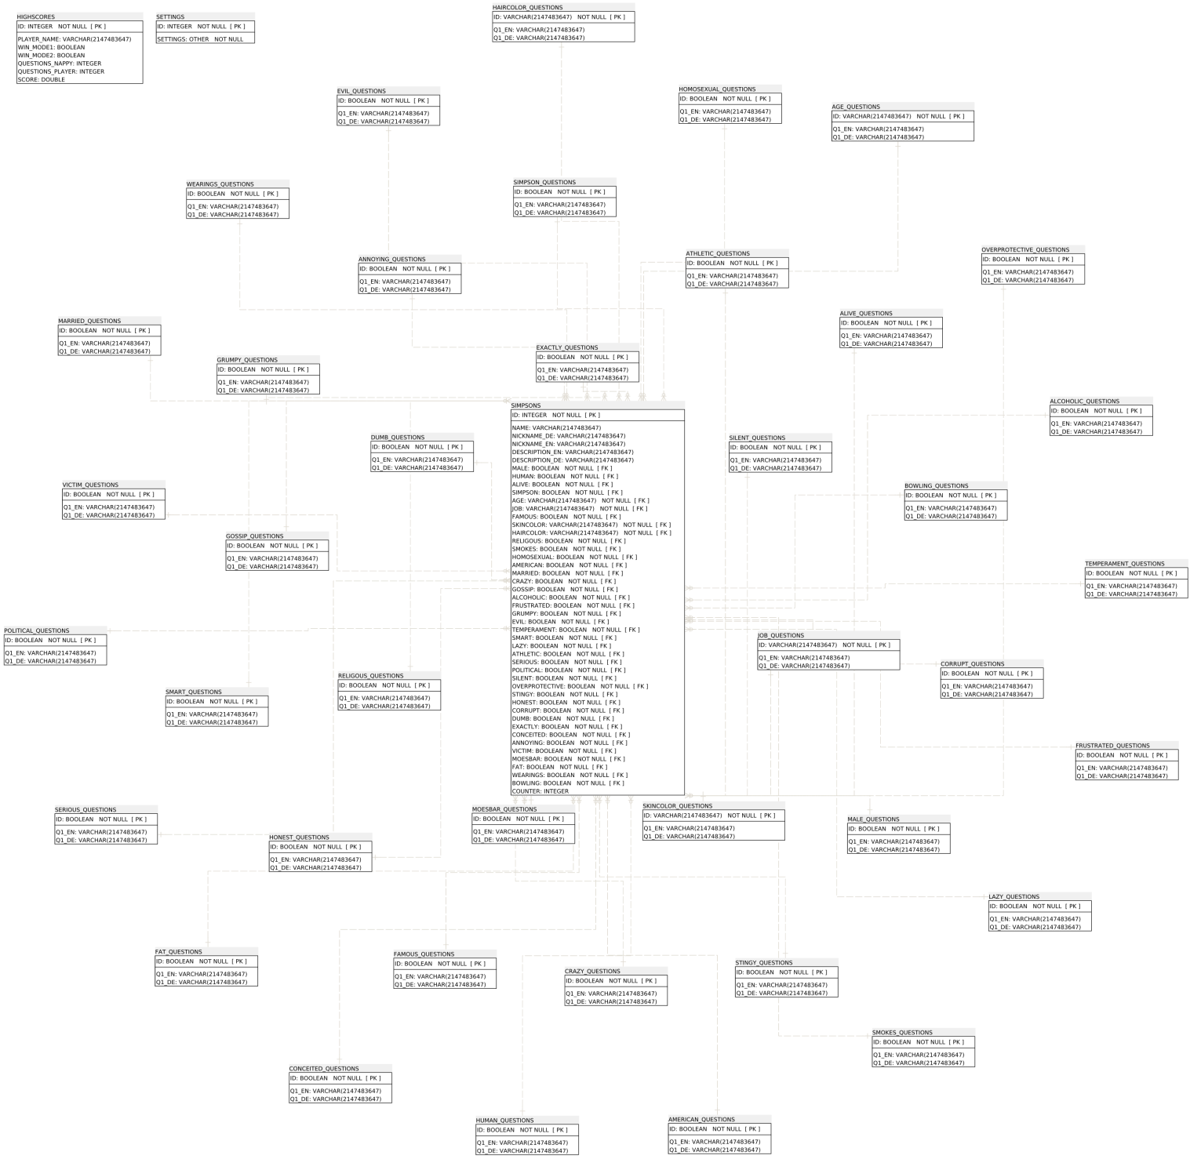
DATABASE ARCHITEKTUR
H2 embedded & in-momory database
Stern-Schema
Notes:
MARVIN

Slide 15
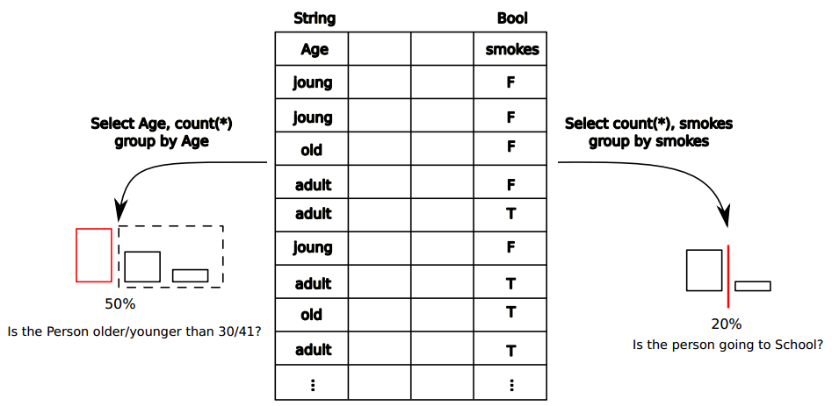
ALGORITHMUS GAMEMODE 1
Notes:
MARVIN

Slide 16
DEMO – ENJOY ☺
Executable Jar:
Notes:
MANU

Slide 17
Zusammenfassung
s
Notes:
MANU

Slide 18
LINKS
GitHub – Code: https://github.com/nappydevelopment/Nappy-the-ingenious
GitHub – Doku: https://github.com/nappydevelopment/docs
Blog: https://nappydevelopment.wordpress.com/
SRS:
SAD:
Test-Plan:

Slide 19

Fragen?

