Slide 1
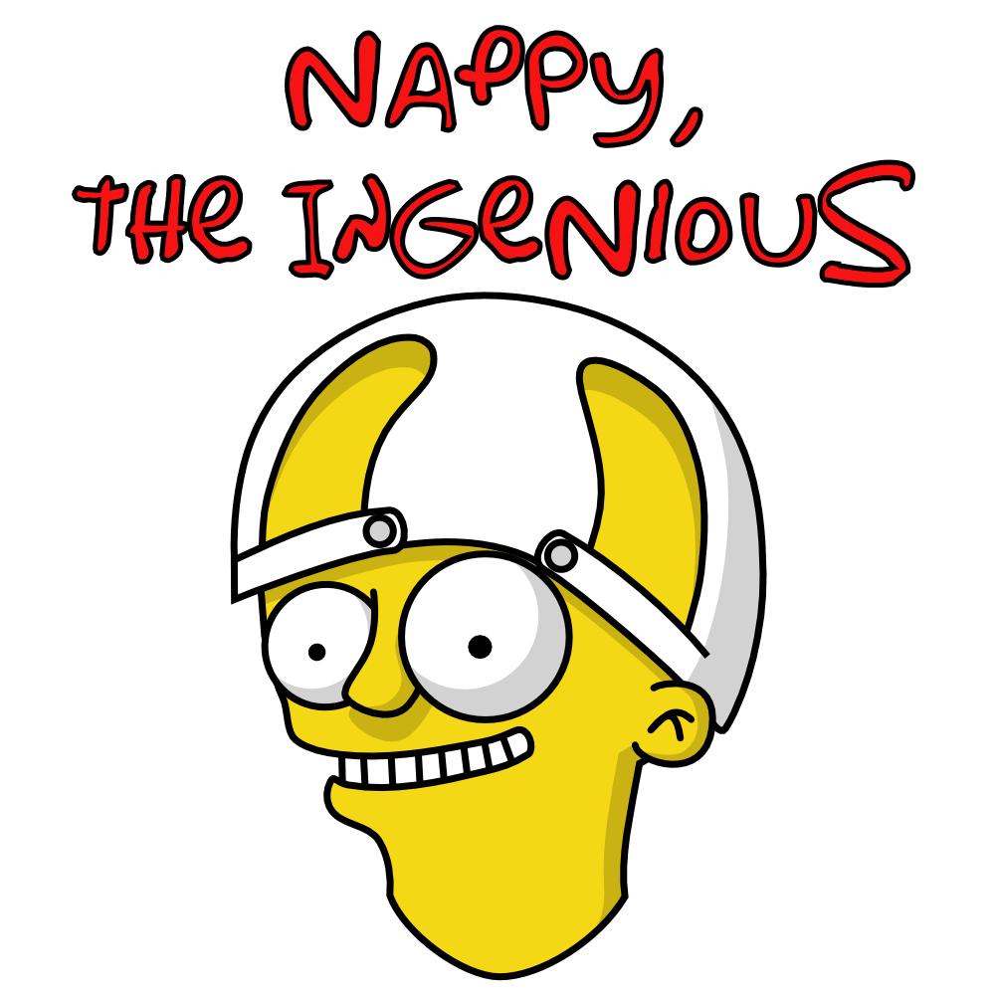
nappydevelopment
von Manuel Bothner, Marc Mahler,
Marvin Zerulla und Mehmet Ali Incekara

Slide 2
AGENDA
Vision
Software Requirements Specifications
UseCase Diagram & UseCase‘s
UseCase Gamemode 1
RUP & Gantt-Chart
JIRA & Burndown-Diagramm
Software Architecture Document
Class Diagramm & Architektur
Database Architektur
Algorithmus Gamemode 1
Live Demo
Ausblick
Links

Slide 3
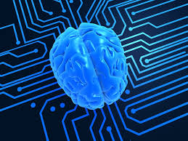

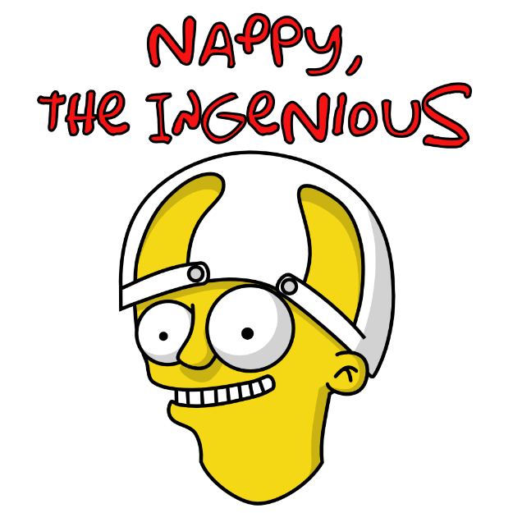



VISION
Notes:
MANU

Slide 4
Software Requirements Specification
SRS: https://github.com/nappydevelopment/docs/blob/master/pdfs/Software%20Requirements%20Specification.pdf
Beinhaltet wichtige Informationen zu:
- der Software generell
- der benötigten Hardware
- unserem gesamten Projekt
Notes:
ALI

Slide 5
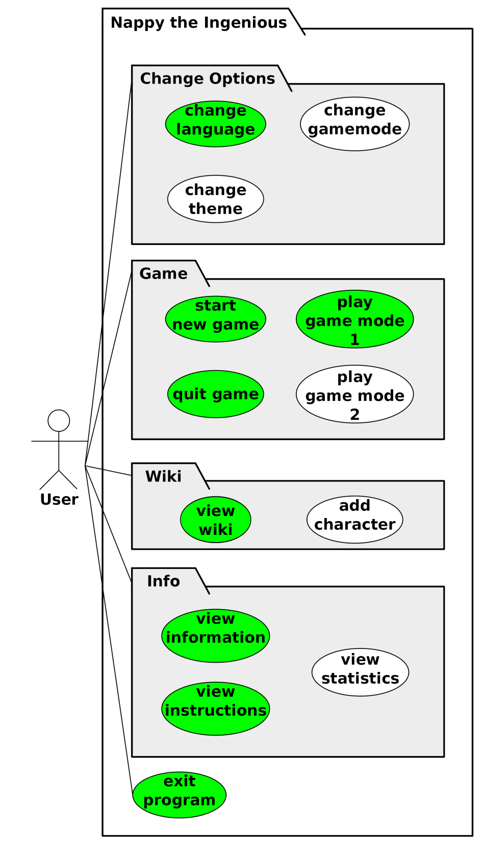
USECASE DIAGRAM & USECASE‘S
1. UseCase: Gamemode 1 (beinhaltet: start new game, play game mode 1, quit game)
2. UseCase: View Wiki (beinhaltet: view wiki)
3. UseCase: View Instruction (beinhaltet: view instruction)
4. UseCase: Change Settings (beinhaltet: change language)
5. UseCase: View Info (beinhaltet: view information)
Notes:
MARVIN

Slide 6
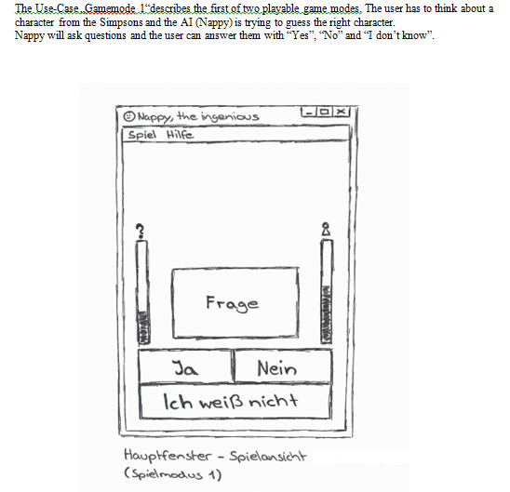
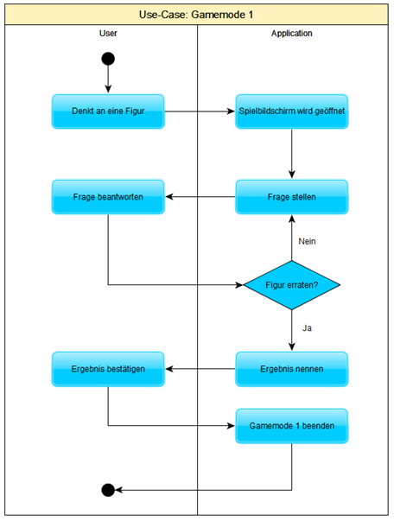
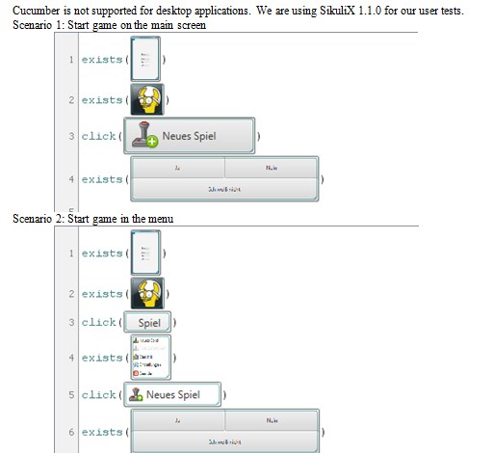
USECASE GAMEMODE 1
.
.
.
Notes:
ALI

Slide 7
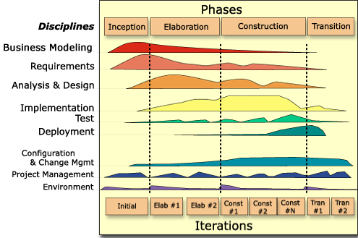
RUP & GANTT-CHART

Slide 8
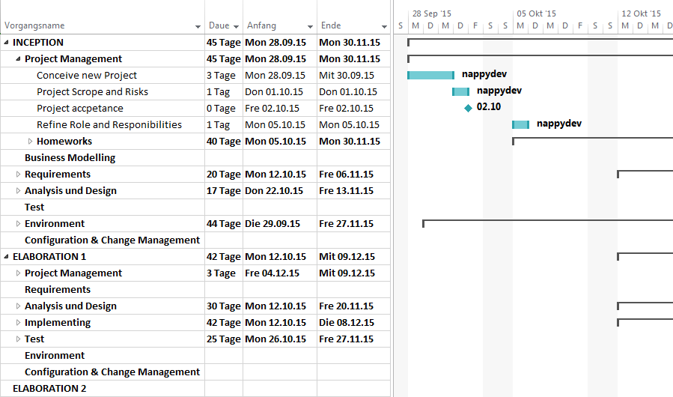
RUP & GANTT-CHART
https://github.com/nappydevelopment/docs/blob/master/pdfs/SE_GanttChart_UntilMidterm.pdf

Slide 9

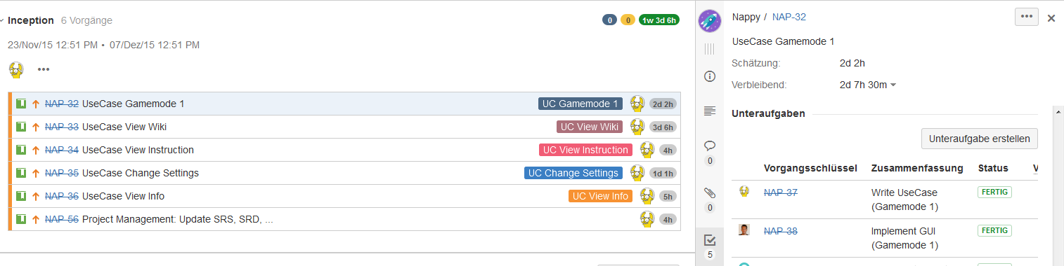
JIRA & BURNDOWN-DIAGRAMM
http://193.196.7.27:8080/secure/RapidBoard.jspa?rapidView=8&projectKey=NAP&view=planning.nodetail

Slide 10
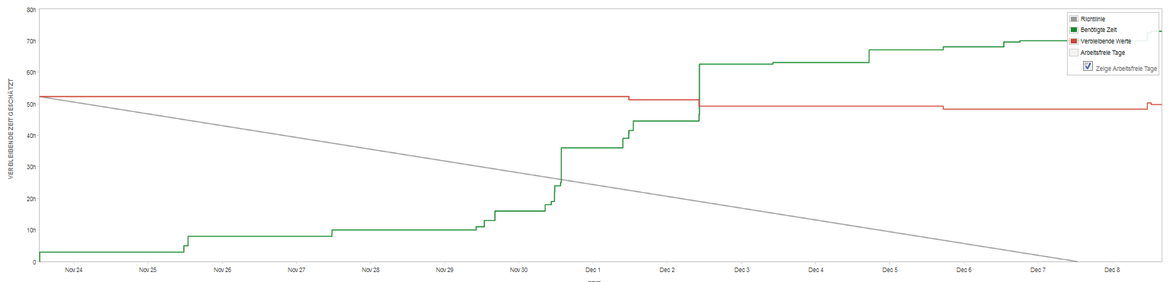
JIRA & BURNDOWN-DIAGRAMM

Slide 11
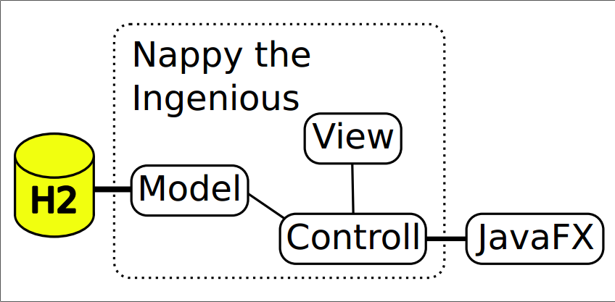
CLASS DIAGRAM & ARCHITEKTUR
Notes:
MARC

Slide 12
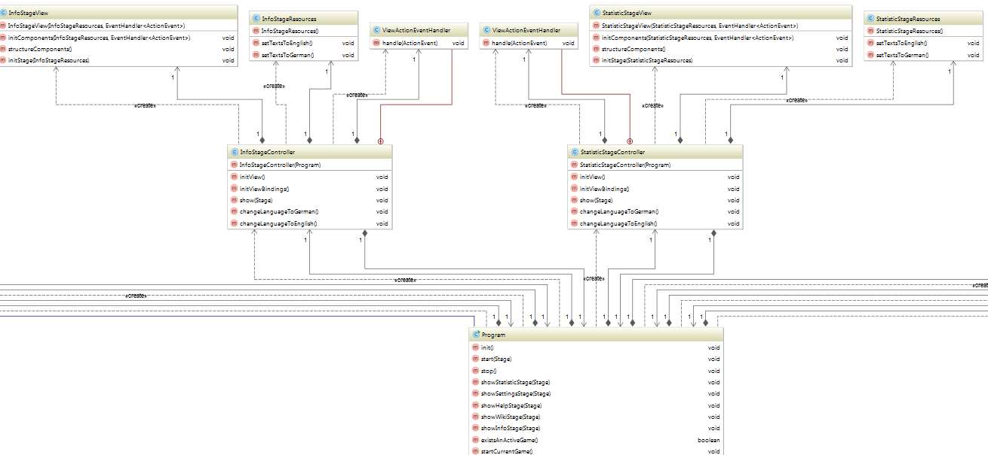
CLASS DIAGRAM & ARCHITEKTUR
Class diagram: https://github.com/nappydevelopment/docs/blob/master/svg/New%20Classdiagram.svg
Notes:
MARC

Slide 13
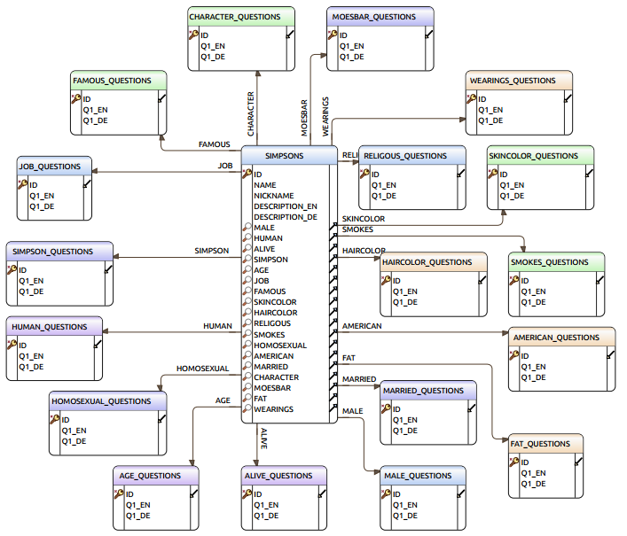
DATABASE ARCHITEKTUR
H2 embedded & in-momory database
Stern-Schema
Notes:
MARVIN

Slide 14
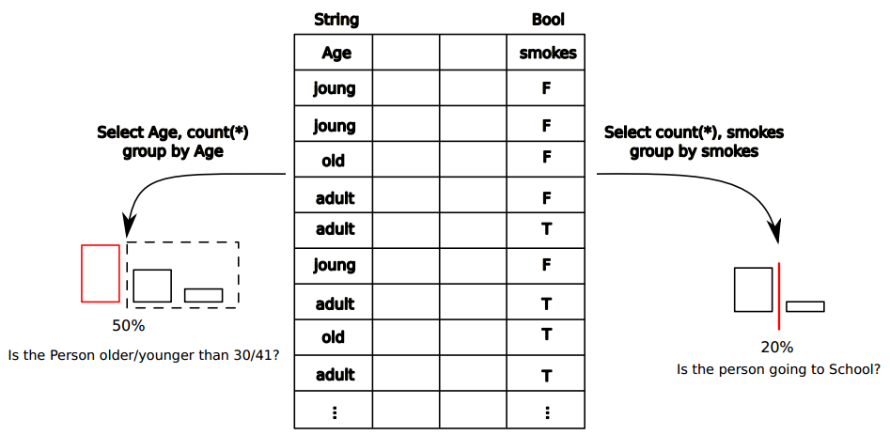
ALGORITHMUS GAMEMODE 1
Notes:
MARVIN

Slide 15
DEMO – ENJOY ☺
Executable Jar: https://github.com/nappydevelopment/Nappy-the-ingenious/blob/master/jar/Nappy-the-ingenious.jar
Notes:
MANU

Slide 16
AUSBLICK
Spielmodus 2
Statistik
Einstellungen (Farbschema und Spielmodus)
Soundeffekte + ggf. Ladebildschirm
Charakter hinzufügen
Optimierungen (Fragen, Algorithmus, …)
Stress-Test, Funktionaltests, …
Notes:
MANU

Slide 17
LINKS
GitHub – Code: https://github.com/nappydevelopment/Nappy-the-ingenious
GitHub – Doku: https://github.com/nappydevelopment/docs
Blog: https://nappydevelopment.wordpress.com/

