Slide 1

nappydevelopment
von Manuel Bothner, Marc Mahler,
Marvin Zerulla und Mehmet Ali Incekara

Slide 2
AGENDA
Vision
UseCase
Software Requirements Specifications
Project Methodology
Architektur
Live Demo
Links

Slide 3
VISION

Slide 4
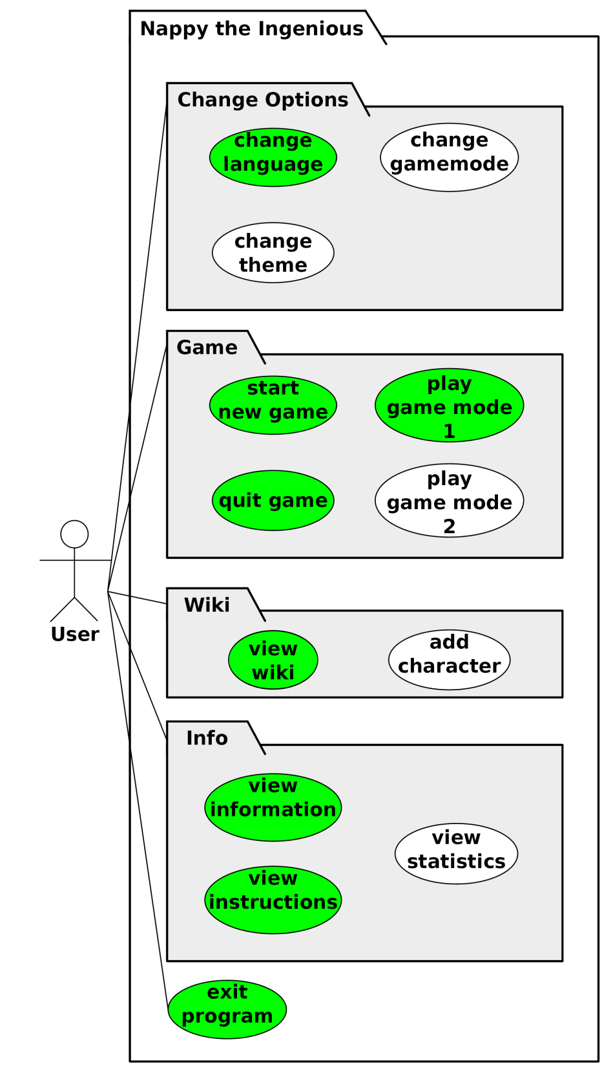
USECASE DIAGRAM & USECASE‘S
1. UseCase: Gamemode 1 (beinhaltet: start new game, play game mode 1, quit game)
2. UseCase: View Wiki (beinhaltet: view wiki)
3. UseCase: View Instruction (beinhaltet: view instruction)
4. UseCase: Change Settings (beinhaltet: change language)
5. UseCase: View Info (beinhaltet: view information)

Slide 5
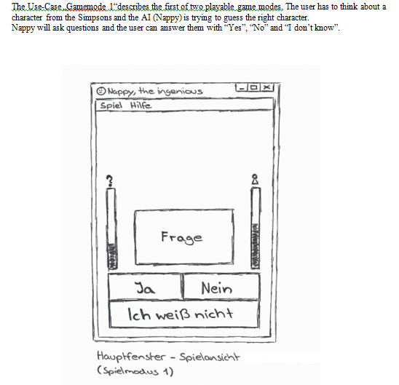
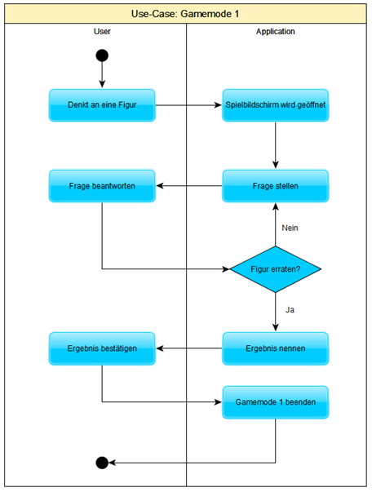
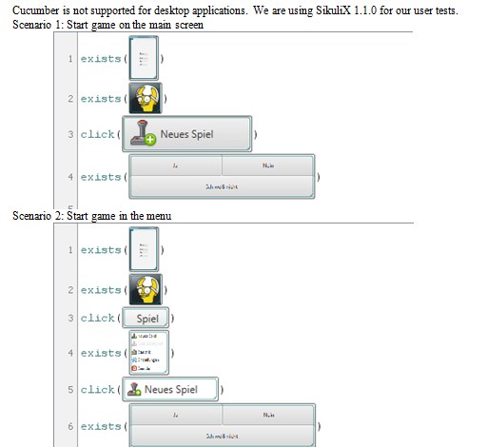
USECASE GAMEMODE 1

Slide 6
SRS

Slide 7
PROJECT METHODOLOGY
Agile (iterativ)
Vorgehensmodell: rup + GANTT-CHART
Scrum board (JIRA)
Zeitschätzung: Stunden

Slide 8
ARCHITEKTUR

Slide 9
CLASS DIAGRAM

Slide 10
DEMO

Slide 11
LINKS

