Slide 1

nappydevelopment
von Manuel Bothner, Marc Mahler,
Marvin Zerulla und Mehmet Ali Incekara
Notes:
Ali

Slide 2
AGENDA
Wer ist nappydevelopment
Vision & Scope
Software Requirements Specification
RUP & long-term planning
JIRA
Riskmanagement
Class Diagramm & Architektur
Testing
Algorithmus 1 + 2
Software Patterns
Metrics
Demo
Notes:
Ali

Slide 3
WER IST NAPPYDEVELOPMENT?
Discipline | Team member
Business Modeling | Marc Mahler and Manuel Bothner
Requirements | Mehmet Ali Incekara
Analysis and Design | Marvin Zerulla and Manuel Bothner
Implementation | nappydevelopment
Test | nappydevelopment
Deployment | Marvin Zerulla and Mehmet Ali Incekara
Project Management | Mehmet Ali Incekara
Environment | Marc Mahler and Manuel Bothner
Configuration and Change Managment | Marvin Zerulla and Mehmet Ali Incekara
Notes:
Ali

Slide 4






VISION & SCOPE
Notes:
MANU

Slide 5
Software Requirements Specification
Notes:
ALI

Slide 6
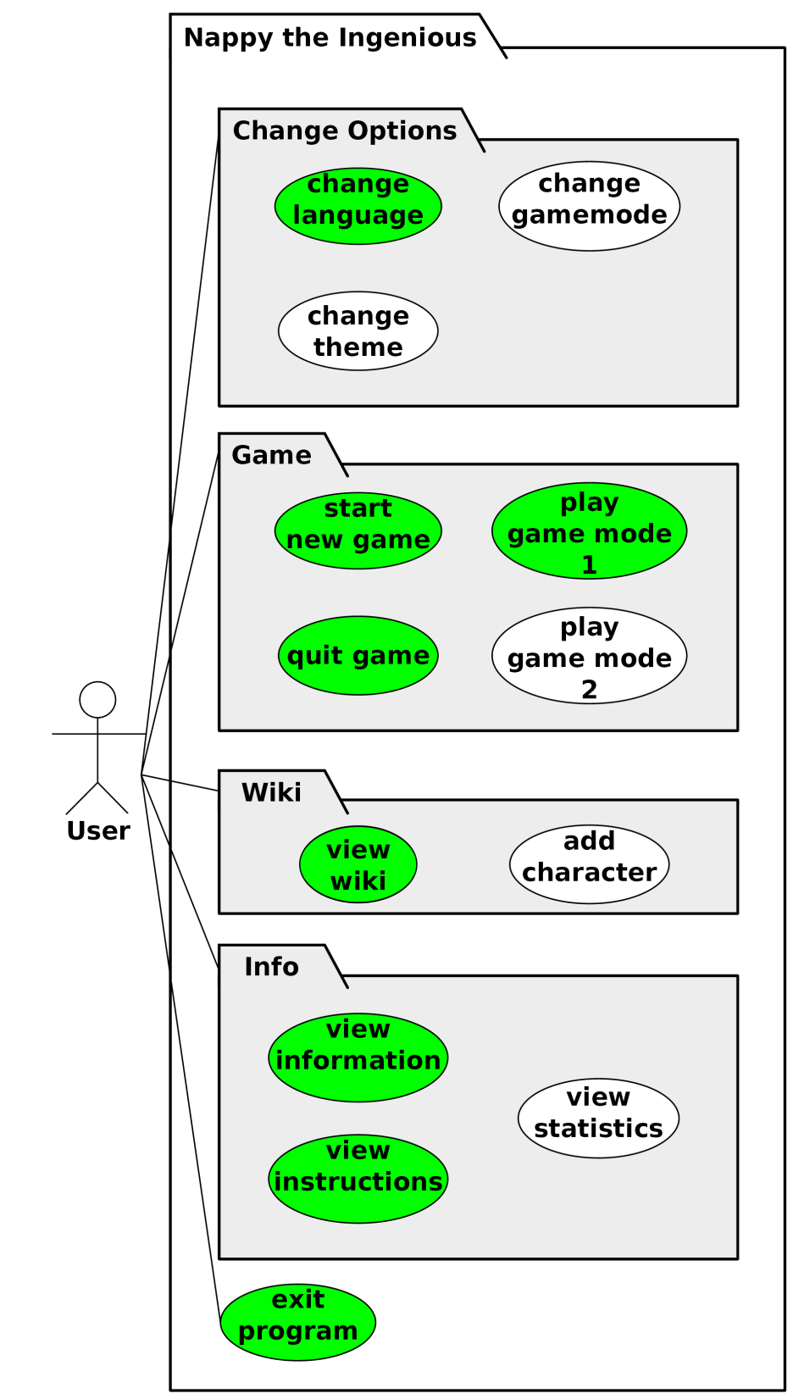
USECASE DIAGRAM & USECASE‘S
1. UseCase: Gamemode 1
2. UseCase: View Wiki
3. UseCase: View Instruction
4. UseCase: Change Settings
5. UseCase: View Info
6. UseCase: Gamemode 2
7. UseCase: Extend Wiki
8. UseCase: View Statistic
9. UseCase: Extend Settings
Notes:
ALI

Slide 7
Non-functional Requirements
Plattformunabhängigkeit
vollständig Offline lauffähig
Antwortzeiten
Startzeit: ~5 Sekunden
Nach Start: ~0,5 Sekunden
Ressourcennutzung
Testabdeckung
Insgesamt > 50%
100 spielbare Figuren
Notes:
Manu

Slide 8
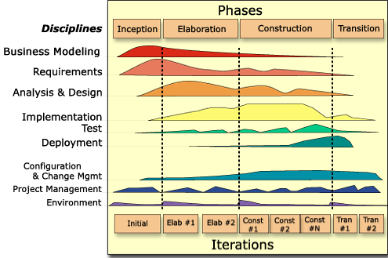
RUP
Notes:
Ali

Slide 9
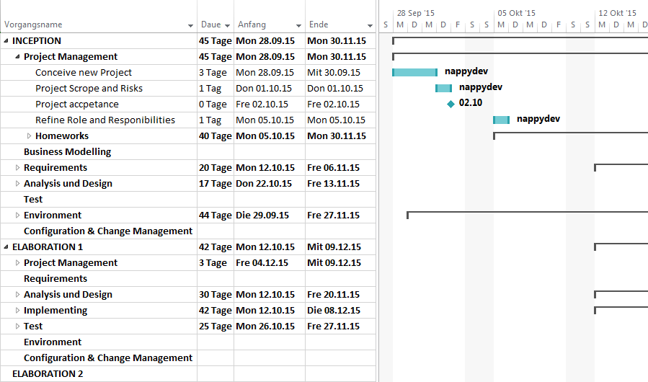
GANTT-CHART
Notes:
Ali

Slide 10
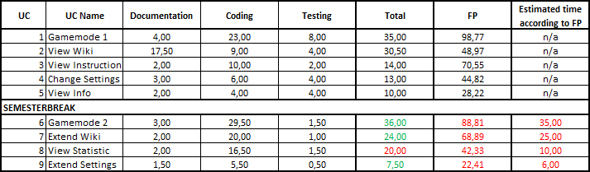
FUNCTION POINTS
Notes:
Ali

Slide 11

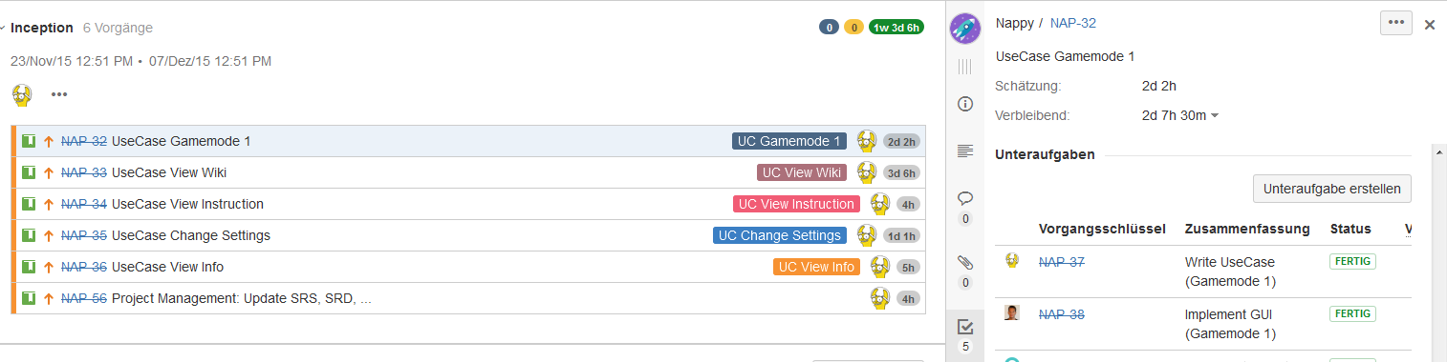
JIRA
http://193.196.7.27:8080/secure/RapidBoard.jspa?rapidView=8&projectKey=NAP&view=planning.nodetail
Notes:
Ali

Slide 12
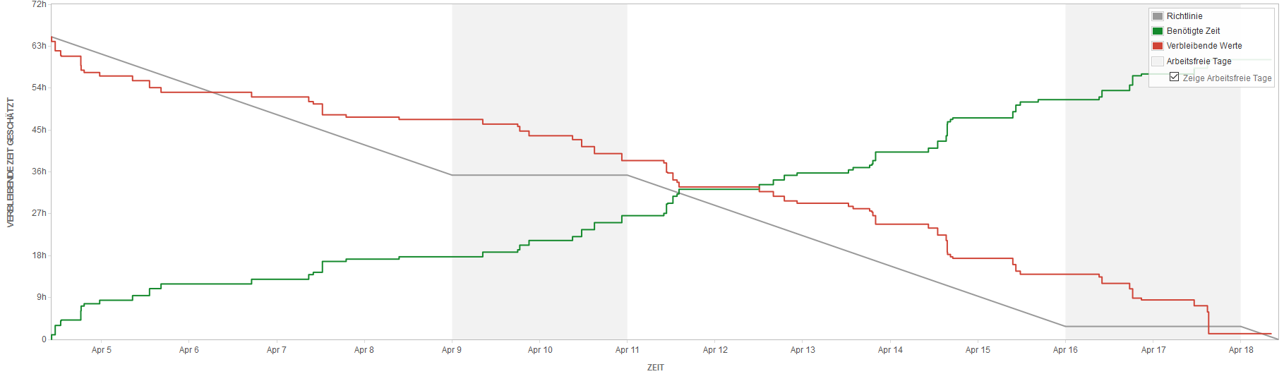
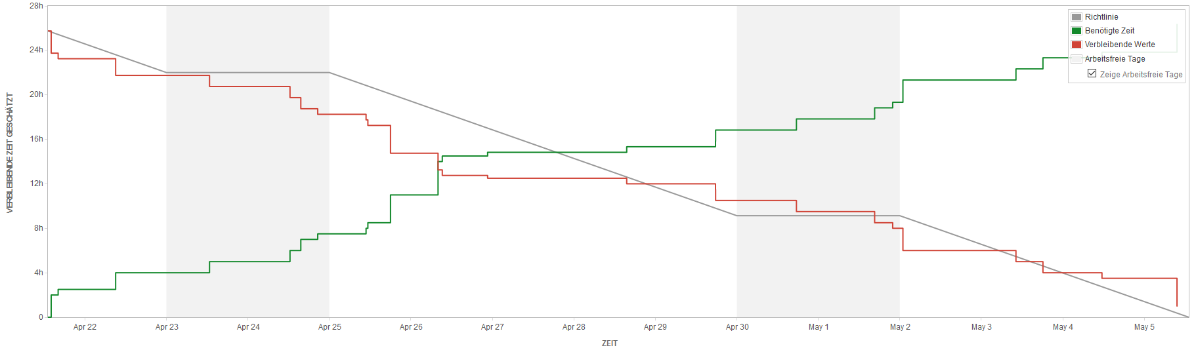
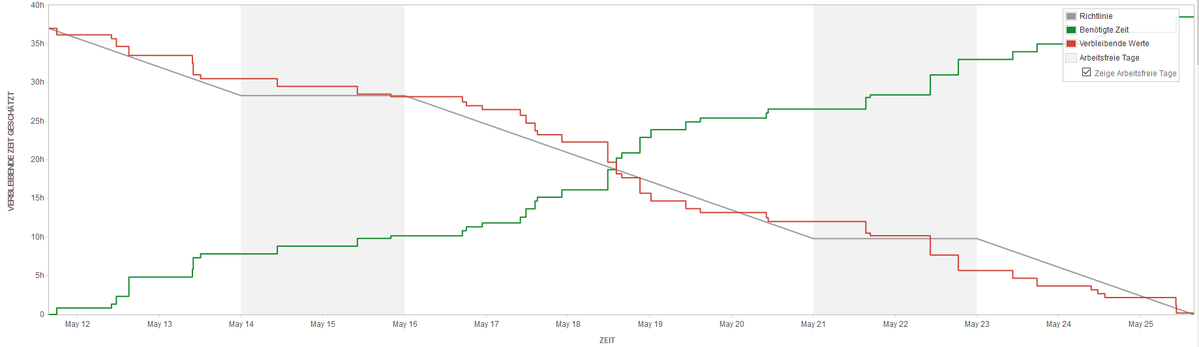
BURNDOWN-DIAGRAMM
Notes:
Ali

Slide 13
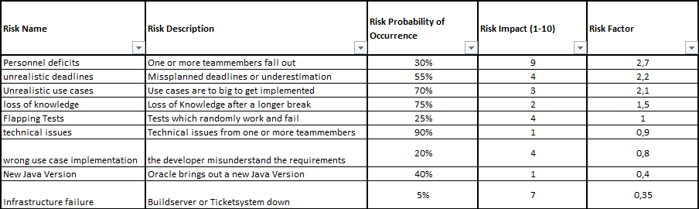
RISKMANAGEMENT
Notes:
Marvin

Slide 14
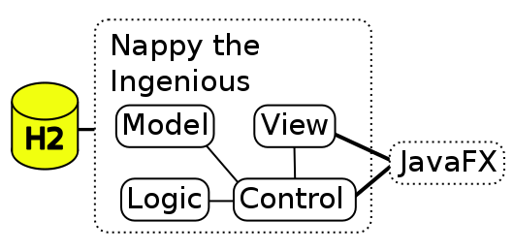
CLASS DIAGRAM & ARCHITEKTUR
Notes:
MARC

Slide 15
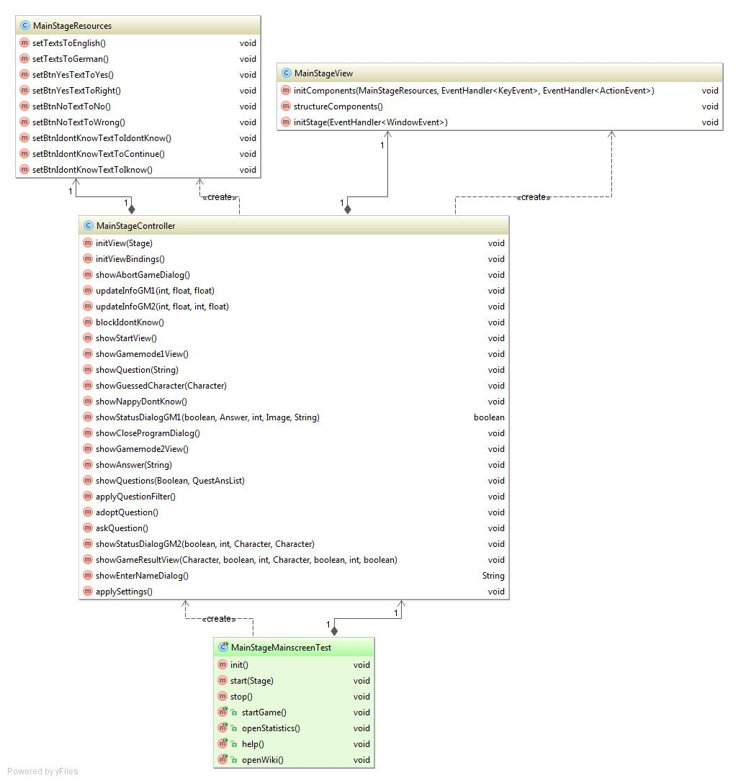
CLASS DIAGRAM & ARCHITEKTUR
Java FX
Jede Stage hat ihr eigenes MVC-Konzept
Abgeschlossenheit
Austauschbar und feste Schnittstellen zur Logik
Notes:
MARC

Slide 16
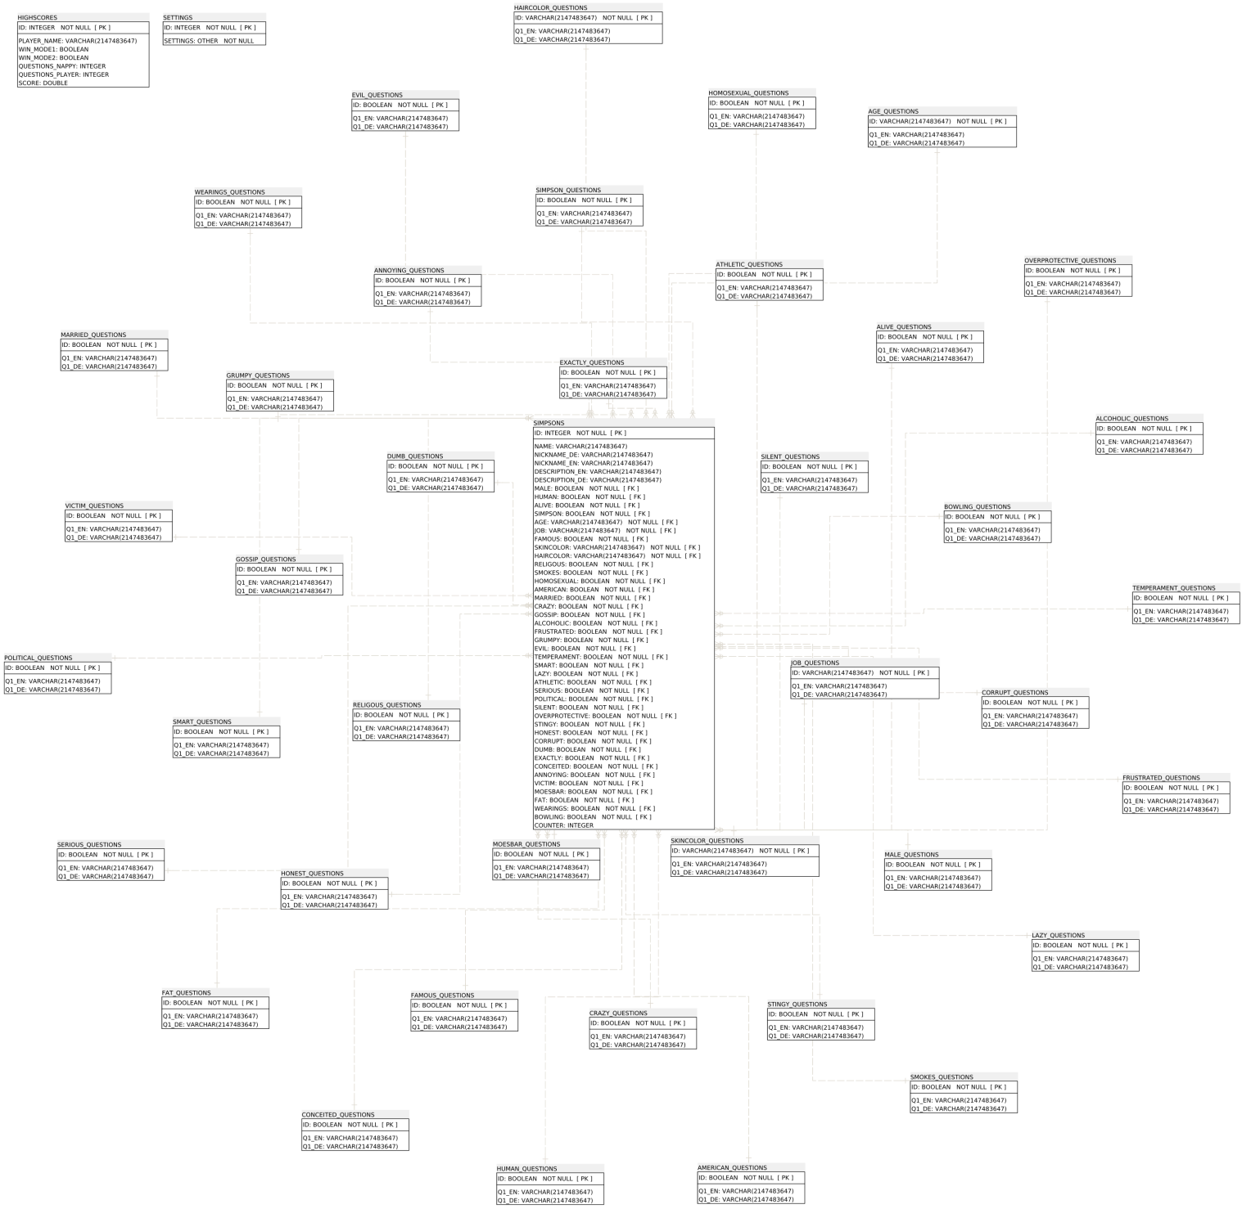
DATABASE ARCHITEKTUR
H2 embedded & in-momory database
Stern-Schema
Notes:
MARVIN

Slide 17
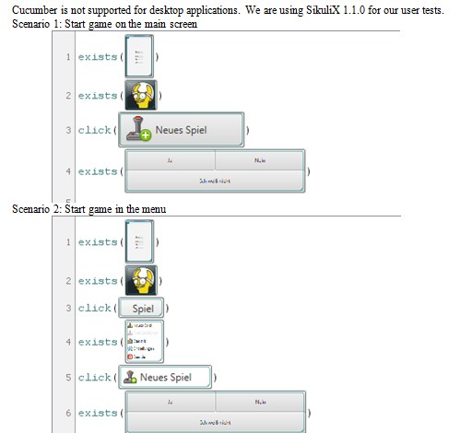
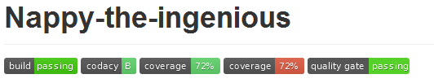
TESTING
SikuliX
JUnit
TestFX
Installation Tests
Notes:
MARVIN

Slide 18
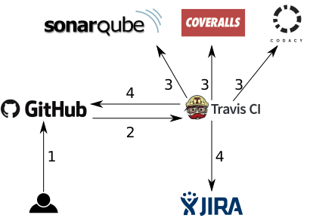
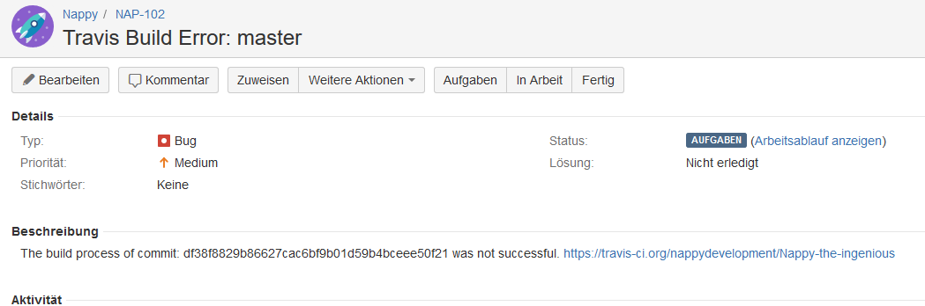
DEPLOYMENT
Notes:
MARVIN

Slide 19
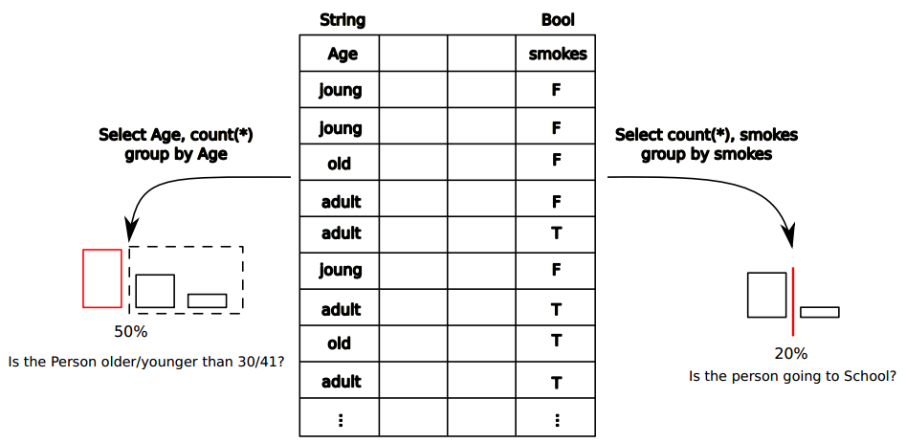
ALGORITHMUS GAMEMODE 1 + 2
Notes:
MARVIN

Slide 20
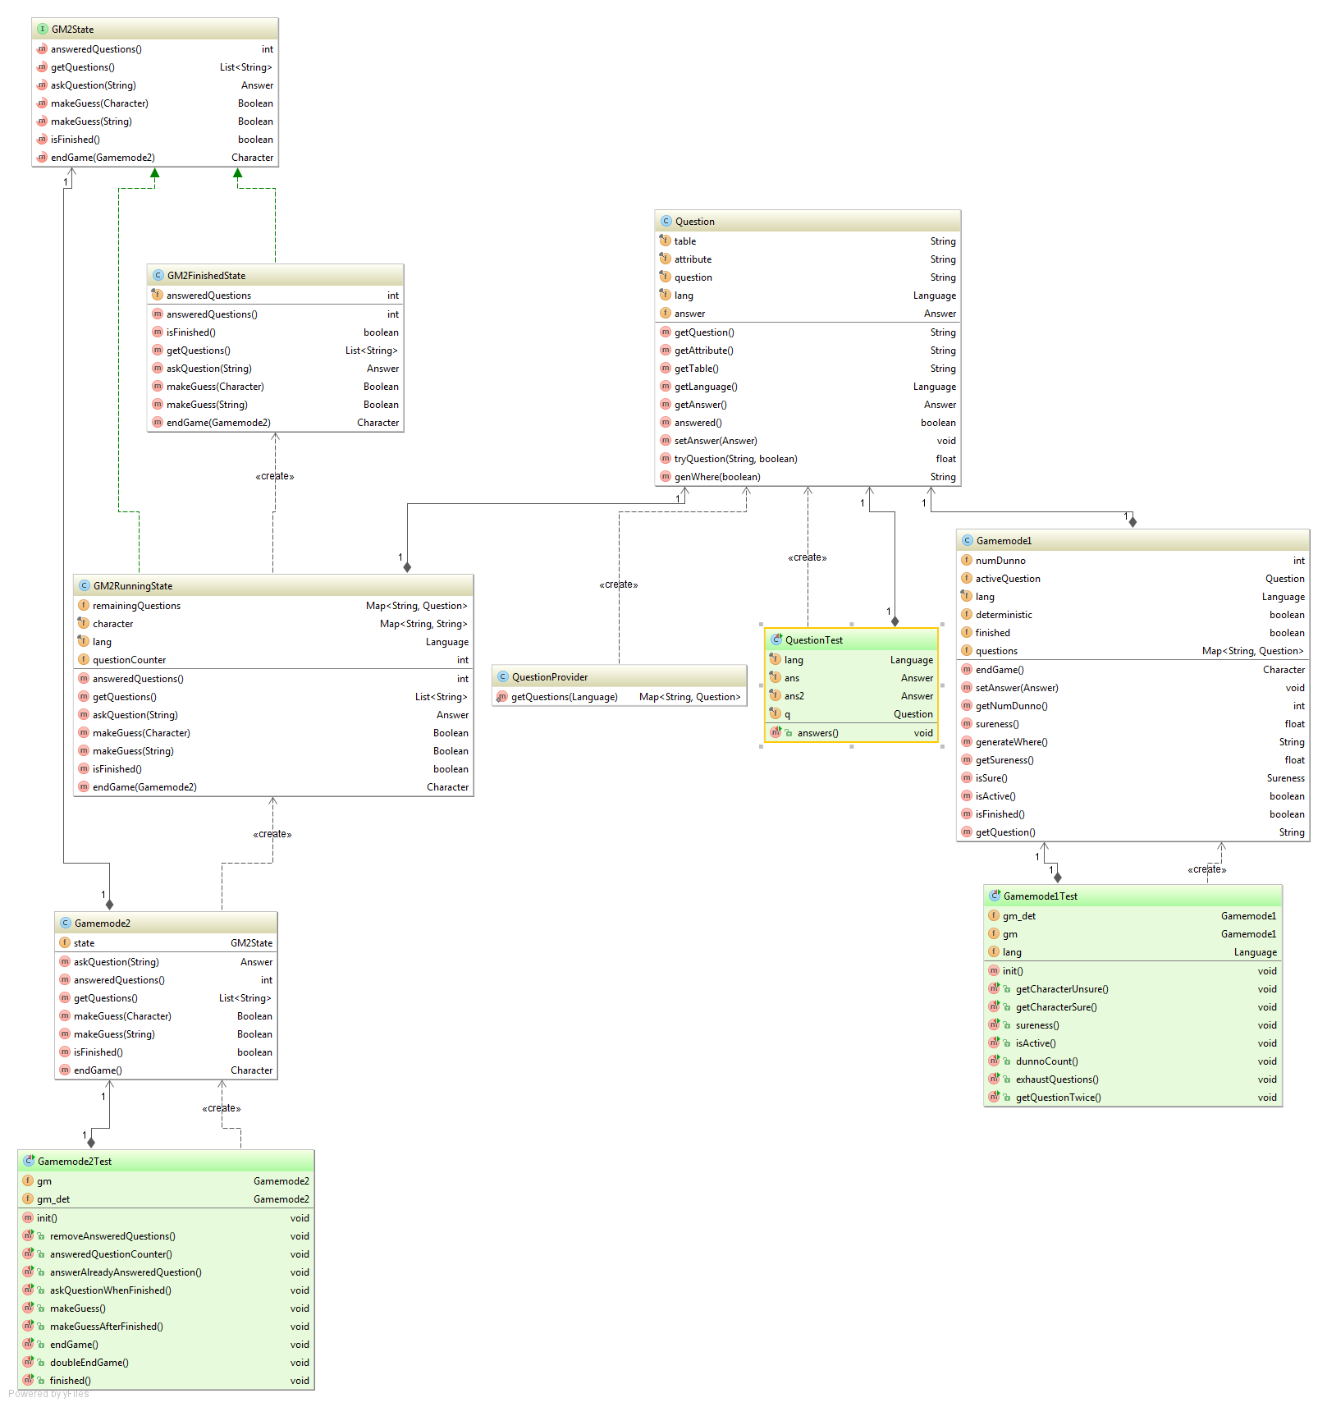
SOFTWARE PATTERNS
State Pattern
Notes:
Marvin

Slide 21
METRICS

Slide 22
DEMO – ENJOY ☺
Executable Jar: https://github.com/nappydevelopment/Nappy-the-ingenious/raw/master/jar/nappy-the-ingenious-1.0.0.jar
Notes:
MANU

Slide 23
LINKS
GitHub – Code: https://github.com/nappydevelopment/Nappy-the-ingenious
GitHub – Doku: https://github.com/nappydevelopment/docs
Blog: https://nappydevelopment.wordpress.com/
Gantt-Chart: https://github.com/nappydevelopment/docs/blob/master/pdfs/SE_GanttChart_UntilMidterm.pdf
SRS: https://github.com/nappydevelopment/docs/blob/master/pdfs/Software%20Requirements%20Specification.pdf

Slide 24

Fragen?

Slide 25

Vielen Dank für
eure
Aufmerksamkeit

