Slide 1

nappydevelopment
von Manuel Bothner, Marc Mahler,
Marvin Zerulla und Mehmet Ali Incekara

Slide 2
AGENDA
Vision
Software Requirements Specifications
UseCase Diagram & UseCase‘s
UseCase Gamemode 1
RUP & Gantt-Chart
JIRA & Burndown-Diagramm
Software Architecture Document
Class Diagramm & Architektur
Database Architektur
Algorithmus Gamemode 1
Live Demo
Ausblick
Links

Slide 3






VISION
Notes:
MANU

Slide 4
Software Requirements Specification
Notes:
ALI

Slide 5
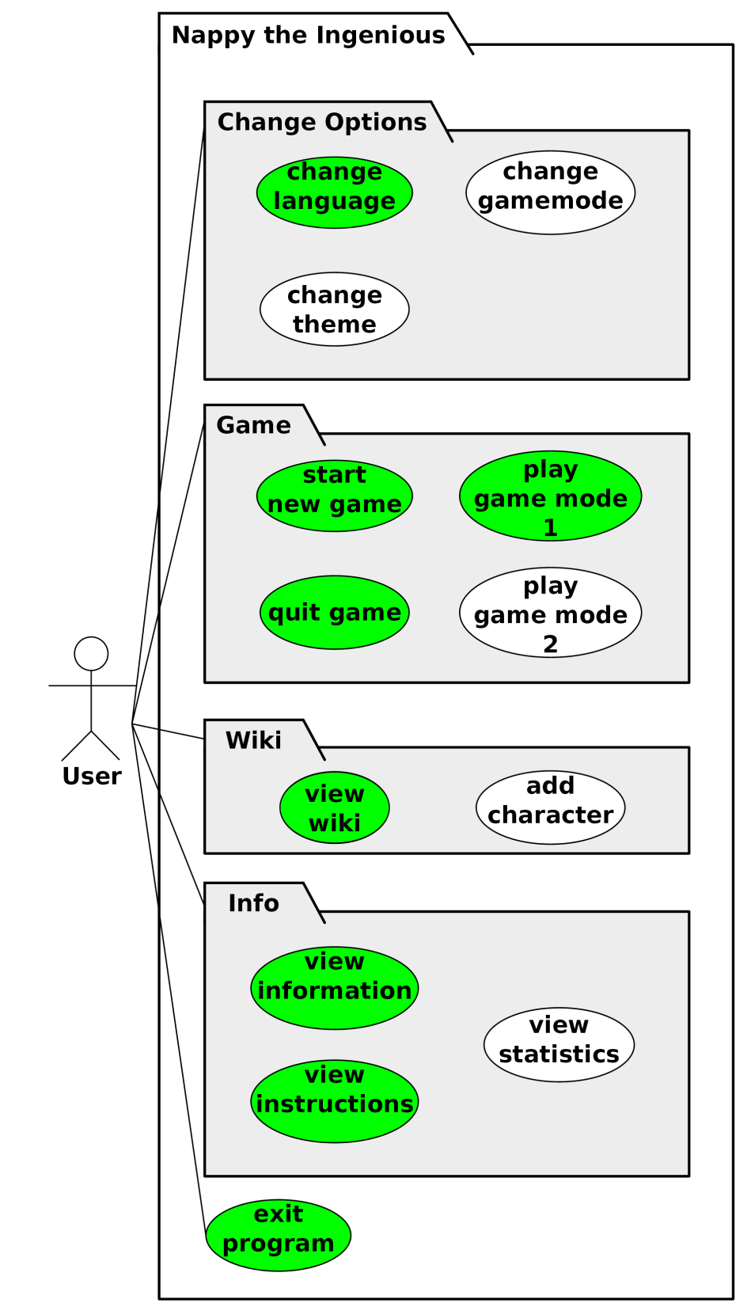
USECASE DIAGRAM & USECASE‘S
1. UseCase: Gamemode 1
2. UseCase: View Wiki
3. UseCase: View Instruction
4. UseCase: Change Settings
5. UseCase: View Info
6. UseCase: Gamemode 2
7. UseCase: Extend Wiki
8. UseCase: View Statistic
9. UseCase: Extend Settings
Notes:
MARVIN

Slide 6
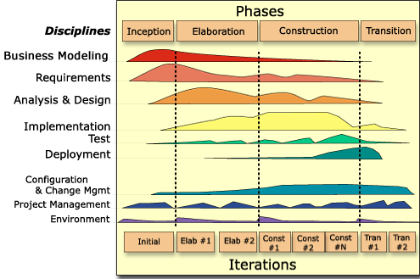
RUP & GANTT-CHART

Slide 7
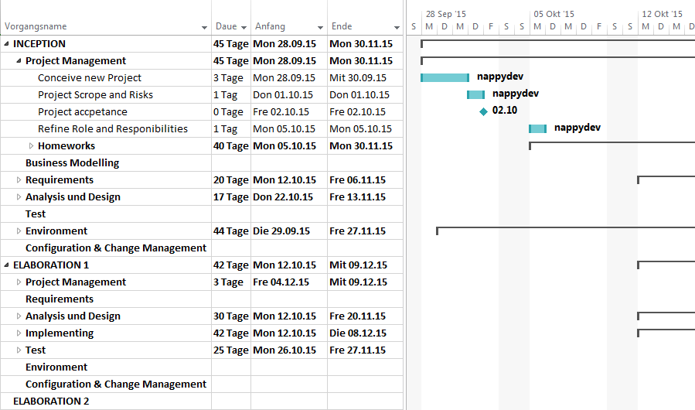
RUP & GANTT-CHART
https://github.com/nappydevelopment/docs/blob/master/pdfs/SE_GanttChart_UntilMidterm.pdf

Slide 8

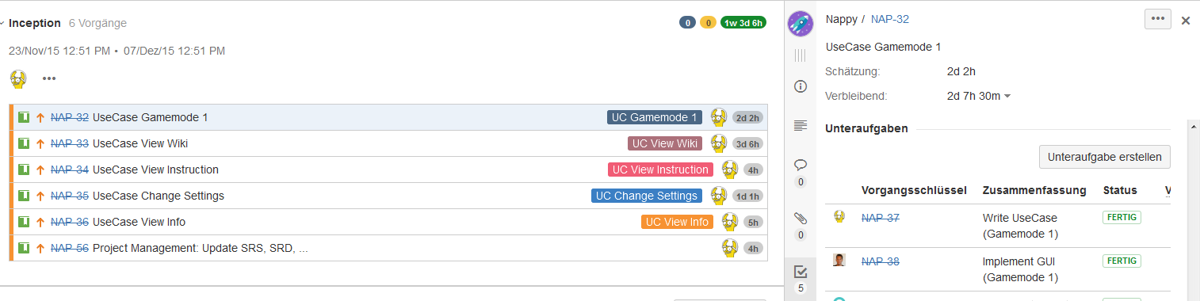
JIRA & BURNDOWN-DIAGRAMM
http://193.196.7.27:8080/secure/RapidBoard.jspa?rapidView=8&projectKey=NAP&view=planning.nodetail

Slide 9
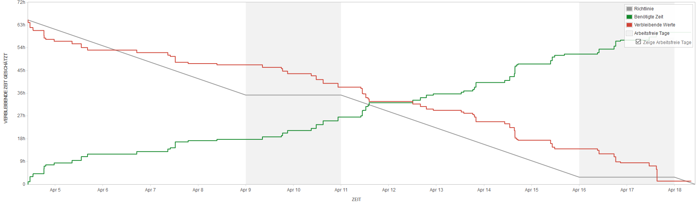
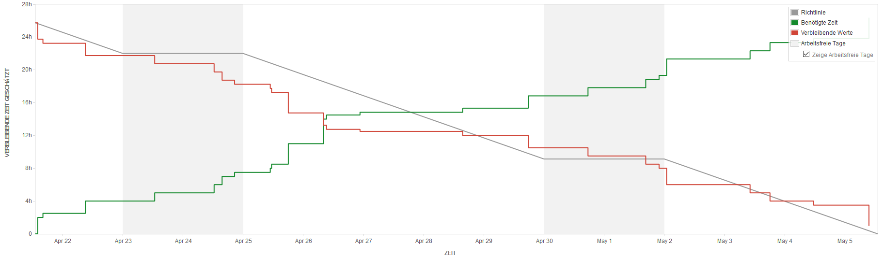
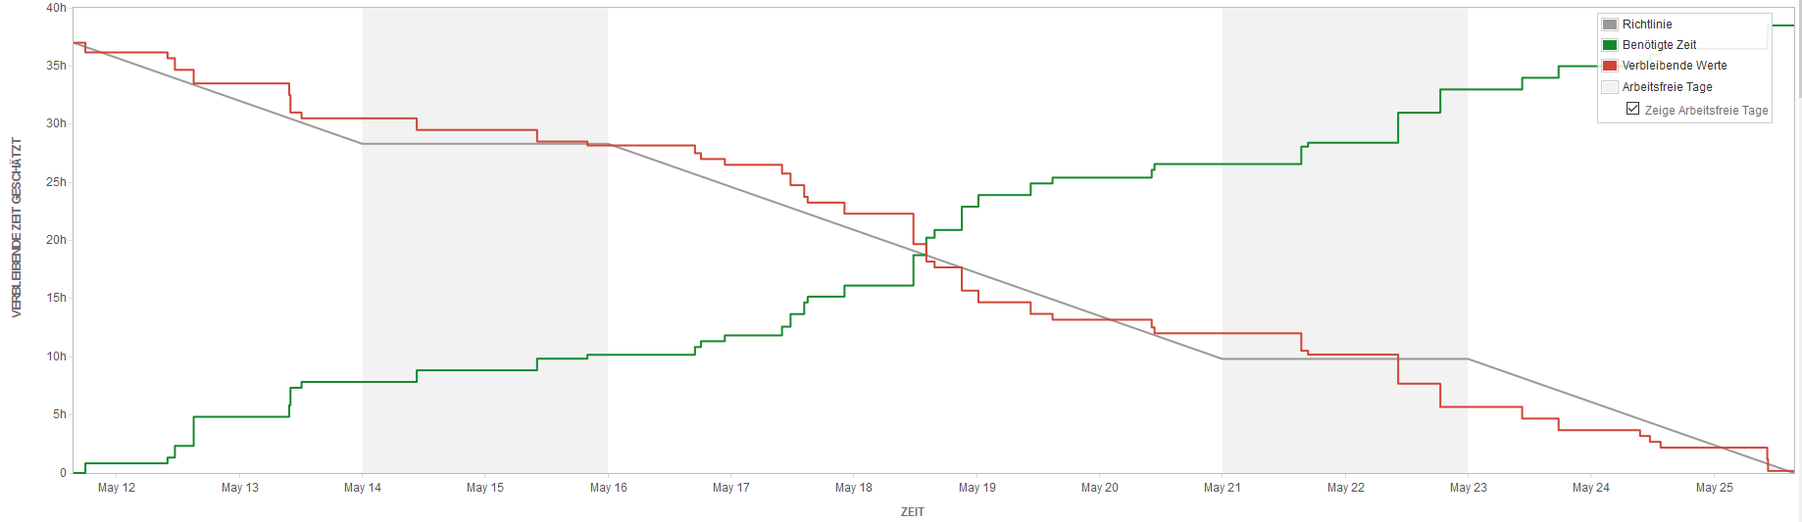
JIRA & BURNDOWN-DIAGRAMM

Slide 10
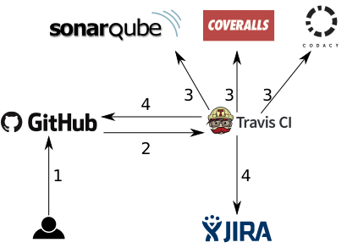
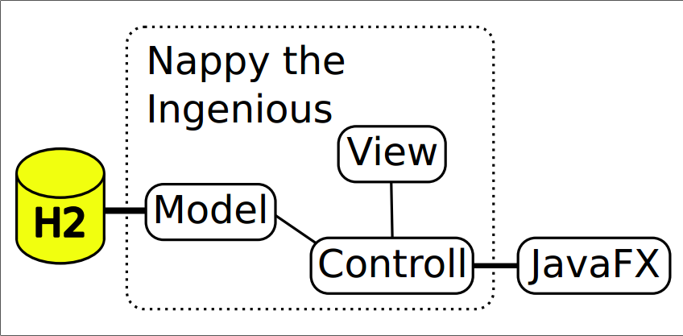
CLASS DIAGRAM & ARCHITEKTUR
Notes:
MARC

Slide 11
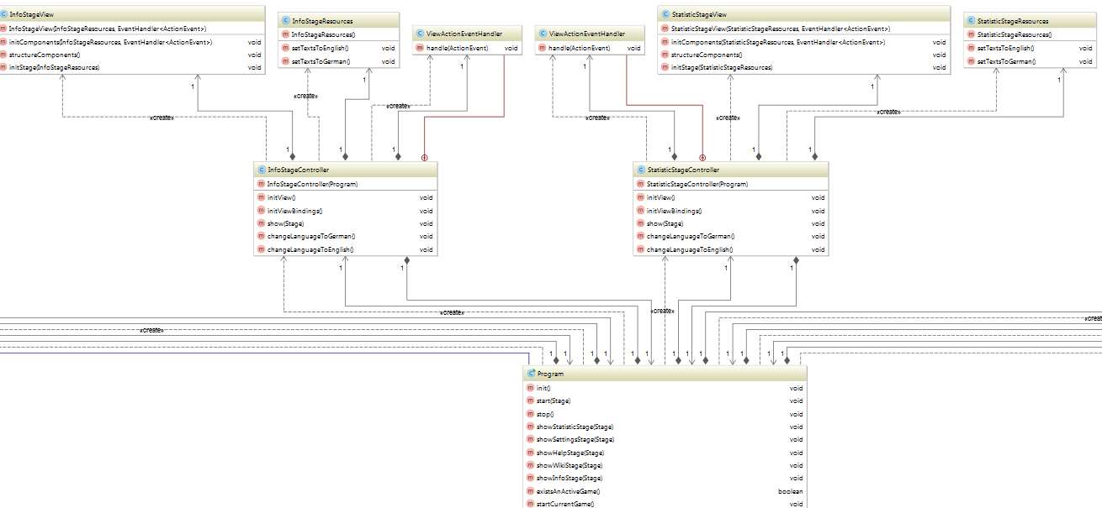
CLASS DIAGRAM & ARCHITEKTUR
Class diagram: https://github.com/nappydevelopment/docs/blob/master/svg/New%20Classdiagram.svg
Notes:
MARC

Slide 12
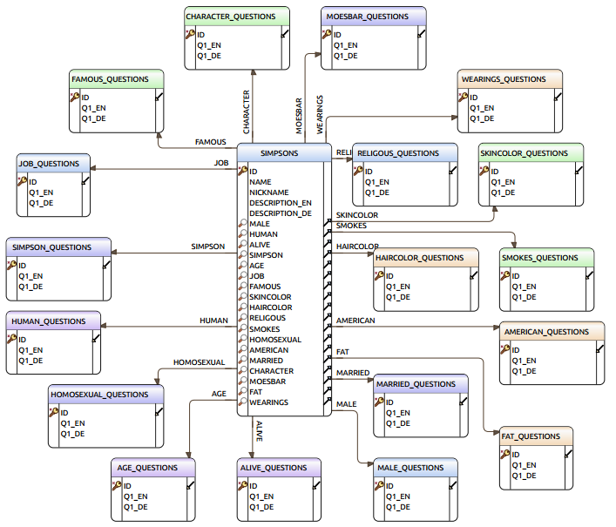
DATABASE ARCHITEKTUR
H2 embedded & in-momory database
Stern-Schema
Notes:
MARVIN

Slide 13
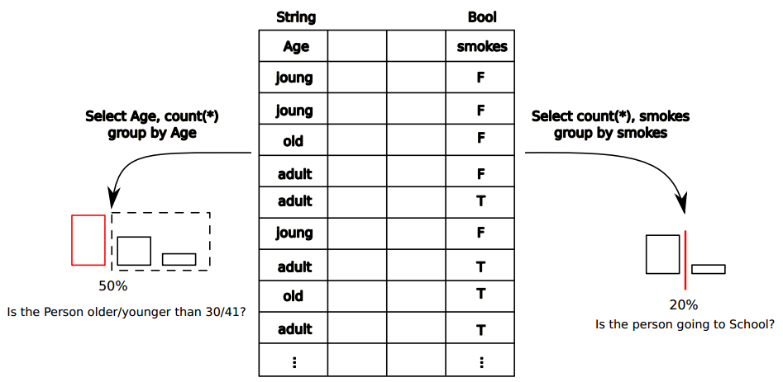
ALGORITHMUS GAMEMODE 1
Notes:
MARVIN

Slide 14
DEMO – ENJOY ☺
Executable Jar: https://github.com/nappydevelopment/Nappy-the-ingenious/blob/master/jar/Nappy-the-ingenious.jar
Notes:
MANU

Slide 15
Zusammenfassung
s
Notes:
MANU

Slide 16
LINKS
GitHub – Code: https://github.com/nappydevelopment/Nappy-the-ingenious
GitHub – Doku: https://github.com/nappydevelopment/docs
Blog: https://nappydevelopment.wordpress.com/

Slide 17

Fragen?

