Slide 1
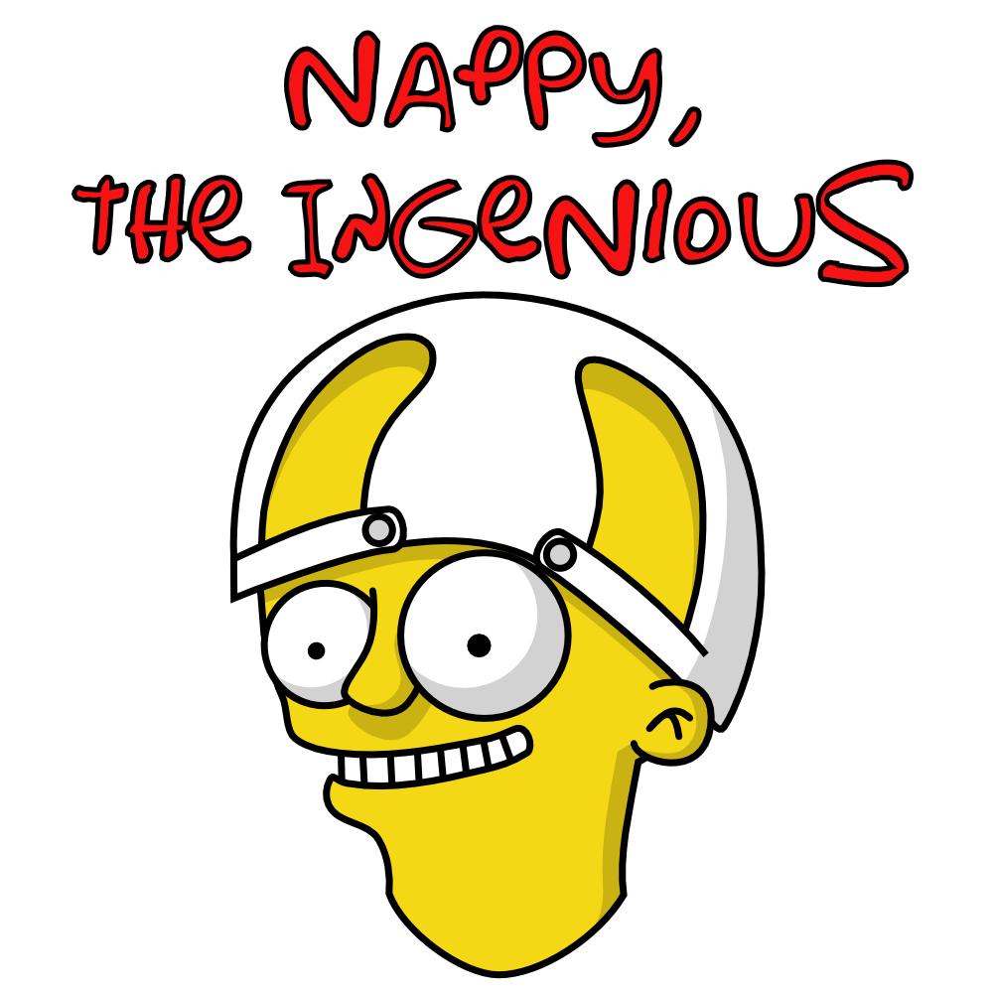
nappydevelopment
von Manuel Bothner, Marc Mahler,
Marvin Zerulla und Mehmet Ali Incekara
Notes:
Ali

Slide 2
AGENDA
Wer ist nappydevelopment
Vision & Scope
Software Requirements Specification
Use Case‘s
Non-functional Requirements
Project Management
RUP
Function Points
Scrum
Quality Assurance
Environment, Integration andAutomation
Riskmanagement
Testing
Metrics
Technical Ability
Architecture
Class Diagram
Patterns
Demo
Notes:
Ali

Slide 3
WER IST NAPPYDEVELOPMENT?
Discipline | Team member
Business Modeling | Marc Mahler and Manuel Bothner
Requirements | Mehmet Ali Incekara
Analysis and Design | Marvin Zerulla and Manuel Bothner
Implementation | nappydevelopment
Test | nappydevelopment
Deployment | Marvin Zerulla and Mehmet Ali Incekara
Project Management | Mehmet Ali Incekara
Environment | Marc Mahler and Manuel Bothner
Configuration and Change Managment | Marvin Zerulla and Mehmet Ali Incekara
Notes:
Ali

Slide 4


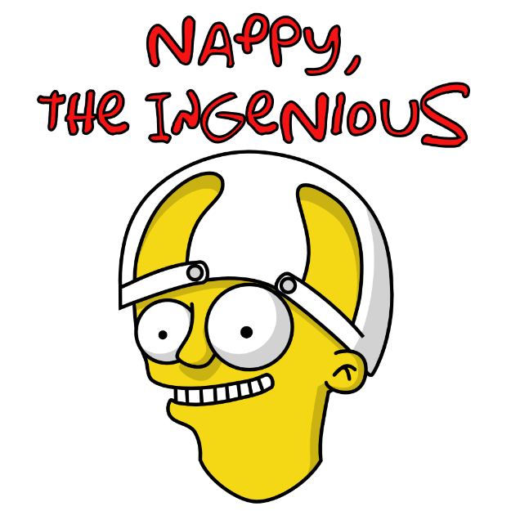



VISION & SCOPE
Notes:
MANU

Slide 5
Software Requirements Specification
Notes:
ALI

Slide 6
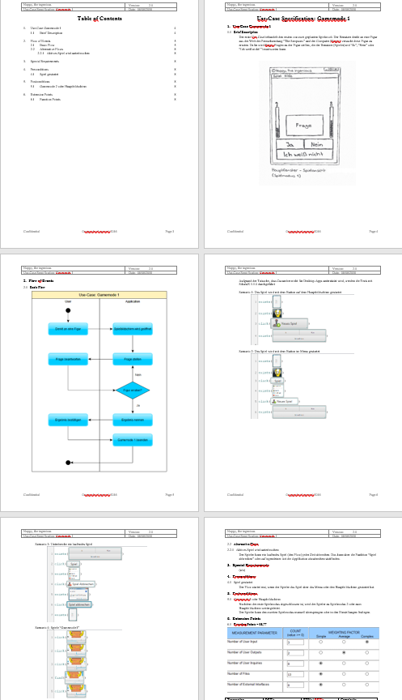
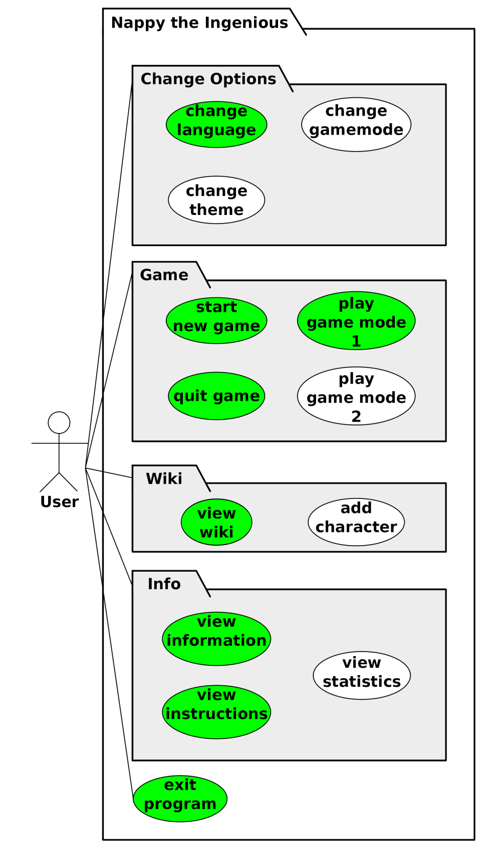
USECASE DIAGRAM & USECASE‘S
1. UseCase: Gamemode 1
2. UseCase: View Wiki
3. UseCase: View Instruction
4. UseCase: Change Settings
5. UseCase: View Info
6. UseCase: Gamemode 2
7. UseCase: Extend Wiki
8. UseCase: View Statistic
9. UseCase: Extend Settings
Notes:
ALI

Slide 7
NON-FUNCTIONAL REQUIREMENTS
Plattformunabhängigkeit
vollständig Offline lauffähig
Antwortzeiten
Startzeit: ~5 Sekunden
Nach Start: ~0,5 Sekunden
Ressourcennutzung
Testabdeckung
Insgesamt > 50%
100 spielbare Figuren
Notes:
Manu

Slide 8
PROJECT MANAGEMENT

Slide 9
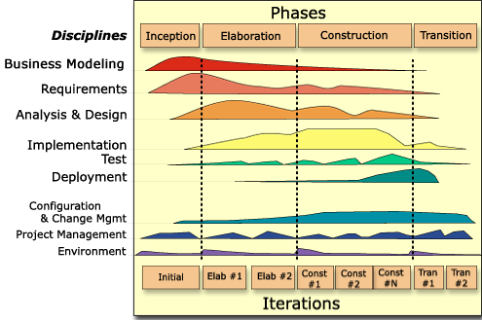
RUP
Notes:
Ali

Slide 10
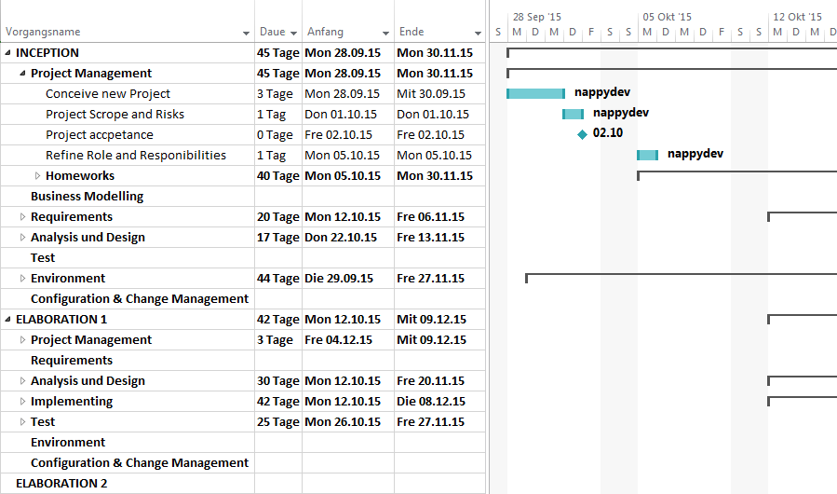
GANTT-CHART
Notes:
Ali

Slide 11
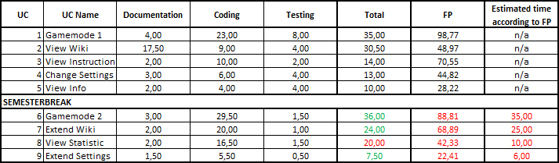
FUNCTION POINTS
Notes:
Ali

Slide 12
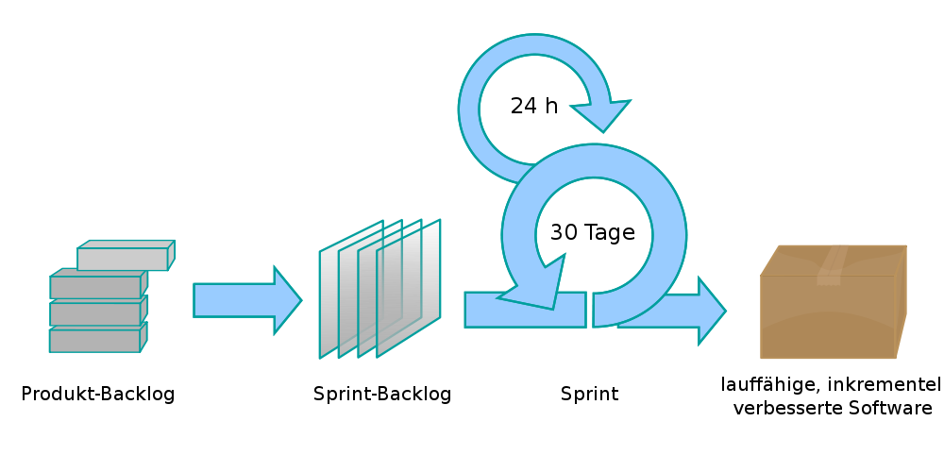
SCRUM
Vorgehensmodell in der agilen Softwareentwicklung

Slide 13

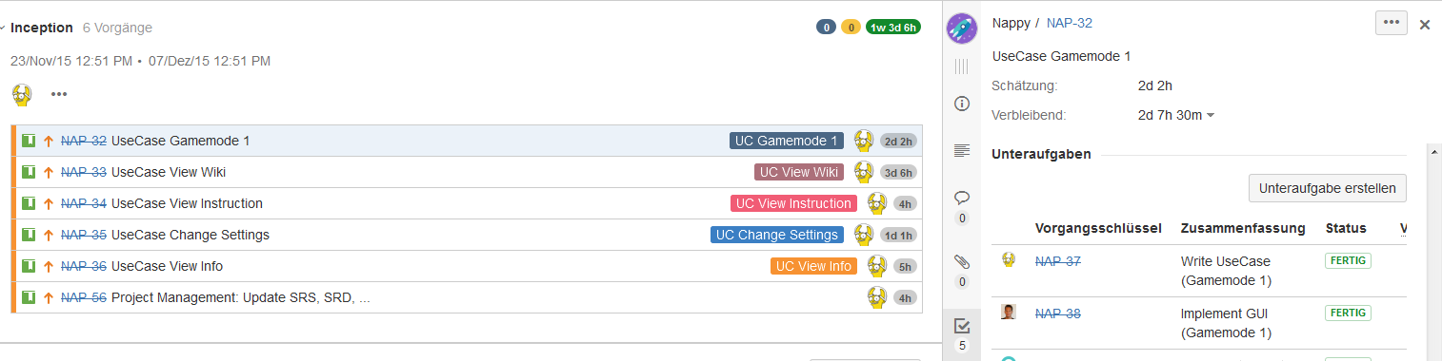
JIRA
http://193.196.7.27:8080/secure/RapidBoard.jspa?rapidView=8&projectKey=NAP&view=planning.nodetail
Notes:
Ali

Slide 14
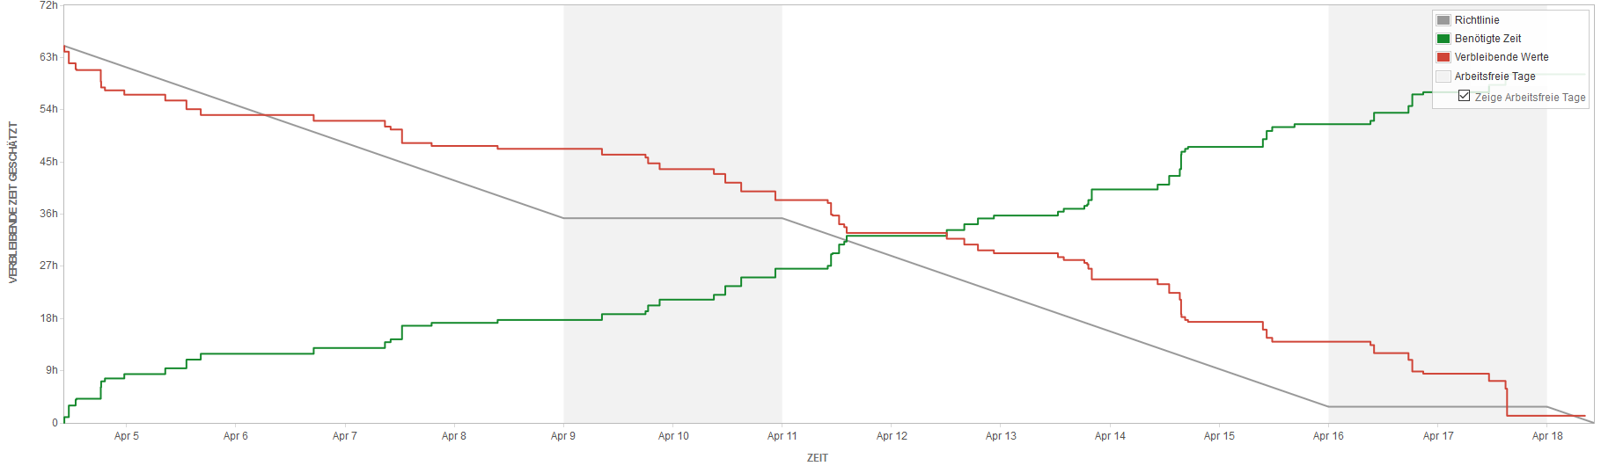
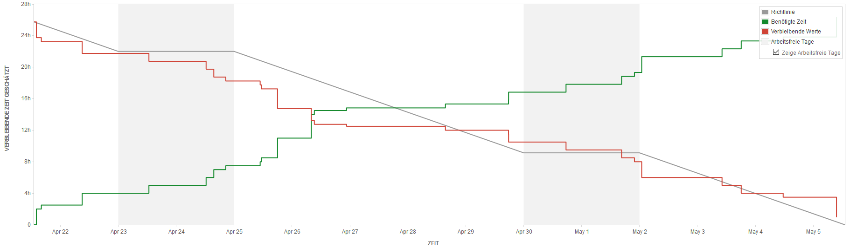
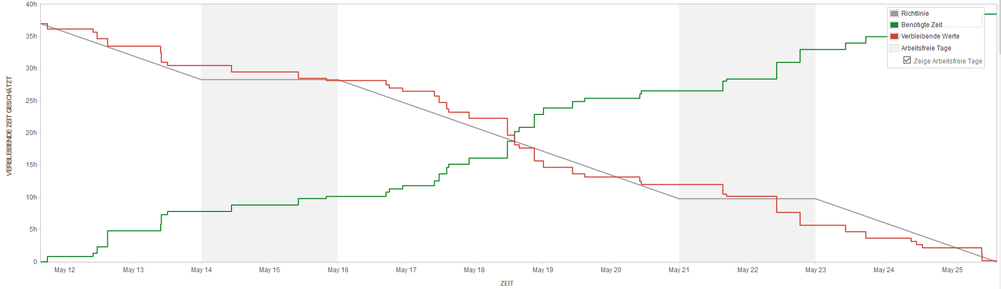
BURNDOWN-DIAGRAMM
Notes:
Ali

Slide 15
QUALTIY ASSURANCE

Slide 16
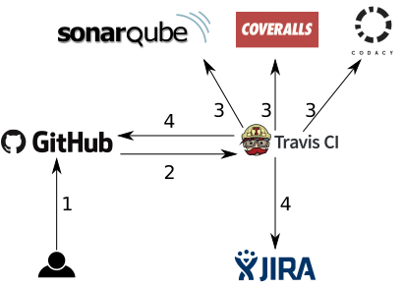
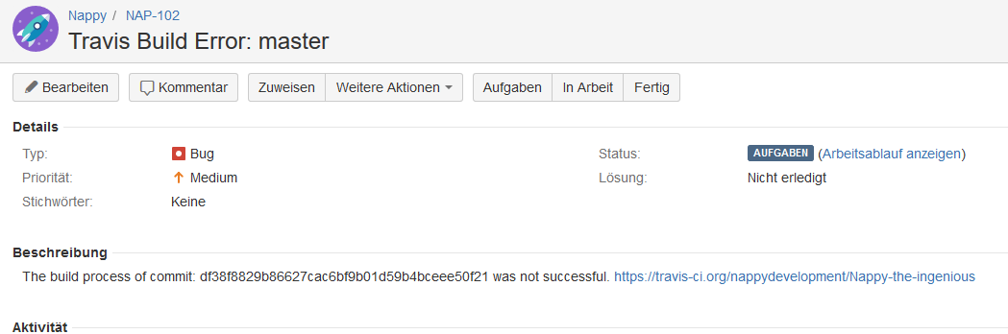

ENVIRONMENT, INTEGRATION AND AUTOMATION
Notes:
MARVIN

Slide 17
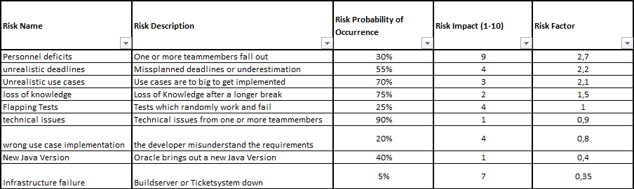
RISKMANAGEMENT
Notes:
Marvin

Slide 18
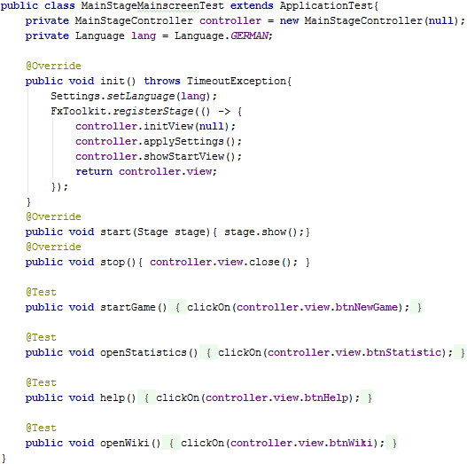
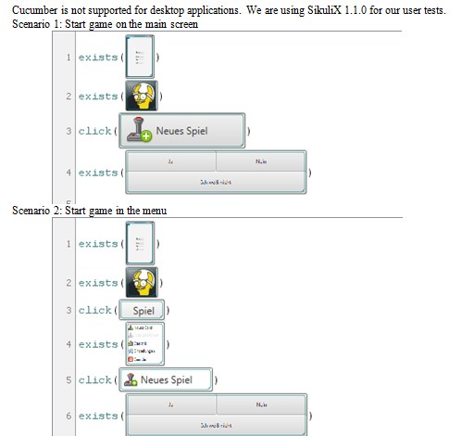
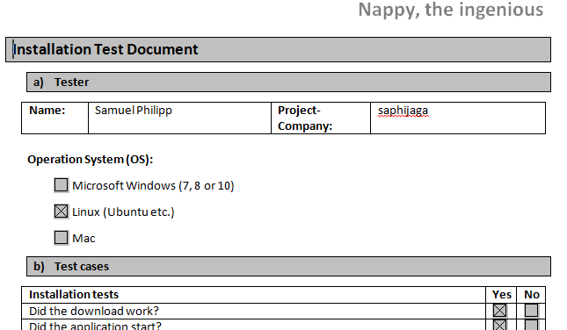
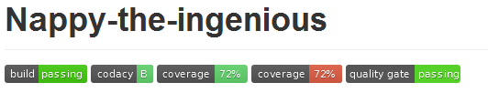
TESTING
SikuliX
JUnit + TestFX
Installation Tests
Notes:
MARVIN

Slide 19
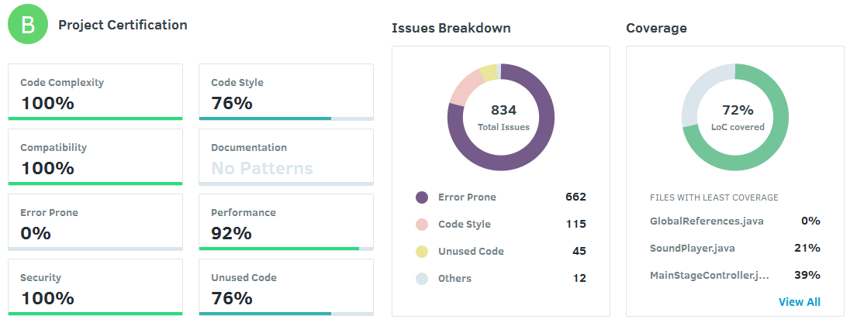
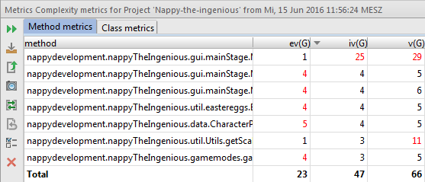
METRICS
Tools
MetricsReloaded
Codacy
Metric Profile
Abhängigkeiten
zyklomaitsche Komplexität

Slide 20
TECHNICAL ABILITY

Slide 21
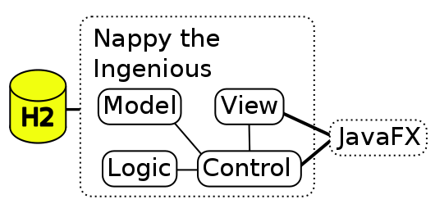
ARCHITECTURE
Notes:
MARC

Slide 22
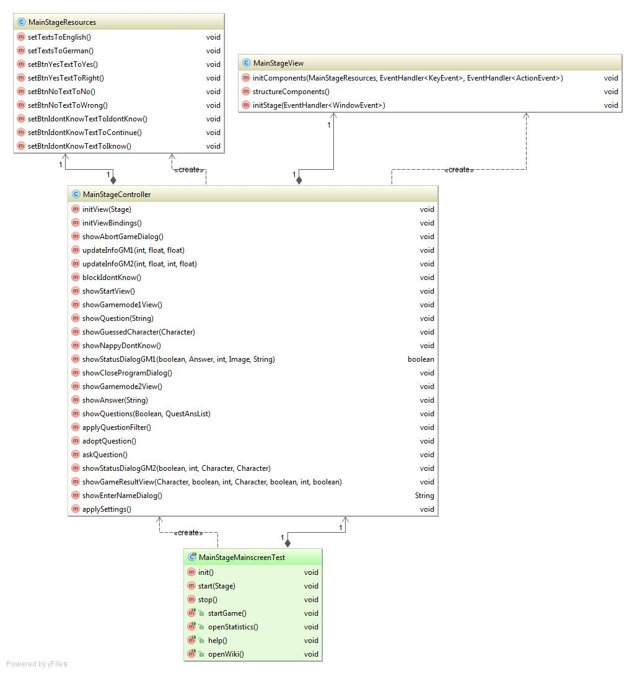
CLASS DIAGRAM
Java FX
Jede Stage hat ihr eigenes MVC-Konzept
Abgeschlossenheit
Austauschbar und feste Schnittstellen zur Logik
Notes:
MARC

Slide 23
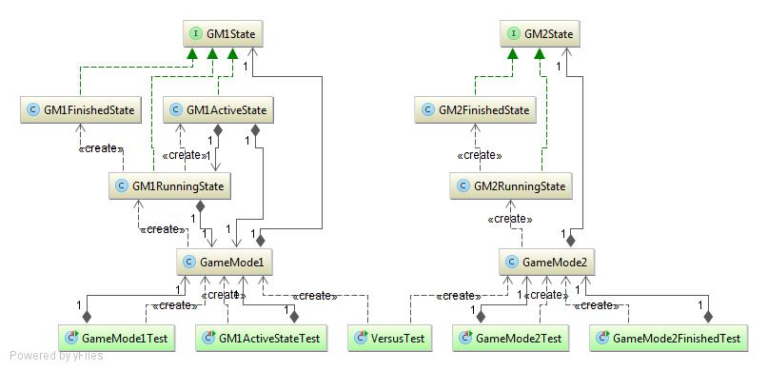
PATTERNS
State Pattern
UC: Gamemode 1 und 2
Notes:
Marvin

Slide 24
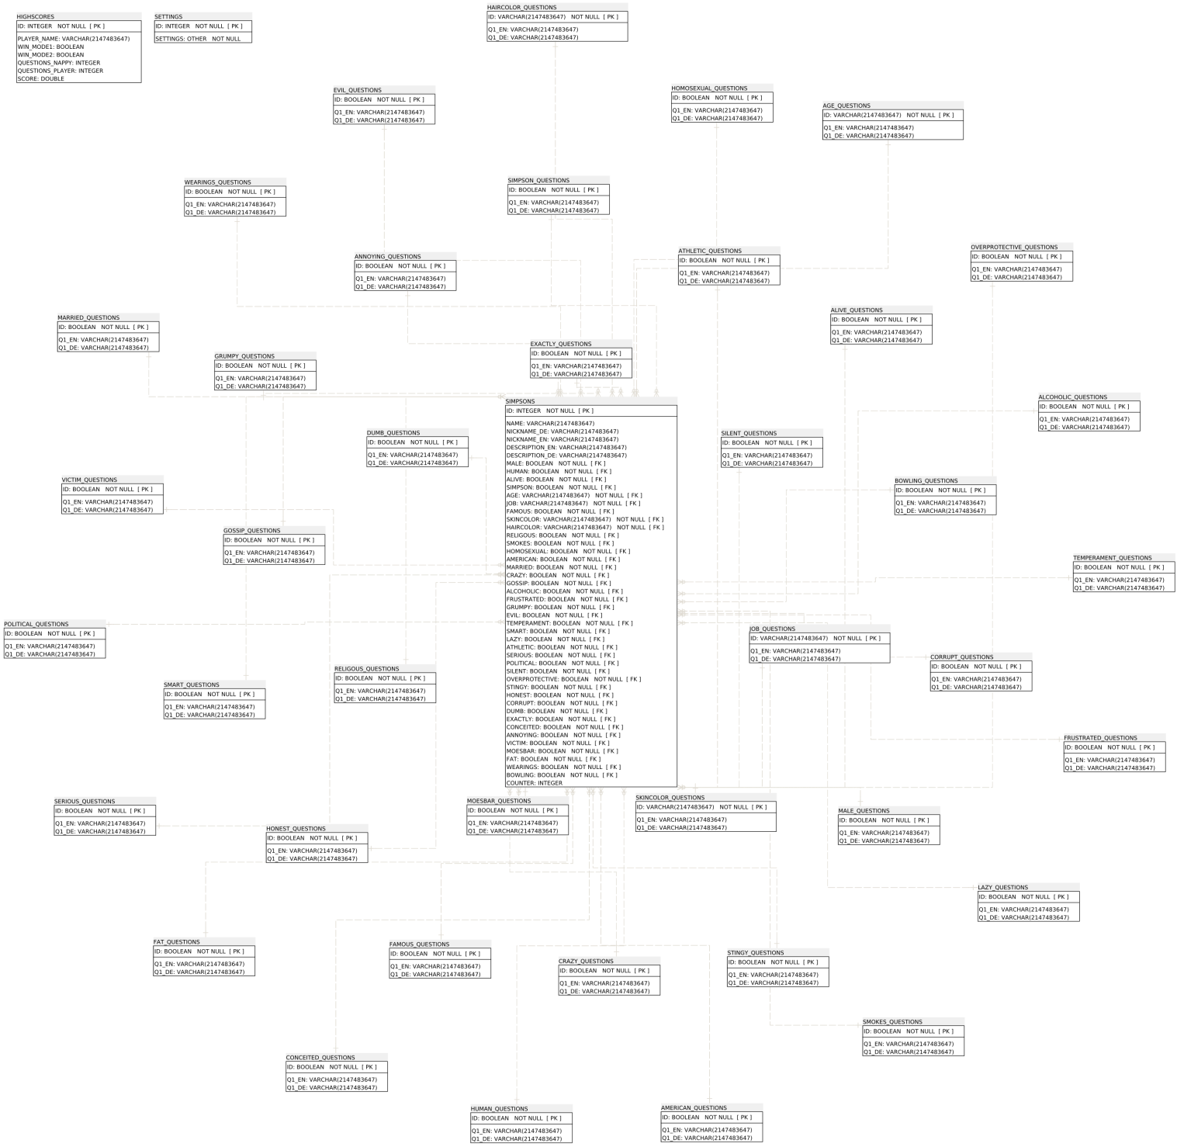
DATABASE ARCHITEKTUR
H2 embedded & in-momory database
Stern-Schema
Notes:
MARVIN

Slide 25
DEMO – ENJOY ☺
Executable Jar: https://github.com/nappydevelopment/Nappy-the-ingenious/raw/master/jar/nappy-the-ingenious-1.0.0.jar
Notes:
MANU

Slide 26
AUSBLICK?
Notes:
MANU

Slide 27

Fragen?

Slide 28

Vielen Dank für
eure
Aufmerksamkeit

Slide 29
LINKS
JIRA - http://193.196.7.27:8080/secure/RapidBoard.jspa?rapidView=8&projectKey=NAP&view=planning
Code - https://github.com/nappydevelopment/Nappy-the-ingenious
Download - https://github.com/nappydevelopment/Nappy-the-ingenious/blob/master/README.md
Coveralls - https://coveralls.io/github/nappydevelopment/Nappy-the-ingenious?branch=master
Codacy - https://www.codacy.com/app/NappyDevelopment/Nappy-the-ingenious/dashboard
SonarQube - http://193.196.7.25/overview?id=5235
Blog - https://nappydevelopment.wordpress.com/
Blog as PDF - https://github.com/nappydevelopment/docs/blob/master/pdfs/Blog%20As%20Book.pdf
Docs - https://github.com/nappydevelopment/docs/
SRS - https://github.com/nappydevelopment/docs/blob/master/pdfs/Software%20Requirements%20Specification.pdf
SAD - https://github.com/nappydevelopment/docs/blob/master/pdfs/Software%20Architecture%20Document.pdf
Testplan - https://github.com/nappydevelopment/docs/blob/master/pdfs/Test%20Plan.pdf
Riskmanagement - https://github.com/nappydevelopment/docs/blob/master/pdfs/Riskmanagment.pdf
Function Points - https://github.com/nappydevelopment/docs/blob/master/pdfs/Usecase%20doc.pdf
Notes:
MANU

Slide 30
Notes:
MANU

