Slide 1

Time Series in R for Data Science
Universitas PGRI Adi Buana, 12 Oktober 2018
Nanda Prasetya Pamungkas

Slide 2
Overview
Stasioner Data
Trend Data
Seasonal Data
Trend dan Seasonal Data

Slide 3
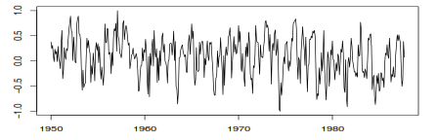
Statsioner Data
Stasioner data adalah data yang persebarannya di antara rata-ratanya

Slide 4
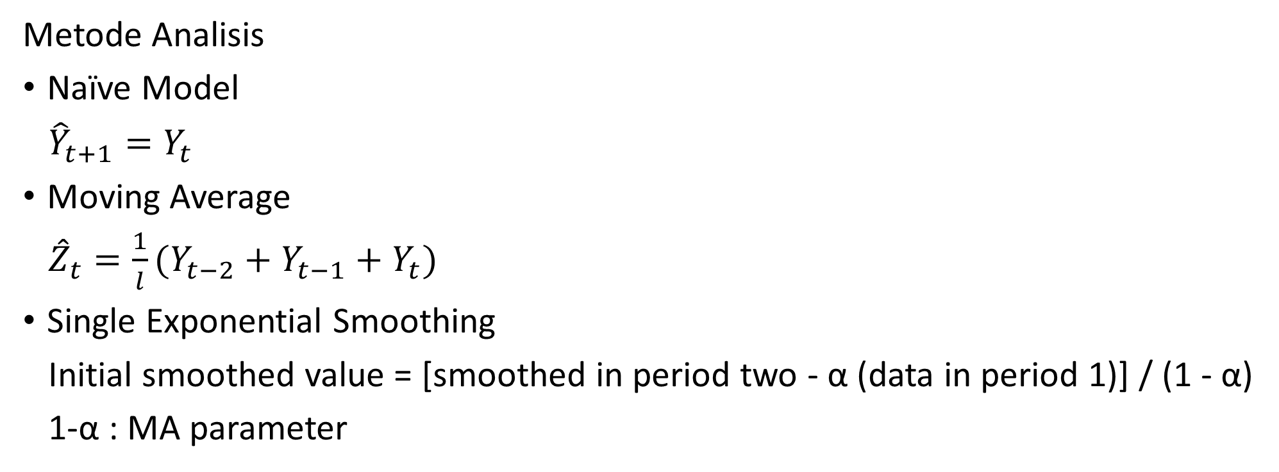
Stasioner Data
Metode Analisis
Naïve Model
${\hat{Y}}_{t+1}=Y_{t}$
Moving Average
${\hat{Z}}_{t}=\frac{1}{l}(Y_{t−2}+Y_{t−1}+Y_{t})$
Single Exponential Smoothing
Initial smoothed value = [smoothed in period two - α (data in period 1)] / (1 - α)
1-α : MA parameter

Slide 5
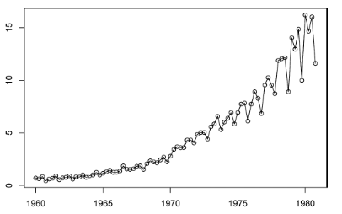
Trend Data
Data Tren adalah data yang mengandung pola naik atau turun dalam jangka panjang

Slide 6
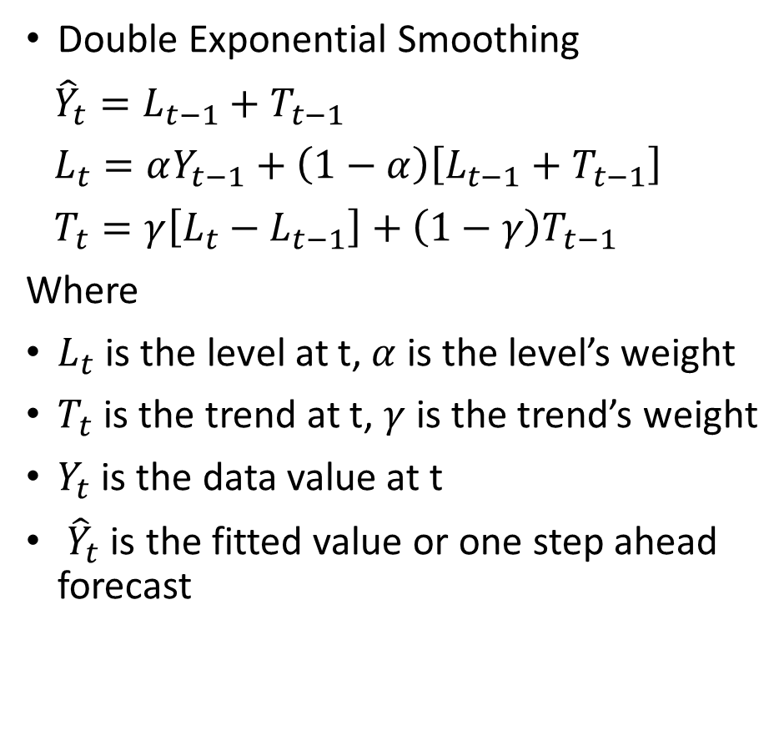
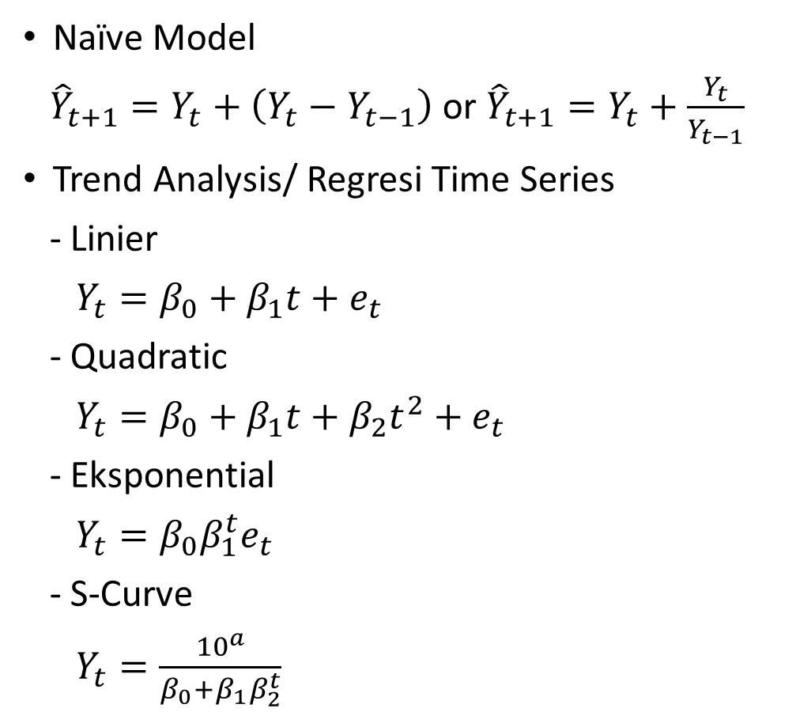
Trend Data
Naïve Model
${\hat{Y}}_{t+1}=Y_{t}+\left(Y_{t}−Y_{t−1}\right)$or ${\hat{Y}}_{t+1}=Y_{t}+\frac{Y_{t}}{Y_{t−1}}$
Trend Analysis/ Regresi Time Series
- Linier
$Y_{t}=β_{0}+β_{1}t+e_{t}$
- Quadratic
$Y_{t}=β_{0}+β_{1}t+β_{2}t^{2}+e_{t}$
- Eksponential
$Y_{t}=β_{0}β_{1}^{t}e_{t}$
- S-Curve
$Y_{t}=\frac{{10}^{a}}{β_{0}+β_{1}β_{2}^{t}}$
Double Exponential Smoothing
${\hat{Y}}_{t}=L_{t−1}+T_{t−1}$
$L_{t}=αY_{t−1}+\left(1−α\right)\left[L_{t−1}+T_{t−1}\right]$
$T_{t}=γ\left[L_{t}−L_{t−1}\right]+\left(1−γ\right)T_{t−1}$
Where
$L_{t}$ is the level at t, $α$ is the level’s weight
$T_{t}$ is the trend at t, $γ$ is the trend’s weight
$Y_{t}$ is the data value at t
${\hat{Y}}_{t}$ is the fitted value or one step ahead forecast

Slide 7
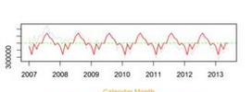
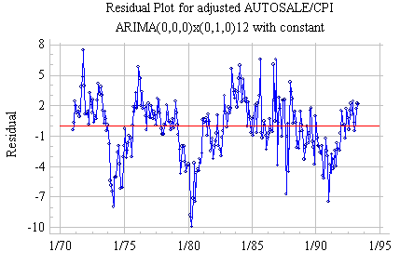
Seasonal Data
Data Seasonal adalah data yang persebaran datanya mengalami perulangan pola. Seasonal ada dua jenis yaitu Additive dan multiplicative.
Additive Multiplicative

Slide 8
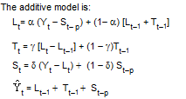
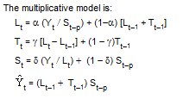
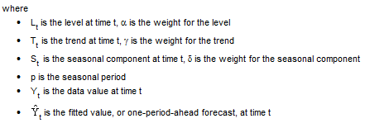

Seasonal Data
Naïve Model
${\hat{Y}}_{t+1}=Y_{\left(t+1\right)−s}$
Winter’s Method

Slide 9
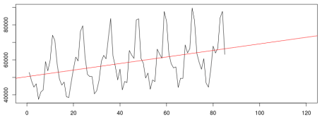
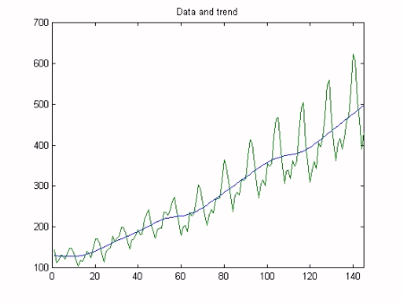
Trend and Seasonal Data
Data Seasonal dan Trend adalah data yang persebaran datanya mengalami perulangan pola disertai tren naik atau turun. Seperti hal nya seasonal data ada dua jenis trend seasonal yaitu Additive dan multiplicative yang di dasarkan pada pola seasonalnya.
Additive Multiplicative

Slide 10
Trend and Seasonal Data
Winter’s Method

Slide 11


Trend and Seasonal Data
Decomposition
Additive Multiplicative
$Y_{t}=T_{t}+S_{t}+E_{t}$ $Y_{t}=T_{t}∗S_{t}∗E_{t}$
1. fits a trend line to the data, using least squares regression.
2. Next, the data are detrended by dividing the data by the trend component.
3. Then, the detrended data are smoothed using a centered moving average with a length equal to the length of the seasonal cycle. When the seasonal cycle length is an even number, a two-step moving average is required to synchronize the moving average correctly.
4. Once the moving average is obtained, it is divided into the detrended data to obtain what are often referred to as raw seasonals.
5. Within each seasonal period, the median value of the raw seasonals is found. The medians are also adjusted so that their mean is one. These adjusted medians constitute the seasonal indices.
6. The seasonal indices are used in turn to seasonally adjust the data.

