Slide 1

Introduction to R for Data Science II
Universitas Airlangga, 28 Agustus 2018
Nanda Prasetya Pamungkas

Slide 2
Overview
Introduction to R
Basic Calculation
Data and Variable
Read and Write Data
Conditional Statement
Looping
Function

Slide 3

Introduction to R
Rstudio
RStudio allows the user to run R in a more user friendly environment. It is open source (i.e. free) and available at http://www.rstudio.com/

Slide 4
Basic Calculation
Simple Calculation
Function Calculation
> sqrt(2) #squareroot
[1] 1.414214
> sin(pi) #cos,tan
[1] 1.224606e-16
> acos(0) #asin,atan,atan2(y,x) == atan(y/x).
[1] 1.570796
> cosh(0) #sinh,tanh
[1] 1
> exp(2) #log
[1] 7.389056
> 1+2
[1] 3
> 1-2
[1] -1
> 1*2
[1] 2
> 1/2
[1] 0.5
> 1^2 # power
[1] 1
> 5 %/% 2 # integerdivision
[1] 2
> 5 %% 2 # modulodivision
[1] 1

Slide 5
Basic Calculation
Mathematical Function
Function | Meaning
log(x) | log to base e of x
exp(x) | antilog of x (=2.7818x)
log(x,n) | log to base n of x
log10(x) | log to base 10 of x
sqrt(x) | square root of x
factorial(x) | x!
choose(n,x) | binomial coefficients n!/(x! (n – x)!)
gamma(x) | Γ.x.(x – 1)! for integer x
lgamma(x) | natural log of gamma(x)
floor(x) | greatest integer < x

Slide 6
Basic Calculation
Mathematical Function
Function | Meaning
ceiling(x) | smallest integer > x
trunc(x) | closest integer to x between x and 0: trunc(1.5) =1, trunc(-1.5) = -1
trunc | is like floor for positive values and like
ceiling | for negative values
round(x, digits=0) | round the value of x to an integer
signif(x, digits=6) | give x to six digits in scientific notation
runif(n) | generates n random numbers between 0 and 1 from a uniform distribution
cos(x) | cosine of x in radians
sin(x) | sine of x in radians
tan(x) | tangent of x in radians
acos(x), asin(x), atan(x) | inverse trigonometric transformations of real or complex numbers.
acosh(x), asinh(x), atanh(x) | inverse hyperbolic trigonometric transformations on real or complex numbers
abs(x) | the absolute value of x, ignoring the minus sign if there is one

Slide 7
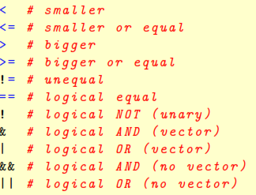
Basic Calculation
Logical Sign

Slide 8
Data dan Variable
Main Structures
Vector array 1 dimensi dengan ukuran m (1 tipe data) Matrix array 2 dimensi dengan ukuran m × n (1 tipe data) Dataframe seperti matrix, namun bisa menampung lebih dari 1 tipe data
Class
character vector of strings
numeric vector of real numbers
integer vector of signed integer
logical vector of boolean (TRUE or FALSE)
complex vector of complex numbers
list vector of R objects
factor sets of labelled observations, pre-defined set of labels
NA not available, missing value

Slide 9
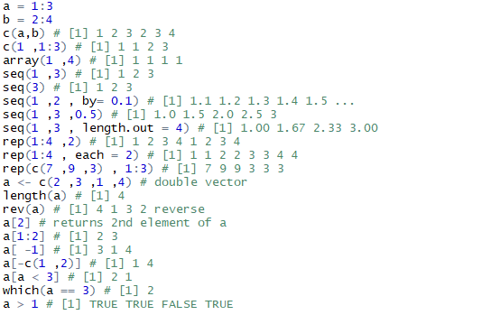

Data dan Variable
Vector

Slide 10
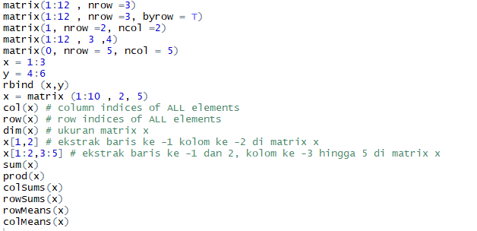
Data dan Variable
Matrix

Slide 11
Data dan Variable
Matrix
x1 = c(2,5)
x2 = c(4,7)
x=cbind (x1,x2)
t(x) #matrix transpose
solve(x) #inverse matrix
[,1] [,2]
x1 -1.1666667 0.6666667
x2 0.8333333 -0.3333333
det(x) #determinant matrix
[1] -6
diag(x) #diagonal matrix
[1] 2 7
y1 = c(3,6)
y2 = c(1,4)
y=cbind (y1,y2)
x*y
x1 x2
[1,] 6 4
[2,] 30 28
x%*%y
y1 y2
[1,] 30 18
[2,] 57 33

Slide 12
Data dan Variable
Dataframe
Age <- c(10 ,20 ,15 ,43 ,76 ,41 ,25 ,46)
Sex <- factor (c("m","f","m","f","m","f","m","f"))
Sibblings <- c(2 ,5 ,8 ,3 ,6 ,1 ,5 ,6)
myframe <- data.frame(Age, Sex, Sibblings)
myframe
Age Sex Sibblings
1 10 m 2
2 20 f 5
3 15 m 8
4 43 f 3
5 76 m 6
6 41 f 1
7 25 m 5
8 46 f 6

Slide 13
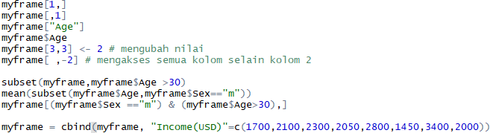

Data dan Variable
Dataframe

Slide 14
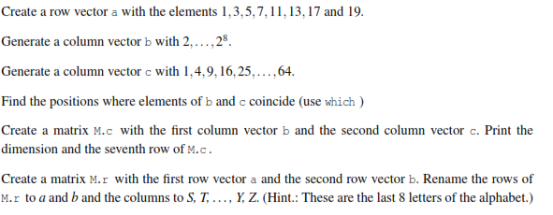
Latihan

Slide 15
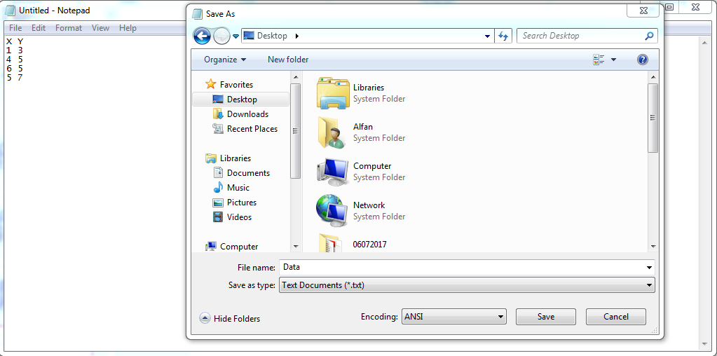
Read and Write Data
For example we create data in notepad

Slide 16
Read and Write Data
#Function read.table
read.table(file, header = TRUE, sep = ",", quote = "\"",
dec = ".“, ...)
File | the name of the file which the data are to be read from
header | a logical value indicating whether the file contains the names of the variables as its first line
sep | the field separator string. Values within each row of x are separated by this string.
quote | the set of quoting characters
dec | the string to use for decimal points in numeric or complex columns: must be a single character.
read.table("E:/Data.txt",header = T)

Slide 17
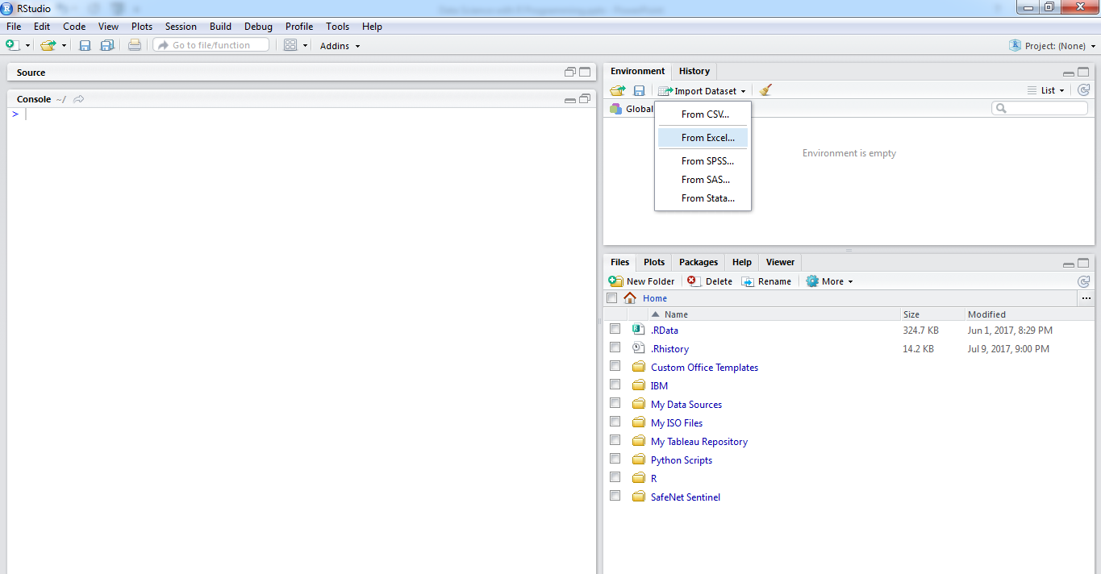
Read and Write Data
Click import dataset at R Studio,
choose from CSV

Slide 18
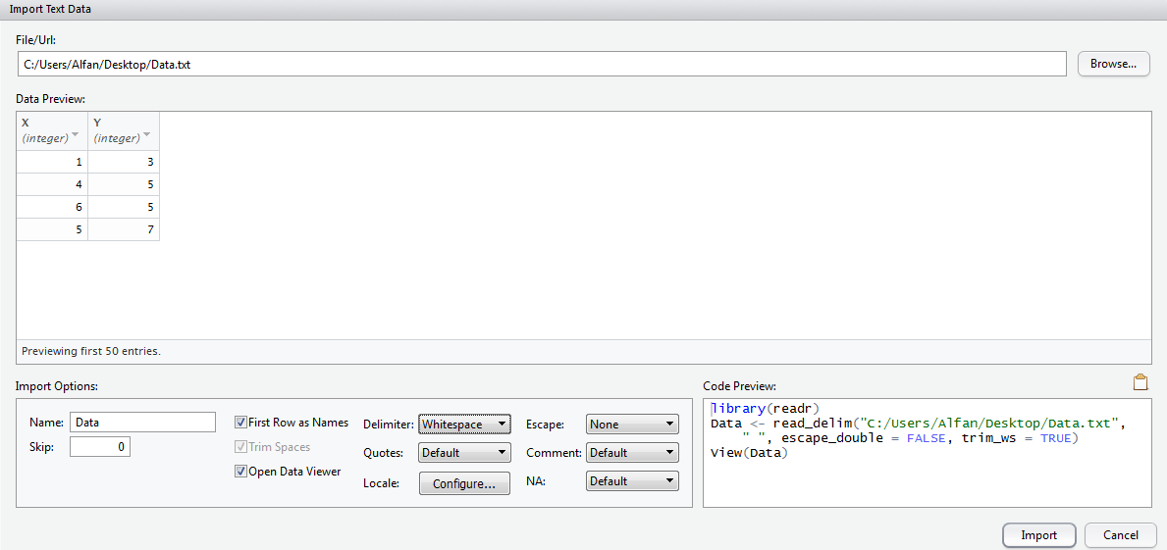
Read and Write Data
Change delimiter with whitespace, and click import

Slide 19
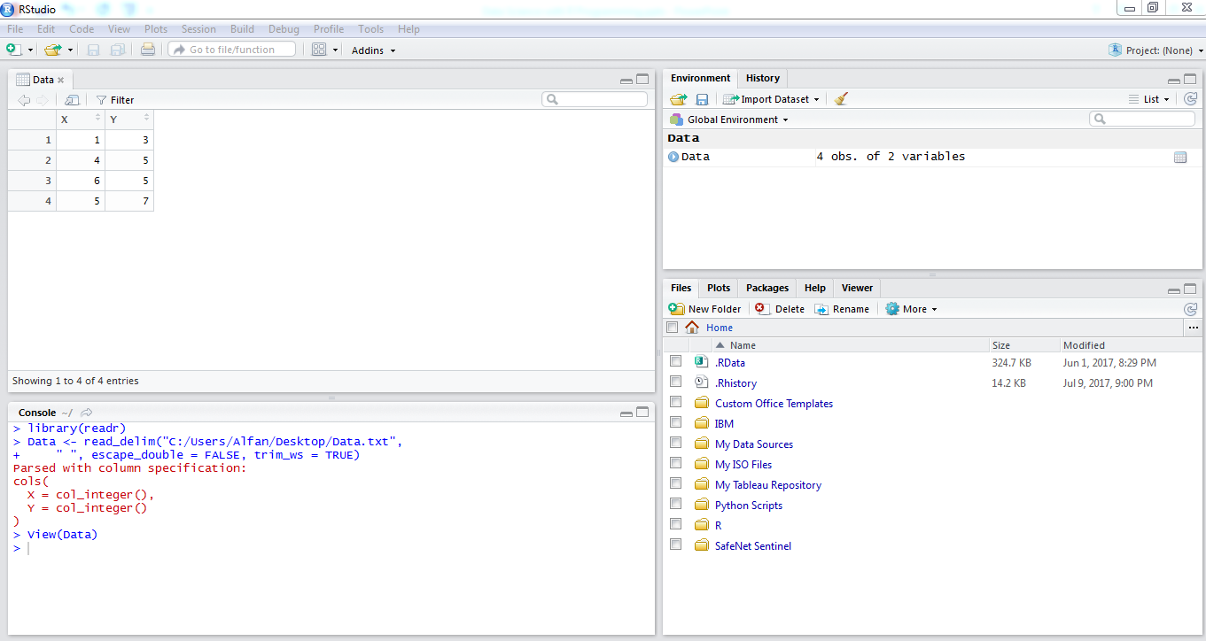
Read and Write Data

Slide 20
Read and Write Data
#Function write.table
write.table(x, file = "", , quote = TRUE, sep = " ", na = "NA", dec = ".", row.names = TRUE, col.names = TRUE)
x | the object to be written, preferably a matrix or data frame. If not, it is attempted to coerce x to a data frame.
file | either a character string naming a file or a connection open for writing. ""indicates output to the console.
quote | a logical value (TRUE or FALSE) or a numeric vector. If TRUE, any character or factor columns will be surrounded by double quotes. If a numeric vector, its elements are taken as the indices of columns to quote. In both cases, row and column names are quoted if they are written. If FALSE, nothing is quoted.
sep | the field separator string. Values within each row of x are separated by this string.
na | the string to use for missing values in the data.
dec | the string to use for decimal points in numeric or complex columns: must be a single character.
row.names | either a logical value indicating whether the row names of x are to be written along with x, or a character vector of row names to be written.
col.names | either a logical value indicating whether the column names of x are to be written along with x, or a character vector of column names to be written. See the section on ‘CSV files’ for the meaning of col.names = NA.

Slide 21
Read and Write Data
#Function write.csv
write.csv(x, file = "", , quote = TRUE, sep = " ", na = "NA", dec = ".", row.names = TRUE, col.names = TRUE)
x | the object to be written, preferably a matrix or data frame. If not, it is attempted to coerce x to a data frame.
file | either a character string naming a file or a connection open for writing. ""indicates output to the console.
quote | a logical value (TRUE or FALSE) or a numeric vector. If TRUE, any character or factor columns will be surrounded by double quotes. If a numeric vector, its elements are taken as the indices of columns to quote. In both cases, row and column names are quoted if they are written. If FALSE, nothing is quoted.
sep | the field separator string. Values within each row of x are separated by this string.
na | the string to use for missing values in the data.
dec | the string to use for decimal points in numeric or complex columns: must be a single character.
row.names | either a logical value indicating whether the row names of x are to be written along with x, or a character vector of row names to be written.
col.names | either a logical value indicating whether the column names of x are to be written along with x, or a character vector of column names to be written. See the section on ‘CSV files’ for the meaning of col.names = NA.

Slide 22
Read and Write Data
Name of file
#Example
write.table(Data, "D:/Folder/Data.txt", sep=" ", col.names=TRUE, row.names=TRUE, quote=FALSE, na="NA")
write.csv(Data, "D:/Folder/Data.csv", sep=" ", col.names=TRUE, row.names=TRUE, quote=FALSE, na="NA")
Location file will be saved

